Slide 1
Unit 4 Adversity and Courage
Period 2 Build up your vocabulary
选择性必修三
人教版（2019）

Slide 2
Match the English meanings with the words.
Lead-in
1.honest and fair; treating people with respect
2.making you feel very unhappy; caused by great unhappiness
3.often angry; in an angry mood
4.warm, comfortable and safe, especially because of being small or confined
5.real; exactly what it appears to be; not artificial
6.very unhappy or uncomfortable
cosy
bitter
decent
genuine
miserable
bad-tempered

Slide 3
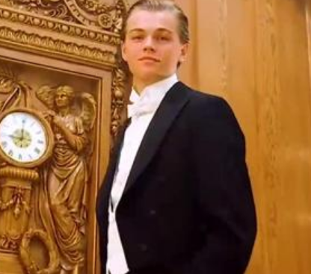
Find the suitable adjectives from the previous text to complete the sentences. The first letter of each word has been given.
Task1
1. He behaves in a d_____ manner and we think he is a real gentleman.
ecent
2. With the gentle music, soft lights, and comfortable sofas, this café is everything you need after a tiring day. It is a c____ and relaxing place.
osy

Slide 4
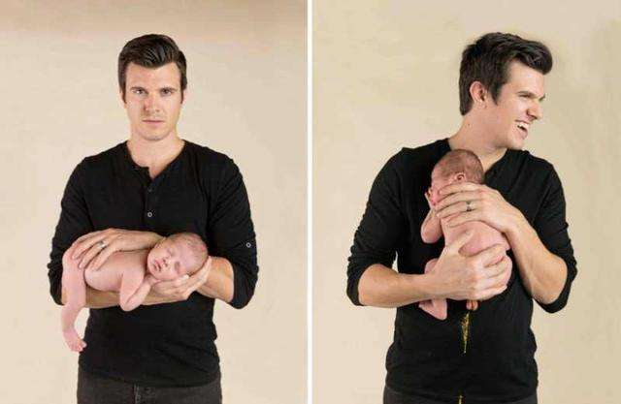
Find the suitable adjectives from the previous text to complete the sentences. The first letter of each word has been given.
Task1
3. He used to be so cross and b___________ that nobody could tolerate him, but the birth of his son changed his life and made him a better person.
ad-tempered

Slide 5
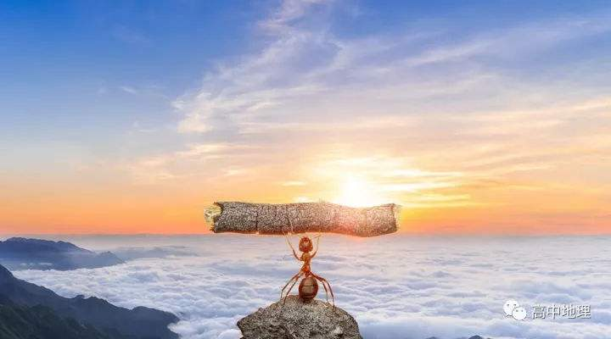
Find the suitable adjectives from the previous text to complete the sentences. The first letter of each word has been given.
Task1
adj.causing pain or suffering
be cruel to sb
4. Life was cruel to Oliver when he was young. Although living a m_______ life, he had a very kind heart.
iserable
itter
5. Try to learn from your mistakes and b_____ failures. It will eventually lead to success as long as you persevere.

Slide 6
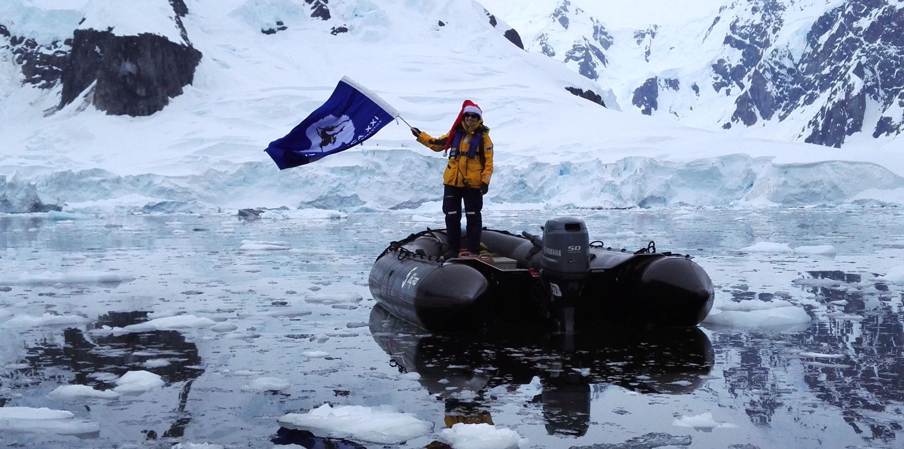
Find the suitable adjectives from the previous text to complete the sentences. The first letter of each word has been given.
Task1
enuine
6. The young boy has demonstrated a g______ interest in the expedition to the Antarctic.

Slide 7
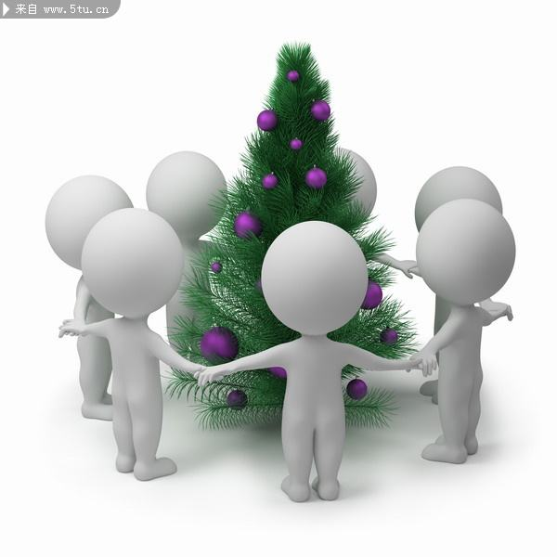
Choose the appropriate word to complete each sentence.
Task 2
四处逃窜
1. The fire alarm caused a panic / worry in the
theatre and the crowd fled in all directions.
2. Although my grandpa is retired, he is very
enthusiastic / concerned about volunteer work.
3. The officer was assigned / employed to conduct a thorough investigation into the incident.
assign: to give sb. sth. that they can use, or some work or responsibility.分配；指派
employ: to give sb. a job to do for payment雇佣
对…进行彻底的调查
adj.深入的；
彻底的；细致的

Slide 8
Choose the appropriate word to complete each sentence.
Task 2
4. The sun was sinking / falling behind the mountains when we reached the top.
5. It took him a lot of vigour / energy to move all the items of furniture inside the house.
sink: to move slowly downwards; to go down below the surface or towards the bottom of a liquid or soft substance下沉；下降
fall: to drop down from a higher level to a lower level.降落；落下；跌倒
vigour: energy,force or enthusiasm活力，精力
energy(pl.) the physical and mental effort that you use to do sth. the ability to put effort and enthusiasm into an activity,work,etc.能力，力气；精力，活力
[U](可移动的)
家具

Slide 9
Complete the passage with the correct forms of the words in the box.
Task 3
abandon aboard assign crew cupboard
resolve set off sink turn…down voyage
After seeing the advertisement in the newspaper, Perce Blackborow _______ to join the Antarctic expedition led by Sir Ernest Shackleton no matter what challenges might lie ahead. Unfortunately, his application ______________ because he was too young and not qualified enough.
珀西.布莱克博罗
resolved
欧内斯特.沙克尔顿
was turned down
adv.不幸地；遗憾地
n.申请；请求；应用

Slide 10
Complete the passage with the correct forms of the words in the box.
Task 3
abandon aboard assign crew cupboard
resolve set off sink turn…down voyage
However, he managed to get ______ the Endurance with his friend’s help. He hid in a ________, but was soon discovered and brought to Shackleton. Although the captain was angry, he _______ the boy the job of cooking for the ____. Their ______ did not go smoothly, and the Endurance became stuck in the ice.
aboard
cupboard
沙克尔顿
assigned
crew
voyage
困在；陷入

Slide 11
Complete the passage with the correct forms of the words in the box.
Task 3
abandon aboard assign crew cupboard
resolve set off sink turn…down voyage
Before the Endurance was crushed and ____ into the sea, Shackleton gave the order to _______ ship, and the crew had to camp on ice. They then sailed to Elephant Island. Soon after that, Shackleton selected a boat party and _____ for South Georgia Island to get help.
sank
abandon
set off
南乔治亚岛

Slide 12
Task 4
Learning the important words
①(江苏卷)Students who are successful in an on－line course are usually able to plan，organize time and complete ___________(assign) and activities.
assign sb. sth.＝assign sth. to sb.分配某人某物
vt.分派；布置；
分配
assignments
②He decided to put off all personal considerations and accept the task ________(assign) to him.
assign sb. to do sth.派某人做某事
assign
assigned
n.
③British forces have been assigned _______(help) with peacekeeping.
to help
assignment
任务；工作；分派

Slide 13
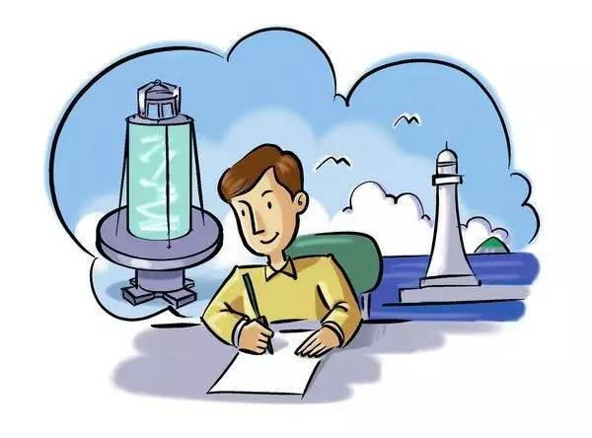
Combine the suffixes with the words to form new words.Think of more words formed with these suffixes.
Task 5
resolve self commit bitter
exhibit vigour persevere
invest real assign cruel
guide tolerate sail envy
navigate
-tion -ance -ment -or -ty -ish -ous -al
-able -less -able -ness

Slide 14
Show time
Task 5
resolution, resolvable, resoluteness
exhibition, exhibitor
reality, realness
tolerance, tolerable, toleration
selfish, selfless
vigorous
assignment
sailor
commitment, committal
perseverance
cruelty, cruelness
envious
bitterness
investment, investor, investable guidance, guidable, guideless
navigation, navigator,
navigable, navigational

Slide 15
language points
【词义】 adj. 残酷的；残忍的；冷酷的
【例句】
Life was cruel to Oliver when he was young. 奥利弗年轻时，生活对他很残酷。
【热点归纳】
be cruel to sb. 对某人残酷
cruelly adv. 残酷地
cruelty n. 残酷；残忍；残酷的行为
cruel
[ˈkruːəl]
Notes:
标题字号固定为黑体 34 加粗 白色，副标题字号固定为黑体 28 黑色，正文字号为黑体 24 黑色。版式仅供参考

Slide 16
language points
【例句】
He was criticized for his cruel acts.
他因行为残忍而受到了批评。
The cruel war caused great disasters to the people.
残酷的战争给人民带来了巨大的灾难。
【语法填空】
①It was cruel _____ him to say that.
②They were very cruel _____ their prisoners of war.
③The king’s __________(cruel)excited the people to rise against him.
答案
（1）of (2)to (3)cruelty
cruel
[ˈkruːəl]
Notes:
标题字号固定为黑体 34 加粗 白色，副标题字号固定为黑体 28 黑色，正文字号为黑体 24 黑色。版式仅供参考

Slide 17
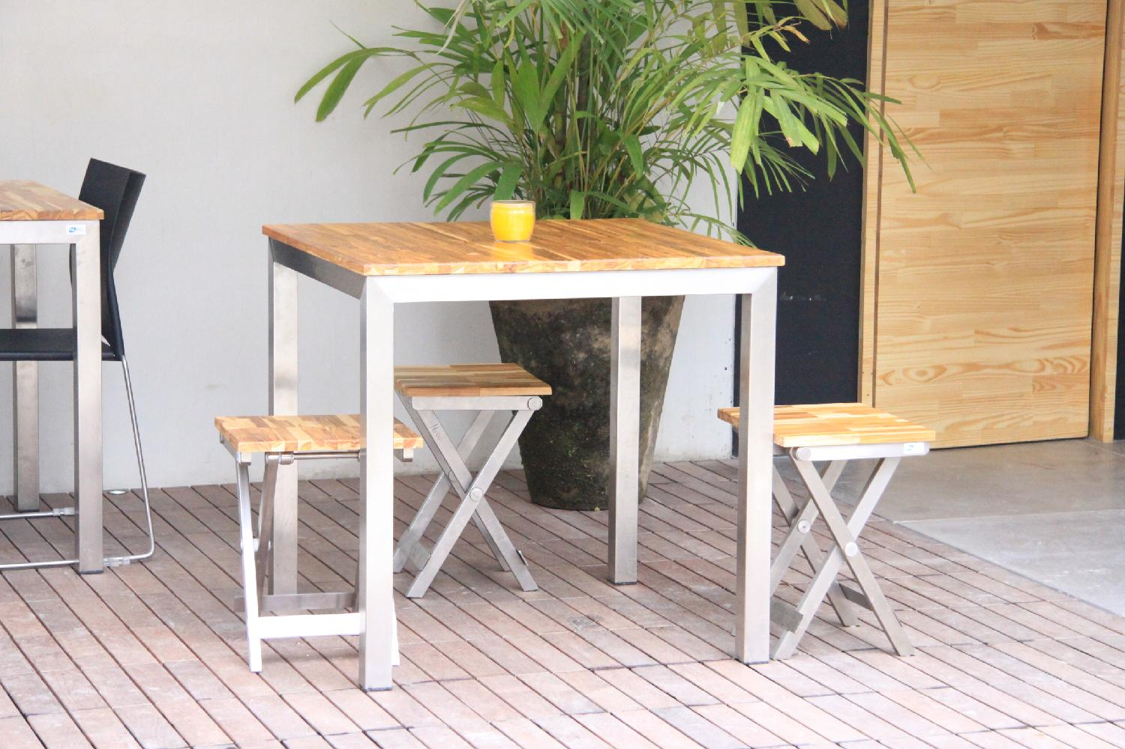
language points
【词义】n. 家具
【教材原句】
It took him a lot of energy to move all the items of furniture inside the house.他花了很大力气才把房子里所有的家具搬到一起。
【例句】
We will buy some furniture for our new house.
我们得给我们的新房子买些家具。
This old table is a valuable piece of furniture.
这张旧桌子是一件很珍贵的家具。
【热点归纳】
a piece of furniture 一件家具
furniture
[ˈfɜːrnɪtʃər]
Notes:
标题字号固定为黑体 34 加粗 白色，副标题字号固定为黑体 28 黑色，正文字号为黑体 24 黑色。版式仅供参考

Slide 18
language points
【热点归纳】
a set of furniture 一套家具
furnish vt. 提供；供应；装备
furnish sb. /sth. with sth. 向(某人 / 某事物)供应，提供某物
【语法填空】
①The factory was built for the manufacture of ____________ (furnish).
②She furnished him _____ the facts surrounding the case.
答案：furniture;with
furniture
[ˈfɜːrnɪtʃər]
Notes:
标题字号固定为黑体 34 加粗 白色，副标题字号固定为黑体 28 黑色，正文字号为黑体 24 黑色。版式仅供参考

Slide 19
language points
【教材原句】
Although living a miserable life, he had a very kind heart.
虽然他过着悲惨的生活，但他有一颗善良的心。
【例句】
Though he is disabled, he lives an active life.尽管他身体残疾，但是他过着积极的生活。
People in some backward regions still live a life without electricity. 一些落后地区的人们仍然过着没有电的生活。
live a… life
过着……的生活
Notes:
标题字号固定为黑体 34 加粗 白色，副标题字号固定为黑体 28 黑色，正文字号为黑体 24 黑色。版式仅供参考

Slide 20
language points
【热点归纳】
have/live a… life过……的生活
dream a… dream做一个……的梦
smile a… smile露出……微笑
能接同源宾语的动词还有：die,laugh, breathe, sing, sigh, sleep等。
【完成句子】
①(北京卷)Meanwhile, with her parents’ help, Moore is generally able to_____________.同时，在父母的帮助下，摩尔基本上能够过上正常的青少年生活。
②The boy can __________________.
那个男孩会唱一首悦耳的歌曲。
答案：live a normal teenage life, sing a beautiful song
live a… life
过着……的生活
Notes:
标题字号固定为黑体 34 加粗 白色，副标题字号固定为黑体 28 黑色，正文字号为黑体 24 黑色。版式仅供参考

Slide 21
Practice
写出单词或将词组补充完整
1．________ adj. 残酷的；残忍的；冷酷的
→__________ adv. 残酷地
→__________ n. 残酷；残忍；残酷的行为
2．___________ adj. 深入的；彻底的；细致的
→_____________ adv. 非常，极其；仔细，缜密；彻底
3．____________ n. 家具
→__________ vt. 提供；供应；装备
cruel
cruelly
cruelty
thorough
thoroughly
furniture
furnish

Slide 22
Practice
写出单词或将词组补充完整
4．________________ adv. 不幸地；遗憾地
→______________ adv. 幸运地
5．live ____… life 过着……的生活
6．_____ all directions向四面八方
unfortunately
fortunately
a
in

Slide 23
Practice
单句语法填空
1．She was even less enthusiastic ________ going to Spain.
2．They assigned the new task _____ me.
3．Fred entered without knocking and，very out of breath，sank _______ a chair.
4．We shouldn’t abandon ____________ (our)to pleasures.
5．He resolved _______ nothing should hold back.
6．If you turn _______, you might find it easier to get to sleep.
about
to
into
ourselves
that
over

Slide 24
Practice
单句语法填空
7．Traditionally，college students hold a graduation ceremony to encourage themselves before they set ______ on their life journey.
8．She asked Ann if she could keep an eye _____ the dog.
9．After hearing the shocking news that a baby was murdered in a washing machine, I couldn’t hold _____ my tears.
10．When I visited him，I saw him ____________ (repair) his car.
off
on
up
repairing

Slide 25
1.Review the words and phrases of this period.
2.Do the exercises of your workbook.

