Slide 1
Unit 10

Slide 2
Unit 10
I'd like some noodles.

Slide 3
Section A 2
Grammar focus-3c

Slide 4
Grammar focus
阅读Grammar Focus部分, 完成下列句子。
1. 你想要什么面条？
________________________________
2. 请给我来牛肉面。________________________________
3. 你想要什么碗的？________________________________
What kind of noodles would you like?
I’d like beef noodles, please.
What size would you like?

Slide 5
4. 请给我来中碗的。
___________________________
5. 你想来一个大碗吗？
___________________________
6. 好的。
___________________________
I’d like a medium bowl, please.
Would you like a large bowl?
Yes, please.

Slide 6
7. 在西红柿鸡蛋汤里有肉吗?
_______________________________
_______________________________
不，没有。
_______________________________
_______________________________
9. I’d = ____________
10. She’d = _________
Is there any meat in the tomato and egg soup?
No, there isn’t any. /No, there’s no meat.
I would
She would

Slide 7
11. 不可数名词有：bread, milk, water,
_______________________________
12. 既是可数又是不可数的名词：salad, chicken, ice cream,
_______________________________
beef, meat, mutton
cabbage

Slide 8
探究乐园
would like 句型
一、would like意为“想要某物”，常用句式结构：
1. 你想要点什么？
What ______ you ______?
我想要一杯茶。
____ _____ a cup of tea.
would like
I’d like

Slide 9
你想要什么面条？
What _____ of noodles ______ you like?
你想要多大号的毛衣？
What ____ of sweater ______ you like?
（以上句型为有礼貌、委婉地表达征求对方的要求）
kind would
size would

Slide 10
2. Would you like …? 你想要……吗？这 也是用来向对方有礼貌地、语气委婉 地 征求对方要求的句型。其答语为： Yes, please. /OK. /No, thanks.
你想要一些牛奶吗？
______ you _____ some milk?
是的，谢谢。/ 不，谢谢。
Yes, _______. / No, _______.
Would like
please thanks

Slide 11
【拓展】Would you like to do sth.? 你愿意做某事吗？
用来有礼貌地向对方提出建议或邀请的句型。答语常为“Yes, I’d like to.” “Sorry, …”
你愿意和我们一起去划船吗？
______ you ____ to ____ boating with us?
Would like go

Slide 12
二、可数名词与不可数名词
1. 可数名词：可数名词有单数、复数之 分。其复数形式一般要加-s或-es。 如： potato — _________
tomato — __________
2. 不可数名词没有复数形式，只有单数 形式。如：
some ______ (米饭)
a lot of _____ (牛肉)
potatoes
tomatoes
rice
beef

Slide 13
(1) 不可数名词表示数量的多少时，必须与表示数量的名词连用，即“数词 + 表示数量的名词（可数名词）+ of + 不可数名词”。如：
两玻璃杯果汁
_____ ________ of juice
三碗米饭
_______ ______ of rice
two glasses
three bowls

Slide 14
(2) 不可数名词做主语时，谓语动词只能用 单数形式。例如：
在碗里有一些羊肉汤。
There ___ ______ mutton soup in the bowl.
【拓展】如果不可数名词前有复数名词短 语修饰时，谓语动词须用复数形式。 如：房间里有两袋子大米。
______ ____ two bags of rice in the room.
is some
There are

Slide 15
Pairwork
3a
Complete the conversation below.
May I have your order? ___
2. What kind of noodles would you like?
3. We have beef, chicken, mutton, cabbage, potato, tomato … ___
4. Yes, there are some carrots. ____
5. Sure. What size would you like? ___
6. We have large, medium and small bowls. ____

Slide 16
a. What kind of noodles do you have?
b. Oh, a medium bowl, please.
c. OK, I’d like the mutton noodles then.
d. I’d like some noodles, please.
e. What sizes do you have?
f. Are there any vegetables in the mutton noodles?

Slide 17
方法指导
先通读一遍问句与答语部分的选项，整体把握对话的大意，明确对话中顾客想要吃的食物。
开头的问答句，已给出答案了，因此应按说话的逻辑顺序，顺藤摸瓜。

Slide 18
比如：第2句，服务员问“想吃什么面条”时，顾客应想知道有何种类型的面条，故用a句来答。第3问句中，服务员介绍了有何类型的面条，并在第4句中，回答了一句Yes，可知顾客仍在询问，故可知应用f作答。对第4句的答语应是选择一种面条作答，故选c。接下来对面条的大小碗型号进行问答就较易选择了。

Slide 19
Check the answers.
May I have your order? ___
2. What kind of noodles would you like? ___
3. We have beef, chicken, mutton, cabbage, potato, tomato … _____
4. Yes, there are some carrots. ____
5. Sure. What size would you like? ___
6. We have large, medium and small bowls. ____
d
a
f
c
e
b

Slide 20
Writing
3b
Write questions and answers using the words in brackets.
1. What kind of noodles would you like? (kind) _____________________________ (chicken / beef / tomatoes)
2. _____________________________ (size)
___________________________ (medium)
3. ____________(any/cabbage/beef noodles)
___________________________ (no)

Slide 21
方法指导
由例句可知，本题要求同学们根据括号中的提示词，分别造三个问句与三个答语。
根据括号中的提示词可知，第二个问句应是询问想要多大碗的面条，回答是中碗的面条。
根据答语中提示词no可知，第三个问句应是一般疑问句，作一个否定的回答语。

Slide 22
Check the answers.
1. What kind of noodles would you like? (kind)
____________________________________
__________ (chicken/beef/tomatoes)
2. _________________________ (size)
_____________________________(medium)
3. ____________________________________
(any/cabbage/beef noodles)
____________________________ (no)
I’d like the chicken/beef noodles with tomatoes.
What size would you like?
I’d like a medium bowl of noodles.
Are there any cabbages in the beef noodles?
No, there aren’t any cabbages.

Slide 23
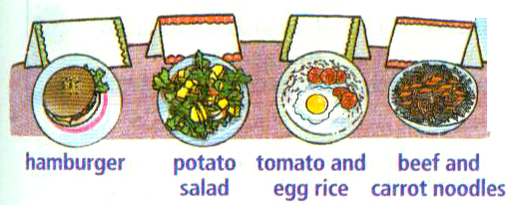
Group Work
3c
Work in small groups. Who would like the food below? Write their names on the cards above the food.

Slide 24
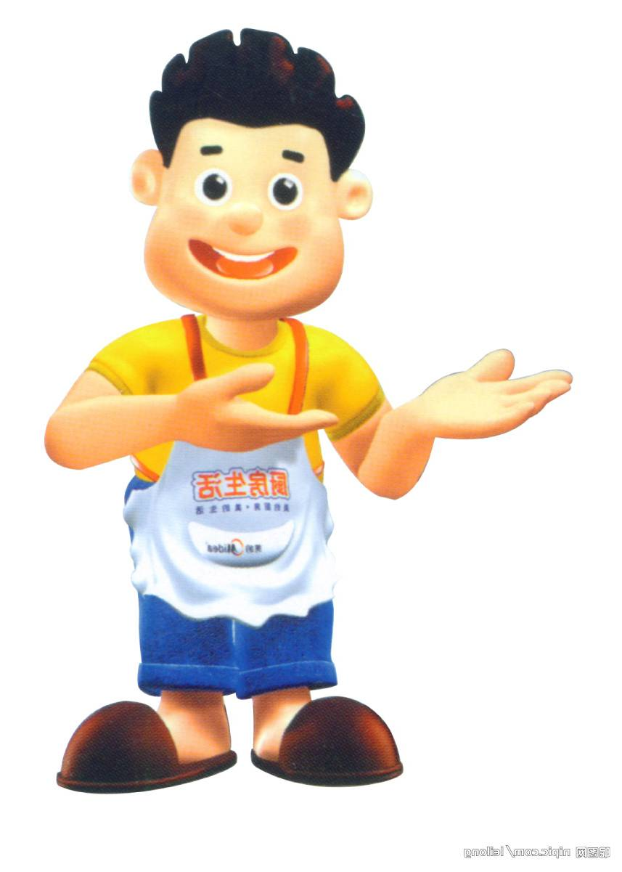
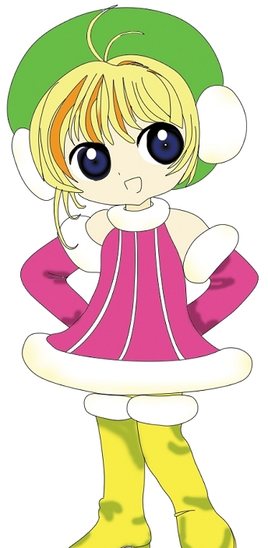
Ask and answer
Anna, what would you like to eat?
I’d like beef noodles with carrots.

Slide 25
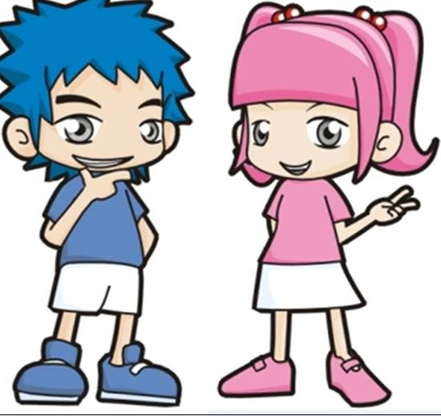
Grace, what would you like to eat?
I’d like tomato and egg rice.

Slide 26
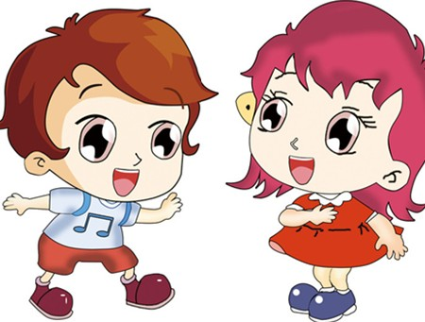
Cindy, what would you like to eat?
I’d like potato salad.

Slide 27
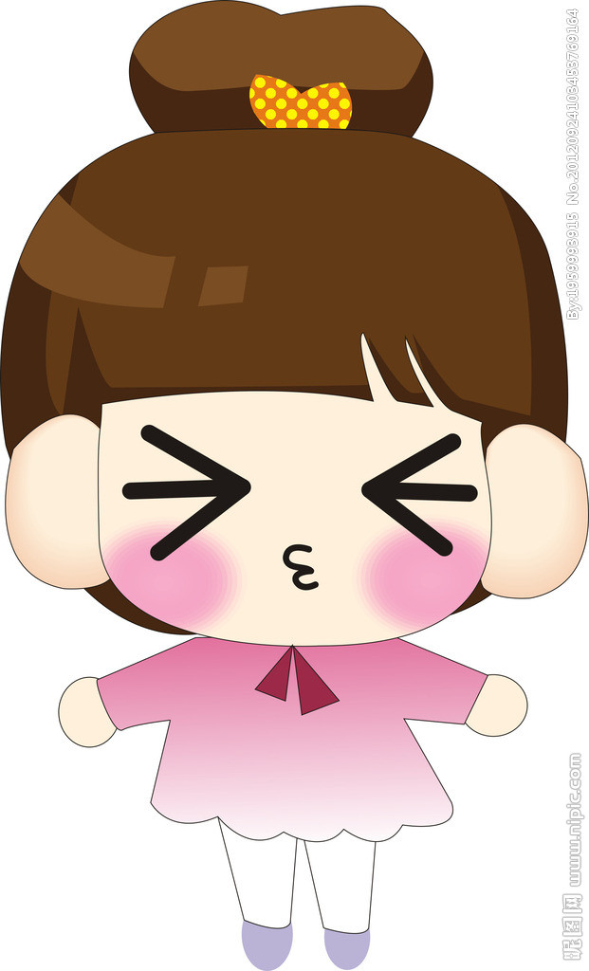
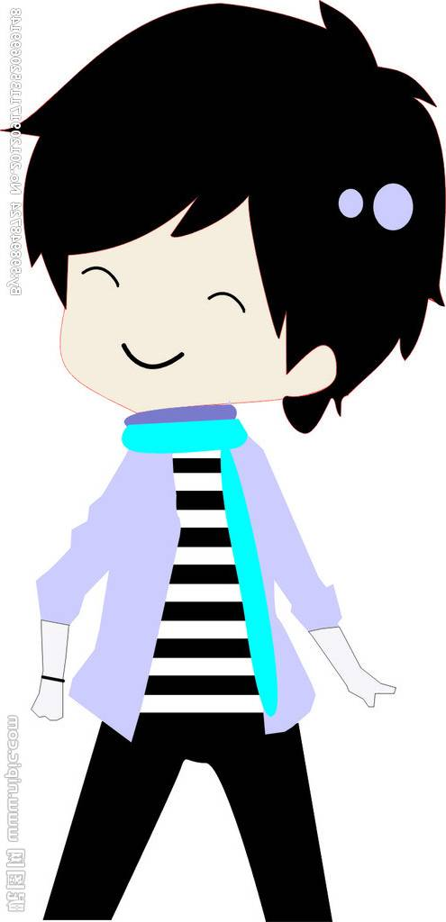
Bob, what would you like to eat?
I’d like a hamburger.

Slide 28
Writing
Bob
Grace
Linda
Anna

Slide 29
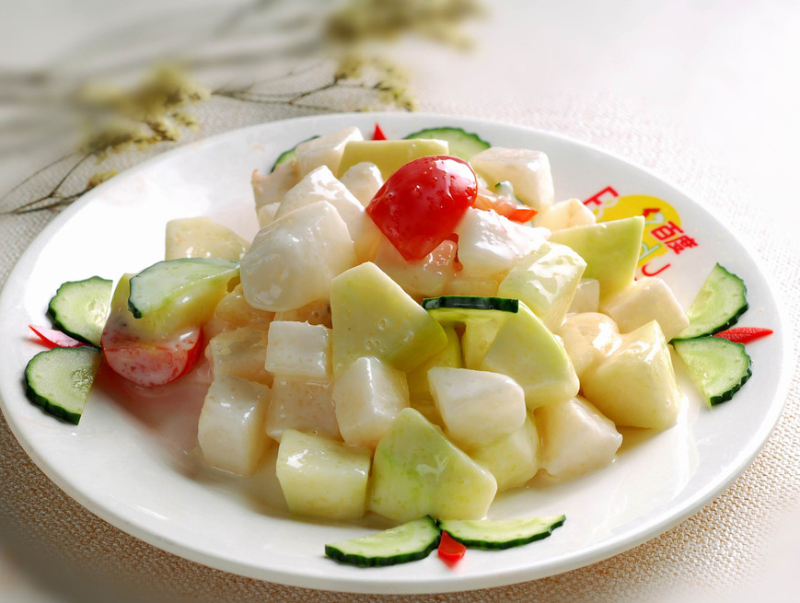
Practice
根据图片提示补全对话。
would
— What _______ you like, Jenny?
— I’d like the fruit _____.
What about you?
salad

Slide 30
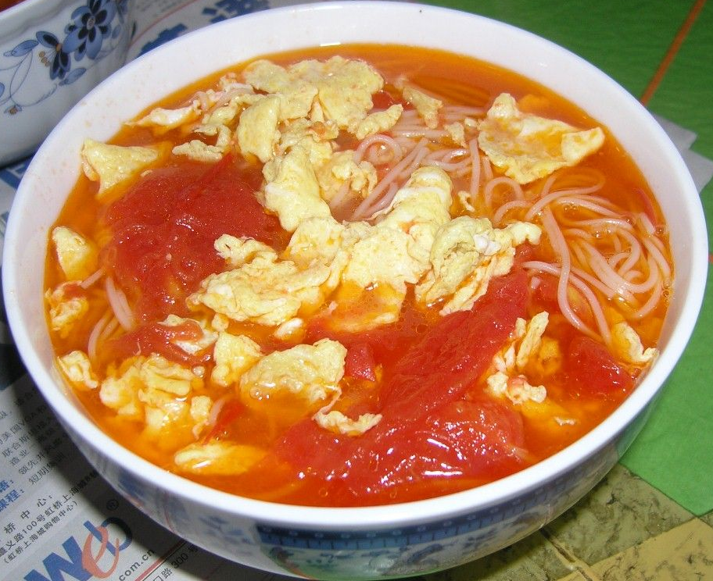
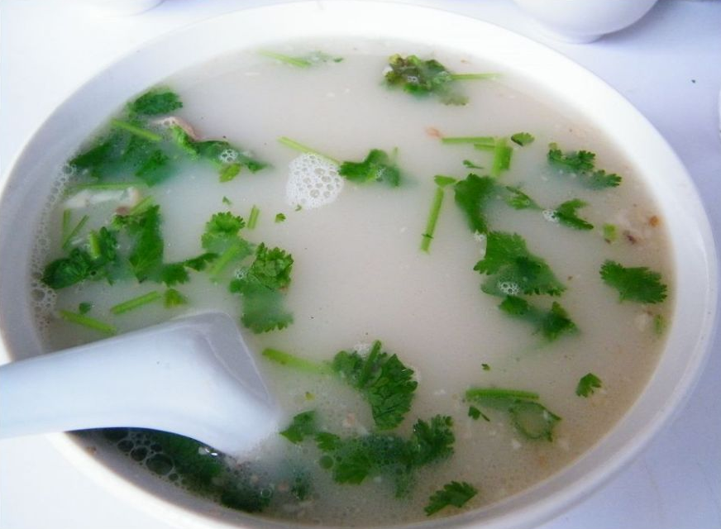
— ___ like the egg and tomato _______.
— Well, what ____ ______ you like?
— I’d like a ______ ____.
— ______ you like some mutton _____?
— No, _______.
I’d
noodles
size would
small one
Would soup
thanks

Slide 31
Exercises
补全对话，每空一词。
W: May I take your ______, please?
Tom: Yes. _____ _____ some rice and
soup, please.
W: What _____ of soup ______ you like?
Tom: What kind of soup do you _____?
W: We have beef and carrot soup, tomato
and egg soup, mutton and potato soup…
order
I’d like
kind would
have

Slide 32
Tom: Can I have a ______ ___ tomato
and egg soup?
W: Sure. What _____ would you like?
Tom: I’d like a medium one, please.
bowl of
size

Slide 33
Homework
1. Remember the sentences in the
Grammar Focus.
2. Make some conversations to ask your
friends what food they would like. Write a short conversation.

Slide 34
Thank you!

