Slide 1
Yesterday Once More

Slide 2
Unit 1
Where did you go on vacation?
Section B ( 1a-1e )

Slide 3
自主学习方案
翻译下列词组。
1. 你能用英语写出下列词语吗？
可口的 ______ 昂贵的_______令人兴奋的_______便宜的______
糟糕的_______ 无聊的_______ 有趣的 _______ 友好的______
2. 写出下列动词的过去式。
sing _________ go_______ study _______ fly ______
have ________ swim_____ do _______ stay______
visit ______ tell _______ lose______ hear______

Slide 4
Let's revise

Slide 5
Guessing game
Look at the pictures carefully and guess what they did.

Slide 6
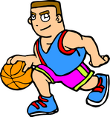
What did he do last weekend?
He played basketball last weekend.

Slide 7
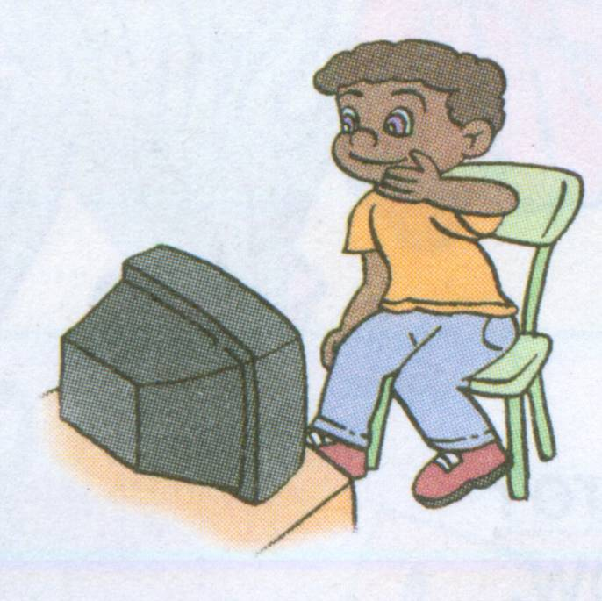
What did he do last weekend?
He watched TV last weekend.

Slide 8
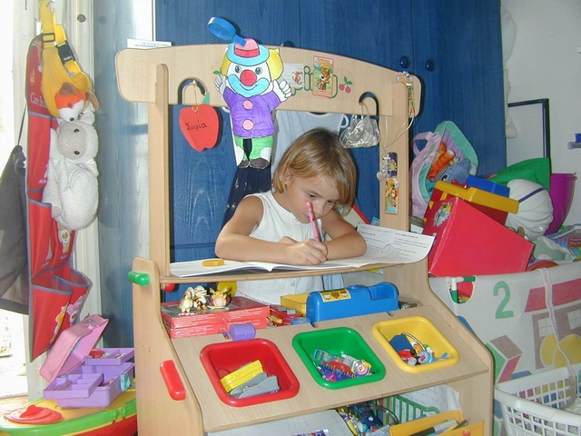
What did she do last weekend?
She did her homework last weekend.

Slide 9
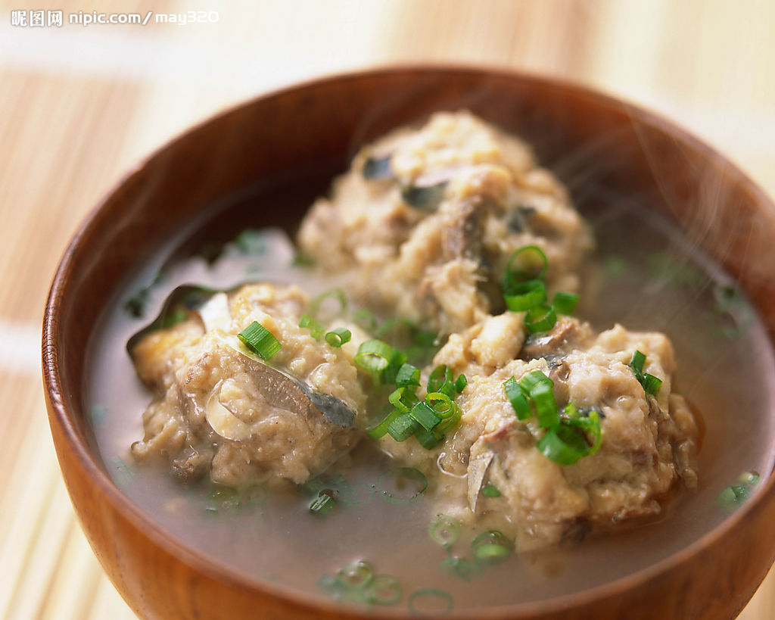
How was the food? It was…
delicious

Slide 10
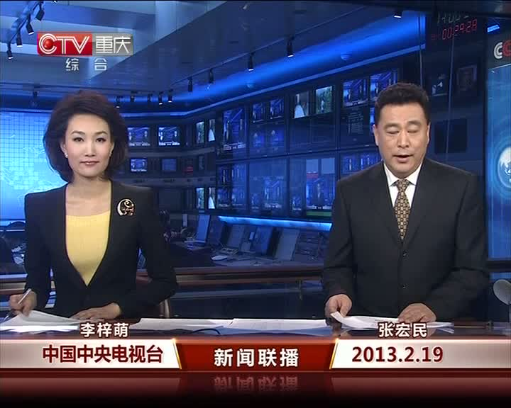
A:How was CCTV News?
B: It was boring.

Slide 11
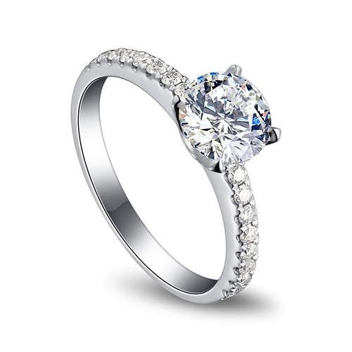
How was the ring?
It was expensive.
10,000,000$

Slide 12
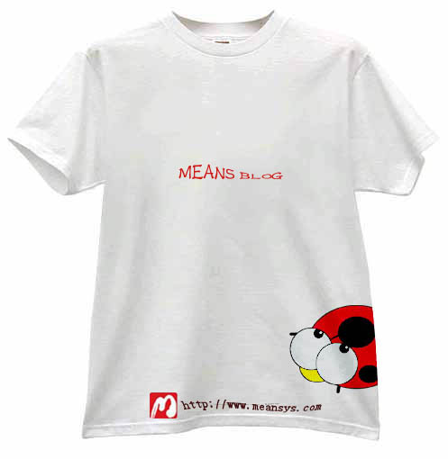
How was the T-shirt?
It was cheap.
5RMB

Slide 13
How were the apples?
They were terrible.

Slide 14
1a
Match the words with the pictures below.
1. __ delicious 3. __ exciting 5. __ terrible
2. __ expensive 4. __ cheap 6. __ boring
f
c
b
a
e
d

Slide 15
1b
Look at the words in 1a again.
Write ☺ words on the left.
Write ☹ words on the right.
☺ words
__________
__________
__________
☹ words
___________
____________
_____________
deliciouse
terrible
cheap
expensive
exciting
boring

Slide 16
Can you write other words?
☺ words
__________
__________
__________
__________
__________
__________
_________
☹ words
___________
___________
___________
___________
___________
___________
___________
excellent
difficult
interesting
bored
funny
tired
wonderful
unhealthy
beautiful
unlucky
happy
scared
popular
lazy

Slide 17
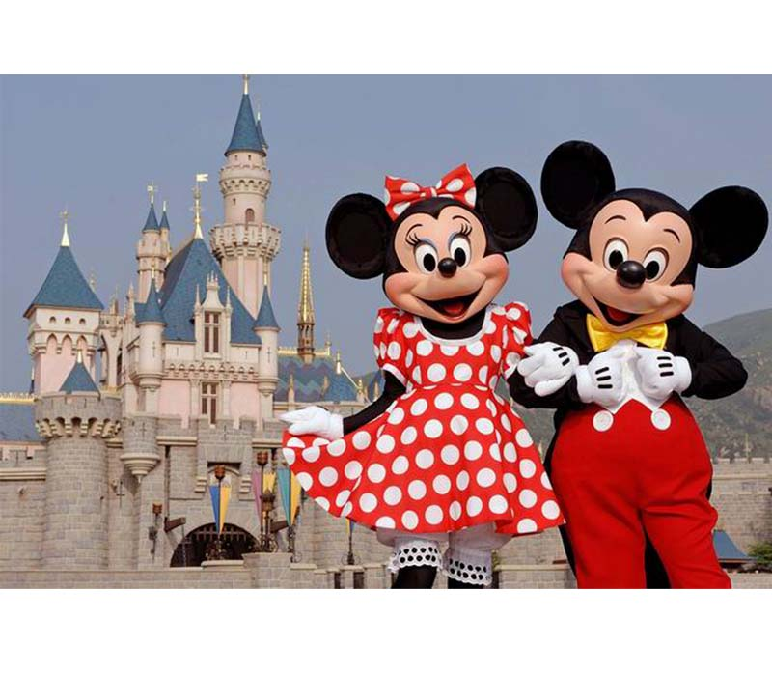
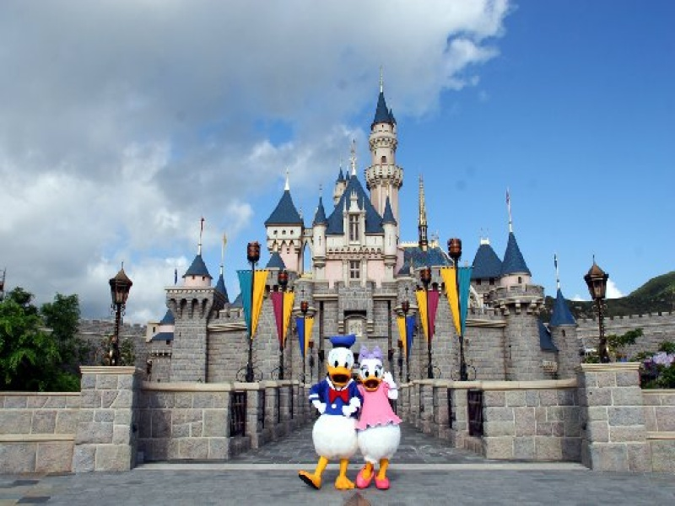
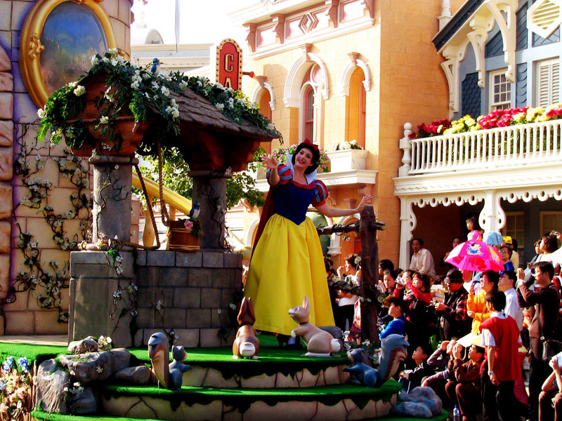
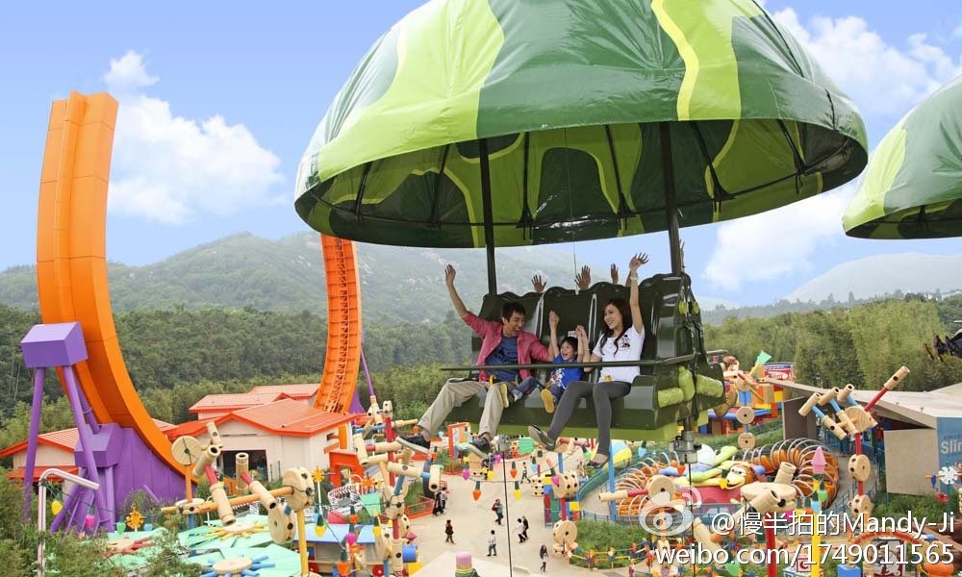
Disney Park
Hong Kong
fun park（娱乐公园）
friendly
Question：
How was Disney park？
Exciting.

Slide 18
1c
Listen. Lisa is talking about her vacation. Answer the questions.
1. Where did Lisa go on vacation?
____________________________
2. Did she do anything special there? What was it?
___________________________________
She went to Hong Kong.
Yes, she did.
She went to a fun park.
3. Did she buy anything for her best friend?
___________________________________
4. Did Lisa like her vacation?
___________________________________
Yes, she did.
Yes, she did.

Slide 19
1d
Listen again and fill in the blanks.
What did Lisa say about…?
her vacation ______ the people _______
the fun park _______ the food _________
the stores _________
great
friendly
exciting
delicious
expensive

Slide 20
G-Gina; L-Lisa
Complete the tape script ！
G: Hi, Lisa. How was your vacation?
L: It was great! I________________________.
G: Really? Wow! Did you do____________ there?
L: Well, we went to a fun park. It was really exciting.
G: Did you ____________?
L: Yeah, I did.
G: How were the stores?
L: Oh, they were very________, but I did__________
_____________.
G: And how were the people? Were they friendly?
L: Yeah, they were really friendly. My parents___________
there, and they had dinner at their house.
G: _______ was the food?
L: It was delicious. I loved their home_________.
G: Did everyone_______________?
L: Oh, yes, we did. Everything was excellent.
went to Hong Kong with my family
anything special
go shopping
expensive
buy something
for my best friend
have some friends
How
cooking
have a good time

Slide 21
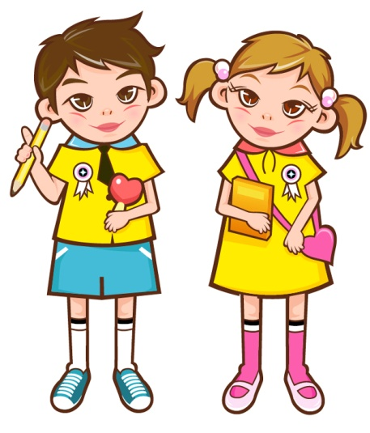
Ask and answer questions about Lisa’s vacation. Begin your questions with:
1e
Where did…?
She ...
How was…?
It...
Where did…?
She ...
How was…?
She...
She ...
Where did…?

Slide 22
针对训练
1. My mother ____________________ (没
有买什么特别的东西 ) for me on vacation.
2. It _________________ (是他第一次去 ) visit
the museum.
3. Mr. Green __________________ (拍了相
当多的照片 ) in the zoo.
didn’t buy anything special
was his first time to
took quite a few photos

Slide 23
4. How was the food ?
________________________ ( 所有的食物味道都很棒).
5. We ________________________ _ ( 和老师
一起去了长城) last month.
6. _____________________ (做了某些有趣的 ) on your
vacation ?
Everything tasted really good
went to the Great Wall with our teacher
Did you do anything fun

Slide 24
Homework
Write about what you did on your
vacation.
2. 完成本单元的练习。

