Slide 1
What were you doing when the rainstorm came?
Unit 5
R 八年级下册
Section B 2c - 3b

Slide 2
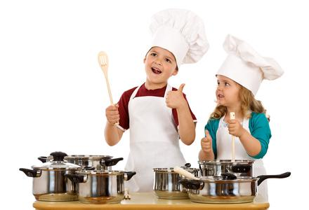
What were you doing
when the rainstorm came?
I was cooking.

Slide 3
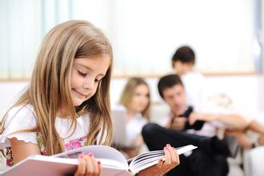
What were you doing
when the rainstorm came?
I was reading.

Slide 4
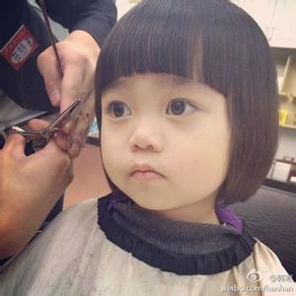
What were you doing
when the rainstorm came?
I was cutting
hair.

Slide 5
2c. Read the passage again. Are the following
statements true (T) or false (F)，or is the
information not given (NG)?
________ 1. Everyone in America remembers
who killed Dr. King.
_____2. Robert Allen was eating lunch when
Dr. King was killed.
_____3. Roberts parents were shocked to
hear the news.
F
T
T

Slide 6
2b
_____4. Kate Smith was watching a movie
when a plane hit the World Trade
Center.
_____5. Kate didn't think her friend was
telling the truth about the event.
NG
F

Slide 7
2d. Underline sentences from the passage with
similar meanings to the ones below.
1. Not everyone will remember who killed him, but they can remember what they were doing when they heard that he got killed.
Although some people may not remember who killed him, they remember what they were doing when they heard the news.

Slide 8
2d
2. No one said anything for the rest of dinner.
3. September 11, 2001— the date alone
means something to most people in the US.
My parents did not talk after that, and we finished the rest of our dinner in silence.
Even the date — September 11, 2001
— has meaning to most Americans.
4. I had trouble thinking clearly after that
because I was very afraid.
I was so scared that I could hardly
think clearly after that.

Slide 9
2e. How much do you remember about the
events in the passage? Test your partner.
When did Dr. Martin
Luther King die?
He died on ...

Slide 10
3a. Make notes about an event you remember
well.
What was the event?
When did it happen?
Where did it happen?
What were you doing?
What were your friends doing?
Why was it important?
Why do you remember this event?

Slide 11
3b. Write a short article about the important
event in 3a. Try to write three paragraphs.
First, write about the event (when and where it happened).
Next, write about what you and some of your friends were doing when this event happened.
Then, write about why this event was important.

Slide 12
3b
An important event that I remember well was ______________________. It happened in/ on________________ at/in ___________.
When I heard the news of this event/ When this event happened, I was______________
_____________________________________.
Wenchuan Earthquake
May 12th, 2008
Wenchuan
staying at home, because I was ill that day

Slide 13
3b
My friends were___________________
_________.This event is very important to me because ___________________
________________________________
__________. /I remember this event well because _____________________
____________________.
having English class
at school
one of my pen pals was in Wenchuan. I was very worried about him.
many people died in
the earthquake

Slide 14
1. While you are writing, remember to
______ those unnecessary words.
A. give out B. leave out
C. take out D. point out
2. He _____ here after he finished his
work.
A. will leave B. leaves
C. left D. would leave
D
D

Slide 15
D
3. The thief _____ the purse and _____.
A. drops, run after B. dropped, ran away
C. dropped, run away D. dropped, ran away
4. People in China are always dressed ______
their best clothes _____ New Year’s Day.
A. at, in B. to, on
C. in, on D. in, a
C

