Slide 1

Unit 1
My name’s Gina.
Section B (1a-1f)
人教版七年级(初中)英语上册
0

Slide 2
Learning objectives
1）Key words & phrase: zero, one, two, three, four, five, six, seven, eight, nine, ten,
telephone number
2）To learn the following sentence patterns:
—What's your telephone number, Li Xin? —It's 281-9176.
3）Emotional Goals：To learn how to ask for and give phone numbers.
0

Slide 3


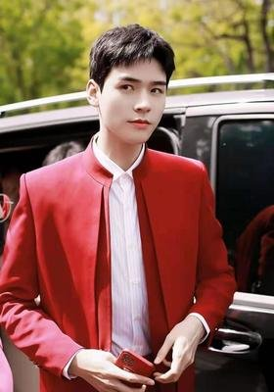
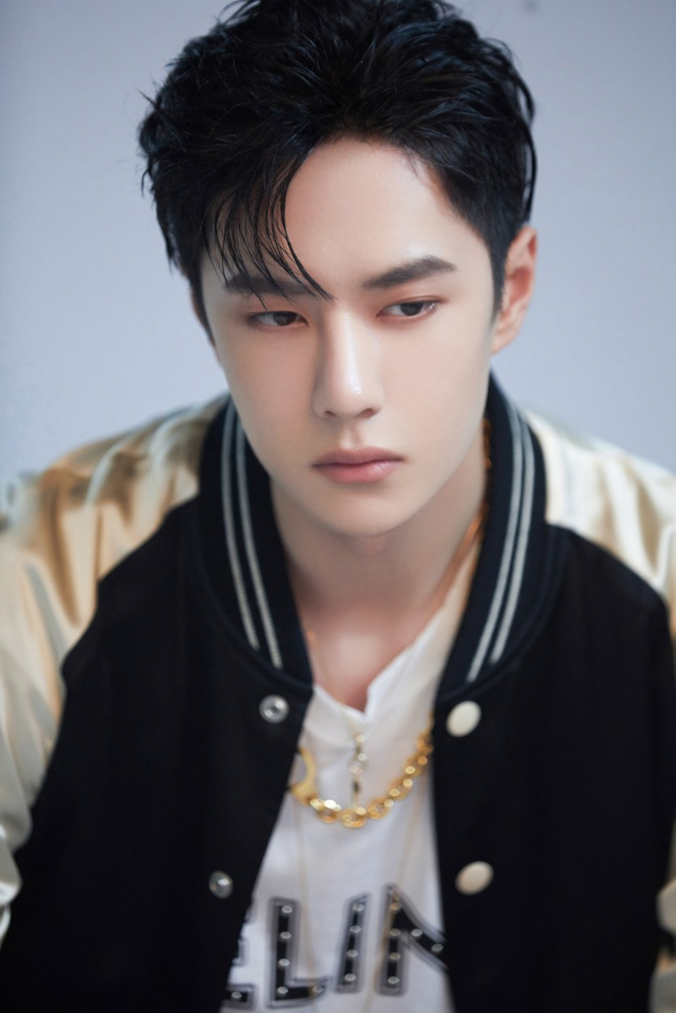
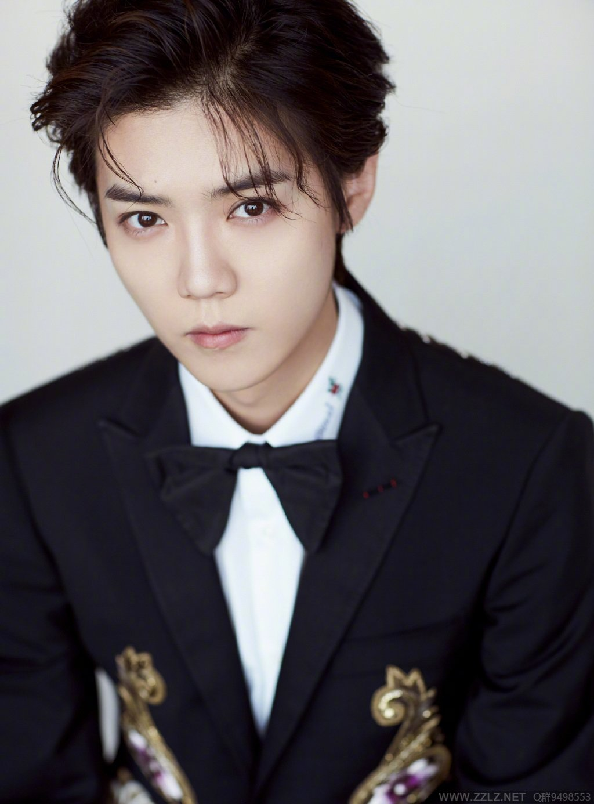
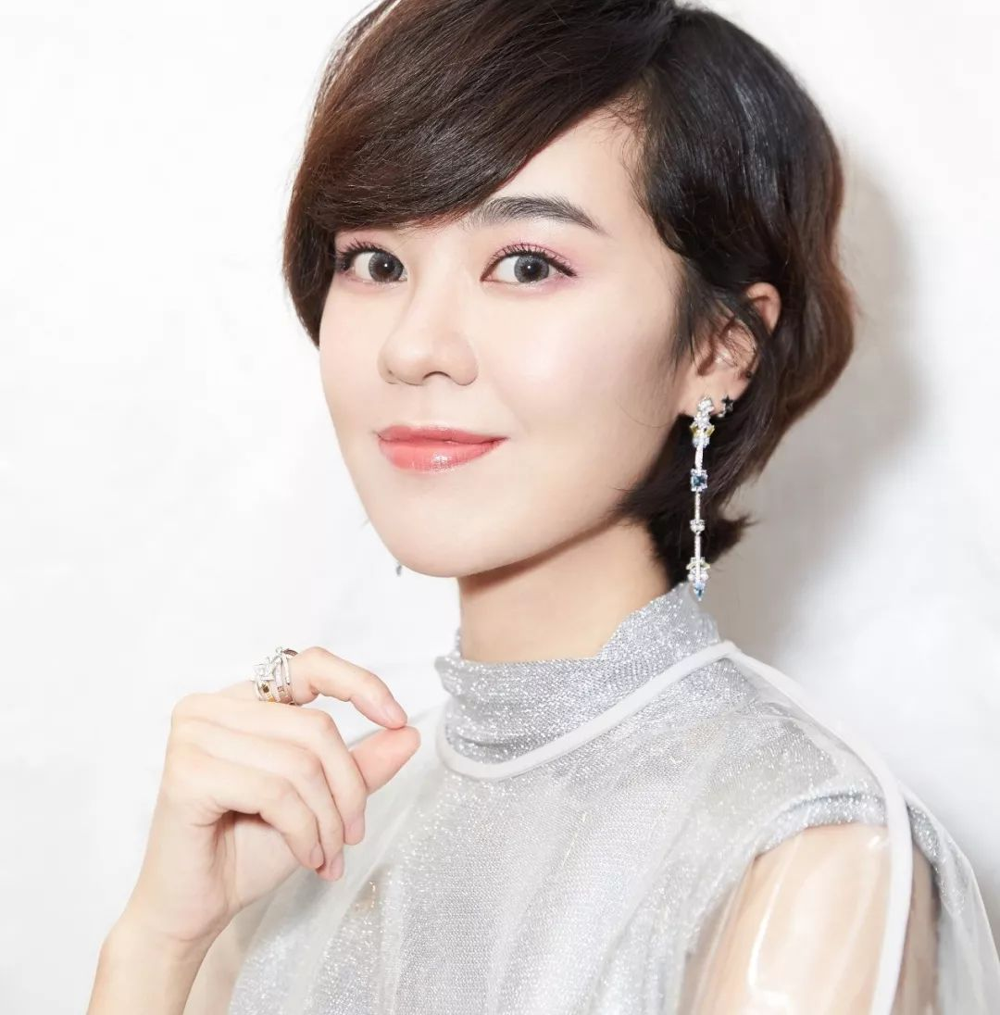
Lead in
—What’s his/her name? —His/Her name's …
— Is he/she ...? —Yes, he/she is. —No, he/she isn't.

Slide 4
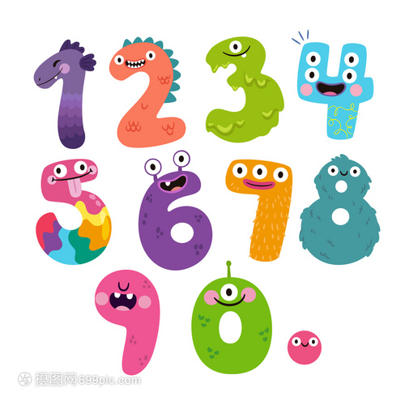
Presentation
Let's learn English numbers from 0-10.
zero
one
one
two
three
three
four
five
six
seven
eight
nine
ten

Slide 5






Presentation
Can you say the numbers?
3
4
1
2
6
5
six
five
two
seven

Slide 6






Presentation
Can you say the numbers?
one
three
four
eight
ten
nine

Slide 7

Presentation
1a Listen and repeat.
0 | zero | 2 | two | 4 | four | 6 | six | 8 | eight
1 | one | 3 | three | 5 | five | 7 | seven | 9 | nine

Slide 8

Presentation
Do you know these numbers?
122
119
110
120

Slide 9
Presentation
Can you read these numbers?
12598
4109358
3157807
6892410
2655416
9461488
0548913
2589715

Slide 10

Presentation
1b Listen to the conversation and write the telephone number.
Telephone number:
____ ____ ____ —— ____ ____ ____ ____
2
7
8
6
9
2
6

Slide 11
Presentation
1d Listen and match the names with the telephone numbers.
Tom __ a. 929-31 __ __
Linda __ b. 398-61__ __
Bob __ c. 278-79 __ __
Mary __ d. 555-80 __ __
c
2 8
d
2 4
b
4 9
a
6 0
1e Listen again and complete the numbers.

Slide 12
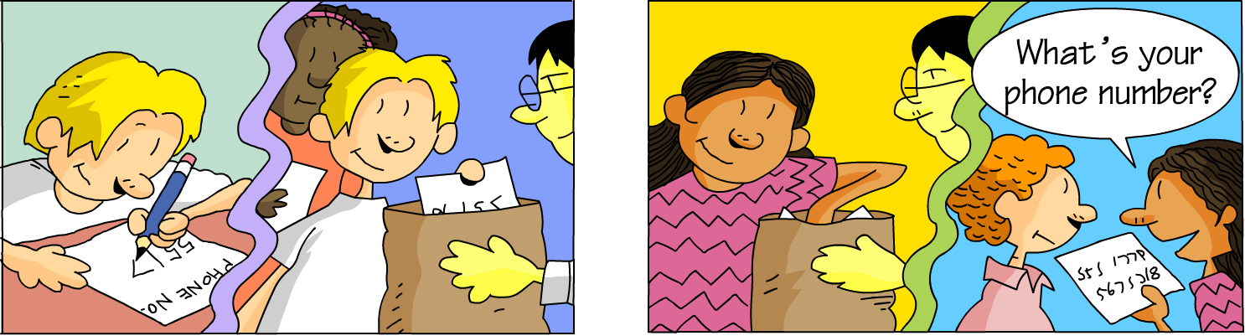
Presentation
1f Write your phone number on a piece of paper and put it
in a bag. Then take out a piece of paper and find the owner.

Slide 13


Presentation
Her name is
Cindy.
What’s her
name?
He/She is... .
What's his/her telephone
number?
Thank you.
His/Her telephone number is... .

Slide 14
Presentation
Write down four students' names and telephone numbers in your group, and then make a report.
There are five students in my groups. His/Her name's... .
His/Her telephone number is... . And my telephone number
is ... .

Slide 15
Language points
1. 基数词0~10分别为：zero, one, two, three, four, five, six, seven, eight, nine, ten。
表示时间
9:10 = nine ten
表示编号
Unit Three
基数词
的用法
表示年龄、数字、日期
two apples
eight yuan
表示电话号码、传真号码、
门牌号、身份证号、车牌号等
119 one one nine

Slide 16
Language points
2. —What’s your telephone number, Li Xin?
—It’s 281-9176.
询问对方电话（身份证、房间、车牌等）号码的句型，what“多少”，答语为“It’s +数字或字母” 或
“My telephone number is… ”。
例：你的房间/身份证/车牌号码是多少？
What’s your room/ID card/car number?

Slide 17
Exercise
一、用英语说出下列电话号码:
one two zero
1.120 ___________________
2.114___________________
3.119 ___________________
4.122 ___________________
5.657241___________________
6.932521___________________
one one four
one one nine
one two two
six five seven two four one
nine three two five two one

Slide 18
Exercise
二、在横线上写出正确的英文数字：
1．two＋six＝___________
2．one＋three＝___________
3．zero＋seven＝___________
4．nine－three×one＝___________
5．four＋two－one＝___________
6．eight÷four＋seven＝___________
eight
four
seven
six
five
nine

Slide 19

Exercise
三、完成下列各题：
1．—____ your ________？
—It's 13887763350.
A．What's, phone number
B．What, number
C．What, telephone number
2．—What's five and five?
—____．
A．Nine B．Six C．Ten

Slide 20
Exercise
三、完成下列各题：
3．His telephone number is 515-6879. （对画线部分提问）
______________his telephone number?
4．发生火灾时，我们应该拨打 .
A.one two zero B.one one nine
C.one one zero D.one one four
What is

Slide 21
Homework
1. Remember the numbers (zero-ten.)
2. Preview the passage in Section B 2b.

