Slide 1
Unit 3
Is this your pencil?
Section A (2a-2d)
人教版七年级(初中)英语上册
0

Slide 2
Learning objectives
1）To learn the key words and phrases：pencil; erasers; books; pencil box; ruler; excuse; me; thank; teacher; about; What about ...? yours; for; thank you for; help; welcome. 2）To learn the following sentence patterns:
① —Is this your schoolbag?
—No, it isn't.
② — Are these your pencils?
— No, they are Bob's.
3）To learn to identify ownership.
4）To learn to use Yes/No question and short answers.
0

Slide 3
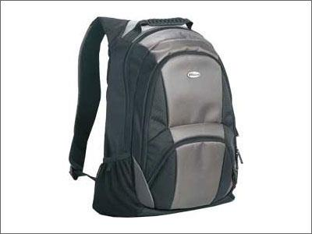
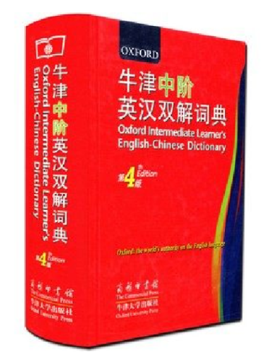
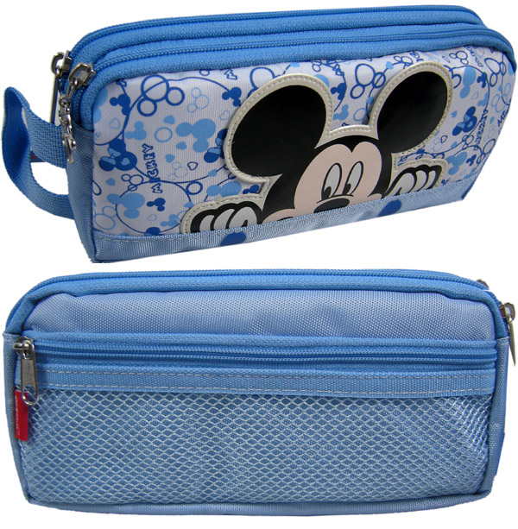
Lead in
What things are there in your schoolbag?
Open your , please.
books
a dictionary
a pencil box

Slide 4
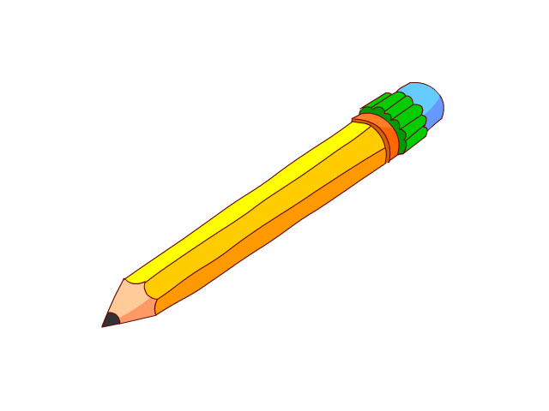
Lead in
What things are there in your pencil box?
Open your , please.
an eraser
a pencil
a pen
a ruler

Slide 5
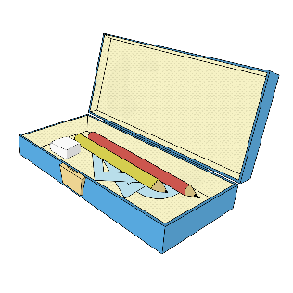
Lead in
What school things are on the desk?
n. books
n. dictionary
n. pencil box
n. schoolbag
n. eraser
n. rulers
n. pen
n. pencil

Slide 6
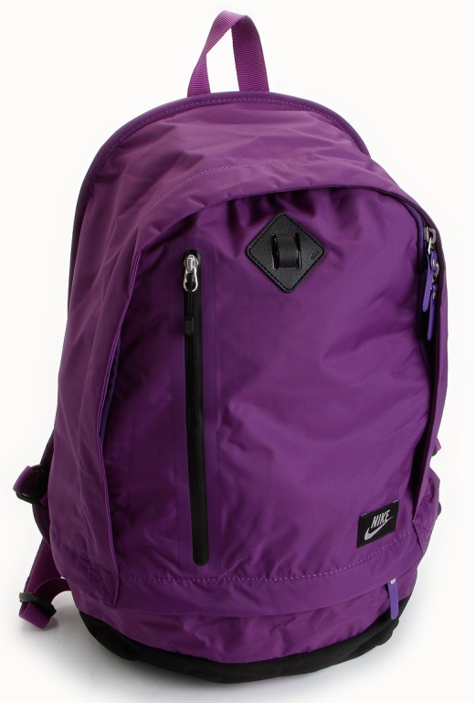
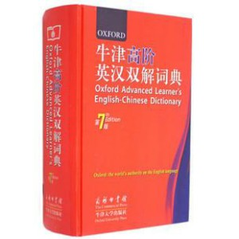
Lead in
Who’s the quickest? 比比谁最快？
It’s a/an …

Slide 7
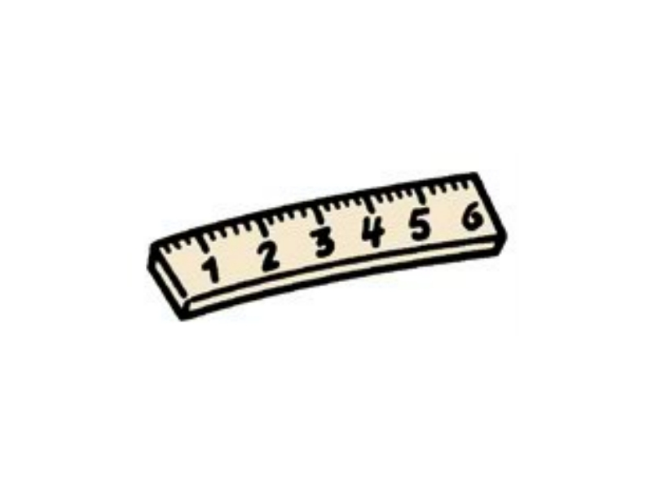
Presentation
2a Listen and check (√) the things you hear.
√
√
√
√
√

Slide 8
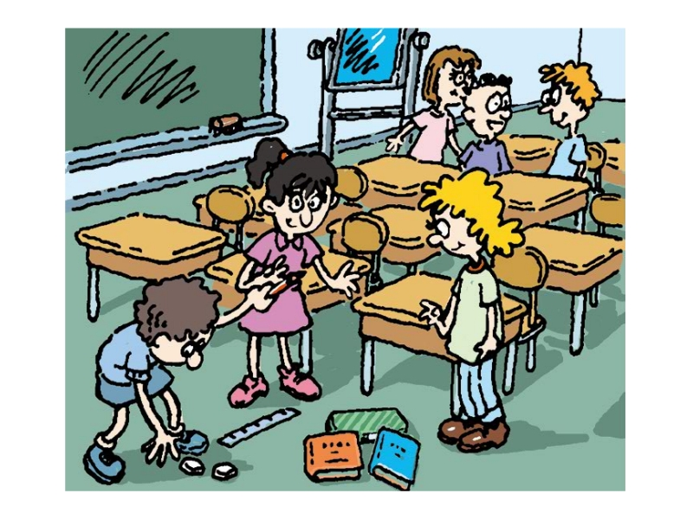
Presentation
2b Listen again. Complete the conversation with the words in the box.
erasers pencil ruler pencil box books
Tom: Excuse me, Grace. Is this your _______?
Grace: Yes, thank you. And those are my _______.
Tom: And Jane, is this your ______?
Jane: No, it isn’t. It’s hers.
Tom: OK, and these are my ______. This is your
__________, Jane.
pencil
erasers
ruler
books
pencil box

Slide 9
Presentation
Listen and match the things with persons.
Grace
Jane
Tom

Slide 10
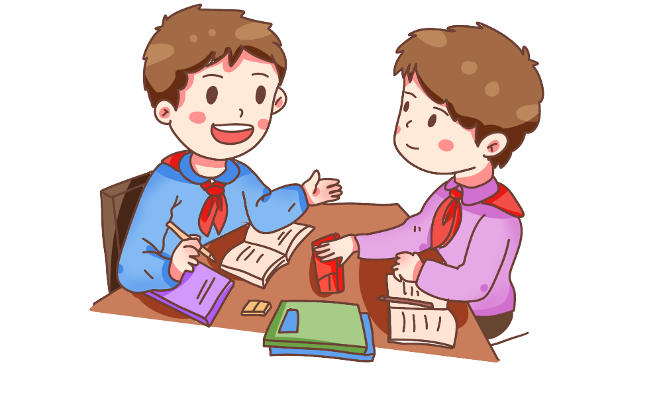
Presentation
2c Practice the conversation in 2b. Then make your own conversations using the things in your classroom.
Is this your schoolbag?
No, it isn’t. It’s hers.

Slide 11
Presentation
2d Listen and fill in the blanks.
These pencils are _______ .
Bob's
Bob has a _______ pen.
blue
The dictionary is _______ .
Helen's
Helen's pen is _______ .
green
Is that Anna's eraser? ___________
Yes, it is .

Slide 12
Presentation
2d Complete the conversation.
Teacher: Hi, Anna. Are these your __________?
Anna: No, they’re _______.
Teacher: And is this ______ green pen?
Anna: No, it isn’t. The blue pen is his.
Teacher: What about this dictionary?
Anna: It’s Helen’s. And the green pen is _____, too.
Teacher: And the eraser? Is that yours?
Anna: Yes, _________.
Teacher: Thank you for ______________, Anna.
Anna: You’re welcome.
pencils
Bob’s
his
hers
it is
your help

Slide 13
Language points
1. Excuse me, Grace.
打扰一下，格雷丝。
Excuse me 意为“劳驾；请原谅”。多用于向对方提出请求、询问情况、打扰对方，以向对方表示歉意或礼貌。
sorry 意为“抱歉；对不起”。一般用于事后对犯错误或
不能满足对方的请求等表示歉意。

Slide 14
Language points
① — , Mr. Brown. Is this your son?
— Yes, he is my son, Jack.
A. Sorry B. OK
C. Thank you D. Excuse me
② — , is this your pen?
— Yes, it's mine, thank you.
A. Sorry B. Excuse me
C. I’m OK D. What is it

Slide 15
Language points
2. No, they're Bob's.
名词所有格, 意为“某人的”，表示所属关系，常用-'s形式
eg: 这是吉姆的尺子， 那是Linda的英语书。
Jim's
Linda's
This is_________ ruler, and that is ________ English book.

Slide 16
Language points
3. What about this dictionary? 这本字典呢？
What about...? 意为“……怎么样？……好不好？”相当于How about...? 后接名词，用于询问对方或他人的意见或看法。
eg: I like this blue pen, what about you?
我喜欢这只蓝色的钢笔，你呢？
what about还可以用来征求对方的意见或向对方提出建议，about是介词，其后还可跟代词或动名词作宾语。
eg: What about playing basketball? 打篮球怎么样？

Slide 17
Language points
① It’s Sunday tomorrow. What about (go) shopping?
② My pen is black. How about yours?
(选出替代画线部分的选项)
A. What about yours B. How are you
C. Excuse me D. Sorry
going

Slide 18
Language points
4.Thank you for your help, Anna.
thank you for … 意为“为……感谢你”,=Thanks for….
for是介词，后加名词、代词或动词-ing 形式。表示感谢的内
容或原因，即 thank you for sth. 或 thank you for doing sth.
他人对自己说“Thank you”时，可以回答“You're welcome!” (不用谢)

Slide 19
Language points
例句：Thank you for your books.
= Thanks for your books. 多谢你的书。
Thank you for your photos. 谢谢你的照片。
Thank you for helping me. 谢谢你帮助我。

Slide 20
Exercise
根据汉语意思完成句子：
1. 请问，这是你的铅笔盒吗？
_____________ , is this _____________ pencil box?
2. 这些书是你的吗, Lucy？
_____________ these _____________, Lucy?
3. 这些字典不是我的。
These _____________ are _____________.
Excuse me
your
Are
books yours
dictionaries
not mine

Slide 21
Exercise
根据提示填写单词：
1. That ____________ （铅笔）is not Jim's.
2. This is her ____________（蓝色的盒子） .
3. That is _______________________ （一本英语字典）.
4. Is this your ____________（书包） ?
5. That ____________（书）is my brother's.
6. Let me ________ (帮助) you now.
pencil
blue box
an English dictionary
schoolbag
book
help

Slide 22
Homework
1. Learn the conversation in 2b by heart.
2. Complete the exercises in students' books.

