Slide 1
Unit 8
How do you make a banana milk shake?

Slide 2
Section B
(2a-2d)

Slide 3
How do you make a sandwich?
We need...

Slide 4
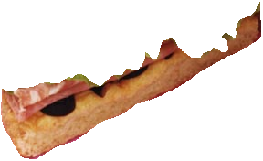
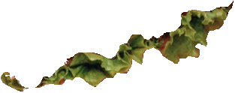
Let’s make a turkey sandwich.
Take a piece of bread.
Put some lettuce on the bread.

Slide 5
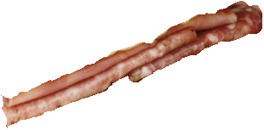
Put two teaspoons of relish佐料on the lettuce.
Put three slices of chicken on the relish.

Slide 6
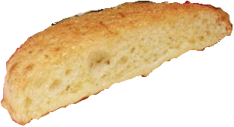
Put another slice of bread on the top.

Slide 7
Thanksgiving
in the United States

Slide 8
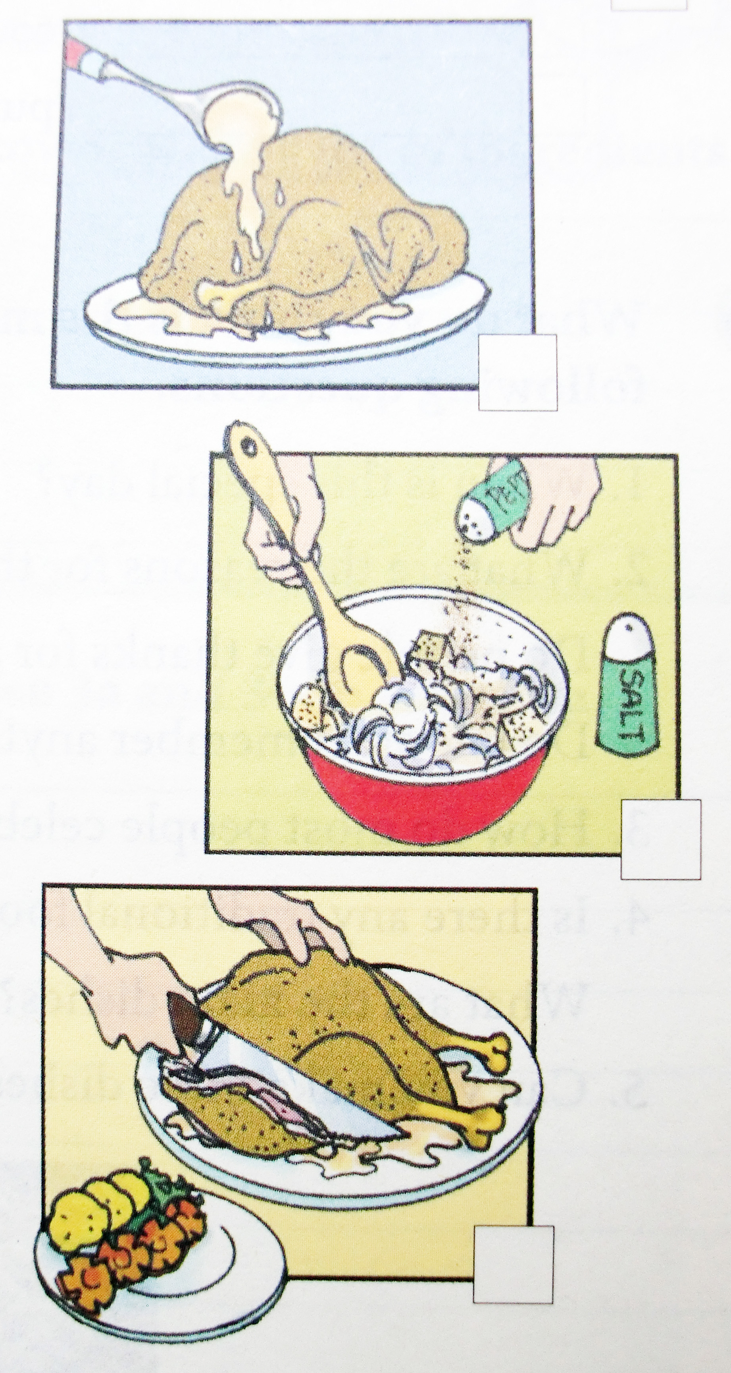
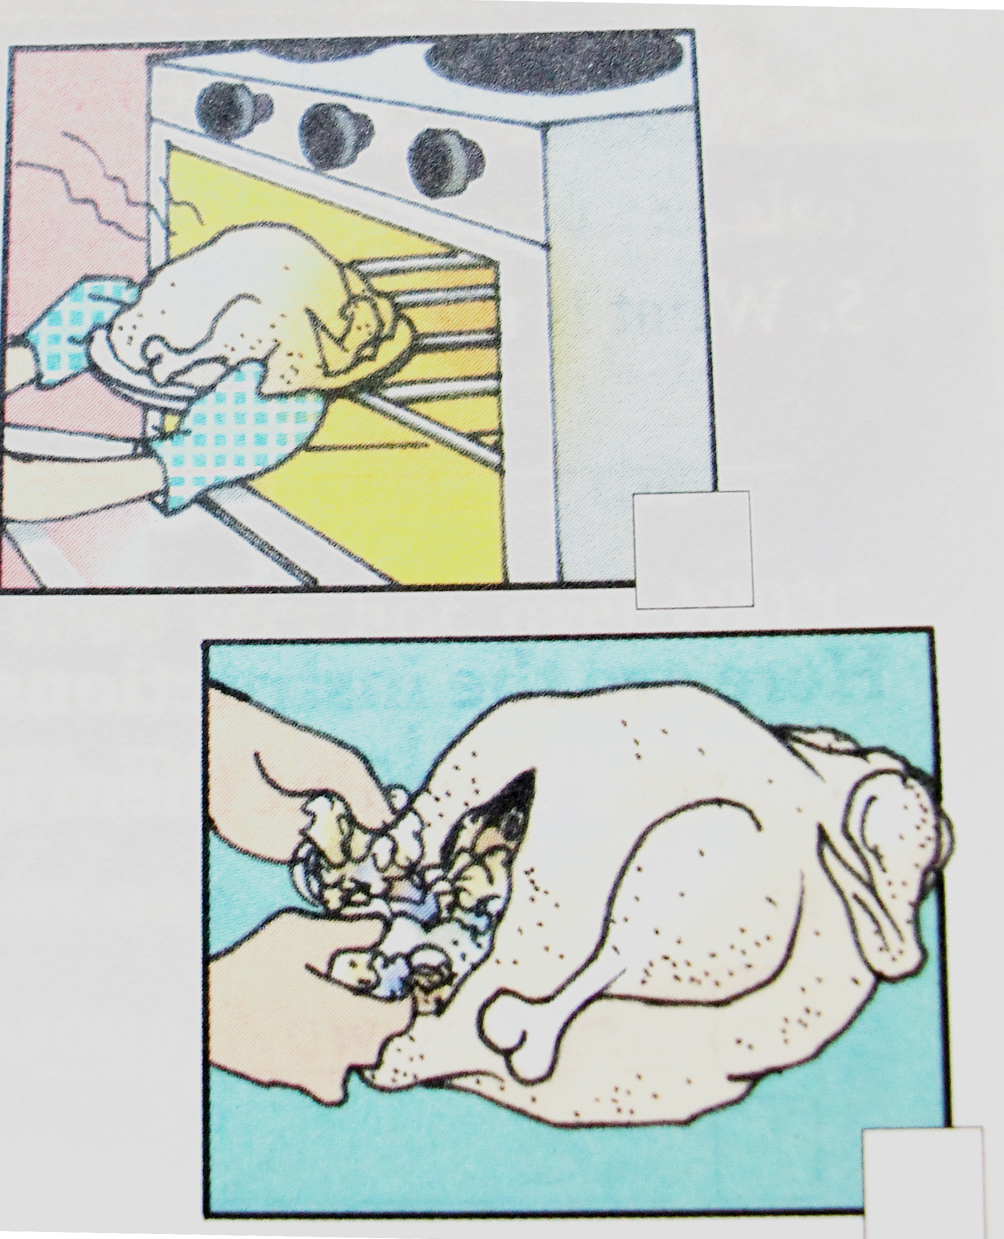
Reading
2b
Read the article and number the pictures [1-5].

Slide 9
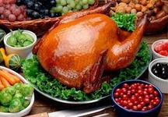
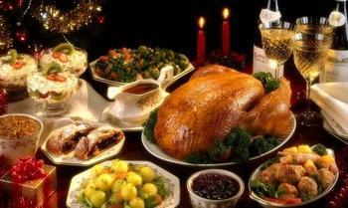
Step1
What kind of traditional food do people eat on Thanksgiving in the United States?
Turkey

Slide 10
Step2
Read the instructions carefully
Then number the pictures
Making a turkey dinner.
Here is one way to make turkey for a Thanksgiving dinner.
◆ First, mix together some bread pieces, onions, salt and pepper.
◆ Next, fill the turkey with this bread mix.
◆Then, put the turkey in a hot oven and cook it for a few hours.
◆ When it is ready ,place the turkey on a large plate and cover it
with gravy.
◆ Finally, cut the turkey into thin pieces and eat the meat with
vegetables like carrots and potatoes.

Slide 11
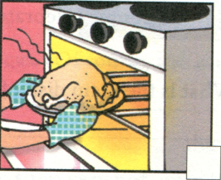
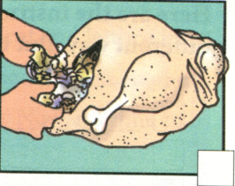
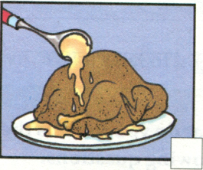
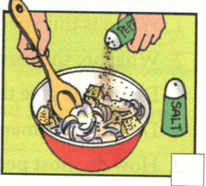
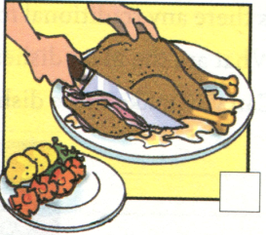
3
2
4
1
5

Slide 12
Step3
2c
Read the article again answer the following questions.
1. Where do people celebrate
Thanksgiving?
2. When do people celebrate it?
In the United States.
It is always on the fourth Thursday in November.

Slide 13
3. Why do people celebrate it?
People celebrate it to give thanks for food in the autumn and also remember the first travelers from England who came to live in America about 400 years ago.

Slide 14
4. How do people celebrate it now?
5. What is the main dish of the
Thanksgiving meal?
By having a big meal at home with their family.
Turkey.

Slide 15
Step4
Thanksgiving in the United States
In most countries, people usually eat traditional food on special holidays. A special day in the United States is Thanksgiving. It is always on the fourth Thursday in November, and is a time to give thanks for food in the autumn. At this time, people also remember the first travelers from England who came to live in America about 500 years ago. These travelers had a long, hard winter, and many of them died. In the next autumn, they gave thanks for life and food in their new home.
Lead in Thanksgiving
when
Original and how to celebrate in the past

Slide 16
How to celebrate these days
These days, most Americans still celebrate this idea of giving thanks by having a big meal at home with their family. The main dish of this meal is almost always turkey, a large bird.
Making a turkey dinner
Here is one way to make turkey for a Thanksgiving dinner.
First, mix together some bread pieces, onions, salt and pepper.
Next, fill the turkey with this bread mix.
Then, put the turkey in a hot oven and cook it for a few hours.
When it is ready, place the turkey on a large plate and cover it with gravy.
Finally, cut the turkey into thin pieces and eat the meat with vegetables like carrots and potatoes.
What to eat
How to make

Slide 17
Reading
2b
Read the article and number the pictures [1-5].
4
3
1
2
5

Slide 18
Here are the instructions for making a turkey dinner written in a different way. Put them in order. Write First, Next, Then and Finally.
2d
________, serve it to your friends with some other food.
________, put this into the bird.
________, cook it at a very high temperature for a long time.
________, put everything you need together in a large bowl.
4
Finally
2
next
3
Then
1
First

Slide 19
check
1. Remember the phrases.
Traditional food
In the next autumn
Have a big meal at home with family
Fill…with
Cover…with
传统的食物
在第二年的秋天
和家人吃一顿大餐
用……充满
用……覆盖

Slide 20
2.Fill in the blanks with the right words or phrases.
Look! They are __________ (celebrate) their festival by singing and dancing.
Many _________ ( travel) visit the West Lake every year.
The Spring Festival is one of the _________ (tradition) festivals in China.
celebrating
travelers
traditional

Slide 21
When ?_____________________________.
3.
Why?_____________________________.
A ____ day
In the past,______________.
How to celebrate?
These days,_____________.
What to eat?
____________
Thanksgiving Day
First ,___________________.
Next ,___________________.
Then,___________________.
After that,________________.
Finally ,__________________.
How to make it?

Slide 22
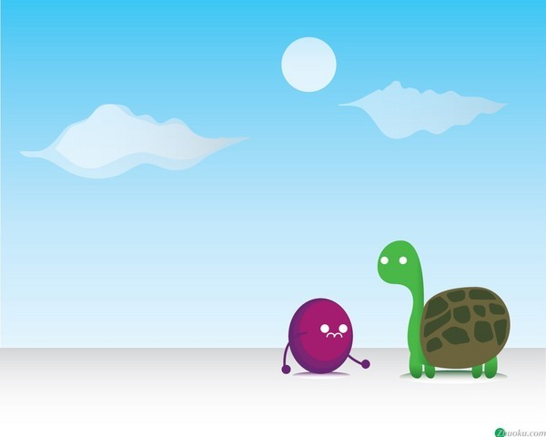
Homework
1. Say thanks to your family!
Say thanks to your teachers!
Say thanks to your friends!
Say thanks to the strangers!
Say thanks to everyone!
2. Tell your friends about Thanksgiving and how to make a turkey dinner.

