Slide 1
Unit 2 Health lifestyle
Period 2 Build up your vocabulary
选择性必修三
人教版（2019）

Slide 2
Think of a word that best fits each definition.Then fill in the blanks with the correct form of the word.
Task1
appropriate
adj:suitable, acceptable or correct for the particular circumstances
The government has been accused of not responding —_____________(appropriate) to the needs of the homeless.
appropriately

Slide 3
Task 1
Think of a word that best fits each definition.Then fill in the blanks with the correct form of the word.
adj:considering only the bad side of sth/sb; lacking enthusiasm or hope
negative
When asked for your views about your current job, on no account must you be negative_______ it.
about

Slide 4
Task 1
Think of a word that best fits each definition.Then fill in the blanks with the correct form of the word.
n:a thing that you are given because you have done sth good, worked hard, etc.
reward
A bonus of up to 5 percent can be added to a pupil's final exam marks as _____reward for good spelling, punctuation and grammar.
a

Slide 5
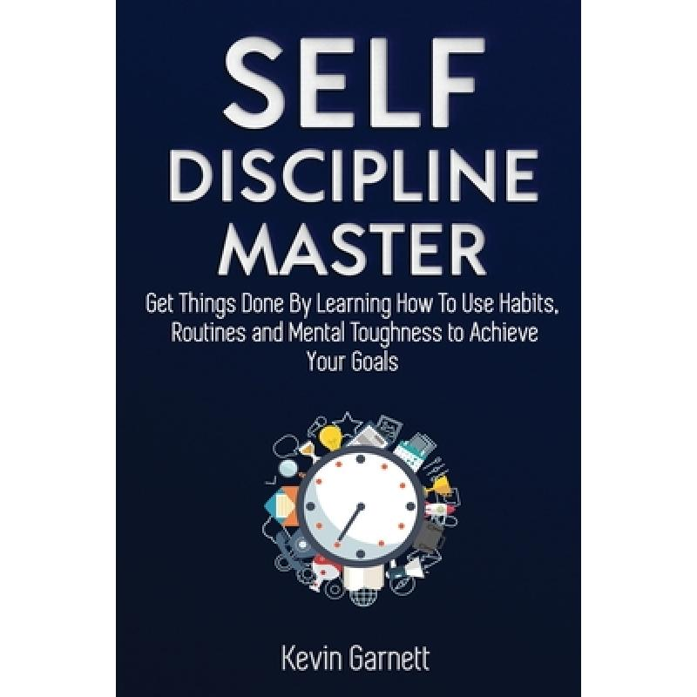
Task 1
Think of a word that best fits each definition.Then fill in the blanks with the correct form of the word.
n:the ability to control your behaviour or the way you live, work, etc.
discipline
He'll never get anywhere working for himself─he's got no _________(discipline).
discipline

Slide 6
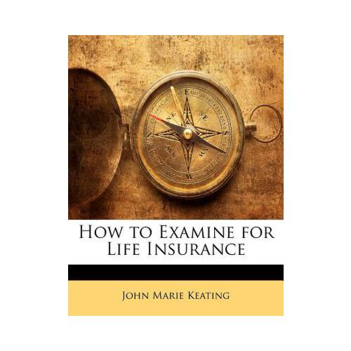
Task 1
Think of a word that best fits each definition.Then fill in the blanks with the correct form of the word.
v:to look at sth/sb closely to see if there is anything wrong or to find the cause of a problem
examine
were examined
The goods ____________
(examine) for damage on arrival.

Slide 7
Task 1
Think of a word that best fits each definition.Then fill in the blanks with the correct form of the word.
n:to control or have a lot of influence over sb/sth, especially in an unpleasant way
dominate
Fathers have the power ____________(dominate) children and young people .
to dominate

Slide 8
Task 1
Think of a word that best fits each definition.Then fill in the blanks with the correct form of the word.
v:to make an action or a process possible or easier
facilitate
Above all, it's the emotions one experiences in teaching ______________ facilitate learning.
that

Slide 9
Complete the summary using the words from the box below.
Task 2
alcohol, appropriate, cue, cycle, negative , pill, psychology, reward, tobacco, discipline
Teenagers often have bad habits. Most can be stopped by taking
___________ action.However,habits like ________and________
abuse can lead to serious addictions. According to modern________ to change bad habits, we must first analyse them using the “habit_______”.To fix or improve a bad habit, we must first find out what the __________ is. Then we must change the old _______ routine to something more positive. If successful, we will feel a sense of _______ and our bad habit may disappear. Changing a bad habit is difficult, and it is easy to make excuses and give up. We need to make up our minds and show some________, and make small changes over time. There is no magic ________changing will ensure we have a happy and healthy life!
appropriate
tobacco
alcohol
psychology
cycle
cue
negative
reward
discipline
pill

Slide 10
Task 3
Read the passage and mark the words that contain “habit”.
form a habit:
However, during this period, it can be easy
for some of them to form bad habits.
change a habit:
To change bad habits is never easy, even with many attempts.
prevent a habit:
To prevent harmful habits like these from dominating a teenager's life is essential.

Slide 11
Task 3
Read the passage and mark the words that contain “habit”.
recognise a habit:
They must learn to recognise bad habits early and make appropriate changes.
examine a habit:
To facilitate a positive change in our bad habits, we must first examine our bad habit cycles and then try to adapt them.
create a habit:
Aside from changing bad habit, we can also use the habit cycle to create good habits.
break a habit:
After all, it is not easy to break bad habits.

Slide 12
Task 4
Then make sentences with "verb+a habit".
form a habit:
We often form a habit without realising it.
change a habit:
The expert gave us some tips on how to change bad habits.
prevent a habit:
Of course, it is better to prevent a bad habit than break one!

Slide 13
Task 4
Read the passage and mark the words that contain “habit”.
recognise a habit:
To recognise a bad habit is the first step.
examine a habit:
By examining our habits closely, we can start to understand them.
create a habit:
You must use your will power to create new habits.
break a habit:
Be disciplined and don't give up trying to break your bad habit!

Slide 14
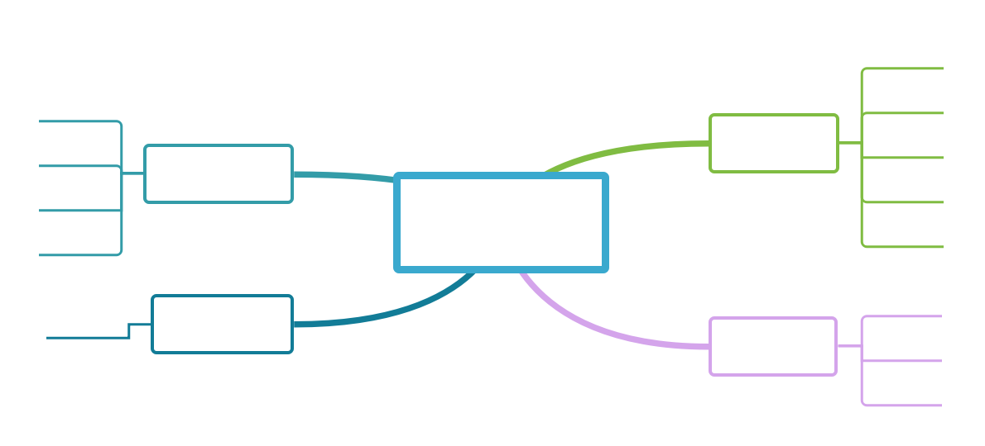
Task 5
Have a brainstorm:Think of more similar expressions.
recognise a habit
understand a habit
change a habit
认知
习惯
改变
习惯
learn about a habit
adapt a habit
verb +
a habit
examine a habit
replace a habit
think about a habit
break a habit
防止
习惯
养成
习惯
form a habit
prevent a habit
create a habit
build a habit

Slide 15
Complete the passage using the correct forms of the words in the box.Add more sentences or paragraphs to the passage if possible.
Task 6
examine ;dominate; facilitate; rely on
Simply speaking, a healthy lifestyle is about finding the right balance and making good choices. Life is composed of many elements, such as family friends,study, work,entertainment, and
so on. If one element _______your life and the others are ignored, you will lose balance and not feel good.
Carefully________your daily activities. Your health______what you choose to do in your daily
dominate
examine
rely on

Slide 16
Complete the passage using the correct forms of the words in the box.Add more sentences or paragraphs to the passage if possible.
Task 6
examine ;dominate; facilitate; rely on
life.A healthy lifestyle is generally a balanced life in which you make wise choices. Neither too much nor too little is good.
Slowly_________changes in your lifestyle by using a step-by-step process. You do not have to change everything at once.Make smallchanges each day and your lifestyle will become healthier.
facilitate

Slide 17
Summarize each paragraph of the passage using the strategies you learned .
Task 7
examine ;dominate; facilitate; rely on
Simply speaking, a healthy lifestyle is about finding the right balance and making good choices. Life is composed of many elements, such as family friends,study, work,entertainment, and
so on. If one element _______your life and the others are ignored, you will lose balance and not feel good.
Carefully________your daily activities. Your health______what you choose to do in your daily
Paragraph 1: What is a healthy lifestyle?
dominate
examine
rely on

Slide 18
Summarize each paragraph of the passage using the strategies you learned .
Task 7
Paragraph 2: It's important to balance the elements in life.
examine ;dominate; facilitate; rely on
life.A healthy lifestyle is generally a balanced life in which you make wise choices. Neither too much nor too little is good.
Slowly_________changes in your lifestyle by using a step-by-step process. You do not have to change everything at once.Make small changes each day and your lifestyle will become healthier.
Paragraph 3: Suggestions on how to build a healthy lifestyle.
facilitate

Slide 19
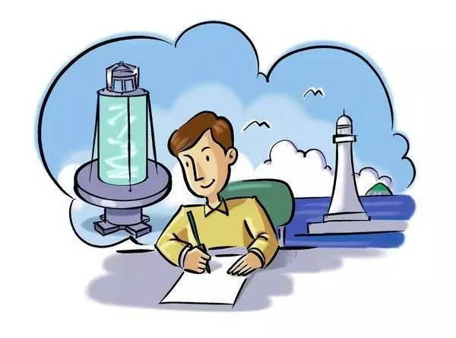
Follow up the third paragraph of the text on Page 16 to write another paragraph.
Task 8
Slowly facilitate changes in your lifestyle by using a step-by-step process. You do not have to change everything at once.Make smallchanges each day and your lifestyle will become healthier.

Slide 20
Task 9
Show time
As you break the old patterns you still need a way to fulfill these needs. You will be not only making an active choice to not do the old action, you will also be making a choice to perform a better, alternative action in its place. Instead of yelling , you might decide to go for a run every time you are feeling tense. Instead of letting dirty dishes pile up ,

Slide 21
Task 9
Show time
you may decide to use paper plates when you are eating alone. What the new habit is that you substitute isn't so important as whether you feel good about the choices you have made. After all, the reason you consider it a bad habit is because it leaves you feeling bad about yourself. It's up to you.

Slide 22
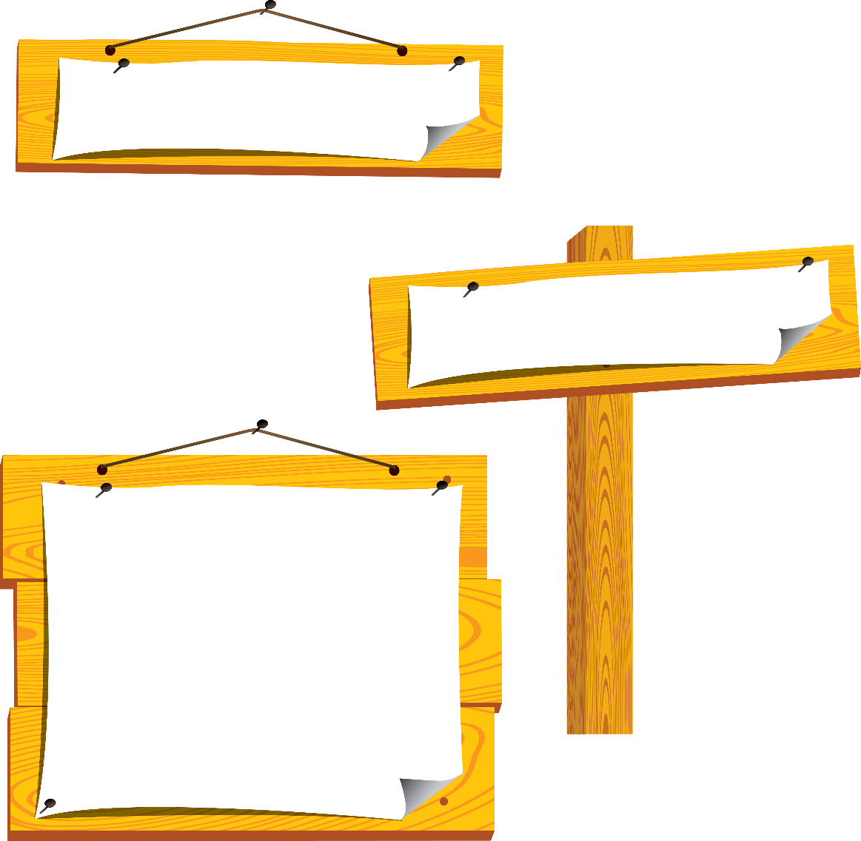
language points
【词义】 vt. & vi. 组成；作曲；撰写
【教材原句】 Life is composed of many elements, such as family friends,study, work, entertainment, and so on.
生活是由许多元素组成的，如家庭朋友、学习、工作、娱乐等。
【热点归纳】
(1)be composed of 由……组成(或构成)
(2)composer n. 作曲家；作家
compose
[kəmˈpoʊz]
Notes:
标题字号固定为黑体 34 加粗 白色，副标题字号固定为黑体 28 黑色，正文字号为黑体 24 黑色。版式仅供参考

Slide 23
language points
【例句】
She began to compose songs at an early age.
她还很年轻时就已经开始创作歌曲。
【语法填空】
(1)The houses in my hometown were chiefly composed _____ wood.
(2)According to a report，the committee _____________ (compose) of 12 members.
(3)Five doctors and ten nurses, ____(compose) the rescue team, were sent to the earthquake-hit area this morning.
(4)Tom delayed his composition, for the first sentence was so hard ____________ (compose).
答案（1）of (2)is composed (3)composing
(4)to compose
compose
[kəmˈpoʊz]
Notes:
标题字号固定为黑体 34 加粗 白色，副标题字号固定为黑体 28 黑色，正文字号为黑体 24 黑色。版式仅供参考

Slide 24
language points
【教材原句】
Changing a bad habit is diffcult and it is easy to make excuses and give up.改变一个坏习惯是困难的，很容易找借口和放弃。
【例句】
Coastguards had given up all hope of finding the two divers alive.海岸警卫队对两位潜水员生还已完全不抱希望。
【热点归纳】
give in让步；屈服；投降
give in to sb. /sth. 向某人/某事让步，屈服于某人/某事
give up
放弃；让出
Notes:
标题字号固定为黑体 34 加粗 白色，副标题字号固定为黑体 28 黑色，正文字号为黑体 24 黑色。版式仅供参考

Slide 25
language points
【热点归纳】
give away赠送；分发；泄露(机密等)
give off发出，放出(气味、热、光等)
give back归还；使恢复
give out分发；公布；耗尽；发出
【语法填空】
①You ought to give _____ smoking because it is harmful to your health.
②If a person has not had enough sleep, his actions will give him ______ during the day.
答案：up;away
give up
放弃；让出
Notes:
标题字号固定为黑体 34 加粗 白色，副标题字号固定为黑体 28 黑色，正文字号为黑体 24 黑色。版式仅供参考

Slide 26
language points
【语法填空】
③At first Robert wouldn’t let his daughter go diving, but eventually he gave _____ as she was so confident about her skills.
④The wood gave ______ a sweet smell as it burned.
⑤ When quarrels break out between them, he always gives in _____ his wife.
答案：in, off,to
give up
放弃；让出
Notes:
标题字号固定为黑体 34 加粗 白色，副标题字号固定为黑体 28 黑色，正文字号为黑体 24 黑色。版式仅供参考

Slide 27
language points
【教材原句】
We need to make up our minds and show some
disciplines, and make small changes over time.
我们需要下定决心，表现出一些约束力，并随着时间的推移做出一些小小的改变。
【例句】
Once she has made up her mind, nothing can change it.她一旦下了决心什么也不能使她改变。
【热点归纳】
change one’s mind 改变主意
keep/bear/have… in mind 记住；牢记在心头
make up one’s mind
下定决心
Notes:
标题字号固定为黑体 34 加粗 白色，副标题字号固定为黑体 28 黑色，正文字号为黑体 24 黑色。版式仅供参考

Slide 28
language points
【热点归纳】
speak one’s mind 直言不讳
read one’s mind 看出某人的心思
在短语make up one’s mind中，mind的单复数要随其前one’s的单复数而变化。
【语法填空】
①They have made ____ their minds to take part.
②You must keep it _____ mind that these exams will affect your final result.
③The man who has made up his mind ________ (win) will never say “impossible”.
答案：up;in;to win
make up one’s mind
下定决心
Notes:
标题字号固定为黑体 34 加粗 白色，副标题字号固定为黑体 28 黑色，正文字号为黑体 24 黑色。版式仅供参考

Slide 29
Practice
写出单词或将词组补充完整
1．__________ vt. & vi. 组成；作曲；撰写→___________ n. 作曲家；作家
2．give _____放弃
3．make _____ one’s mind下定决心
4．be composed _____ 由……组成(或构成)
compose
composer
up
up
of

Slide 30
Practice
Complete the passage with the correct forms of the words in the box.
discipline;cycle;dominate;reward;rely;stimulate
Balancing one’s work and personal life can be rather difficult. Many people get into the_______of coming home from work and watching TV or surfing the Internet.Although this may seem relaxing
, it is not appropniate in the long term for personal growth.Therefore, for the sake of a healthy personal life, it is essential to be___________and not just ________
cycle
disciplined
rely

Slide 31
Practice
Complete the passage with the correct forms of the words in the box.
discipline;cycle;dominate;reward;rely;stimulate
on such passive activities. Show some passion and challenge yourself to do something different every night, if only for one hour at least.Set yourself goals, find a hobby that__________your mind or just get round to doing all those little things you’ve been meaning to do. Once you resist allowing
work to__________your life,your________will
be a great sense of achievement.
stimulates
dominate
reward

Slide 32
1.Review the words and phrases of this period.
2.Do the exercises of your workbook.

