Slide 1
Unit 9

Slide 2
Unit 9
What does he look like?

Slide 3
Section A 1
1a-2d

Slide 4
Look at the picture of 1a and think about the questions:
1. How many people are there in the
picture? 2. Where are they?
3. What are the two girls doing?
4. Can you describe the people in the
picture?

Slide 5
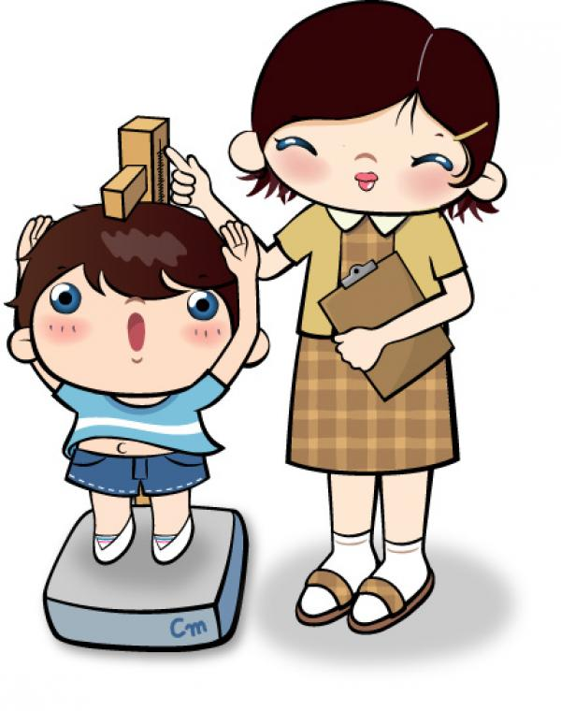
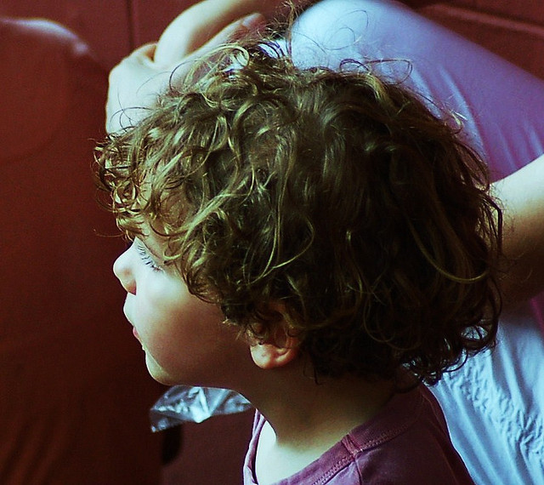
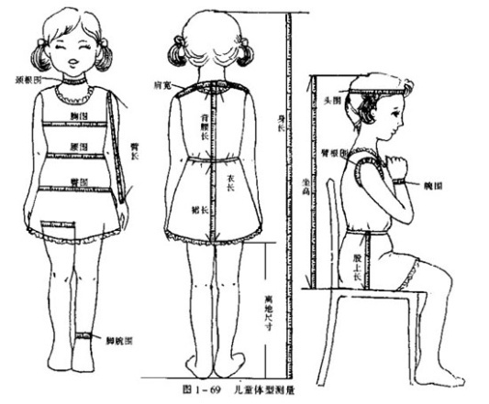
New words for describe people
curly
卷曲的
straight
直的
height
身高，高度
build n.
身材

Slide 6
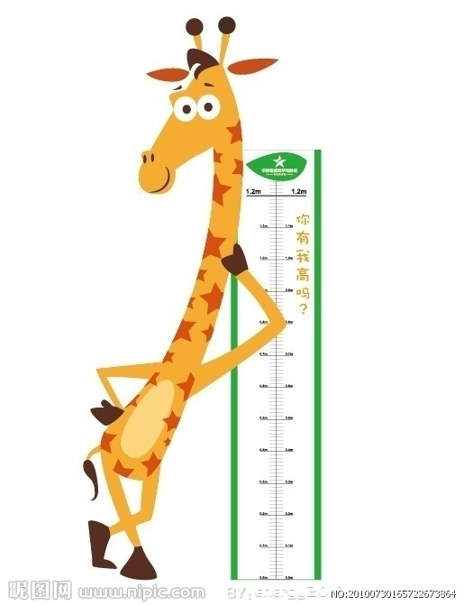
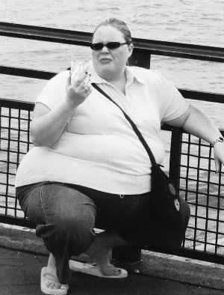
tall
高的
thin
瘦的
heavy
重的

Slide 7
1a Match the words with the people in the picture. You can use some letters more than once.

Slide 8
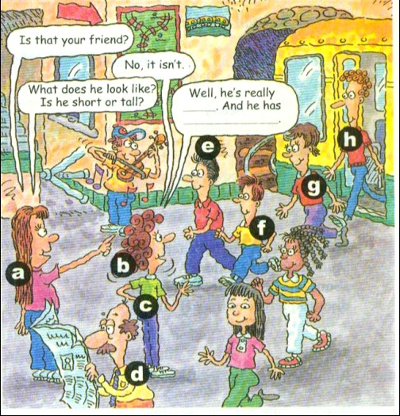
g
short hair ____
curly hair ___
long hair ___
straight hair ____
tall ____
short _____
medium height __
thin ____
heavy ____
medium build ___
f
h
b
h
a
e
a
h
f
g
h
a
g

Slide 9
Presentation
What does your brother look like?
He’s short. He has short hair and big eyes.
What does your sister look like?
She’s really tall. She has long straight hair.

Slide 10
1b. Listen and fill in the blanks in the picture above. Can you find Amy’s friend?
A: Is that your friend?
B: No, it isn’t.
A: What does he look like? Is he tall or short?
B: Well, he’s really ____. And he has _________.
tall
curly hair

Slide 11
Well, I think h is Amy’s friend.

Slide 12
Listen to the dialogue of 1b again and try to find the sentence pattern for asking people’s appearance and the sentences for describing people.
What does he look like? Is he tall or short?
He is really tall.
He has curly hair.

Slide 13
比眼力!
What does he look like?
He’s tall. He has curly hair.

Slide 14
What does she look like?
She’s short. She has long
straight hair.

Slide 15
What does she look like?
She’s of medium height. She has short curly hair.

Slide 16
What does he look like?
He’s tall and heavy. He has short curly hair.

Slide 17
What does he look like?
He’s thin. He has short
straight hair.

Slide 18
Pairwork
1c. One of the people in the picture is your friend. Describe your friend. Your partner will find him or her.

Slide 19
You may use the following sentences:
Is that your friend?
No, it isn’t.
Is he tall or short?
Is he thin or heavy?

Slide 20
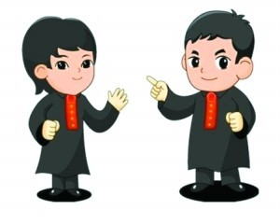
What does your friend look like?
He’s of medium height. He has curly hair.
Is it e?
Yes. You’re right.

Slide 21
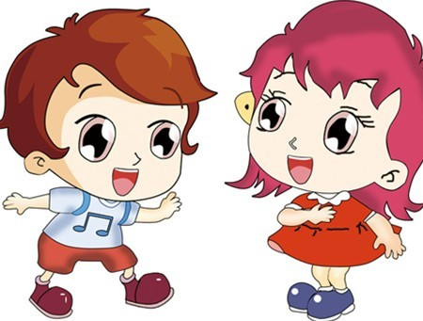
What does your friend look like?
He’s short. He has short straight hair.
Is it f?
Yes. You’re right.

Slide 22
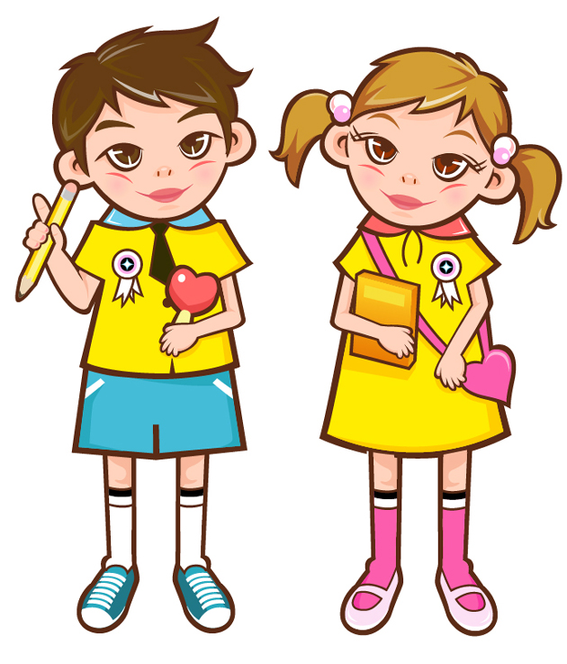
What does your friend look like?
She’s tall and heavy. She has long straight hair.
Is it a?
Yes. You’re right.

Slide 23
2a. Listen and circle the correct
answers firstly and then answer
the questions in your own words.
Is David tall or short?
__________________
Does Sally have long or short hair?
_________________
3. Is peter tall or short?
_________________
He is tall.
She has long hair.
He is short.

Slide 24
2b. Listen again. Fill in the chart.
 | David | Sally | Peter
is | heavy, tall
has
of medium height, thin
short, of medium build
long straight hair
curly hair
short hair

Slide 25
Describe David, Sally, Peter’s appearances according to the information of 2b.
David is heavy and tall. He has curly hair.
Sally is thin and of medium height. She has long straight hair.
Peter is short and of medium build. He has short hair.

Slide 26
Pairwork
2c. Student A looks at the chart in 2b.
Student B asks student A questions
about one of the people and then
draws a picture of the person.
What does David look like?
He’s heavy and he has curly hair.

Slide 27
She’s thin and of medium height.
Is Sally thin or heavy?
Does she has long hair?
Yes. She has long straight hair.

Slide 28
He’s short and of medium build.
Is Peter tall or short?
Does he has long hair?
No, he doesn’t. He has short hair.

Slide 29
2d. Read the conversation and
answer the questions.
Where are Mike and Tony going tonight?
_________________________
2. Where are they meet?
________________________________
They’re going to the movie.
In front of the cinema.

Slide 30
3. Who is going with them?
______________________________
4. What does David look like?
______________________________
______________________________
Mike’s friend David.
He is of medium height, and has brown hair and wears glasses.

Slide 31
Role-play
Role-play the conversation.

Slide 32
Language points
1. We’re meeting at seven, right? 我们七点见，对吗?
1) meet相当于汉语中“集合；见面；碰头；聚集”。如：
Let’s meet at the school gate tomorrow at eight.
让我们明天八点在校门口集合。

Slide 33
2) right表示“对吗，是吧”，用来表示对此前陈述内容进行确认和核实。全句为Is that right? 口语中常用不完整的句子表达意见或想法。

Slide 34
2. …, but I may be a little late.
a little意为“有点儿”，用来修饰形容词。
e.g. It’s a little cold tonight.
【拓展】a little意为“一些；少许”后
跟不可数名词。
e.g. There’s a little meat in the bowl.
碗里有点肉。

Slide 35
3. Well, he has brown hair and wears
glasses.
glass作“玻璃”讲时，是不可数名词；作
“玻璃杯”讲时为可数名词；而glasses则
是“眼镜”之意。
e.g. Glass is broken easily. 玻璃很易碎。
There’s no water in your glass.
你的杯子里没有水了。
Does she wear glasses? 她戴眼镜吗？

Slide 36
4. He isn’t tall or short. 他不高也不矮。
英语在受到否定概念限定的部分中一般
不用and, 而用or。
e.g. I don’t have any brothers or sisters.
我没有兄弟和姐妹。
在以上这种用法中，or相当于and not。
试比较：
Sophie never cleans or even offers to wash the dishes. =Sophie never cleans and does not even offer to wash the dishes. 索菲从不打扫房间，甚至从不主动洗碗。

Slide 37
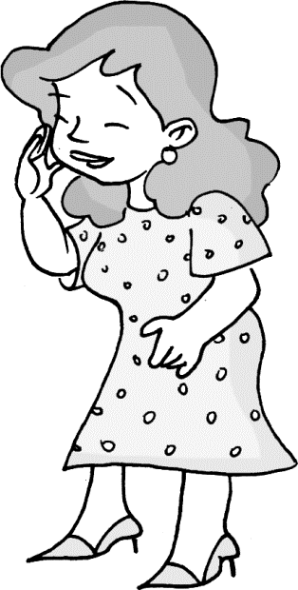
小试身手
I. 看图补全对话。
1. —What does your aunt ____ ____?
— She has long ______ hair. And she is ____ ________ height. She’s a little _______.
look like
curly
of medium
heavy

Slide 38
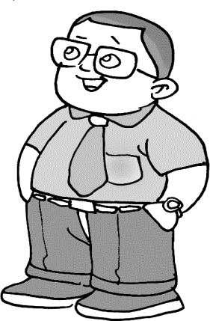
2. —What does your math teacher ____ ____?
— He has ______ straight _____. He’s ______ and of ________ build.
— Does he wear _______?
— Yes, he does.
look like
short hair
short
medium
glasses

Slide 39
II. 根据句意及所给汉语提示，写出句中所缺单词。
1. She wants to buy a pair of _______ (眼
镜).
2. There is a(n) ________ (电影院) in front
of the supermarket.
3. Can you come to my birthday party
________ (今晚)?
glasses
cinema
tonight

Slide 40
Homework
总结所学过的描述人物长相的词汇，用英语写出来。
编写三个小对话来描述一下你的家庭成员（爷爷/奶奶；爸爸/妈妈；哥哥/妹妹）。

