Slide 1
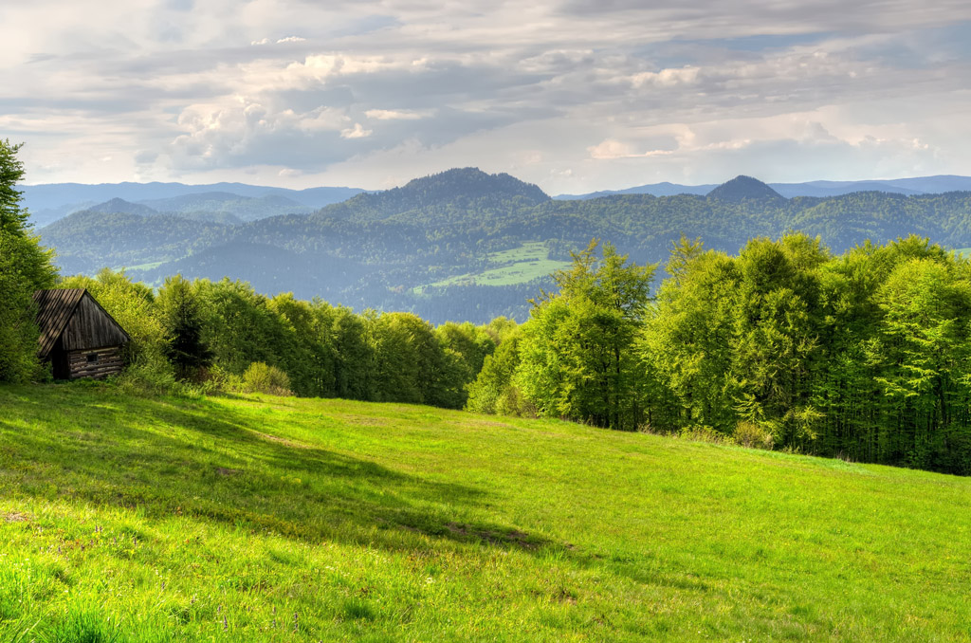
Unit 5
Into the unknown

Slide 2
内容索引
Period Five Writing—Writing about the unexplained
技法点拨 文体分析 把握写作动脉
写作训练 弄清文路 写作妙笔生花

Slide 3
技 法 点 拨
文体分析 把握写作动脉
写作指导
本单元要求写一篇与自然之谜有关的文章。介绍自然之谜属于说明类文章，是高考英语书面表达中一种常见的考查形式。它要求从科学文献或权威机构搜集相关资料，并加以调查、整理，清楚地介绍自然之谜发生的时间、地点、经过等情况，使读者对此有一个完整、准确的了解。其基本框架为： 第一段整体介绍自然之谜并具体介绍其发生的经过和特点等；第二段对此提出若干有一定科学依据的解释。

Slide 4
常用表达
1.The monster of...is back in the news.
2.It is known to all that...
3.Do you know where...come from?
4.It lies in...
5.Its hair is...
6.It looks like a(n)...
7.Some people saw it in...for the first time.
8.Some scientists think that...
9.Some people believe in its existence，because...

Slide 5
10.By recent research，we can learn that...
11.Other scientists consider...
12.Personally，I (don’t) believe...
返 回

Slide 6
写 作 训 练
弄清文路 写作妙笔生花
下表是关于自然界之谜“百慕大三角(Bermuda Triangle)”的一些信息，请根据此表写一篇80词左右的英语短文，介绍“百慕大三角”。
地理位置 | 发生的怪事 | 人们的猜测
位于百慕大和佛罗里达之间的大西洋西部。 | 自1945年以来，数以百计的飞机和船只，以及一千多人在这里神秘失踪，没留下任何痕迹。 | 外星人在作怪；当地特殊的天气条件；没人给出让人信服的理由。

Slide 7
注意：
1.开头已给出，不计入总词数；
2.可以适当增加细节，以使行文连贯。
参考词汇：残骸wreckage

Slide 8
审题谋篇
此篇作文体裁应为介绍自然之谜的说明文，写作时应注意下面几点：
1.确定文体：这是一篇说明文；
2.主体时态：一般现在时、一般过去时和现在完成时；
3.主体人称：第三人称。

Slide 9
遣词造句
核心词汇
1.自然界未解之谜
2.成百上千的
3.带走
4.由……造成
5.随着……的发展
unexplained mysteries of the natural world
hundreds of
take away
be caused by
with the development of
_____________________________________
___________
_________
___________
_____________________

Slide 10
连词成句
1.这片区域位于百慕大和佛罗里达之间的大西洋西部。
2.在这个地区发生了一些奇怪的事情。
3.自1945年开始，数以百计的船只和飞机，以及一千多人在这里失踪。
4.事发后没留下任何残骸或遗体。
This is an area of the western Atlantic between Bermuda and Florida.
Some strange things happened in this area.
Since 1945，hundreds of ships and planes and over a thousand people have disappeared.
No wreckage or bodies was left after that.

Slide 11
5.人们给出了许多理由来解释这些令人不安的事件。
6.这些令人不安的事件发生在百慕大三角地区。
Some reasons have been given to explain the disturbing incidents.
The disturbing incidents occurred in the area of Bermuda Triangle.

Slide 12
句式升级
1.根据括号里的要求合并句1和句2。
This is an area of the western Atlantic between Bermuda and Florida，
.(将句2改写为定语从句修饰an area)
2.根据括号里的要求合并句3和句4。
Since 1945，hundreds of ships and planes and over a thousand people have disappeared， .(将句4改写为现在分词短语作结果状语)
3.根据括号里的要求合并句5和句6。
Some reasons have been given to explain the disturbing incidents
.(将句6改写为定语从句修饰 incidents)
where
some strange things happened
leaving no wreckage or bodies
that occurred
in the area of Bermuda Triangle

Slide 13
组句成篇
用适当的过渡词语，把以上词汇和句式，再加上联想内容，组成一篇80词左右的英语短文。

Slide 14
参考范文
There are many unexplained mysteries of the natural world，of which the Bermuda Triangle is a particular one.
This is an area of the western Atlantic between Bermuda and Florida，where some strange things happened.Since 1945，hundreds of ships and planes and over a thousand people have disappeared，leaving no wreckage or bodies.
Some reasons have been given to explain the disturbing incidents that occurred in the area of Bermuda Triangle.Some think aliens might have arrived there and taken everything away.Others believe they might be caused by special weather there.But no one can give a believable reason.Maybe in the future we can find the answer with the development of science and technology.
返 回

Slide 15
本课结束

