Slide 1
人教版必修第二册
Unit 5 Music
Period 2 Reading and Thinking
The Virtual Choir

Slide 2
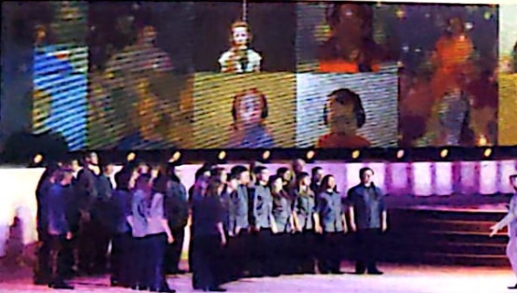
Prediction
Let’s look at the picture and the title and guess what the text will be about?
The virtual choir
About the introduction of the Virtual Choir

Slide 3
Global Reading
1.Read quickly and figure out the main idea of each paragraph.
Paragraph 1:
Paragraph 2:
Paragraph 3:
Paragraph 4:

Slide 4
Lead in
1.What are the ways for people to experience music?
By listen to radios or watch IV or attend concerts.
2.How can the Internet help us experience music differently?
We can listen to music on the Internet or download music from the Internet and share what we like listening to with our close friends.

Slide 5
Global Reading
Read quickly and figure out the main idea of each paragraph.
Paragraph 1:
Paragraph 2:
Paragraph 3:
Paragraph 4:

Slide 6
keys
Read quickly and figure out the main idea of each paragraph.
Paragraph 1: What is a virtual choir
Paragraph 2: Eric Whitacre—the creator of the virtual choir
Paragraph 3: Eric’s first virtual choir
Paragraph 4: the importance of the virtual choir

Slide 7
Read for details
Read the passage quickly to solve the following questions.
1. What is a virtual choir?
2.Who is the man coming up with the idea for a virtual choir and where did he study musical composition?
3.What is the name of his song?
4．If you want to take part in a virtual choir，What things may you need?
5．At what age did Eric receive his master’s degree in musical composition?

Slide 8
keys
What is a virtual choir?
A virtual choir is not a real choir and in a virtual choir, anyone can play a part with a video camera and an internet connection. They can record themselves and update videos on the internet.
2.Who is the man coming up with the idea for a virtual choir and where did he study musical composition?
He is called Eric who studies at Juilliard School.
3.What is the name of his song?
What if

Slide 9
keys
4．If you want to take part in a virtual choir，What things may you need ?
video camera
An Internet connection
A studio
5．At what age did Eric receive his master’s degree in musical composition?
27

Slide 10
6．What caused Eric Whitacre to fall in love with classical music?
Mozart’s music
7．It is proved that a virtual choir has a ____________influence on the lives of many people.
A．pessimistic B．Positive
C．negative D．neutral

Slide 11
Scanning for specific information:
Read the text quickly and fill in the form.
2 January 19________ | Eric Whitacre was born.
19________—1995 | Whitacre attended the University of Nevada，Las Vegas.
19________ | Whitacre got a master’s degree from the Juilliard School in New York.
70；
88；
97

Slide 12
2009 | Whitacre first got the idea for the virtual choir.His first virtual choir used ____________singers from____________different countries；received more than ____________________views on the Internet.
________ July 2014 | Whitacre formed the Virtual Youth Choir for UNICEF，____________ young people from ____________countries sang “what If”.
185；
12；
millions of
23；
2,292；
80

Slide 13
consolidation
on
Eric Whitacre was born in the USA 1.______ January 2,1970.when he studied music at the University of Nevada in 1988，he fell in love 2.________ Mozart’s classical music.3._________ (move)by his music，he said that it was like seeing color for the first time. After 4.________________________(graduate)from university in 1995，he received his master’s degree in 1997.Over the next 10 years，Whitacre’s 5.____________ (origin)compositions began to become quite popular among choirs and singers, 6._________ led to the creation of the virtual choir.
with
Moved
graduating/graduation
original
which

Slide 14
When he received a video of a girl who was singing one of his 7._________(work)in 2009，he asked his fans 8.__________(make)videos，which he then joined together into one performance.Since then，the virtual choir 9._____________(become)a worldwide phenomenon. It has proved to be 10._____ positive influence on the lives of many people.
works
to make
a
has become
a

Slide 15
Critical thinking
1.What will you write when you write about a person?
2. Why does the author use those numbers and why?
3.How is a virtual choir different from other choirs?

Slide 16
Critical thinking
1.What will you write when you write about a person?
Who he is and his personalities?
What does he do?
Where does he study and what does he study?
How did he grow up?
Who are his friends or teachers?
….

Slide 17
Critical thinking
2. Why does the author use those numbers and why?
It is vey important to use data as supporting evidence when organizing an article , as it is more convincing compared to a general introduction or argument.

Slide 18
3.How is a virtual choir different from other choirs?
The differences between VC and RC:
 | Virtual choir | Reality choir
form | video | live
place | Internet (home /anywhere) | stage of music hall
Identity of singers | ordinary people | usually professionals 1 musicians
Number of singers | not limited (sometimes can be very large) | limited to the required program
Influence on singers | many people as singers (becoming part of the global community) | many people as singers (becoming part of the global community)

Slide 19
Summary
Introduce the topic：
Virtual choir
Anyone can take part in it.
Record through video
Upload onto the Internet
Put together into one
Video online
What
who
Eric Whitacre
personal information
learning experience
how
Learn composition inspired by a girl
A worldwide phenomenon
a wonderful way to sing
make the world a better place
influence

Slide 20
Homework
Write a short passage to describe the advantages and disadvantages of the virtual choir and list your ideas about whether it can really bring people together.

Slide 21
人教版必修第二册

