Slide 1
Unit 5 Poems
Period 6 Assessing your progress
选择性必修三
人教版（2019）

Slide 2
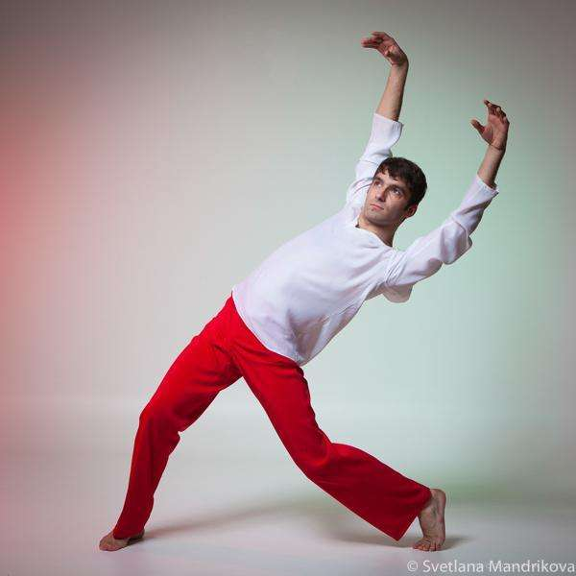
Write down the word that matches each English definition.
Revision
___________ n.someone who pursues a study or sport as a pastime
amateur
【语法填空】
Jerry is an amateur _____ dances because he feels like it.
who

Slide 3
Revision
Write down the word that matches each English definition.
era
__________ n. a period marked by distinctive character or reckoned from a fixed point or event
【语法填空】
These talks could mark ____ new era of peace.
a

Slide 4
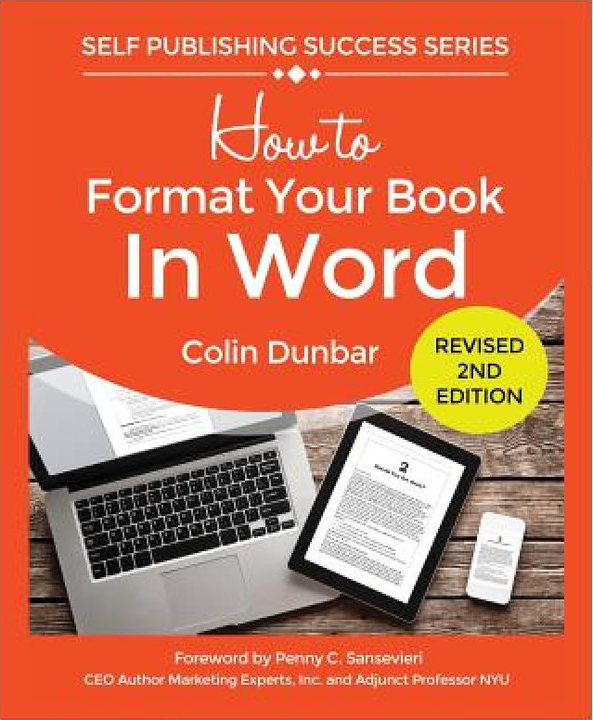
Revision
Write down the word that matches each English definition.
format
n.the shape and size of a book, magazine, etc.
【语法填空】
They've brought out the magazine ____ a new format.
in

Slide 5
Revision
Write down the word that matches each English definition.
recite
v. to say a poem, piece of literature, etc. that you have learned, especially to an audience
【语法填空】
Students ______(recite) poetry to one another.
recited

Slide 6
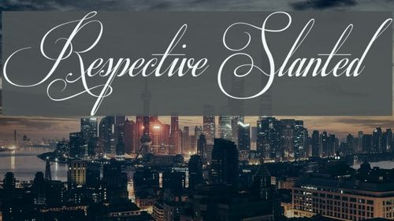
Revision
Write down the word that matches each English definition.
adj. belonging or relating separately to each of the people or things already mentioned
respective
【语法填空】
Their sons, Ben and Jonathan, were three and six ___________
(respective).
respectively

Slide 7
Revision
Write down the word that matches each English definition.
n. a word that has the same sound or ends with the same sound as another word
rhyme
【语法填空】
Can you think of a rhyme
______ ‘beauty’?
for

Slide 8
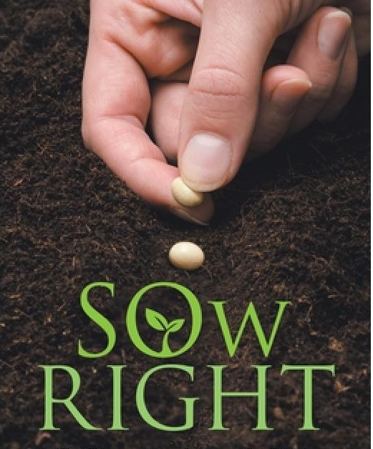
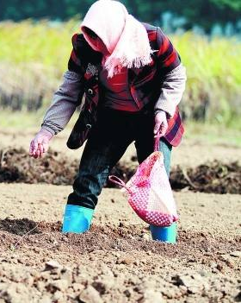
Revision
Write down the word that matches each English definition.
v. to plant or spread seeds in or on the ground
sow
【语法填空】
The fields around __________________
(sow) with wheat before they came.
had been sown

Slide 9
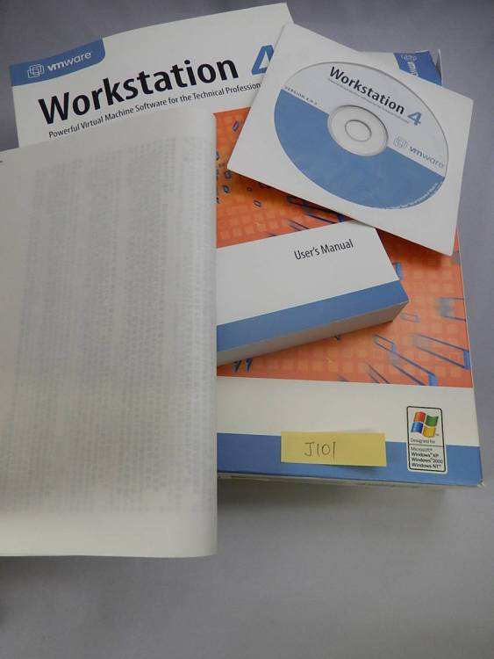
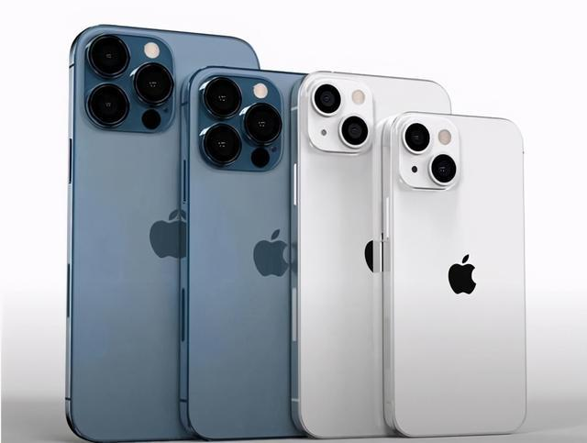
Revision
Write down the word that matches each English definition.
n. a film, play, piece of music, etc. that is based on a particular piece of work but is in a different form, style or language
version
【语法填空】
The English version ___
the novel is due for publication next year.
of

Slide 10
Complete the passage using the correct forms of the words in the box.
Activity 1
amateur era format recite
respective rhyme sow version
Poetry probably had its origins in traditional folk music tens of thousands of years ago. In that ________, there were no TVs or films, and writing had not been invented, so people would sit around the fire at night and sing songs to entertain themselves. These songs reflected themes
era

Slide 11
Complete the passage with the correct forms of the words in the box.
Activity 1
amateur era format recite
respective rhyme sow version
from the people’s daily lives, such as
hunting animals or ______ crops.
Since nothing was written down, over the years different _____ of these songs developed, and each area would have its own _______ rhythm. In addition to this, people would ______ stories of past heroes. As these stories were often quite long, they
sowing
versions
respective
recite

Slide 12
Complete the passage with the correct forms of the words in the box.
Activity 1
amateur era format recite
respective rhyme sow version
often had ________ and rhythm to help
people remember them more easily. While in the beginning such songs and stories had a very simple ________, over time they became more complicated and more polished.
rhyme
format

Slide 13
Complete the passage with the correct forms of the words in the box.
Activity 1
amateur era format recite
respective rhyme sow version
These were no longer the works of _______sitting around a fire, but works of true poets who cared about their art and who sometimes made a living from it.
amateurs

Slide 14
Discuss the following questions.
Activity 1
1.What is the short passage about?
2.Can you retell the passage briefly?
The origins of poetry.
Yes.In the old days people would sit around a fire at night and sing songs,which reflect people's daily life. Different versions of these songs developed over the years, and people sang stories about heroes. Since these stories are often long, there’re often rhymes and rhythms to help people remember them. They started in simple forms, but over time they became complex works of poets who cared about art and made a living from them.

Slide 15
Read the conversations and write a short description about the poetry or the poet they are talking about. Use relative clauses to connect your sentences.
Activity 2
Conversation 1
A: What is free verse?
B: Free verse is an open form of poetry.
A: What do you mean by “open”?
B: A free verse poem does not follow any rules. It has no regular metre or rhythm.
A: I see. So it means the poet has complete control over their creation.

Slide 16
Write a short description about the poetry or the poet in Conversation 1. Use relative clauses to connect your sentences.
Activity 2
Free verse is an open form of poetry that does not follow any rules. It has no regular metre or rhythm, which means the poet has complete control over their creation.

Slide 17
Read the conversations and write a short description about the poetry or the poet they are talking about. Use relative clauses to connect your sentences.
Activity 2
Conversation 2
A: Who was Langston Hughes?
B: He was a famous African-American poet.
A: What’s special about his poems?
B: Well, his poems mainly tell the story of black people in
America, including their joys and pain.
A: Can you give me an example?
B: Dream Variation, for example. It was one of his most
celebrated poems. The poem is about the dream of a
world free of inequality and racial prejudice.
n. 头韵
n. 种族歧视

Slide 18
Write a short description about the poetry or the poet in Conversation 2. Use relative clauses to connect your sentences.
Activity 2
Langston Hughes was a famous African-American poet whose poems mainly tell the story of black people in America, including their joys and pain. Dream Variation was one of his most celebrated poems that is about the dream of a world free of inequality and racial prejudice.

Slide 19
Activity 3
Reflecting
What forms of poetry from this unit have you learnt?
I have learnt different forms of poetry from this unit, including ___________________________________________
____________________________________________________.
What kind of poetic devices have you learnt from this unit?
The poetic devices that I have learnt from this unit include ___________________________________________________
__________________________________________________.

Slide 20
Activity 3
Reflecting
What is your favorite poem of this unit and what does it describe?
My favourite poem of this unit is ________. It describes ___________________________.
Do you have difficulty in understanding the poems? What are they?
I had difficulty in understanding ______________________.
•I thought writing an English poem was interesting useful challenging.

Slide 21
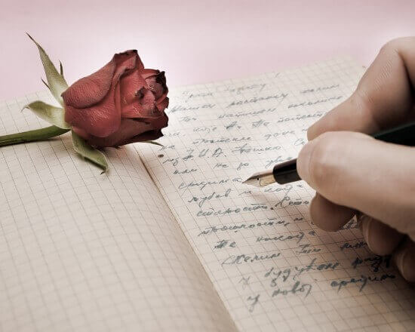
Activity 4
Writing
Triplet : A three-line stanza by rhyme to the next stanza.The rhymes are ABA, BCB, CDC, etc.
三行诗:英文中的三行诗顾名思义就是每段三行,并和下一节押韵，其韵式为aba bcb cdc, etc.

Slide 22
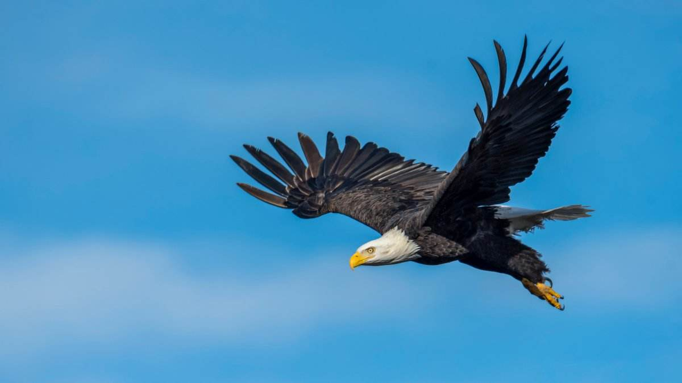
Activity 4
Writing
The Eagle
He claps the crag with crooked hands;
Close to the sun in lonely lands,
Ringed with the azure world, he stands.
The wrinkled sea beneath him crawls;
He watches from his mountain walls,
And like a thunderbolt he falls.
Alfred, Lord Tennyson
[a]
[a]
[a]
[b]
[b]
[b]

Slide 23
Activity 4
Writing
The Eagle
He claps the crag with crooked hands;
Close to the sun in lonely lands,
Ringed with the azure world, he stands.
The wrinkled sea beneath him crawls;
He watches from his mountain walls,
And like a thunderbolt he falls.
Alfred, Lord Tennyson
利爪如铁钩，紧抓巉岩角；
雄踞红日边，大地正静寂；
蓝天长万里，傲然独耸立。
脚下海涛急，浪花阵阵白；
高瞻峭壁上，俯视瞪双目；
突如闪雷电，降落何神速。

Slide 24
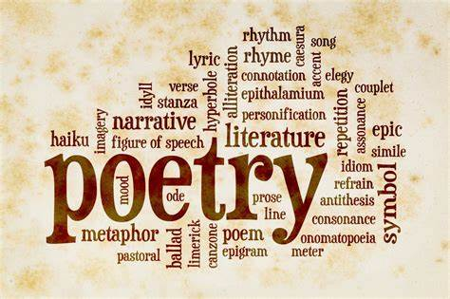
Show time
Writing your Triplet poem .

Slide 25
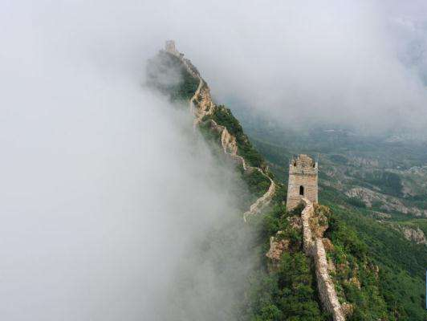
Activity 4
Show time.
Great Wall
There on the Great Wall
Something great
Suddenly appears small
长城
在长城上我们看到
一个庞然大物
突然变小

Slide 26
Activity 4
Show time.
Internet
The fisherman and the fish
Happen to meet
In the very same dish
互联网
渔夫和鱼
在同一道菜里
不期而遇

Slide 27
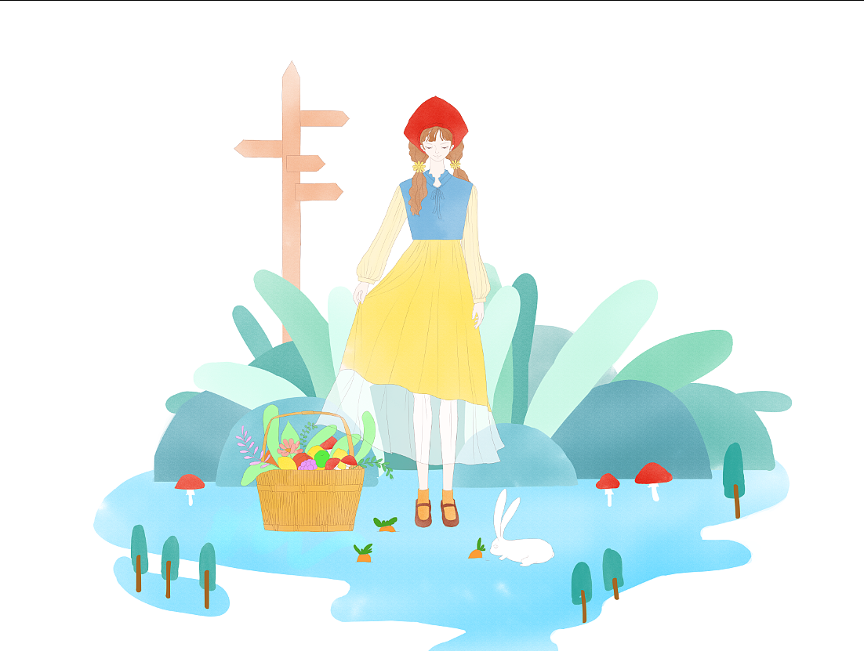
Activity 4
Show time.
Holiday
Headless a dog
Heads me
Into a heavy fog
假日
一只无头之犬
带我跑进
大雾一片

Slide 28
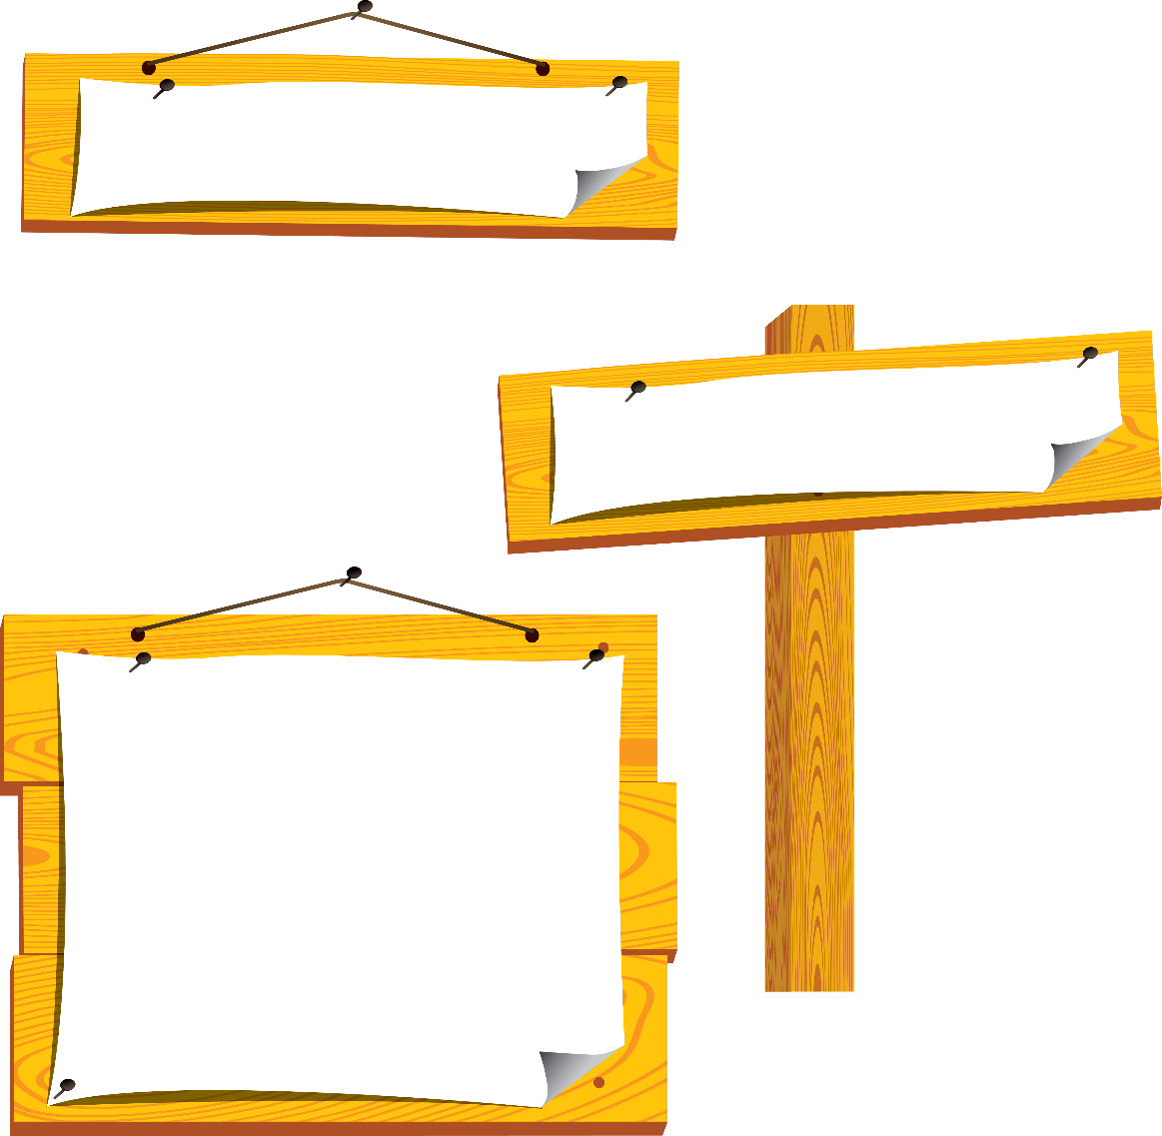
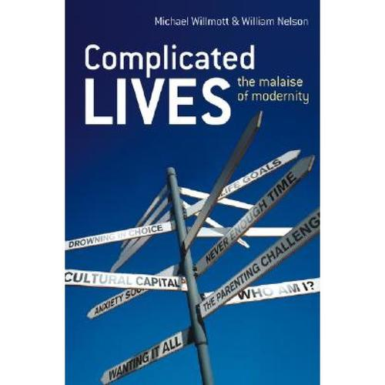
language points
【词义】adj. 复杂的
【教材原句】 ...over time they became more complicated and more polished.
......随着时间的推移，它们变得更加复杂和完善。
【热点归纳】
complication n.并发症；复杂化；混乱
complicate vt.使复杂化；使恶化；使卷入
complex : 侧重内在关系的复杂，需通过仔细研究与了解才能掌握和运用。
complicated : 与complex的含义接近，但语气更强，着重极其复杂，很难分析、分辨或解释。
complicated
[ˈkɑːmplɪkeɪtɪd]
Notes:
标题字号固定为黑体 34 加粗 白色，副标题字号固定为黑体 28 黑色，正文字号为黑体 24 黑色。版式仅供参考

Slide 29
language points
【例句】
The text is approachable, coping well with quite complicated subjects.
这篇课文把相当复杂的主题讲述得深入浅出、通俗易懂。
【语法填空】
(1)The situation __________(complicate)by the spread of a serious forest fire.
(2)The age difference was a____________
(complicate) to the relationship.
答案(1)was complicated (2)complication
complicated
[ˈkɑːmplɪkeɪtɪd]
Notes:
标题字号固定为黑体 34 加粗 白色，副标题字号固定为黑体 28 黑色，正文字号为黑体 24 黑色。版式仅供参考

Slide 30
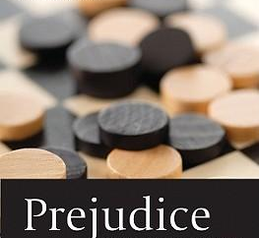
language points
【词义】n. 偏见；成见 vt. 使怀有(或形成)偏见
【教材原句】 The poem is about the dream of a world free of inequality and racial prejudice.
这首诗是关于一个没有不平等和种族偏见的世界的梦想。
【例句】
This will result in social prejudice.
这会产生社会偏见。
A judge must be away from prejudice.
法官不应存有偏见。
prejudice
[ 'predʒudis ]
Notes:
标题字号固定为黑体 34 加粗 白色，副标题字号固定为黑体 28 黑色，正文字号为黑体 24 黑色。版式仅供参考

Slide 31
language points
【热点归纳】
have a prejudice against…
对……有偏见
prejudice sb. against…
使某人反感……
【语法填空】
①He has ___ strong prejudice against modern poetry.
②I want to make it clear _____I have no prejudice against you.
答案(1)a (2)that
prejudice
[ 'predʒudis ]
Notes:
标题字号固定为黑体 34 加粗 白色，副标题字号固定为黑体 28 黑色，正文字号为黑体 24 黑色。版式仅供参考

Slide 32
Practice
应用文写作:
请将下面的英文短诗，以“Reading Is Valuable”为题改写成为一篇短文。
I love reading books，
Which are my best friends.
They are an important bridge to a new world，
Always helping me avoid getting puzzled.
They remove all troubles just like a sharp knife，
And bring happiness to me in daily life.
As for me a book is the angel’s sweetest kiss.
注意：1．词数：80个左右；
2．展开合理想象，突出主题，但不得照抄短诗原文。

Slide 33
Practice
写作指导:
审题谋篇
第一步 明确要求
1．确定体裁：本次写作是改写诗歌，内容为阅读；
2．确定人称：本文要用第_________；
3．确定时态：时态以_____________为主。
第二步、谋篇布局
本文属于说明文，可以从以下几个方面入手：
Para 1：我为什么喜欢阅读书籍；
Para 2：阅读在几个方面给我带来的益处；
Para 3：综述阅读给我带来的影响。
一人称
一般现在时

Slide 34
Practice
第三步 核心词汇
1．____________ 通过
2．_____________________ 用许多灵活的方式
3．_______________________ 阅读一些译本
4．__________________ 摆脱困境
5．________________ 感到沮丧
6．_______________________ 欣赏美丽风景
by means of
in many flexible ways
read some translations
get out of trouble
feel depressed
enjoy beautiful scenes

Slide 35
Practice
第四步 句式升级
1．那就是我这么喜欢读书的原因。(why引导表语从句)
That is _____________________________.
2．每当感到沮丧时，阅读帮助我把消极情绪转化为快乐和勇气。(让步状语从句)
_________________________，reading helps me transform negative moods into joy and courage.
3． 总之，我从阅读中受益匪浅，这使我成为一个更好的人。(非限制性定语从句)
All in all, I have benefited a lot from reading, ________________ _____________.
why I love reading books so much
Whenever I feel depressed
which makes me a better person

Slide 36
Practice
应用文写作参考范文:
Reading Is Valuable
Although the Internet is becoming more and more popular, books are still very important and valuable to people. That’s why I love reading books so much.
Reading is valuable in many ways. Firstly, by means of reading, I can get to know the writers’ thoughts and feelings that writers express in books in many flexible ways. Secondly, I can learn about the writing styles of many foreign writers by reading

Slide 37
Practice
应用文写作:
some translations and even get to know the appropriate words and action in different situations by reading. Besides，reading can help me solve many difficult problems and get me out of trouble. Whenever I feel depressed, reading helps me transform negative moods into joy and courage.
All in all, I have benefited a lot from reading, which makes me a better person. I think books are the best gifts that God has given me.

Slide 38
Homework
Review the important words and phrases of this unit.

