Slide 1

Unit10
If you go to the party, you’ll have a great time!
Section A（1a-2d）

Slide 2
自主学习题
1.为了考试做准备
2.帮我父母
3.看医生
4.得流感
5.和我的朋友见面
6.谢谢你的邀请
7.下一次
8.和我们闲逛

Slide 3

Warm-up
She is going to
walk to school.
She will be late.
If she _____ to school, she _____ ___late.
walks
will
be

Slide 4
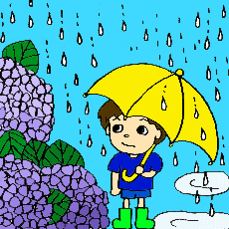

It is going to rain tomorrow.
I will stay at home.
rains
will
stay
If it _____ tomorrow, I _____ _____ at home.

Slide 5
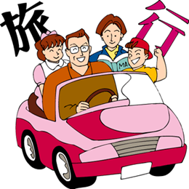

It will be sunny tomorrow.
They will have a trip
tomorrow.
If it ____ sunny tomorrow, they _____ ______ a trip.
is
will
have

Slide 6

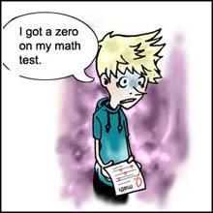
He won’t study hard.
He will fail in the exam.
“If he _______ study hard. He ____ _____ in the exam.”
doesn’t
will
fail

Slide 7
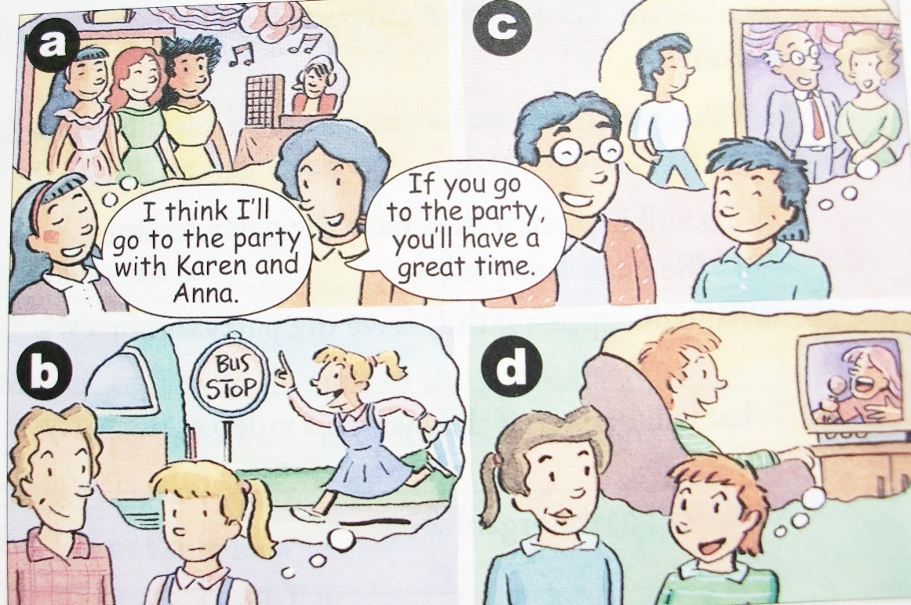
Match the statements with the pictures [a-d].
1a
1. ___ I think I’ll wear jeans to the party.
2. ___ I think I’ll stay at home.
3. ___ I think I’ll take the bus to the party.
4. ___ I think I’ll go
to the party
with Karen
and Anna.
c
d
b
a

Slide 8

Listening
1b
Listen and complete the responses in 1a.
If you do, the teachers won’t ________
If you do, you’ll _______________
If you do, you’ll _______________
If you do, you’ll _______________
let you in.
be sorry.
be late.
have a great time.

Slide 9
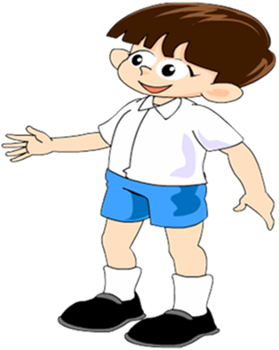
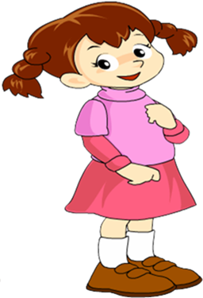
Pair work
1c
Look at the pictures and make conversations.
Are you going to the party tomorrow night?
Yes, I am.

Slide 10
Who will you go with?
I think I’ll go with Karen and Anna.
If you do, you’ll have a great time.

Slide 11
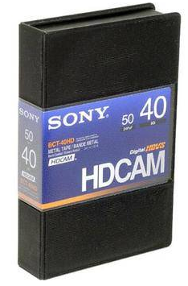

New words
Is the video on the bookshelf?
录像带在书架上吗？
video n. 录像带；录像
I’d like some potato chips, please.
我想买些薯条。
potato chips 炸土豆片；炸薯条

Slide 12
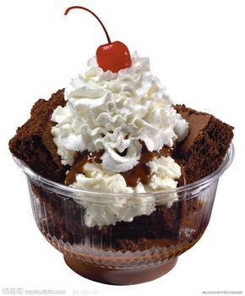
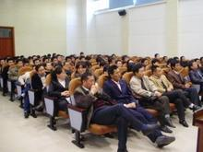
I like chocolate ice-cream best.
我最喜欢巧克力冰淇淋。
chocolate n. 巧克力
Is the meeting on Wednesday?
会议是在星期三吗？
meeting n. 会议；集会；会面

Slide 13
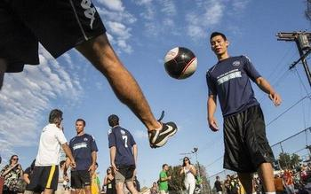
Let’s organize a soccer game.
让我们组织一次足球比赛吧。
organize v. 组织；筹备

Slide 14
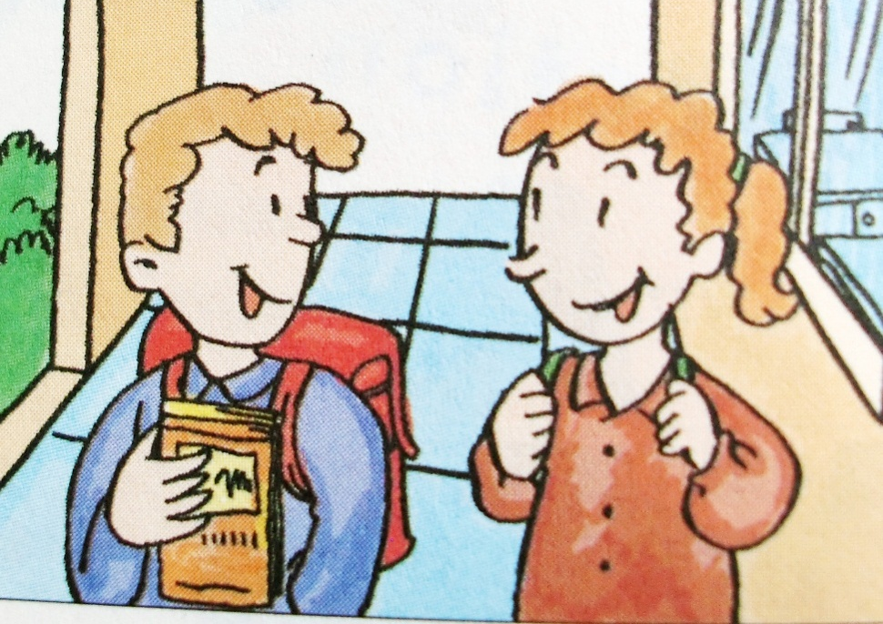
Listen and circle the correct answers to complete the sentences.
Listening
2a
1. The students are talking about when to
have (a class party/
a class meeting / a
birthday party).

Slide 15

2. They plan to have it on (Friday evening /
Saturday afternoon/ Saturday evening).

Slide 16
Listen again. Choose the correct short answer in the box to answer each question.
2b
half the class won’t come; some students will be bored; make some food; students will leave early; the party games
1. What will happen if they have the
party today?
_____________________________
Half the class won’t come.

Slide 17
2. What will happen if they have the party
tomorrow?
________________________________
3. What will happen if they watch a video
at the party?
________________________________
Students will leave early.
Some students will be bored.

Slide 18
4. What will Mark organize?
_____________________________
5. What will Nelly do?
_____________________________
The party games.
She will make some food.

Slide 19
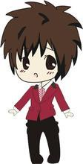
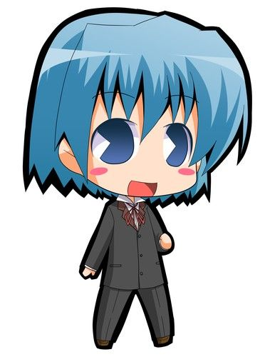
Pair work
Role-play a conversation between Nelly and Mark.
2c
OK, when is a good time to have the party?
Let’s have it today.

Slide 20
Hmm. If we have it today, half the class won’t come.
Ok, good idea.
Why not have it on the weekend?

Slide 21
Reading
Read the conversation and answer the questions.
2d
1. What will happen if we ask people to
bring food?
_____________________________________
_____________________________________
2. What will happen if we give people some
small gifts if they win?
___________________________________
They’ll just bring potato chips and chocolate because they’ll be too lazy to cook.
More people will want to play the games.

Slide 22
Role-play
Role-play the conversation.
Hey, Ben. For the party next week, should we ask people to bring food?
No, let’s order food from a restaurant…
…

Slide 23
Language points
1. If we ask people to bring food, they’ll
just bring potato chips and chocolate…
ask sb. to do sth. 请求/要求某人做某事
e.g. He asked the doctor to tell him the
truth.
他请求医生告诉他真相。

Slide 24
2. Yes, the games will be more exciting, too.
exciting 意为“令人兴奋的, 令人激动的”。
e.g. The movie has an exciting opening.
电影的开头非常刺激。

Slide 25

exciting&excited
前者是“对……感到兴奋”，通常主语是人，后者是“令人感到兴奋的”，通常主语是物/事件。
e.g. Are you excited about going to Beijing?
你要去北京了，感到兴奋吗？
He told us an exciting story yesterday.
他昨天给我们讲了一个使人激动的故事。

Slide 26
Exercises
用括号内所给单词的正确形式填空。
has
1. I’ll buy a computer if I _______ (have)
enough money.
2. I’m sure if he _____ (go) to the party,
he ________ (have) a great time.
goes
will have

Slide 27
3. You ___________ (not get) nervous if
you _____ (do ) enough exercise.
4. If she _______ (finish ) work early, she
______ (go) home.
5. If it _____(rain), we ________ (stay) at
home.
won’t get
do
finishes
will go
rains will stay

Slide 28

1. Recite the conversation in 2d after school.
2. 用括号里所给词的适当形式补全句子。
(1) If she stops smoking, _______________ (be
more healthy).
(2) If it rains, ____________.(stay at home).
(3) If I go on a diet, ___________ (lose weight).
(4) If we get up early, ________________ (go out
for the day).
(5) If he gets a job, _____________ (earn lots of
money) .

