Slide 1
R·九年级全一册
Unit 5 What are the shirts made of?
第二课时

Slide 2
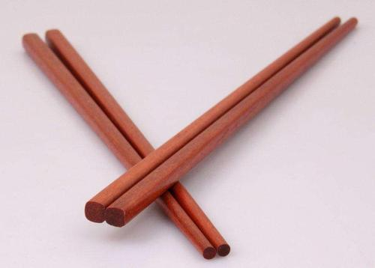
Look and guess
The chopsticks are made of wood. They're made in China.

Slide 3
The wine is made from grapes. It's made in France.

Slide 4
The blouse is made of silk. It's made in China.

Slide 5
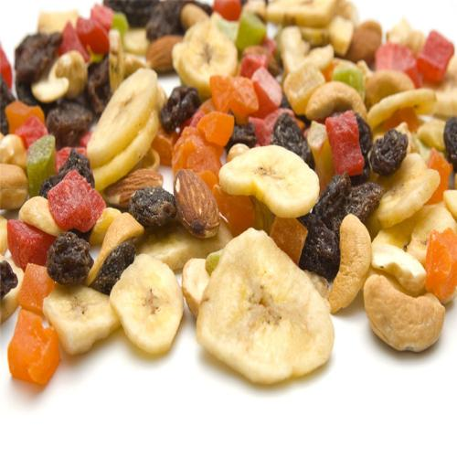
The food is made of fruits. It's made in Thailand.

Slide 6
Language points
Tea plants
_________
are picked by hand.
Tea leaves________________
are grown.
are
sent for processing.
Then tea leaves ___
________________
状元成才路
is packed.
The tea _________
Finally the tea ________ many countries and places around China.
is sent to

Slide 7
一、被动语态
Many people speak English.
English is spoken by many people.
动作的执行者
动作的承受者
被动语态

Slide 8
助动词 be ＋ 及物动词的过去分词
助动词 be 有人称、时态和数的变化

Slide 9
1. 肯定句: 主语 + be + V-ed + (by…)
This coin is made of gold.

Slide 10
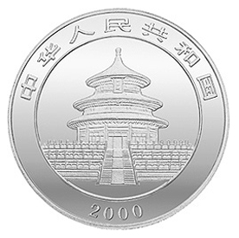
2. 否定句: 主语 + be + not + V-ed + (by…)
This coin isn't made of gold.

Slide 11
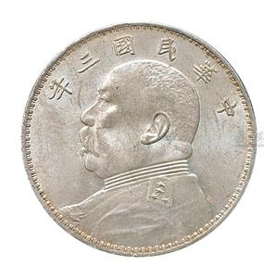
3. 一般疑问句: Be + 主语 + V-ed + (by…)?
Is this coin made of gold?

Slide 12
特殊疑问句:疑问词 + be + 主语 + V-ed + (by…)?
Where is the coin made?
When is the coin made?
How is the coin made?

Slide 13
二、主动语态→被动语态
1. 把主动语态的宾语变为被动语态的主语。
2. 把谓语变成被动结构（be＋过去分词）。
3. 把主动语态中的主语放在介词by之后作宾语，将主格改为宾格，如主语是人称代词，一般省略。

Slide 14
We often use a recorder in our English class.
A recorder is often used in our English class
(by us).

Slide 15
4. 在主动语态句中动词make、have、let、see、watch、hear、feel等后接动词不定式作宾语补足语，动词不定式不加to。
但变成被动语态时后面的不定式都须加上to。
My mother makes me do my homework.
I am made to do my homework by my mother.

Slide 16
5.常用双宾语的动词：
show/give/offer/send /bring/lend/teach/buy
宾变主，主变宾，by短语后面跟。
谓语动词变被动，be后“过分”来使用。

Slide 17
宾变主，主变宾，by短语后面跟。
谓语动词变被动，be后“过分”来使用。
The teacher gives the pupils some advice.
间接宾语
直接宾语
→The pupils are given some advice by the teacher.
→Some advice is given to the pupils by the teacher.

Slide 18
Mr. Li corrects the students’ homework every morning.
The students’ homework is corrected by Mr. Li every morning.

Slide 19
People play basketball all over the world.
Basketball is played by people all over the world.

Slide 20
Practice
将下列句子变为被动句。
1. The boss makes them work ten hours a day.
2. Tom lets his little sister water flowers.
→ They are made to work ten hours a day.
→ His little sister is let to water flowers by Tom.

Slide 21
Summary
主动语态→被动语态
1. 把主动语态的宾语变为被动语态的主语。
2. 把谓语变成被动结构（be＋过去分词）。
3. 把主动语态中的主语放在介词by之后作宾语，将主格改为宾格，如主语是人称代词，一般省略。

Slide 22
THANKS

