Slide 1
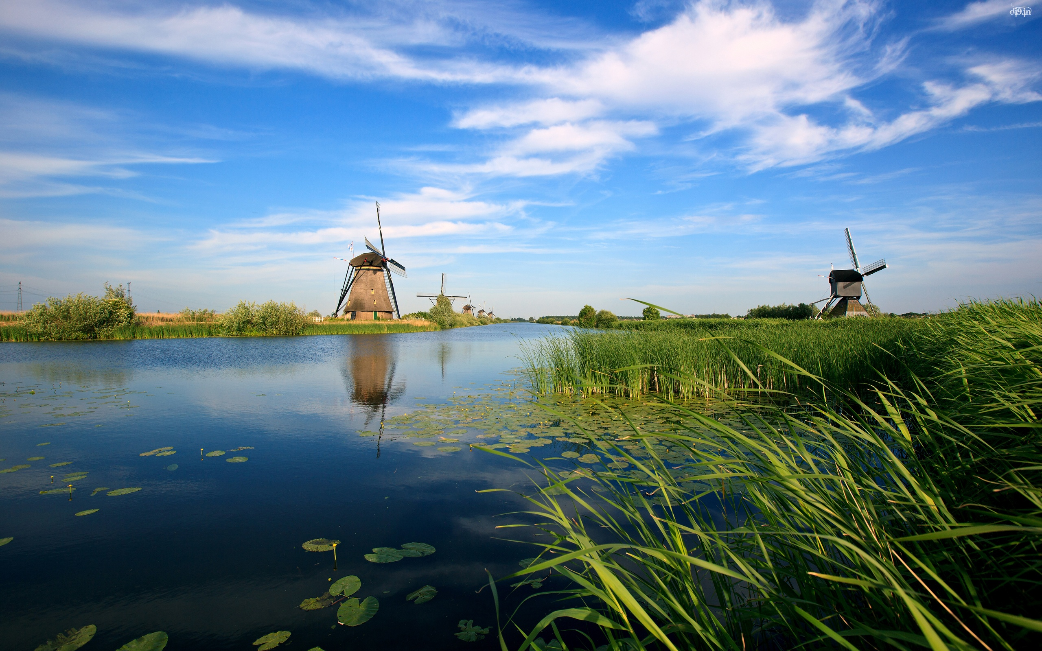
Unit 3
The world meets China

Slide 2
单
元
主
题
语
境
人与社会——历史、社会与文化
The world is a book, and those who do not travel read only a page.
世界是一本书，没有旅行过的人只读了 一页。

Slide 3
话题导入
A group of researchers and scientists from China and other countries are working together to record and collect digital images of cultural relics from the Mogao Caves，which were a key stop along the Silk Road throughout China’s ancient history.Nearly 500,000 high quality digital photographs have been produced since the international project started in 1994¹.

Slide 4
The Mogao Caves studied in many countries have long been a meeting point for different cultures.Today the caves are just as international as they were at the time when people travelled the Silk Road².Tourists from all over the world visit Dunhuang to see the caves，and the Getty Museum in Los Angeles has reproduced a copy of the caves and paintings for people to admire in America.

Slide 5
By sharing so many digital photos over the Internet，the group hopes to promote even wider interest around the world in China’s ancient history，culture，and traditions.As one researcher who is working on the project explains，“Appreciating one’s own cultural heritage is very important for understanding oneself.Recognizing the cultural heritage of other countries does good to international communication and understanding.”

Slide 6
靓句运用于写作
1.Many awards have been won by my English teacher since she graduated in 2013.(2020·全国Ⅰ，书面表达)
2.For many of us students, it is the perfect time when we can enjoy being close to nature.(2020·全国Ⅱ，书面表达)

Slide 7
内容索引
Period One Starting out & Understanding ideas—Comprehending
读前清障 识记单词 快速顺畅阅读
语篇理解 精读演练 萃取文本精华

Slide 8
读 前 清 障
识记单词 快速顺畅阅读
品句猜词——请预读下列课文原句，并猜测句中加颜色词汇的意思。
1.Dunhuang’s long and glorious history represents its significance as a centre of cultural and commercial exchange. _______
2.The painting of Apsaras reached a peak during the Tang Dynasty；these images are full of life，reflecting the confidence and optimism of people from that time. ___________
3.Dunhuang has once again become a global crossroads since it hosted hundreds of representatives from 51 countries for the Silk Road International Cultural Expo in 2017. _________________
辉煌的
巅峰，顶点
活动中心，汇集地

Slide 9
4.Given that the theme of the Expo was to promote cultural exchange and strengthen mutual cooperation between the countries along the Silk Road，Dunhuang was the ideal place. ______________
(使)变强；加强
返 回

Slide 10
语 篇 理 解
精读演练 萃取文本精华
Step 1 Fast-reading
1.What’s the main idea of the passage?
A.Dunhuang has a splendid history and is once again a meeting place for
people from around the world.
B.Dunhuang’s cultural relics attract tourists from all over the world.
C.The Silk Road passed through Dunhuang.
D.Dunhuang will be more attractive because of the Silk Road.
√

Slide 11
2.Read the passage and match the main idea of each paragraph.
Para.1 A.Dunhuang has once again become a global crossroads.
Para.2 B.Dunhuang faded from memory in the Ming Dynasty.
Para.3 C.The Library Cave was found in 1900s.
Para.4 D.The Apsaras are unique to Dunhuang.
Para.5 E.Dunhuang is a tourist destination boasting sites with UNESCO-
protected heritage status.
Para.6 F.Dunhuang was the gateway to and from Ancient China.

Slide 12
Step 2 Careful-reading
Read the passage carefully and choose the best answer.
1.Which one is NOT true about the description of Mogao Grottoes?
A.It can date from more than 1,000 years ago.
B.It is a UNESCO-protected heritage.
C.There are many paintings and other artworks.
D.It has been destroyed by humans.
√

Slide 13
2.From the third paragraph，we know that .
A.the subjects of Dunhuang murals are the same
B.the Apsaras are a unique mural which can be found in other places of
the world
C.in the Tang Dynasty，Dunhuang murals reached their peak
D.the murals reflected the confidence and expectation of people at that
time
√

Slide 14
3.The scrolls in the Library Cave .
A.describe how the cave was discovered
B.reveal how many different communities lived together
C.tell us the rise and fall of Dunhuang
D.explain why the cave was sealed up
√

Slide 15
4.Why was Dunhuang the ideal place to host the Silk Road International Cultural Expo?
A.Because the theme of the Expo had something to do with the countries
along the Silk Road.
B.Because the city had a strong cultural atmosphere.
C.Because people could travel here while attending the Expo.
D.Because the environment here was attractive.
√

Slide 16
Step 3 Post-reading
After reading the passage，please fill in the following blanks.
Dunhuang was the gateway to and from Ancient China，a place where East met West.Its long and glorious history represents its 1.________________
(significant) as a centre of cultural and commercial exchange.It is a world-class tourist destination 2. (boast) sites with UNESCO-protected heritage status.3. (know) as the Mogao Grottoes，these ancient caves were carved out of the rock over a period of 1,000 years.The subjects of the Dunhuang murals vary from religious stories to scenes of everyday life.One type of mural unique 4. Dunhuang shows the Apsaras,5. are full of life，
significance
boasting
Known
to
which

Slide 17
reflecting the confidence and optimism of people from that time.In 1900，a Taoist priest made one of the 6. (important) finds of the 20th century.In a sealed cave，now known as the famous Library Cave，were hidden 7. (thousand) of manuscripts，paintings and scrolls，which are so detailed 8. they describe the vast range of goods that were imported and exported from Dunhuang and reveal how many different communities lived side-by-side within this great city.Today，Dunhuang has once again become a 9. (globe) crossroads since it 10. (host) hundreds of representatives for the Silk Road International Cultural Expo in 2017.
most important
thousands
that
global
hosted

Slide 18
Step 4 Sentence-learning
1.You can only imagine how travellers felt when they saw the oasis of Dunhuang ahead of them.
[句式分析] 句中how引导 从句，在该从句中含有when引导的________
从句。
[自主翻译] ____________________________________________
宾语
时间状语
你可以想象当游客看到前面的敦煌绿洲时的感受。

Slide 19
2.The Apsaras are depicted sailing in the bright blue sky，with their scarves flying，as if they are about to fly down to meet us.
[句式分析] 该句为复合句，句中as if引导 从句，with their scarves flying 为with复合结构，be about to do... 。
[自主翻译] _______________________________________________________
__________________
方式状语
就要做……
飞天被描绘成在蔚蓝的天空中飞行，他们的彩带飞舞着，仿佛要飞下来迎接我们。

Slide 20
3.Dating from 405 AD to 1002 AD，these hidden treasures give us a picture of Dunhuang when it was at the very centre of the Silk Road trade.
[句式分析] 此句的主干是：these hidden treasures give us a picture。Dating from...为现在分词短语作 ，when引导的是 从句。
[自主翻译] _______________________________________________________
_____________________________________________
状语
时间状语
从公元405年到公元1002年，这些隐藏的宝藏给了我们一幅敦煌的图片，当时敦煌正处于丝绸之路贸易的中心。

Slide 21
4.However，the reason why the Library Cave was sealed up all those years ago remains a mystery.
[句式分析] 此句的主干是：the reason remains a mystery。句中why引导__
从句，修饰先行词 。
[自主翻译] ________________________________________
定
语
the reason
然而，藏经洞多年前被封的原因仍然是个谜。
返 回

Slide 22
本课结束

