Slide 1
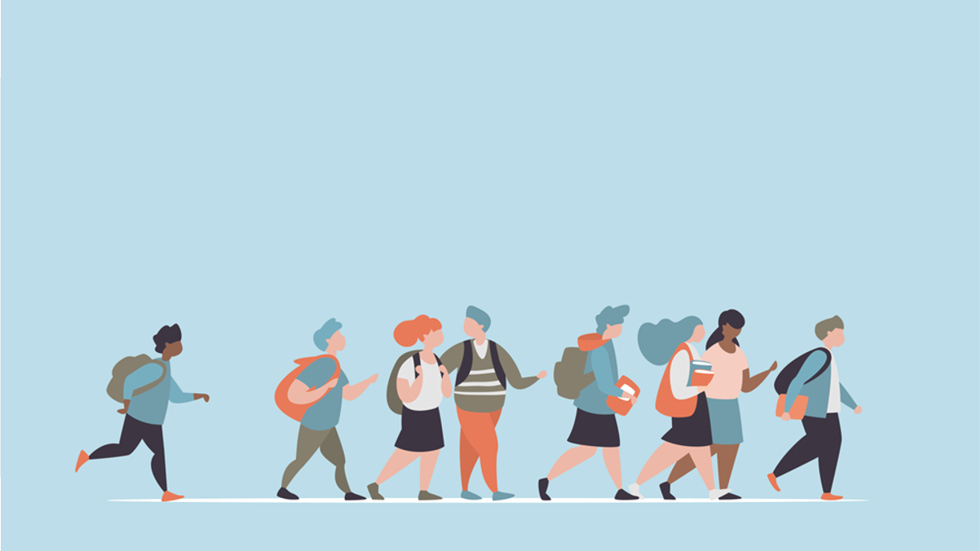
R·九年级全一册
Unit 1 How can we become good learners?
第三课时

Slide 2
What good learning habits can you think of? Make a list and discuss them with your partner.

Slide 3
study with a group
read English every day

Slide 4
be active in thinking
always read English aloud

Slide 5
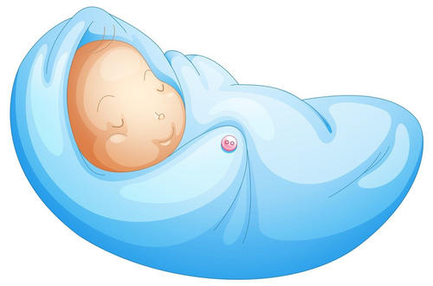
Language points
Everyone is born with the ability to learn.

Slide 6
一、固定搭配
1. be born 意为“天生，出生”为被动语态， be 动词通常用was 或were，born 为bear 的过去式。
2. ability 在此处为不可数名词，意为“能力”。
have the ability to do sth. 有能力做某事

Slide 7
But whether or not you can do this well depends on your learning habits.
3. whether or not 意为“是否”。 whether引导主语从句，不能与if 替换。
4. depend on/ upon 依据；依赖
depend on sb./ sth. to do sth.

Slide 8
They can pay attention to what they need to learn for a long time.
Successful learners have some good habits in common.

Slide 9
二、“共同”的表达
have sth. in common (with sb./ sth.)
与某人、某物有相同之处
in common 共同的，共有的
pay attention to意为“注意； 关注”，其中to为介词， 后跟名词、代词或动词-ing形式作宾语。

Slide 10
Good learners think about what they are good at and what they need to practice more. Because even if you learn something well, you will forget it unless you use it.

Slide 11
Practice makes perfect.

Slide 12
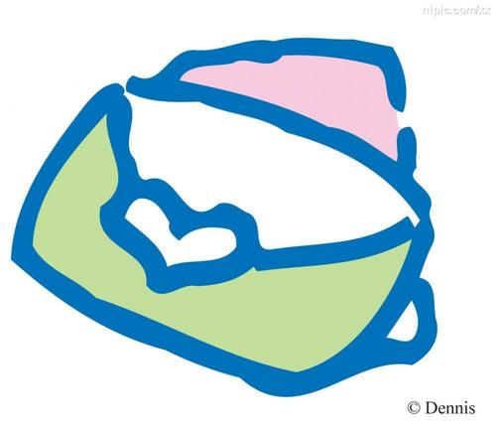
Writing
Write a letter telling a friend how to become a better language learner.

Slide 13
Beginning
I know you want to improve your English and you need some help. There are three good ways to learn English.

Slide 14
Give advice
I think you should...
If you do this, your brain will...
It is also a good idea to ... because ...
You could try to improve your English by... This will help you.

Slide 15
Ending
I hope all these will be helpful to you.

Slide 16
Practice
Give advice to these people.
Jane is a very slow reader. She should improve her reading speed_______________________.
Li Ming wants to improve his listening. He could practice his listening__________________.
Meiping doesn’t know many English words. She could learn more words____________________.
by reading word groups
by listening to tapes
by using dictionaries

Slide 17
Summary
1. Everyone is born with the ability to learn.But whether or not you can do this well depends on your learning habits.
2. Successful learners have some good habits in common.
3. They can pay attention to what they need to learn for a long time.

Slide 18
THANKS

