Slide 1
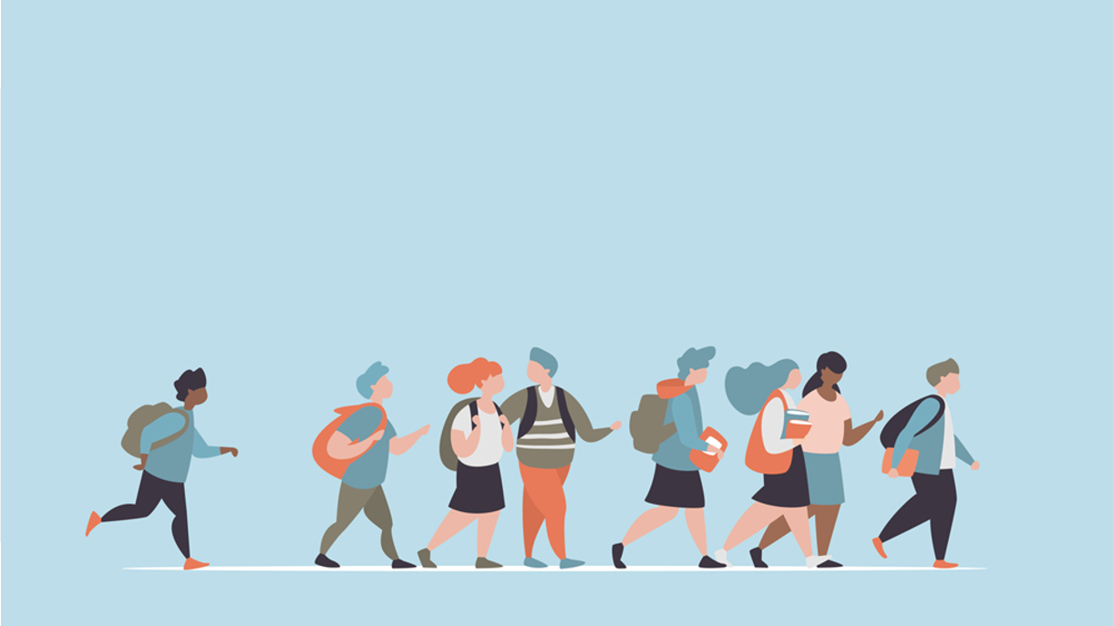
R·九年级全一册
Unit 12 Life is full of the unexpected.
第三课时

Slide 2
Lead in
What festivals are they?
The Mid-Autumn Festival

Slide 3
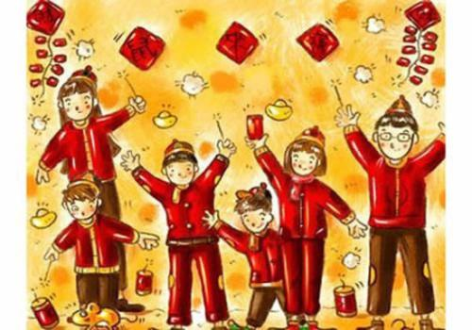
Spring Festival

Slide 4
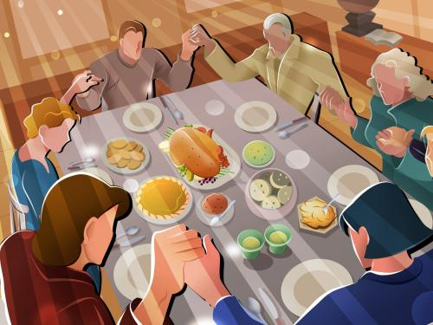
Thanksgiving Day

Slide 5
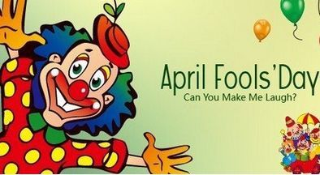
April Fools' Day

Slide 6
Language points
Have you ever played jokes on others, especially on April Fools’ Day?
Have you ever been fooled by others?
Tell your story to your partner.

Slide 7
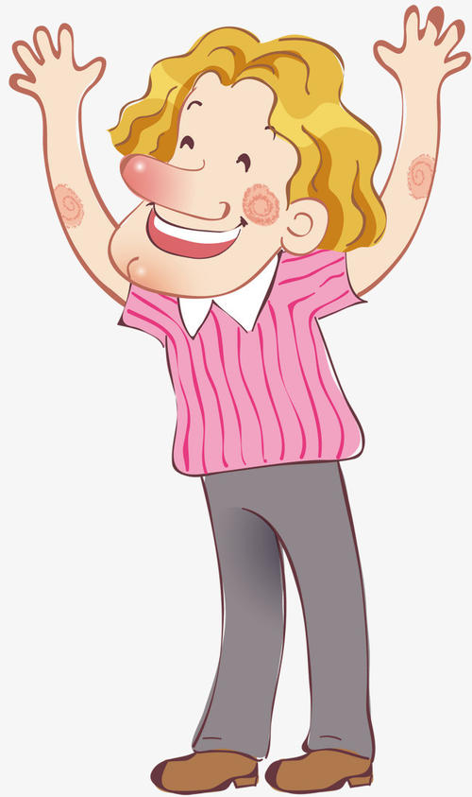
What happened to you
on April Fools’ Day?
Well, a friend invited me
to a costume party.

Slide 8
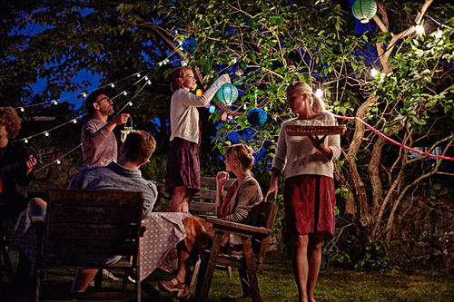
When I got there, I found that it wasn’t a costume party. I was the only person wearing a costume. I was really embarrassed.

Slide 9
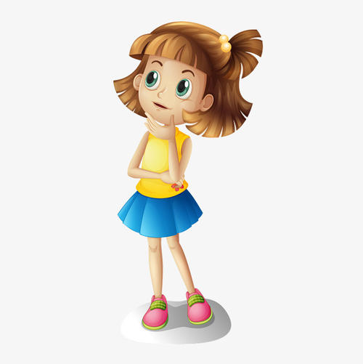
What happened to the famous TV star on April Fools’ Day?
He asked his girlfriend to marry him.

Slide 10
How did the lady feel?
The lady was so happy because she really wanted to get married.

Slide 11
一、marry v. “结婚；嫁；娶”
1. marry sb. 表示 “和某人结婚”
2. get married to sb. 意为“与某人结婚”，
该短语表示动作，不能与一段时间连用。
3. be married to sb. 意为“与某人结婚”，
表示状态，可以和表示一段时间的状语连用。

Slide 12
Then what happened? Did they get married?
No, it's just a trick. The TV star lost his girlfriend and his show was canceled.

Slide 13
Many April Fools’ jokes may end up being not very funny.
Yes, so we should end up some jokes.

Slide 14
二、end up的用法
end up (doing sth.) (以…)结束；最终成为；最后处于
end up sth. 表示“结束某事”
end up with sth. （以…）结束

Slide 15
Let's write
Write a story about your lucky or unlucky day and tell your story to a partner or the class.

Slide 16
What was the date?
What happened first?
Was this lucky or unlucky? Why?
What happened next?
How did the day end?
How did you feel about this day?

Slide 17
I will always remember the date...
This was the luckiest/ unluckiest day of my life...
开篇点题

Slide 18
When I woke up that morning...
Later that day... I couldn’t believe... Then/After that,... Finally,...
阐述经历
总结感慨
What a lucky/ an unlucky day!

Slide 19
Practice
Think of ways to finish the answers.
A: Why didn’t you hand in your science homework?
B: Before I could start working on it,
________________________________________
________________________________________
I remembered I had left my science book in the classroom.

Slide 20
2. A: Why didn’t you take a shower this morning?
B: By the time I got up,
________________________________________
_________________________________________
my sister had already gone into the bathroom and the bus was honking for me to hurry up.

Slide 21
Summary
1. marry
marry sb.
get married to sb.
be married to sb.
2. end up
end up (doing sth.)
end up sth.
end up with sth.
Unit 12 Life is full of the unexpected.

Slide 22
THANKS

