Slide 1
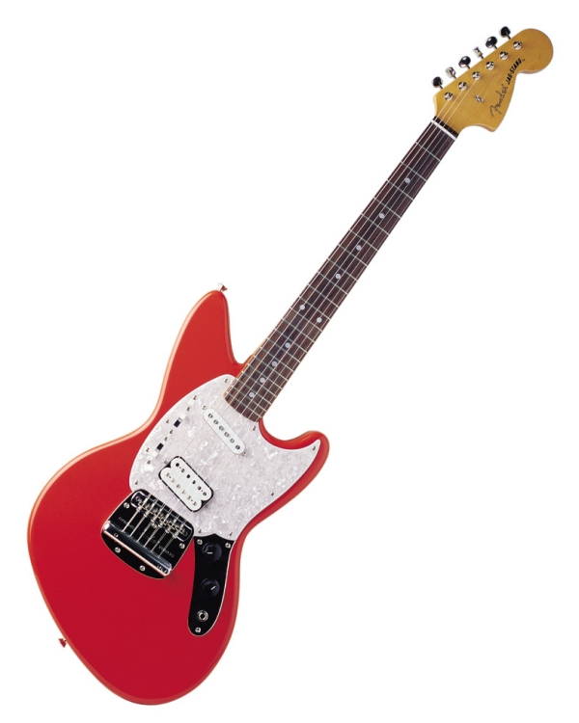

Unit 1
Can you play the guitar?
Section A
Period Two

Slide 2
Words and expressions
write show
or
talk
talk to…
Kung fu
v. 写作；写字
n. 演出；节目
v. 给……看；展示
conj. 或者；也不(用于否定句)
v.&n.说话；交流
跟……说
n. (中国)功夫

Slide 3



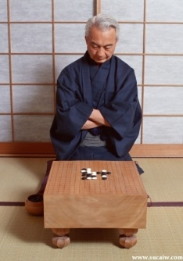



Work in pairs
Can you…?
Yes, I can.
speak English
No, I can’t.
swim
play the guitar
play chess
paint
dance
sing

Slide 4
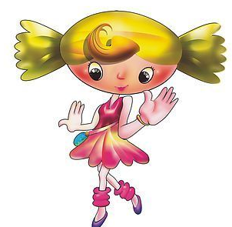


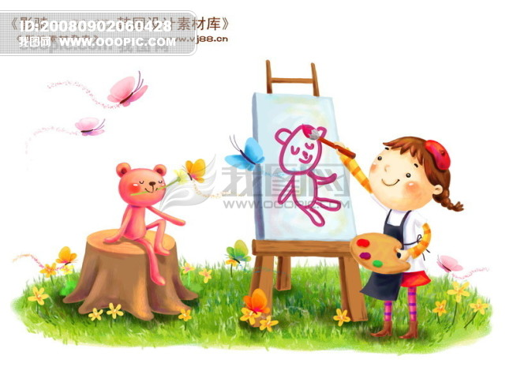
Show yourself
A: I can… but I can’t…
swim
B: I can … but I can’t…
dance
sing
paint
play the guitar

Slide 5
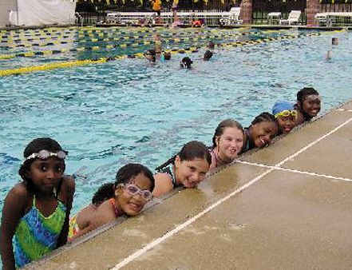
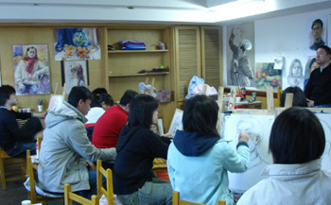
Do you know the club?
swimming club
music club
art club

Slide 6

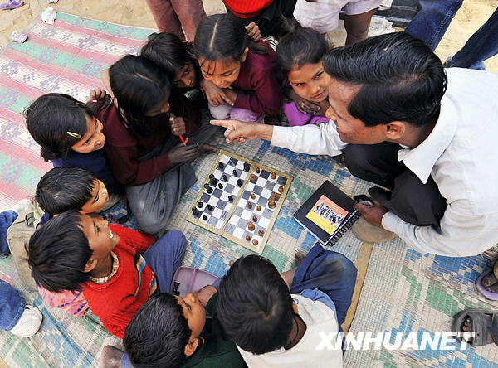
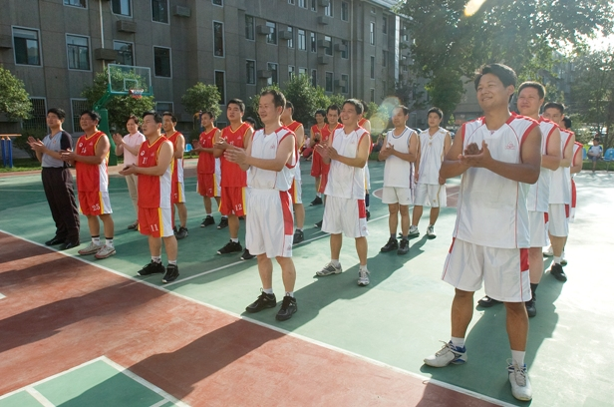
English club
chess club
basketball club

Slide 7






I want to join ...
1
3
2
_______ club
English
_________ club
swimming
4
5
_____ Club
music
chess
art
_____ club
_____ club

Slide 8
join the swimming club
the dancing club
the singing club
the music club
the art club
the English club
the chess club
the sports club
the basketball / tennis / golf club

Slide 9
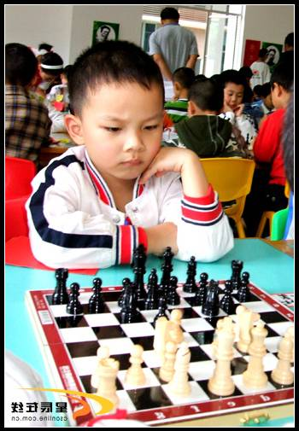
Look and say
I can play the guitar but
I can’t play it very well.
Tom _______ chess ___
he_________ it very well.
can play
but
can’t play

Slide 10
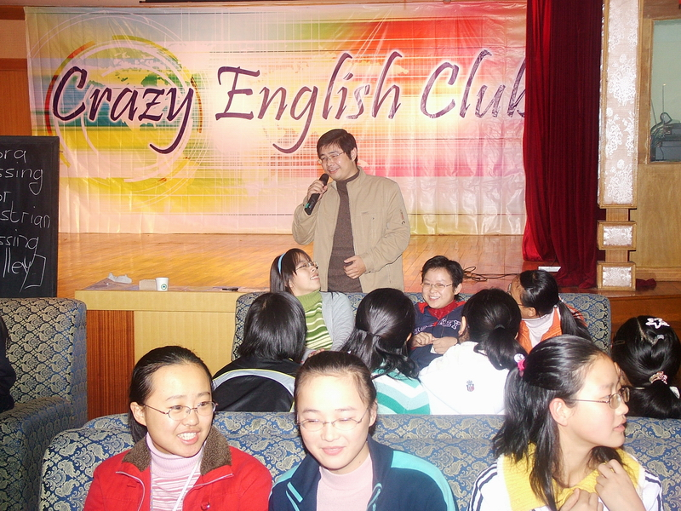
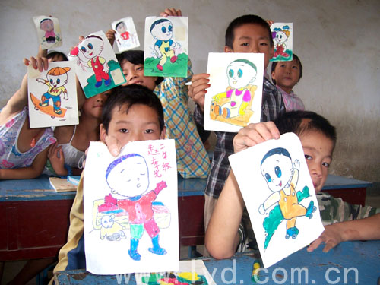
He________________ but
he____________________.
can speak English
can’t speak it very well
We ________ ____we
__________________.
can paint
but
can’t paint very well

Slide 11
3a
Write questions and answers with the words and phrases.
1. Wu Jun/speak English/speak Chinese
______________________________
_________________________________
2. Mike/play basketball/play tennis
_________________________
_______________________________
Can Wu Jun speak English?
No, he can’t, but he can speak Chinese.
Can Mike play basketball?
No, he can’t, but he can play tennis.

Slide 12
3. Jane and Jill/dance/sing
_______________________
____________________________
4. Grace/play soccer/play volleyball
_____________________
_________________________________
5. Bill/write stories/tell stories
____________________
______________________________
Can Jane and Jill dance?
No, they can’t, but they can sing.
Can Grace play soccer?
No, he can’t, but he can play volleyball.
Can Bill write stories?
No, he can’t, but he can tell stories.

Slide 13

3b
Complete the following poster with the words in the box.
play sing tell dance
Students Wanted for School Show
We want students for the school show. Can you ____or _____? Can you ____ the guitar? Can you ___ stories? Please talk to Mr. Zhang after school.
sing
dance
play
tell

Slide 14
3. Students Wanted for School Show
学校文艺表演招募学生(演员)
英语广告或告示的标题多采用单词首字母大写或全大写的形式。此处wanted是英语中一种特定的语言现象，主要用于标题，常用于招聘、求购或求租广告。本单元用于招募人员广告，相当于汉语中的“招募；征集；招聘；寻求”等含义。

Slide 15
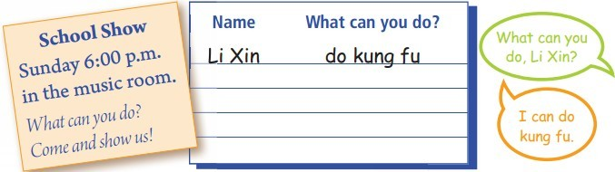
Groupwork
3c
What can your group do in the school show? Make a list.

Slide 16

Language points

Slide 17
Review
课时重点回顾
Grammar
Focus
Can you swim?
Yes, I can. / No, I can’t.
Can he play chess?
Yes, he can. / No, he can’t.
Can you speak English?
Yes, we can. / No, we can’t.

Slide 18
Review
课时重点回顾
Can Jane and Jill swim?
Yes, they can. / No, they can’t.
What can you do?
I can dance. / I can’t sing.
What club do you want to join?
We want to join the chess club.
I want to join the basketball club.
Grammar
Focus

Slide 19
Translate and write them down.
1. 汤姆会弹吉他，但是他弹的不太好。
2. - 你能帮助孩子们游泳吗？
- 是的，我能。
Tom can play the guitar but he can’t play it very well.
Can you help kids with swimming?
Yes, I can.

Slide 20
Thank you.

