Slide 1
Unit 4
What’s the best movie theater?
Section B (2a-3c)

Slide 2
Learn by yourself
1.唱得最美妙____________________
2.越来越流行____________________
3.把这些节目太当真______________________________
4.有一个相同特征________________
5.钢琴弹得最好 _________________
6.世界各地_____________________

Slide 3
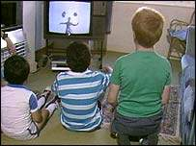
Who was the best performer?
Eliza was the best performer.

Slide 4
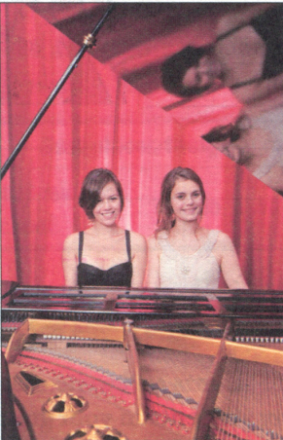
2b Read the passage below.
Which three talent shows are mentioned?
Who’s Got Talent?
Everyone is good at something, but some people are truly talented. It’s always interesting to watch other people show their talents. Talent shows are getting more and more popular. First, there were shows like American Idol and America’s Got Talent. Now, there are similar shows around the world, such as China’s Got Talent.

Slide 5
have sth. in common
与……相同,有共同点
All these shows have one thing in common: They
try to look for the best singers, the most talented dancers, the most exciting magicians, the funniest actors and so on. All kinds of people join these shows. But who can play the piano the best or sing the most beautifully? That’s up to you to decide. When people watch the show, they usually play a role in deciding the winner. And the winner always gets a very good prize.
be up to…
由……决定
play a role in
在……方面发挥作用

Slide 6
make up
编造
However, not everybody enjoys watching these shows. Some think that the lives of the performers are made up. For example, some people who say they are poor farmers are in fact just actors. But if you don’t take these shows too seriously, they are fun to watch. And one great thing about them is that they give people a way to make their dreams come true.

Slide 7
Then answer the questions:
What do talent shows have in common?
2. Who decides the winner?
3. Why do some people not like these shows?
4. Why do some people like these shows?
5. What do you think of these shows?
They try to look for the best singers,
the most... and so on.
The people who watch the show.
Because they think that the lives of the performers
are made up.
Because they are fun to watch.
I think they can make people’s dream come true.

Slide 8
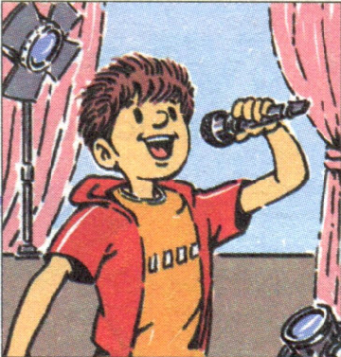
2d Underline all the superlatives in the
passage. Then write sentences using
at least four of them.
best singer: In my class, Tom is the best singer because he can sing fast songs very well.

Slide 9
班级之最
A: Who (do you think) is the funniest person you
know?
B: I think … is the funniest person I know.
A: Why do you think so?
B: Because ….
funniest most creative
best quietest
smartest tallest
heaviest friendliest
thinnest busiest most popular

Slide 10
Then complete the chat !
Who’s got talent in your class?
Talents | Classmates’ names | How many students agree?
the best chess player
the most talented dancer
the most interesting writer
the fastest runner

Slide 11
3a Read the article about Greenwood Park.
crowded creative good fast quietly
Greenwood Park is the best place to go to on weekends. I always finish my breakfast _____________on Saturdays because I went to get to Greenwood Park before 10:00 a.m. to meet my friends. The park is _________________ place on weekends because almost everyone goes there to see the street performers. Some people think they are boring, but I think they are _________________ people. However, the place where you can enjoy your time _________________ is at one of the small coffee shops near the park. You can read or relax there. There is something for everyone at Greenwood Park.
the fastest
the most crowded
the most creative
the most quietly

Slide 12
Language points
1. That’s up to you decide. 那由你来决定。
be up to sb. 是一个习惯用语，用来表示“由某人做
出决定”，句子的主语通常为it ,有时也用this或that。
e.g. You can join the clue once or twice a week. It’s
up to you.
—How much should he play?
—That’s up to him to decide!

Slide 13
2. When people watch the show, they usually play a
role in deciding the winner.人们看这样的节目时，
通常承担着评判优胜的角色。
play a role 意为 “扮演某一角色；起到某种作用”，
后面接介词in ,表示“在某事或某个方面起到作用
或承担角色”。
e.g. John is playing the leading role in this year’s
play. 今年的演出中约翰是主角。
Schools play the most important role in
education. 学校在教育中起着最为重要的作用。

Slide 14
3. However, if you don’t take these shows too seriously,
they are fun to watch.但是如果你不把这些节目太当
回事，它们还是有看头的。
take 在此处有consider(认为;觉得)的意思。take
sb./sth. seriously 相当于“认真对待某人或某事；把
某人或者某事当真”的意思。
e.g. He was joking, but your sister took him seriously.
他是在开玩笑，但你姐姐却当真了。
Something teachers take student’s homework too
seriously. 有时候老师们把学生作业看的太重。

Slide 15
Homework
Imagine you went to a talent show of famous people. Write an article about the talent show.

Slide 16
Thank You!

