Slide 1
What were you doing when the rainstorm came?
Unit 5
R 八年级下册
SectionA 3a-3c
Grammar Focus-4c

Slide 2
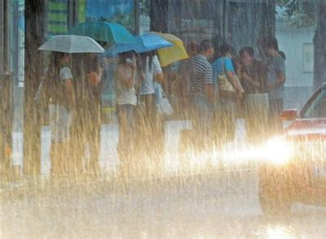
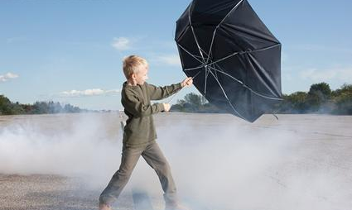
storm n.
暴风雨
wind
n. 风

Slide 3
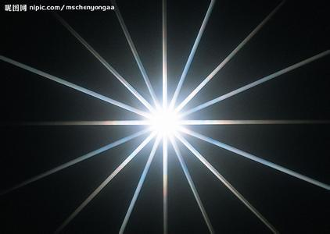
light n.
光；光线
report v. / n. 报道；公布

Slide 4
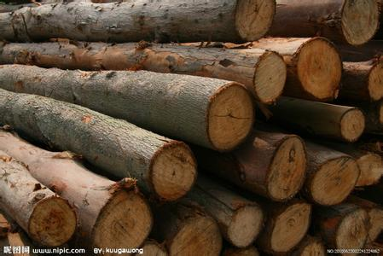
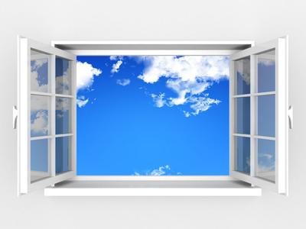
wood n.
木；木头
window
n. 窗户

Slide 5
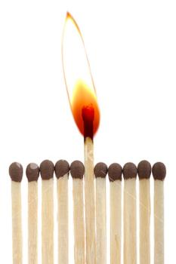
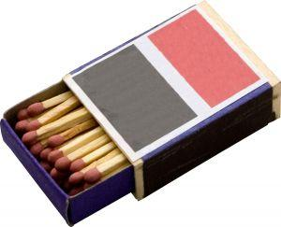
flashlight n.手电筒；火炬
match
n. 火柴

Slide 6
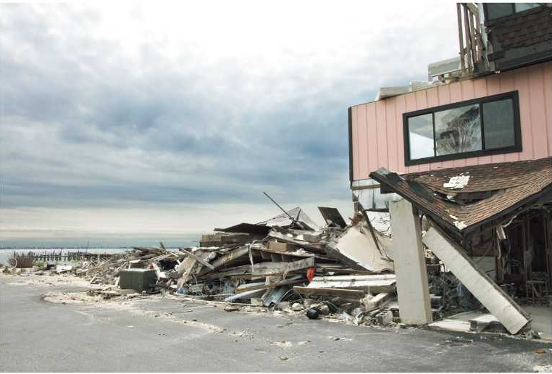
3a. Read the passage and answer
the questions.
1. What was the weather like before the heavy rain started?
2. What was the neighborhood like after the storm?

Slide 7
3a
1. What was the weather like before the heavy
rain started?
2. What was the neighborhood like after the
storm?
Strong winds were blowing, and black clouds were making the sky very dark.
The neighborhood was in a mess. There were fallen trees, broken windows and rubbish everywhere.

Slide 8
3b. Complete the sentences using
information from the passage.
1. When the news on TV was reported, strong
winds __________________.
2. While Ben's mom was making sure the radio
was working, his dad ___________________
_____________________.
3. Ben _________________________________
when the heavy rain finally started.
4. When Ben __________ at 3:00 a.m., the wind
_____________________.
were blowing
was putting pieces of
wood over the windows
was helping his mom make dinner
fell asleep
was dying down

Slide 9
3c. Discuss the questions with a partner.
"Although the storm broke many things
apart, it brought families and neighbors
closer together." What other things can
bring people closer together? How can
we help each other in times of difficulty?

Slide 10
Grammar
Focus
语法内容请见学案对应处
What were you doing at eight last night? | I was taking a shower.
What was she doing at the time of the rainstorm? | She was doing her homework.
What was he doing when the rainstorm came? | He was reading in the library when the rainstorm came.
What was Ben doing when it began to rain heavily? | When it began to rain, Ben was helping his mom make dinner.
What was Jenny doing while Linda was sleeping? | While Linda was sleeping, Jenny was helping Mary with her homework.

Slide 11
4a. Look at the table and write sentences
with both while and when.
John | Mary
take photos | buy a drink
play the piano | leave the house
clean his room | turn on the radio
shop | take the car to the car wash

Slide 12
4a. Look at the table and write sentences
with both while and when.
While John was taking photos, Mary bought a drink.
John was taking photos when Mary bought a drink.
____________________________________________________________________________________________________________________________________________________________________________________
While John was playing the piano, Mary left the house.
John was playing the piano when Mary left the house.

Slide 13
4a. Look at the table and write sentences
with both while and when.
________________________________________________________________________________________________________________________________________________________________________________________________________________________________________________________________________________________________________________________________________
While John was cleaning his room, Mary turned on the radio.
John was cleaning his room when Mary turned on the radio.
While John was shopping, Mary took the car to the car wash.
John was shopping when Mary took the car to the car wash.

Slide 14
4b. Fill in the blanks with was, were,
when or while.
At 7:00 a.m., I woke up. ______ I ______ making my breakfast, my brother _______ listening to the radio. _______ I was eating, the radio news talked about a car accident near our home. My brother and I went out right away to have a look.
While
was
was
While

Slide 15
4b
_______ we got to the place of the accident, the car ______ in bad shape from hitting a tree. But luckily, the driver _______ fine. The roads ________ icy because of the heavy snow from the night before.
When
was
was
were

Slide 16
4c. What were you doing at these times last
Sunday? Fill in the chart. Then ask your
partner.
 | You | Your partner
9:00 a.m.
11:00 a. m.
4:00 p. m.
9:00 p. m.

Slide 17
4c
What were you doing
at nine o'clock last
Sunday morning?
I was sleeping.
How about you?

Slide 18
4c
I was doing my
homework.
You're kidding!

Slide 19
Language points
1. With no lights outside,it felt like midnight.
light是名词，意为“光；光线；光亮”， 如果其前有形容词修饰,可与a连用。 light在句中有时可用作定语。
如：I try to see but I'm blinded by the white
light.
我试着去看，但是有道白光让我什么都看不到。
I can't read while you are standing in my light.
你挡住了我的光线，我没法看书。

Slide 20
Language points
2. The news on TV reported that a heavy rainstorm in the area.
report是动词，意为“报道；公布”。
如：The death of the premier was reported in
the newspapers.
总理的逝世已在各报纸上报道。
For some, I have good news to report.
但对其中一些问题，我有好消息要公布。

Slide 21
Language points
3. She also put some candles and matches on the table.
put...on...是“动词+介词”结构，意为“把......放在......之上”，与表示“穿上”“戴上”的put on是有区别的。后者是“动词+副词”构成的词组，后接名词时，可位于副词on之前或之后；接代词时，只能位于on之前。
如：She put the book on the table.
她把书放在桌子上。

Slide 22
Language points
4. He finally fell asleep when the wind was dying down at around 3:00 a.m.
die down意为“逐渐变弱；逐渐消失”，其中die的现在分词是dying。
如：The fire had died down, so we put more
coal on it.
炉火变弱了，我们再加了些煤。
Open the air hole; the fire is dying down.
把气孔打开，火要熄了。

Slide 23
1. It took a long time for the excitement to
_______.
A. die of B. die down
C. dying down D. die from
2. It was raining heavily outside and I could
not ______ for a long time.
A. go to bed B. be asleep
C. fall asleep C. be sleepy
B
B

