Slide 1
Unit 3 Environmental protection
Period 5 Write a report on an environmental issue
选择性必修三
人教版（2019）

Slide 2
Lead in
Watch the video

Slide 3
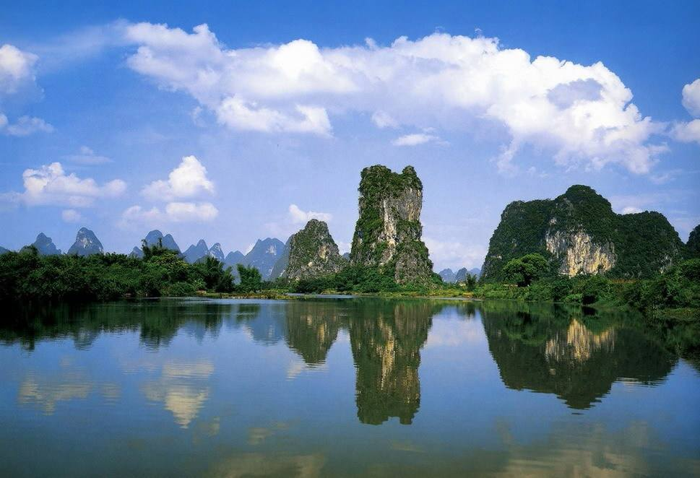
Task 1
Look at the pictures and answer the questions.
What river is it? Have you ever been there?
What do you know about it?
Li River
It is one of the most well-known tourist destinations in China’s Guangxi Zhuang Autonomous Region.

Slide 4
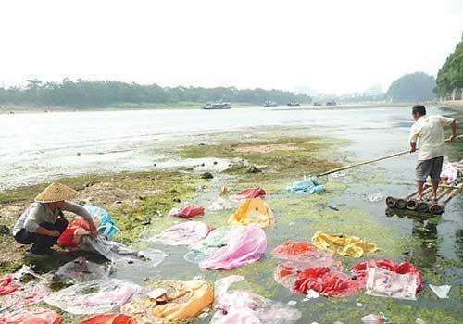
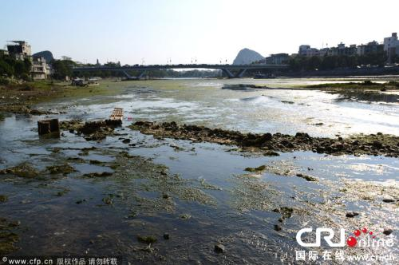
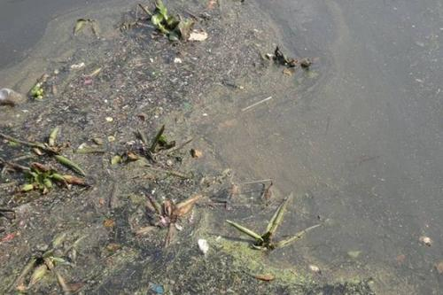
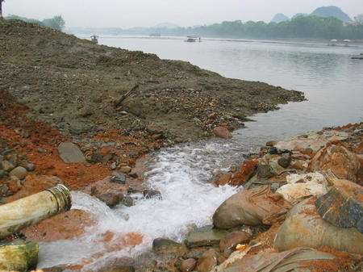
Task 1
Look at the pictures and answer the questions.
Now let’s look at some pictures of Li River.
What do you think of them?
Pollution

Slide 5
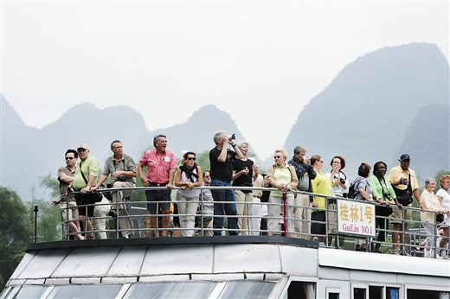
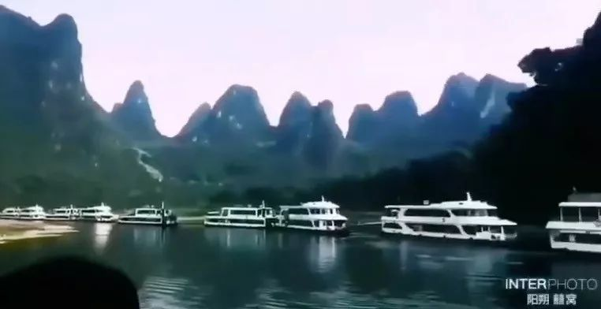
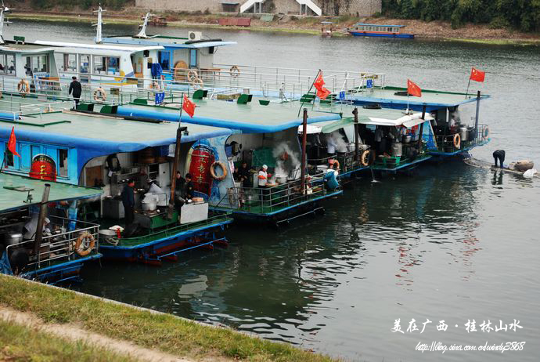
Task 1
Look at the pictures and answer the questions.
What might have caused water pollution in the Li River?
the increase of local population …
an increasing volume
of tourists
many tour boats
kitchens on board

Slide 6
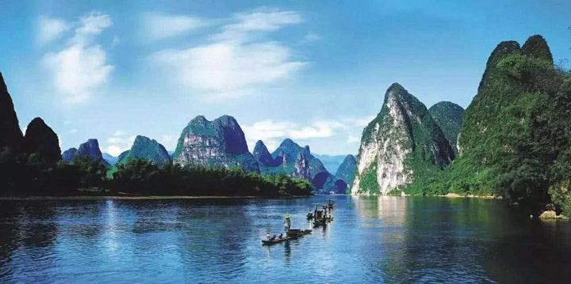
Task 2
Pre-reading: Think and talk
Here is a report on the Li River —
REDUCING WATER POLLUTION IN THE LI RIVER.
What might be talked about in the report?
Water pollution and the causes of pollution.

Slide 7
Task 2
Reading for the structure.
Read the report and complete the form.
Paragraph 1 | Paragraph 2 | Paragraph 3 | Paragraph 4
Introducing the topic | Describing the ________ | Presenting some ___________ | Presenting further __________
problem
measures
solutions

Slide 8
Task 3
Reading for the details .
Para1:
1.What is the problem of Li River?
2. What is the function of the last sentence of Para 1?
Its reputation as a top destination has had negative effects on the river’s water quality.
To introduce the following context.

Slide 9
Task 3
Reading for the details .
Para2:What are the factors that caused the pollution?
increasing tourists
kitchens on board
Li River Pollution
the rise of local population
more chemicals for crop production
rise in commercial and industrial enterprises

Slide 10
Task 3
Reading for the details .
Para 3:What measures have been taken to improve the Li River’s water quality?
waste water treatment facilities
the collection and transport of household waste
Solutions
the closure of polluting enterprises
media
strict regulations & new rules

Slide 11
Task 3
Reading for the details .
Para5:
What is the “River Chief System”?
The "River Chief System,, holds senior officials responsible for reducing water pollution.

Slide 12
Task 4
Fill in the table about the problem-solution pattern .
Para 1
Para 2
Para 3
Para 4
Problems (negative effects on the river’s water quality)
Causes
Solutions
Result and prospection

Slide 13
Task 5
Read the text again and find out the related words .
Cause and effect
Problem and solution
have negative effects on, suffer from, contribute to, in order to, lead to, cause
Urgent steps should be taken to ...
A comprehensive initiative ...
with a number of measures that addressed ...
With these measures ...
With such campaigns in effect...
Verbs: improve, close, set up, introduce, spread, carry out, fine, preserve, tackle, head towards

Slide 14
Task 6
Writing

Slide 15
Use what you have learnt to write a report on an environmental issue.
Task 7
Choose an environmental problem that directly affects you or your local community. Research the issue on the Internet. Consider the following questions:
What is the issue? Why does it need to be dealt with?
Where does the issue occur? What are its causes? What effects does it have?
What actions have been taken so far? What future actions are planned?
Has the issue been dealt with well? Is it likely to be solved completely? Why or why not? What alternative solutions are possible?

Slide 16
Write your report.You may use the following tips to help your writing.
Task 8
体裁 |  | 时态
主题 |  | 人称
结构 | 第一段: ______________ 第二段: ________________ 第三段: _______________
一般现在时一般过去时
议论文
环境
保护
第三人称
提出问题及原因
给出解决建议
得出结论

Slide 17
You may use the following tips to help your writing.
Task 8
导致/造成
对……有影响
对……造成极大伤害
对……有危害
呼吁某人做某事
与……和谐相处
用完; 耗尽
采取措施做某事
对……负责任
lead to/result in/contribute to
have a … effect/impact/influence on
cause great damage to
do harm to
call on sb. to do sth.
live in harmony with
run out
take steps/measures/actions to do sth.
take responsibility for

Slide 18
Task 8
Show your article.
Litter is a big issue in our local community. We must deal with it because it is bad for local wildlife and it makes our community look terrible.
This mostly occurs in our local park. It is caused by people dropping food wrappers from the nearby fast food restaurant.
So far, we make sure the park is cleaned

Slide 19
Task 8
Show your article.
every day. We have added more rubbish bins in the park to make it easier for people to dispose of this waste. We also spoke to the fast food restaurant and asked them to encourage people to dispose of their waste properly.
There is a plan to add more bins and signs to inform people about the need to dispose of waste properly. We have also asked the restaurant to provide help in

Slide 20
Task 8
Show your article.
cleaning up their waste.
The issue has been dealt with well, but more work is needed. It is hard to deal with these issues because there is a never-ending source of waste as people will always need to buy food. In the future, the best solution would be to find alternative ways of packaging.

Slide 21
Language points
Important words
1.restore 考查热度★★★★
【热点品味】restore vt. 恢复；使复原；修复
【教材原句】...urgent steps should be taken to restore the river's original beauty.
......应采取紧急措施恢复这条河原有的美丽。
【实例品读】
His health was entirely restored.他已完全康复了。
He feels completely restored in health after a period of intensive care.经过一段时间的精心照料，他的精神才恢复正常。

Slide 22
Language points
Important words
【热点归纳】
restore communications 恢复交通
restore to (把……)归还给……，使……复职
restore to life 苏醒过来
restore to the owners 归还给原主
restoration n. 恢复
【考点精练】 单句语法填空
①I volunteered to contribute to ________ (restore) wildlife habitats.
②The police have now restored the painting _____ its rightful owner.
③The ______________ (restore) took almost 4,000 man-hours over four years.
restoring
to
restoration

Slide 23
Language points
Important words
2.conservation 考查热度★★★
【热点品味】conservation n. 对(环境、文物等)保护；保持
【教材原句】The construction of waste water treatment facilities improved the water quality and water conservation.
污水处理设施的建设，改善了水质和节约用水。
【实例品读】
He isn’t interested in conservation.
他对保护环境这个问题不关心。
Most people have come to accept the need for conservation of natural resources.现在大多数人已认识到保护自然资源的必要。

Slide 24
Language points
Important words
【热点归纳】
water conservation 水力资源保护
wildlife conservation 野生动物保护
conserve vt. 保存
conservative adj. 保守的； 守旧的
【考点精练】单句语法填空
①The district is under consideration for designation as a _______________ (conserve) area.
②It is no pleasure working with the young people who are sensitive and _______________ (conserve).
conservation
conservative

Slide 25
Language points
Important words
3.inspection 考查热度★★★
【热点品味】inspection n. 检查；查看；视察
【教材原句】At the same time, they started to carry out inspections regularly and fine tourist organisations for abuses.与此同时，他们开始对旅游组织滥用职权的行为进行定期检查和罚款。
【实例品读】
He made an inspection of the school.他视察了这所学校。
We aren’t nearly ready for the inspection.
对检查一事，我们还远未准备好。

Slide 26
Language points
Important words
【热点归纳】
inspect v. 检查；视察；检阅
inspector n. 检查员；巡视员
【易混辨析】inspect, examine，check
inspect | 强调上级对下级的视察、检查 | The captain wants to inspect your kit. 船长想要检查你的配备。
examine | 指“观察、察看”以了解情况； 还可指检查身体 | Let me examine your teeth first. 让我先检查一下您的牙齿。
check | 强调“核实”对错 | Will you check your homework yourself first？ 你能自己先检查一下作业吗？

Slide 27
Language points
Important words
【考点精炼】
选词填空(inspect/examine/check)
①The doctor ___________ the patient
carefully.
②I want to ________ with my secretary
before I sign the papers.
③The newly-elected president ____________
the troops.
④A team of divers was sent down to __________ the
wreck (沉船).
examined
check
inspected
examine

Slide 28
Language points
Important Phrases
4.contribute to 考查热度★★★★
【热点品味】contribute to 有助于；促成
【教材原句】Many tour boats contributed to the problem too.
许多游船也造成了这个问题。
【实例品读】
Fresh air and exercise contribute to good health.
新鲜空气和锻炼有益于健康。
Does smoking contribute to lung cancer?
吸烟会导致肺癌吗？

Slide 29
Language points
Important Phrases
【热点归纳】
contribute v. 捐献；捐助； 投稿
contribute… to把……贡献给……；捐助
contribution n. 贡献；捐赠
make a contribution/contributions to为……作贡献
【考点精练】单句语法填空
①(2021·新高考I卷)Research has shown that emotional skills may contribute __________ some of these qualities.
②The Chinese people should make a greater ___________ (contribute) to mankind.
to
contribution

Slide 30
Language points
Important Phrases
5.carry out 考查热度★★★★★
【热点品味】carry out 执行，实行；贯彻
【教材原句】At the same time, they started to carry out inspections regularly and fine tourist organisations for abuses. 与此同时，他们开始对旅游组织滥用职权的行为进行定期检查和罚款。
【实例品读】
He will carry out his plan.
他要执行他的计划。
He hasn’t the funds to carry out his design.
他没有资金来施行他的设计。

Slide 31
Language points
Important Phrases
【热点归纳】
carry on继续；坚持
carry on (with)把……继续进行下去
carry on doing sth. 继续做某事；不停地做某事
carry through帮助……渡过难关；顺利完成
carry off赢得；获得
【考点精练】单句语法填空
①We carried _____ our daily work not suspecting what was about to happen.
②They promised to carry ______ their duties faithfully.
on
out

Slide 32
Language points
Important Sentences
7.it is believed that... 句式 考查热度★★★★
【教材原句】With these measures, it is believed that the beauty of the Li River will be preserved for generations to come.
有了这些措施，人们相信漓江的美景将世代保存。
【句式分析】
本句为主从复合句。It is believed that… 意为“人们相信……”，其中的it是形式主语，真正的主语是后面的that从句。
It is believed that… 中believed还可换为其他动词，
如said, hoped, reported, learned, predicted等。

Slide 33
Language points
Important Sentences
It is believed that John will help us with some money.
大家都相信约翰会给我们一些金钱上的帮助。
It is hoped that it won’t rain on our camping day.
大家都希望露营那天别下雨。
【热点归纳】It is thought that… 大家认为……
It is said that… 据说……
It is hoped that… 人们希望……
It is reported that… 据报道……
It is well known that… 众所周知……
It is generally considered that… 大家认为……
It is supposed that… 据推测……

Slide 34
Language points
Important Sentences
【注意】此结构可转换为：sb. is/are＋过去分词＋to do sth. ，但是hope，suggest不可用于此结构。
It is said that he has gone abroad.→
He is said to have gone abroad.据说他出国了。
【考点精练】单句语法填空
①It is __________ (report) that a space station will be built on the moon in years to come.
②He is thought ______________ (act) foolishly. Now he has no one but himself to blame for losing the job.
③Before your trip, it is strongly suggested _______ he (should) make some preparations.
reported
to have acted
that

Slide 35
Exercises
单词拼写
1．We were prevented by heavy _______ (烟雾) from seeing anything.
2．Please keep the place clean, and throw away any __________ (垃圾).
3．They are involved in an exciting scientific _____________ (事业).
4．After an _____________ (视察), the inspectors must publish a report.
5．I cannot ___________ (忍受) your bad manners.
6．She became more and more interested in wildlife _______________ (保护).
smog
garbage
enterprise
inspection
tolerate
conservation

Slide 36
Exercises
单词拼写
7．The new manager’s job is to __________ (恢复) the company to profitability.
8．The company was ________ (处罚) $20,000 for breaking safety regulations.
9．The presidential ___________ (运动) was in full swing.
10．What’s on your _________ (议事日程) for tomorrow?
restore
fined
campaign
agenda

Slide 37
Exercises
语法填空
The beautiful Li River attracts millions of domestic and foreign visitors each year. However，it suffered serious water pollution with more household and commercial waste 1._________ (end) up in the river. Local officials were 2.____________ (concern) that the pollution was damaging the natural environment. They took a number of measures 3._____________ addressed the issue. The construction of waste water treatment 4._____________ (facility) improved the water
ending
concerned
that/which
facilities

Slide 38
Exercises
语法填空
quality and water conservation. The collection and transport of household waste 5.______ (be) also improved.
Dozens of polluting enterprises were closed 6.___________ moved. The local government set up strict regulations regarding further industrial 7.__________ (develop). New rules were also introduced regarding tour boat routes and garbage disposal methods.
was
or
development

Slide 39
Exercises
语法填空
Furthermore，the local authorities began to use the media 8._____________
(spread)environmental awareness and encourage greater use of clean energy. At the same time, they started to carry out inspections 9._______ (regular) and fine tourist organisations for abuses. 10._______ these measures, it is believed that the beauty of the Li River will be preserved for generations to come.
to spread
regularly
with

Slide 40
Homework
Do Exercises on Page 78-79 of the workbook.

