Slide 1
Unit 3
Is this your pencil?
Section B (2a-2c)
人教版七年级(初中)英语上册
0

Slide 2
Learning objectives
1）To learn the new words: library, some, classroom, e-mail, find, lost, ask for, must, call. 2）To learn the following sentence patterns:
① Some keys are in Classroom 7E.
② I lost my school ID card. I must find it.
③ Call me at 685-6034./E-mail me at marygz@gfimail.com.
3）To train students’ reading skills and abilities.
0

Slide 3
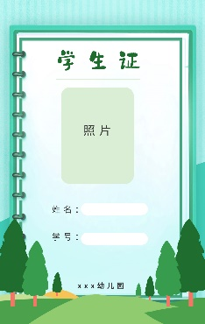
Lead in
Let's speak English:
A: What’s this?
B: It’s a/an _______.
A: How do you spell it?
B: _______________.
A: Is this your _______?
B: Yes, it is. It’s mine.
/ No, it isn’t. It’s _____.

Slide 4
Presentation
Tommy lost many things. Can you talk about them and spell the words?
He lost ______________.
a baseball
a notebook
a ring
a computer game
an ID card
a watch
E.D. School
Student
No. 118
What should he do?

Slide 5
Presentation
2a Write the things you lose easily.
school ID card
watch
key
wallet(钱包)
schoolbag
pen
ruler
eraser
notebook …

Slide 6
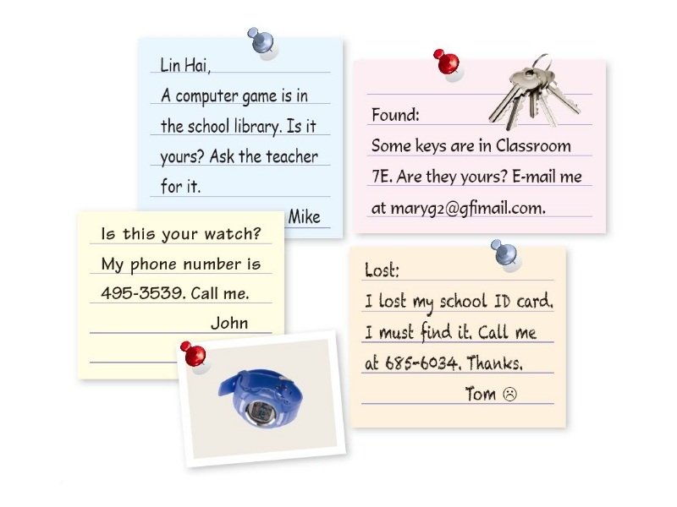
Presentation
Some students are reading the notices on the board.
The notices are about the things students lost and found. Let’s have a look.
How many notices can you see?
Lost and found

Slide 7
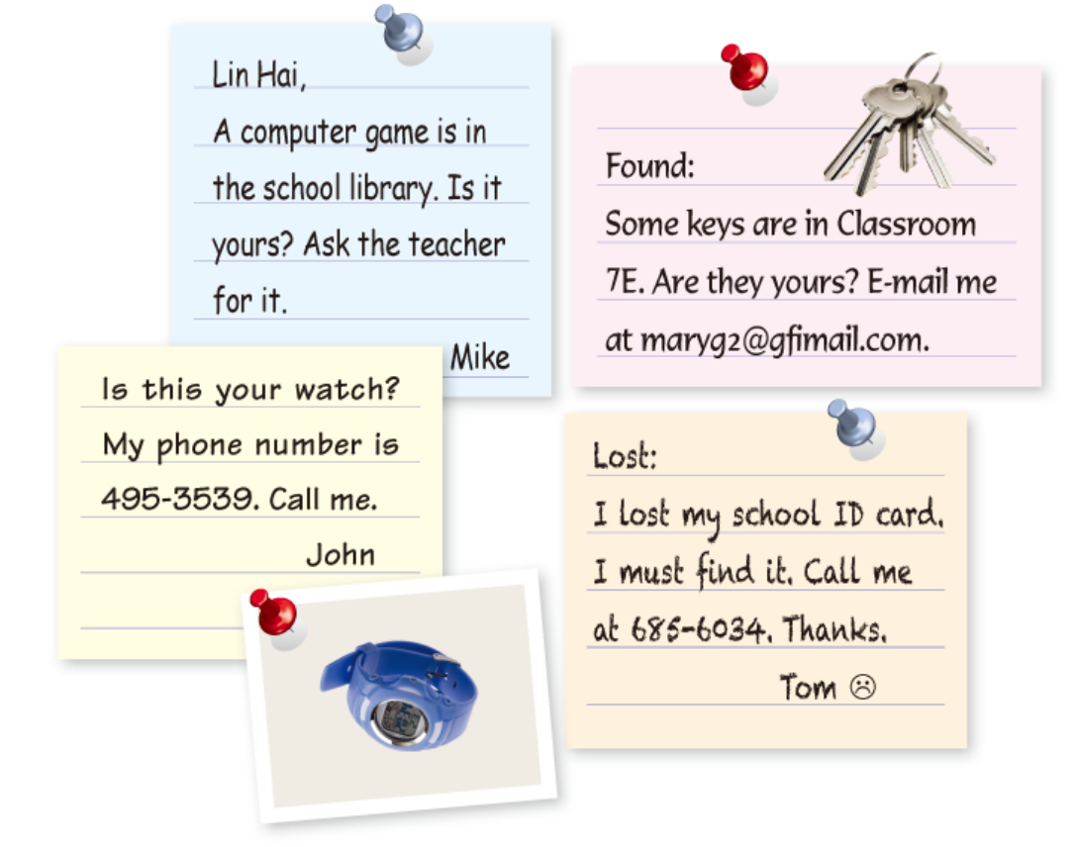
Presentation
How many notices are there?
What kind of notice is it?
Four.
a found
notice
a found
notice
a lost notice
a found
notice

Slide 8
Presentation
How do you know that?
a found
notice
a found
notice
a found
notice
a lost notice

Slide 9
Presentation
2b Read the notices on the board and circle the lost things.
ask for
寻求；要求
ask sb. for sth.
向某人要某物
ask sb. to do sth.
要求某人做某事
Is this your watch?
My phone number is 495-3539. Call me.
John
Lin Hai,
A computer game is in the
school library. Is it yours？
Ask the teacher for it.
Mike
find 找到； 发现
强调“找到”这一结果。
look for寻找
强调“寻找”这一动作。
Found:
Some keys are in
Classroom 7E.
Are they yours? E-mail me
at maryg2@gfimail. com.
Lost:
I lost my school ID card. I must find it. Call me at 685-6034. Thanks.
Tom
call sb. at +电话号码
拨打电话……找某人
call sb. 给某人打电话
give sb. a call 给某人打电话

Slide 10
Presentation
Read the notices, can you match the items with the people?
John
Tom
Mary
Mike

Slide 11
Presentation
Read the notices and fill in the blanks.
1. _______ lost the computer game.
2. Mike found the computer
game in the _________.
3. Lin Hai can ask the _______
for his computer game.
4. John found the ______.
5. John’s phone number is__________.
Lin Hai
library
teacher
watch
495-3539

Slide 12
Presentation
Read and answer
1. Who lost the computer game?
2. Who found the computer game?
3. Where is the computer game?
4. What are in Classroom 7E?
5. Who found the watch?
6. What did Tom lose?
Lin Hai.
Mike.
It is in the school library.
Some keys.
John.
His school ID card.

Slide 13
Presentation
2c Read the notices again and write down the items. Then check (√ ) Lost or Found.
Item Lost Found
______________
______________
______________
______________
ID card
√
watch
√
keys
√
computer game
√

Slide 14
Presentation
According to 2b, first fill in the blanks and then make conversations to find lost things like this.
A: Excuse me, is this your _______?
B: No, it isn’t.
A: Are these keys ______?
B: Yes, they are. They are _____.
A: Here you are.
B: Thank you _____ your help.
A: You are welcome.
watch
yours
mine
for

Slide 15
Language points
1. ask. . . for. . . 请求；恳求 （给予）
eg: Ask the teacher for help. 向老师求助吧。
Ask Jack to help you. 让杰克帮你。
(1) ask为动词，意为“询问；问”，ask. . . for. . . 意为“请求；恳求 （给予）”， 固定短语。
(2) ask sb. to do sth. “让某人做某事”。

Slide 16
Language points
1. Please ask Tom here.
A. come B. comes
C. to come D. coming
2. If you need, you can ask me _______ help.
A. to B. for C. from D. in

Slide 17
Language points
2. Call me at 685-6034. 拨打685-6034找我。
这是以动词原形开头的祈使句。
call sb. at +电话号码，意为“拨打……找某人”。
eg: Please call me at 13170656612.
请拨打电话13170656612与我联系。
call的常见用法
call sb. 给某人打电话
give sb. a call 给某人打电话
call+电话号码 拨打……号码

Slide 18
Language points
1. Please call if there is a fire (火灾) .
A.119 B. at 119
C. in 119 D. on 119
2. Is this your watch in the lost and found case?
Call Mary 999-9789.
A. on B. for C. in D. at

Slide 19
Language points
3. find 找到； 发现
eg: I can’t find my ruler.
我找不到我的尺子了。
He finds an eraser on his desk.
他在课桌上发现了一块橡皮擦。
find是动词， 意为“找，发现”，后跟代词、名词等。强调“找到”这一结果。

Slide 20
Language points
I can’t my eraser. Can you help me?
A. look B. look for
C. find D. found

Slide 21
Exercise
连词成句。
1. my watch, lost, I (. )
__________________________________
2. computer game, this, is, your (? )
__________________________________
3. these, your keys, are (? )
__________________________________
I lost my watch.
Is this your computer game?
Are these your keys?

Slide 22
Exercise
根据汉语提示填单词。
1. You ________（必须）learn English hard.
2. Linda ________（丢失）her eraser yesterday.
3. There are two ____________（图书馆）in my town.
4. You can _________（发电子邮件）him at jack2003@qq.com.
must
lost
libraries
e-mail

Slide 23
Homework
1. Do the exercises in students’ book.

