Slide 1
Unit 2
How often do you exercise?

Slide 2
Section B
(3a-Self check)

Slide 3
自主学习案
翻译下列词组。
1高中生___________________
2看电视超过两个小时___________________
3超过 ___________________
4八个或者更多___________________
5看牙医___________________
6通过用互联网放松___________________
7坏习惯___________________
8别担心___________________
9 喝果汁 ___________________
10 不到六天 ___________________

Slide 4



Lead in
Talk about your good habits.
I read English books every day.
I always exercise.
I usually help with the housework.

Slide 5
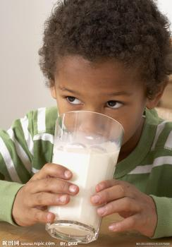
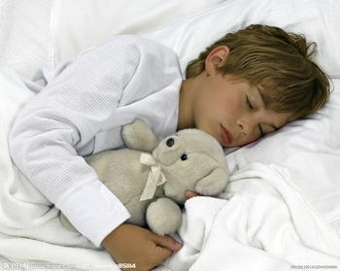
I drink milk every day.
I never stay up late.

Slide 6


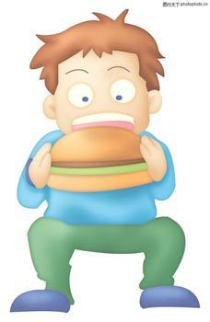
Talk about your bad habits.
I watch TV for over two hours every day.
I use the Internet every day.
I often eat hamburgers.

Slide 7
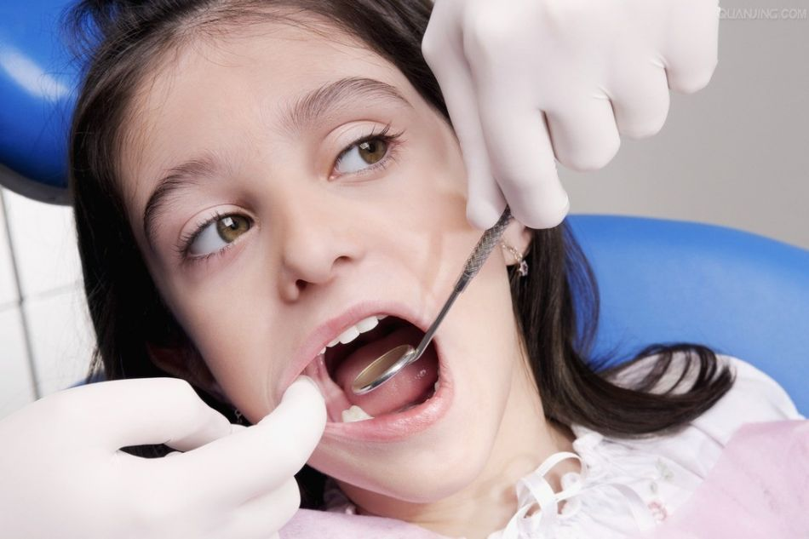
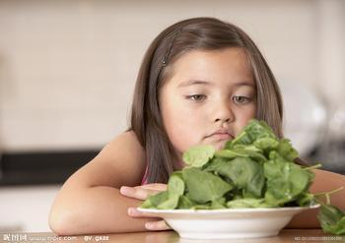
I hardly ever go to the dentist (看牙医).
I don’t like vegetables.

Slide 8
New words
1. however adv. 意为“然而，可是”，表示转折关系，可放在句首、句中或句末。
e.g. I was hungry, however, she gave
me some water.
我很饿，但她却给了我一些水。
My father, however, didn’t drive
there.
可是我父亲没有开车去那里。

Slide 9
2. more than 意为“多于”，相当于over; 其反义词为less than ，意为“少于” 。
e.g. It never takes more than/over half
an hour to get to school.
到达学校用时从未超过半小时。
They’ll stay there for less than three
days.
他们会在那里呆不到三天。

Slide 10
3a
Look at the information in the chart and complete the report.
Activities | Days a year
Exercise Read books Watch TV for over 2 hours Drink juice | 365 365 320 210
Eat hamburgers Help with housework Stay up late Go to the dentist | 95 20 15 0

Slide 11
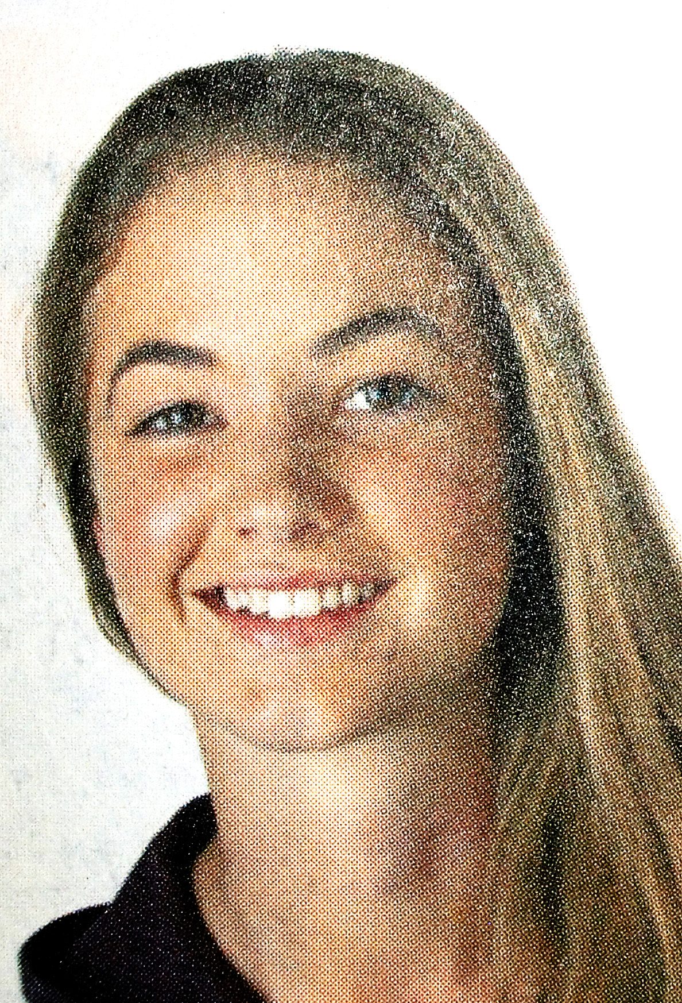
Jane is a 16-year-old high
school student in the United
States. American Teenager magazine asked her about her habits. Jane has a lot of good habits. She always exercises and she reads books ________. Also, she _______ drinks juice and she __________ stays up late.
every day
usually
hardly ever

Slide 12
However, she has some bad habits, too. She _______ watches TV for more than two hours a day, and she __________ eats hamburgers. Her parents are not very happy because she __________ helps with housework and she ______ goes to the dentist for teeth cleaning. She says she is afraid!
always
sometimes
hardly ever
never

Slide 13
3b
Complete the chart with your own information. In the last column, use expressions like always, every day, twice a week and never.
Habits | Activities | How often?
Good habits | Exercise Read books Eat fruit Drink milk Stay up late
every day
always
every day
twice a week
never

Slide 14
Habits | Activities | How often
Bad habits | Watch TV for over 2 hours Use the Internet Eat hamburgers Help with housework Go to the dentist
always
twice a week
often
hardly ever
never

Slide 15
Writing
3c
Write a report about your good and bad habits. Say how often you do things. Use the report in 3a as an example.
________________________________________
________________________________________
________________________________________
________________________________________

Slide 16
写作指导
本文为写自己日常生活中的好习惯与坏习惯。因此，应用一般现在时态。
首先，应在将自己的好坏习惯列个清单，标明自己做这些事情的频率。
然后，依次将这些事情完整地表达出来。
最后，通读一遍自己的文章，看有没有错误的地方。

Slide 17
One possible version:
I have lots of good habits. I exercise every day. I always read books. I eat fruit every day. I drink milk twice a week. I never stay up late. But I have some bad habits, too. I always watch TV for two hours a day. I use the Internet twice a week. I hardly ever help with housework. I never go to the dentist.
Now, it’s your turn. Try your best.

Slide 18
Group work
Take the health quiz. Compare your results with your partner’s. Who’s healthier?
4
How often do you eat breakfast?
Almost every day.
A few times a week.
How often do you eat fast food?

Slide 19
How often do you eat vegetables and fruit?
A few times a week.
How often do you exercise?
A few times a month.

Slide 20
How many hours do you watch TV every week?
Five or more.
Less than six.
How many hours do you usually sleep at night?

Slide 21
Now look at the charts in Page 16 and check the points:
题号 | 1 | 2 | 3 | 4 | 5 | 6 | 总分
得分 | 2 | 1 | 1 | 1 | 0 | 0 | 5
Look at the first chart. It says:
4-8 points: You’re smart about health most
of the time.
Well. Now do it with your partners.

Slide 22
Complete the chart with activities you do and don’t do. What about your mother/father?
Self Check
 | I | My mother/father
always
usually
often
sometimes
hardly ever
never
play basketball
play chess
read books
read newspapers
eat hamburgers
eat chicken
drink juice
drink tea
watch TV
use the Internet
stay up late
get up early

Slide 23
Writing
Write five sentences using
the information above.
1. I always play basketball after school.
2. My father always plays chess on weekends.
3. I usually read books on weekends.
4. My father sometimes drinks tea.
5. I hardly ever watch TV.
6. My father never gets up early.

Slide 24
Fill in the blanks in the conversation.
A: What do Tom and Mike ________ do on weekends?
B: They sometimes go to the museum.
A: _________ do they go to the shopping center?
B: ______ ever. Maybe about twice a month.
usually
How often
Hardly

Slide 25
A: _________ do they watch TV?
B: Mike never watches TV, but Tom watches TV _______________ a day.
A: Oh, I’m just like Tom. I ______ watch TV, too.
How often
over two hours
never

Slide 26
Homework
Do a survey in your family using the questions and charts in Part 4.
Do exercises in the workbook.

Slide 27
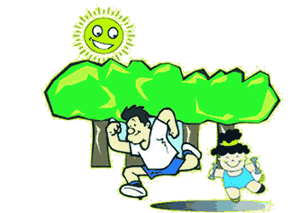
记住好好锻炼身体哟！
Thank you!

