Slide 1

Unit 9
Can you come to my party?

Slide 2
Ask and answer
Can you/he /she /they …?
Now look at the picture and answer the questions.

Slide 3
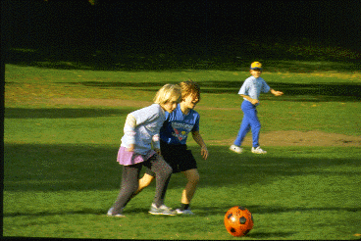


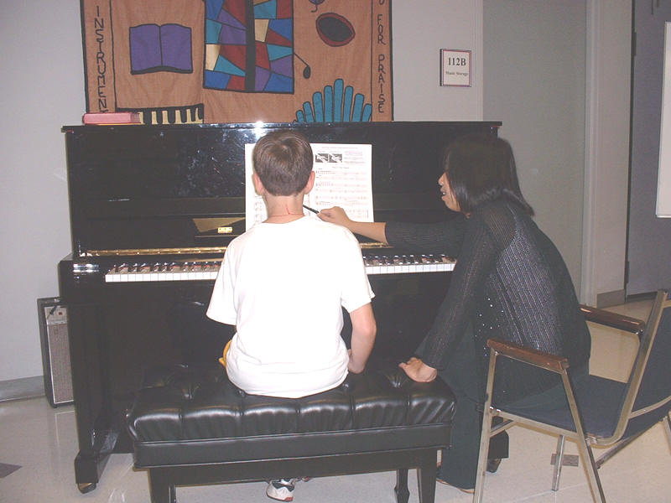
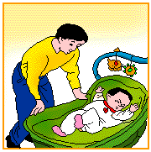

Slide 4
Do you know how to use the word “can”?
Can 是情态动词，“能，能够”。
1：表示某人具有做某事的能力
Put the sentences into English.
你会游泳吗？
Can you swim?
是的，我会。
Yes, I can.
很抱歉， 我不会。
Sorry/no. I can’t
你会干什么呢？
What can you do?

Slide 5
can 可以用来表示请求。=may
Put the sentences into English.
现在我可以回家吗？
May I go home now ？= can I go home now ?
当然可以了。
Of course/ Sure / Certainly, you can.
很抱歉，你不能。
Sorry，you can’t . / Sorry, you mustn’t.

Slide 6
Today is my birthday, I will have a party. And I want to invite ( 邀请） somefriends to my party.
Can you come to my party?
Would you like to come to my party?
Can you tell me how to invite sb?
can和would like 可以用来表示邀请。

Slide 7
她能和我们一起去看电影吗？很抱歉， 她不能，她要去购物。
A:Can she go to the movies with us ?
B: sorry,/ NO. she can’t . She is going to
shopping.

Slide 8
Sorry, I/ he / she / we… can’t . 提出理由。
也可以用no 直接回答。
1:I’m sorry, I can’t. I have to look after my grandmother.
I have a piano lesson.
I am going shopping with my friend.
3:I’d love to ,but I have to …

Slide 9
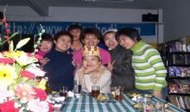
Can you come to my party?
sure, I’d love to.
Of course ,I’d love to.
Certainly, I’d like to.
go to the party

Slide 10
Can you play football with us?
Sure , I ’d love to.

Slide 11
Can you play tennis with us?
Sure , I ’d love to.

Slide 12

go to the movies
do homework
A: Can you go to the movies?
B:( I’m) sorry, I can’t. I have to do homework.
I’m sorry, I’m doing my home work.
I’d love to, but I have to do my homework.

Slide 13
Can you go camping tomorrow?
Sorry, I can’t . I have to have a piano lesson.
Sorry, I can’t . I’m having a piano lesson.
I’ d love to, but I …

Slide 14
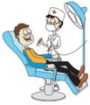
A: Can you go to the party?
B: Sorry, I can’t . I have to go to see a dentist.

Slide 15
Can he go to the party?
No ,he can’t. He has to babysit his brother.
Sorry, he can’t . He is babysitting his brother.
He’d love to. But he …

Slide 16
Can he come to the party on Monday?
No, he can’t. He has to study for a test.

Slide 17
Can you make some conversations with your partners?

Slide 18
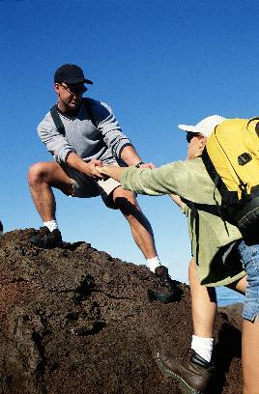
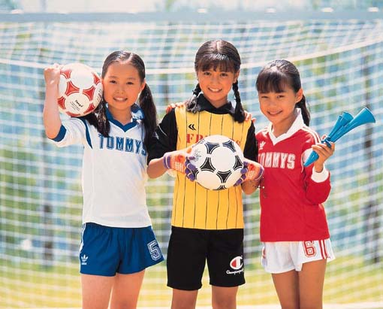
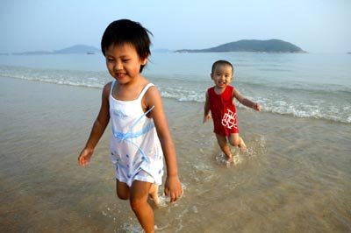
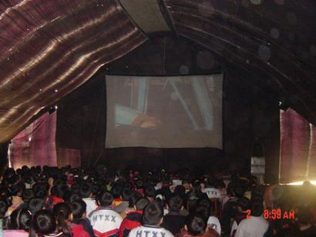
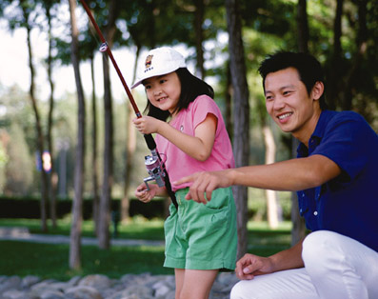
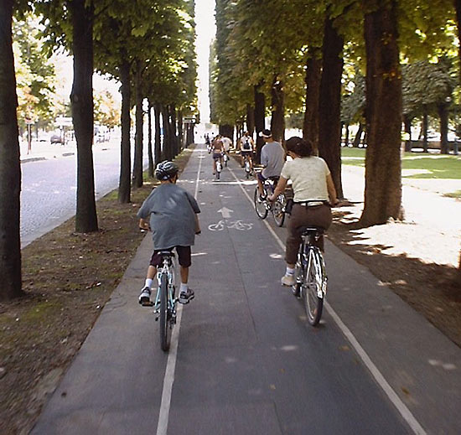
Can you go to the party on Monday?

Slide 19
have to do sth.
Put the sentences into English.
她不得不乘公共汽车去上学。
She has to go to school by bus.
如果你生病的话，你得怎么办。
What do you have to do if you are ill?
昨天，我得学习，为数学考试做准备。
I had to study for the math test yesterday.
今天下午她不必来。
She doesn’t have to come this afternoon.

Slide 20
每天你得做作业吗？
Do you have to do your homework ?
探究总结
1：have to 后面加动词原形，表示客观的必须，不得不。
2：在一般现在时中，当主语是第三人称单数时，要用has to, 其余人称用have to；一般将来时中用will have to一般过去时中用had to。
have to 的疑问及否定形式借助助动词do, does，在过去时态中要借助did。

Slide 21
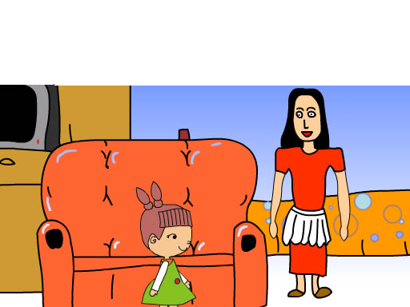

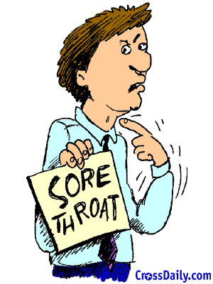
What do you have to do on weekends?
I have to …
visit my aunt
help my parents
study for a test
go to the doctor
have a piano lesson

Slide 22
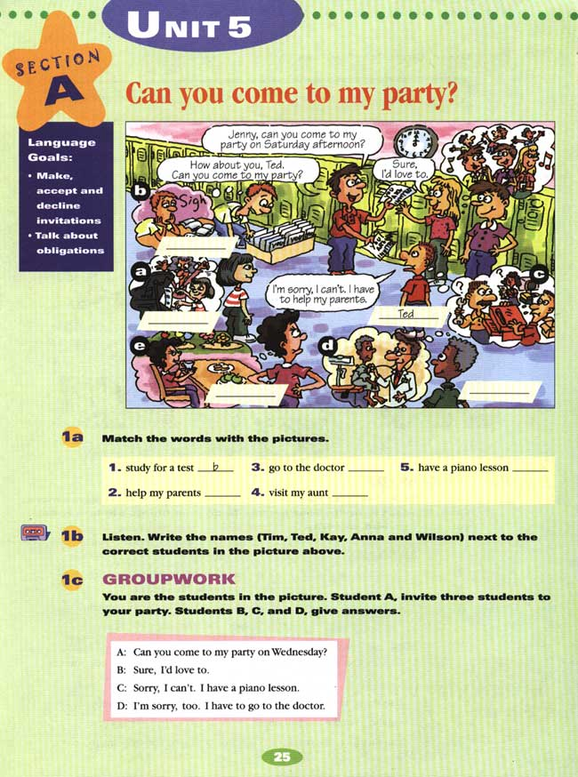
d
a
c
e

Slide 23
1B: listen and write the names
( Tim, Ted, Kay, and Wilson)

Slide 24
Tim
Kay
Anna
Wilson

Slide 25
SN: Hey, Ted. Can you come to my party on Saturday afternoon?
Ted: I’m sorry, I can’t, Sun Ning. I have to help my parents.
SN: Too bad. How about you, Carlos? Can you come to my party?
Carlos: I’d love to.
SN: Tim? Can you come to my party?
Tim: When is it?
SN: Saturday afternoon.
Tim: Oh, no, I can’t. I have to study for a test.
SN: What about you, Wilson?
Wilson: Sorry, I have to go to the doctor.
SN: Anna, can you come?
Anna: I can’t, Sun Ning. I have to visit my aunt.
Kay: I can’t either, Sun Ning. I have a piano lesson.
SN: That’s too bad, Kay. Oh, maybe next time. What a small
party!

Slide 26
Group work
A: Can you come to my party on
Wednesday?
B: Sure, I’d love to.
A: Can you come to my party?
C: Sorry, I can’t. I have a piano lesson.
A: Can you come to my party?
D: I’m sorry, too. I have to go to the doctor.

Slide 27
Make an invitation
Can you come to my party?
Would you like to come to my party?
Accept ion（接受 ）
Declination（拒绝）
Yes, I’d love/like to.
Certainly, I’d love/like to.
Sure, I’ d love/like to.
I’m sorry, I can’t. I have to…
(play the piano…)
I’d love to,but I have to…
(go to the doctor…)

Slide 28
Now , please make some conversations according to the pictures In 1a.
Make some conversations with your friends.

Slide 29

Thank you for listening.

