Slide 1
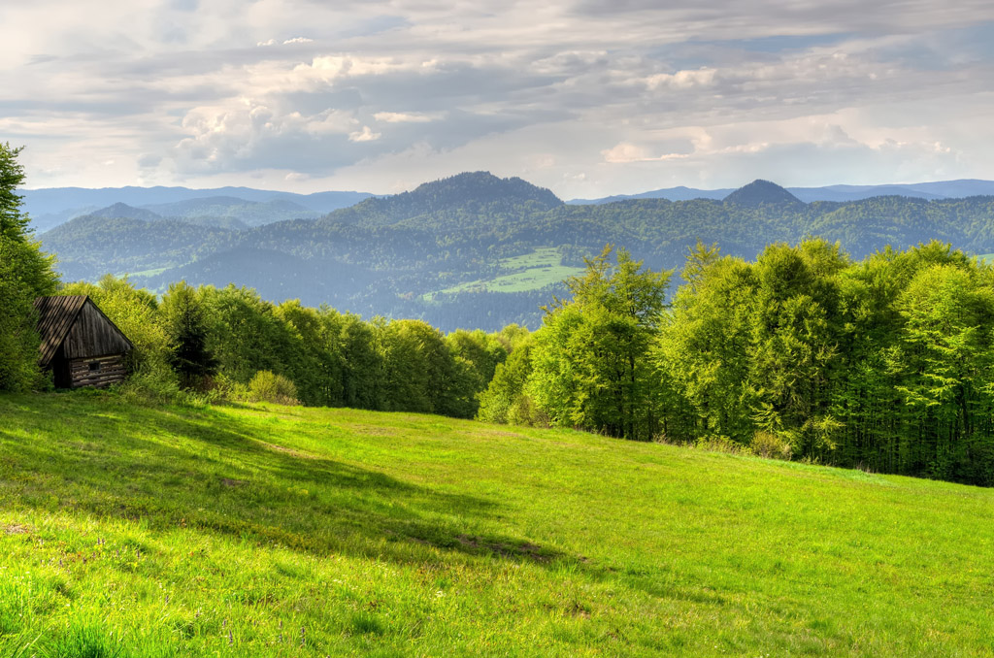
Unit 5
Into the unknown

Slide 2
单
元
主
题
语
境
人与自然——大自然的难解之谜
Nature is full of mysteries,even unexplained mysteries.In the face of mystery,we are excited,curious,eager to know everything.
大自然充满了奥秘，甚至是一些难解之谜。面对神秘，我们兴奋，我们好奇，我们想探 知一切。

Slide 3
话题导入
One of the greatest mysteries on the Earth is the statues(雕像) standing on Easter Island¹.Easter Island is one of the most remote islands on the Earth.It is in the southern Pacific Ocean,2,300 miles west of the coast of Chile and 2,500 miles southeast of Tahiti.
Who built these statues and why and how did they get there? Nobody knows the answer for sure，but many are trying to find it out.It has even been suggested that space aliens may have played a role regarding the statues.There are also other theories about them.

Slide 4
One theory suggests that Easter Island was occupied by Polynesian sailors，who traveled thousands of miles in their canoes(独木舟)，guided by the stars² and the birds making flights out to look for food.They first arrived on the island in 400 AD.However，they were trapped by the current(洋流).
The Easter Islanders had their own system of writing，different from any other in the world.No other Pacific Islanders knew how to write.Who taught the Easter Islanders how to write，or did they develop their own system?
In brief，Easter Island continues to be one of the world’s greatest unexplained mysteries.

Slide 5
靓句运用于写作
1.We will play against the team coming from Hong-xing High School.
(2019·全国Ⅱ，书面表达)
2.I would be happy to see you at the welcome ceremony，dressed in traditional Chinese dress.(2019·江苏，书面表达)

Slide 6
内容索引
Period One Starting out & Understanding ideas—Comprehending
读前清障 识记单词 快速顺畅阅读
语篇理解 精读演练 萃取文本精华

Slide 7
读 前 清 障
识记单词 快速顺畅阅读
品句猜词——请预读下列课文原句，并猜测句中加颜色词汇的意思。
1.Intrigued by Maya civilisation from a very young age,15-year-old Canadian William Gadoury thought he had made an incredible discovery from his study of ancient star charts. _______________ _____
2.Based on this，he believed he had spotted an unknown Maya city buried deep in the jungle. _______________
3.The fact that Maya society was technologically primitive makes its achievements all the more incredible and mysterious. _______
4.But the greatest mystery of all is what caused the Maya to abandon most of their great cities. ____________
激起……的兴趣
文明
将……埋在下面
神秘的
离弃，逃离

Slide 8
5.Although his theory has been dismissed by scholars，it shows how powerful the secrets of Ancient Maya civilisation are among people. _______________
6.Some research seems to indicate that the Maya people themselves may have played a part in their downfall. _____
否定，拒绝考虑
衰败
返 回

Slide 9
语 篇 理 解
精读演练 萃取文本精华
Step 1 Fast-reading
1.What’s the main idea of the passage?
A.William Gadoury’s new discovery about the Maya civilisation.
B.A true writing system that the Maya people had created.
C.Some possible reasons why the Maya civilisation fell down.
D.How the Maya civilisation was formed.
√

Slide 10
2.Read the passage and match the main idea of each paragraph.
Para.1 A.Why Maya civilisation collapsed.
Para.2 B.A Canadian boy spotted an unknown Maya city buried deep
in the jungle.
Para.3 C.We should learn from the downfall of the Maya civilisation.
Paras.4－5 D.What caused the Maya to abandon their cities.
Para.6 E.Maya civilisation has been surrounded by mystery.

Slide 11
Step 2 Careful-reading
Read the passage carefully and choose the best answer.
1.Which of the following is TRUE about William Gadoury?
A.He found that the Maya created a true writing system.
B.He thought he had discovered an unknown city in the jungle.
C.He has a good command of the Maya characters.
D.He made a discovery about how the Maya built these impressive temples
and palaces.
√

Slide 12
2.What caused the downfall of the Maya civilisation?
A.Fighting between cities.
B.A serious disease.
C.A natural disaster.
D.Still unknown.
√

Slide 13
3.What do people know about the Maya writing system?
A.It is similar to the present writing system that Americans use today.
B.It contained more than 8,000 words and signs.
C.It is very complicated and hard to interpret.
D.Some words were used to represent animals，objects and syllables.
√

Slide 14
4.When did Maya civilisation reach its highest level?
A.Before 700 BC.
B.By 700 AD.
C.In the early 16th century.
D.At around 900 AD.
√

Slide 15
5.What achievement of the Maya makes us amazed?
A.They had a good knowledge of mathematics and astronomy.
B.They carved some beautiful paintings on stones.
C.They built some pyramids using only animal power.
D.They created the Maya calendar which was accurate to within 30
minutes.
√

Slide 16
Step 3 Post-reading
After reading the passage，please fill in the following blanks.
The Maya created great civilisation.They built many impressive temples and palaces without the use of modern 1. (equip).They also invented their own calendar 2. was accurate to within 30 seconds per year,3._____
(use) their understanding of mathematics and astronomy.Their writing system was so complicated 4. no one has been able to interpret it completely.
equipment
which
using
that

Slide 17
5. ，only after a couple of generations，the Maya civilisation
6. (disappear) within the deep jungle，leaving 7. (vary) mysteries for later people 8. (solve).Some scientists believe that the droughts were the main reason why it collapsed.The droughts led to food
9. (shortage)，conflicts and 10. (ultimate)，the downfall of the cities.
However
disappeared
various
to solve
shortages
ultimately

Slide 18
Step 4 Sentence-learning
1.Intrigued by Maya civilisation from a very young age,15-year-old Canadian William Gadoury thought he had made an incredible discovery from his study of ancient star charts.
[句式分析] 该句为复合句。Intrigued by Maya civilisation from a very young age在句中作 ，intrigued 与句子主语15-year-old Canadian William Gadoury为 关系，所以用过去分词形式；he had made an incredible discovery from his study of ancient star charts为省略了that的____
从句。
[自主翻译] _______________________________________________________
__________________________________________________________________
状语
动宾
宾语
从很小的时候就对玛雅文明感兴趣，15岁的加拿大男孩William Gadoury认为自己从对古代星象图的研究中有了一个惊人的发现。

Slide 19
2.What is most extraordinary about these complex structures is how they were built without the use of wheels，metal tools or even animal power.
[句式分析] 该句为一个主系表结构的简单句。名词性从句What is most extraordinary about these complex structures在句中作 ；how引导的部分为表语。
[自主翻译] _______________________________________________________
________________________________
主语
那些复杂的建筑结构最不同寻常的是，它们是怎样在没有轮滑、金属工具甚至畜力的情况下建造的。

Slide 20
3.It contained more than 800 characters，with some signs representing animals，people and objects and others representing syllables.
[句式分析] 该句为一个复合句。with some signs representing animals，people and objects and others representing syllables是with的复合结构作 ，修饰characters；signs 与represent之间存在逻辑上的 关系，所以用动词的-ing形式。
[自主翻译] _______________________________________________________
_______________
定语
主谓
它含有800多个字，还有一些符号代表动物、人、物体等，其他符号代表音节。

Slide 21
4.The fact that Maya society was technologically primitive makes its achievements all the more incredible and mysterious.
[句式分析] 该句为一个复合句。The fact是主语，Maya society was technologically primitive为 ，解释说明fact 的内容；its achievements为宾语，两个形容词incredible 和mysterious为 。
[自主翻译] _______________________________________________________
___________________________
同位语从句
宾语补足语
事实上，玛雅社会在技术上是比较原始的，这使得它的这些成就更加难以置信，更加神秘。

Slide 22
5.Its once-great cities fell into ruin，leaving various mysteries for later people to solve.
[句式分析] 该句为一个复合句。Its once-great cities fell into ruin为主句，leaving various mysteries for later people to solve为现在分词短语在句中作__
，表示一种 的结果。
[自主翻译] _______________________________________________________
______
结
果状语
自然而然
它曾经的大城市荒废了，留下了各种各样的谜团等待后人去解决。
返 回

Slide 23
本课结束

