Slide 1
Unit 2
How often do you exercise?

Slide 2
Section B
(1a-1e)

Slide 3
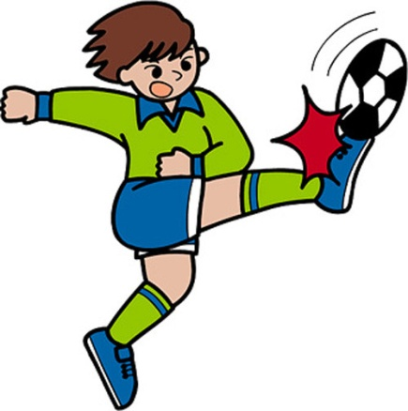
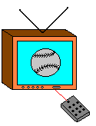
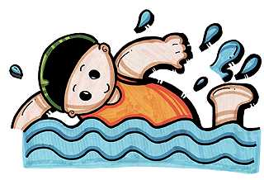
Revision
Li Ming/ twice a week
Tony/ 3 or 4 times a week
Jim / once a week
Bob /every day
Peter/ never
Li Lei/ hardly ever

Slide 4
Lead in
How can we be healthy?
Exercise often and eat healthy food.
Well. Fruit, vegetables, milk, rice and meat.
Could you tell us some healthy food?

Slide 5
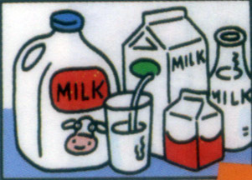
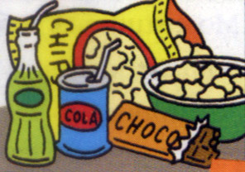
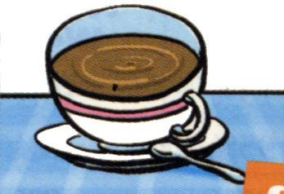
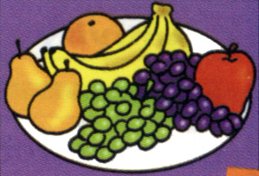
1a
Match the words with the pictures below.
1. ___ junk food 3. ___ fruit 5. ___ sleep
2. ___ milk 4. __ vegetables 6. ___ coffee
b
e
f
a
c
d
b
c
a
e
f
d

Slide 6
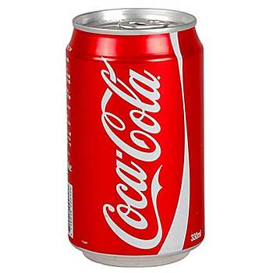
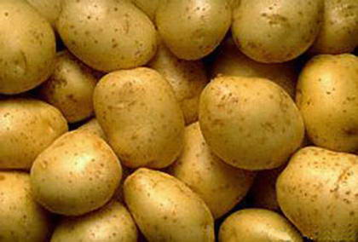
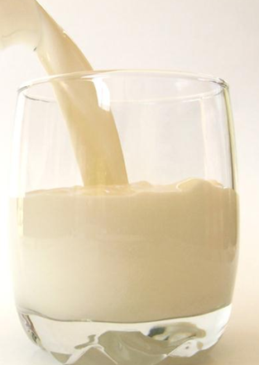
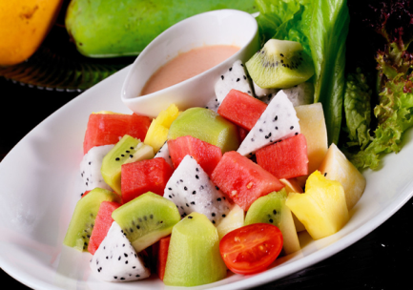
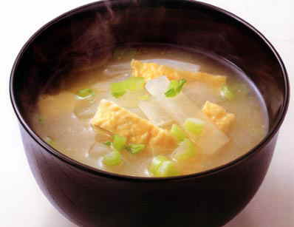
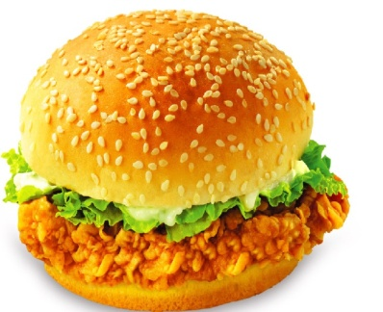
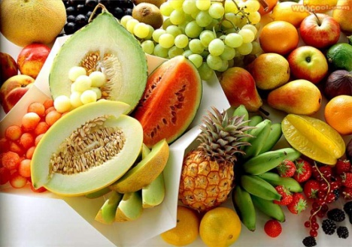
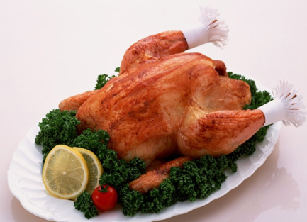
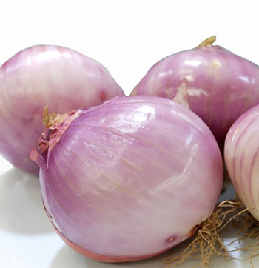
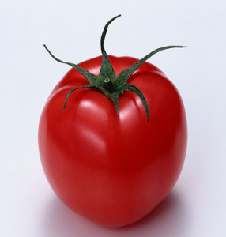
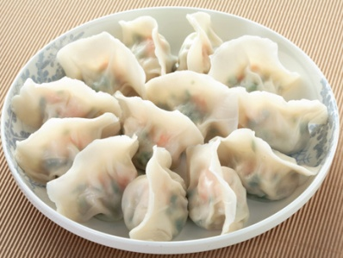
cola, salad, soup, hot dog, milk, hamburger, dumpling, fruit, chicken, onion, potato, tomato
healthy:
unhealthy:

Slide 7
healthy:
unhealthy:
salad, soup, milk, dumpling, onion, fruit, chicken, potato, tomato
cola, hot dog, hamburger

Slide 8
be good for 对……有好处
e.g. Milk is good for our health.
牛奶对我们的健康有好处。
be bad for 对……有坏处
e.g. Hot dog is bad for our health.
热狗对我们的健康有坏处。

Slide 9
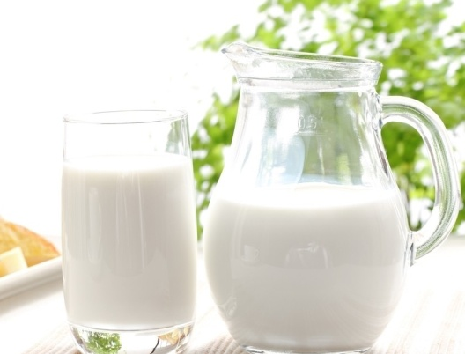
1b
Ask and answer questions. Use the words from 1a.
How often do you drink milk, Liu Fang?
I drink milk every day.
No. But my mother wants
me to drink it. She says it’s good for my health.
Do you like it?

Slide 10
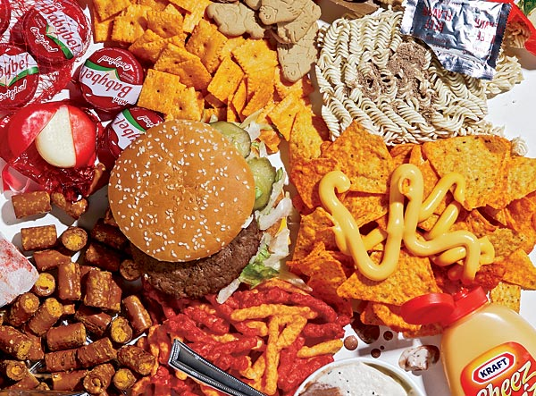
Pair work
How often do you eat junk food?
I eat it once a week.
Yes. But my mother doesn’t let me eat it. She says it’s bad for my health.
Do you like it?

Slide 11
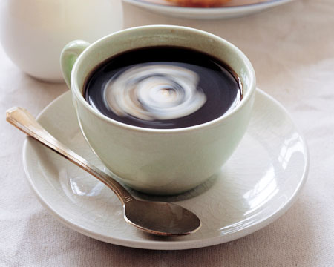
How often do you drink/eat…?
I eat …
…
Do you like …?

Slide 12
Listen to an interview about two people’s daily habits. Circle your answers to each question.
Listening
1c
Does Tina have good habits?
Yes. No. I don’t know.
Does Bill have good habits?
Yes. No. I don’t know.

Slide 13
Listen again. Fill in the blanks in the survey.
1d
Questions
1. How often do you exercise?
2. How often do you eat fruit?
3. How many hours do you
sleep every night?
4. How often do you drink
milk?
5. How often do you eat junk
food?
6. How often do you drink
coffee?
Tina Bill
_______ _____
_______ _____
_______ _____
_______ _____
_______ _____
_______ _____
every day

Slide 14
Answers
1. How often do you exercise?
2. How often do you eat fruit?
3. How many hours do you sleep every night?
Tina: every day Bill: hardly ever
Tina: every day Bill: never
Tina: nine Bill: nine

Slide 15
4. How often do you drink milk?
5. How often do you eat junk food?
6. How often do you drink coffee?
Tina: every day Bill: never
Tina: two or three times a week
Bill: three or four times a week
Tina: never Bill: four times a day

Slide 16
1e
Student A is the reporter. Student
B is Tina or Bill. Ask and answer questions. Then change roles.
I exercise every day.
How often do you exercise?
And how often do you …?

Slide 17
Pair work
I never exercise.
How often do you exercise?
How often do you eat fruit?
I never eat fruit.
…
…

Slide 18
Homework
1. 读1b中的短文。
2. 根据1e的调查结果写一个报告。

Slide 19
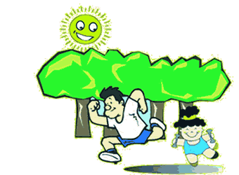
记住好好锻炼身体哟！
Thank you!

