Slide 1
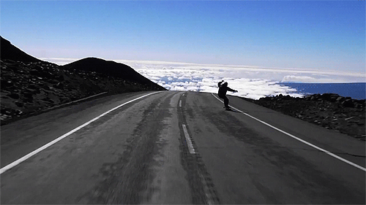
Unit 2
How often do you exercise?
Unit 2
How often do you exercise?
Section B (2a-2e)

Slide 2
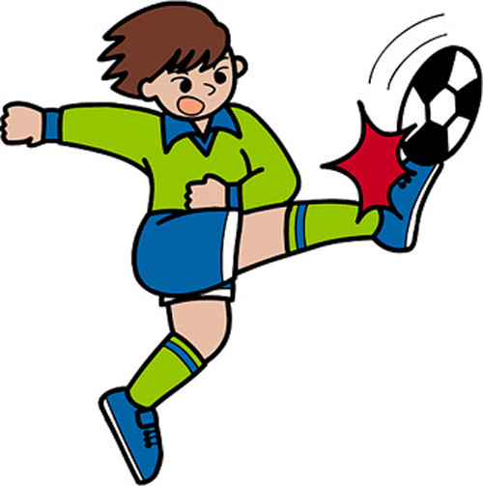
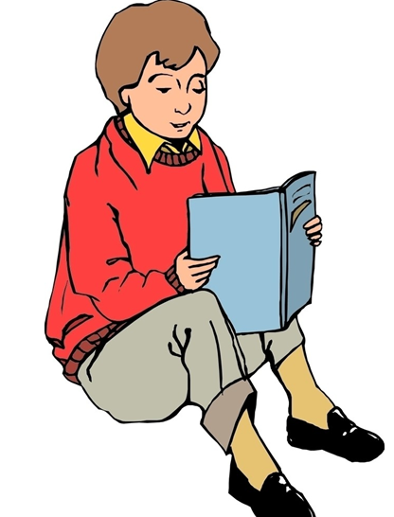
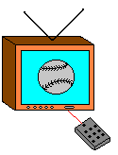
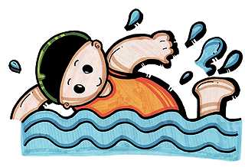
Review
Tony/3 or 4 times a week
Li Ming / twice a week
Jim/once a week
Bob/every day
Peter/never
Lilei/hardly ever

Slide 3
自主学习案
翻译下列词组。
1.去乡村野营___________________
2.15%的学生___________________
3.上线，登互联网 ___________________
4.用它为了好玩___________________
5.问题的答案___________________
6.通过用互联网放松___________________
7.一周四到六次___________________
8.积习难改___________________
9. 一起玩 ___________________
10 .例如 ___________________

Slide 4
2b Read the article
What Do No.5 High School Students Do in Their Free Time
Last month we asked our students about their free time activities. Our questions were about exercise, use of the Internet and watching TV. Here are the results.
We found that only fifteen percent of our students exercise every day. Forty-five percent exercise four to six times a week. Twenty percent exercise only one to three times a week. And twenty percent do not exercise at all!
We all know that many students often go online, but we were surprised that ninety percent of them use the Internet every day. The other then percent use it at least three or four times a week. Most students use it for fun and not for homework.

Slide 5
The answers to our questions about watching television were also interesting. Only two percent of the students watch TV one to three times a week. Thirteen percent watch TV four to six times a week. And eighty-five percent watch TV every day! Although many students like to watch sports, game shows are the most popular.
It is good to relax by using the Internet or watching game shows, but we think the best way to relax is through exercise. It is healthy for the mind and the body. Exercise such as playing sports is fun, and you can spend time with your friends and family as you play together. And remember, “old habits die hard”. So start exercising before it’s too late!

Slide 6
Reading
Read the passage quickly and find the answers to the questions below.
2b
How many kinds of free time activities are mentioned in the passage?
_______________________________
2. What is the best way to relax?
__________________________________
Three.
The best way to relax is through exercise.

Slide 7
Read the passage carefully and complete the pie chart below.
______ %
every day
10
15
______ %
3 or 4 times a week
20
______ %
no exercise
20
______ %
1-3 times
a week
45
90
______ %
4-6 times a week
______ %
every day
Exercise
Use the Internet

Slide 8
13
______ %
4-6 times a week
______ %
1-3 times a week
2
______ %
every day
85
Watch TV

Slide 9
Read the article again and answer the questions.
2c
1. How many percent of the students do not exercise at all?
__________________________________
2. How many percent of the students use the Internet every day?
__________________________________
Twenty percent of the students.
Ninety percent of the students.

Slide 10
3. How often do most students watch TV?
_________________________________
What do they usually watch?
_________________________________
4. What does the writer think is the best way to relax?
_______________________________
Why?
__________________________________
Every day.
They usually watch sports, game shows.
Exercising.
It’s healthy for the mind and the body.

Slide 11
5. Do you think the students in No. 5 are healthy?
_________________________________
Why or why not?
_________________________________
_________________________________
_________________________________
No, I don’t think so.
Because most students use the Internet or watch TV on their free time. They don’t like exercising. It’s unhealthy.

Slide 12
5. Do you think the students in No. 5 are healthy?
_________________________________
Why or why not?
_________________________________
_________________________________
_________________________________
No, I don’t think so.
Because most students use Internet or watch TV on their free time. They don’t like exercising. It’s unhealthy.

Slide 13
According to the article and the pie charts, write sentences with the percentages using always, usually or sometimes.
2d
Ninety percent of the students always use the Internet.
1. 90%：__________________________
__________________________
2. 85%: __________________________
__________________________
3. 45%: ____________________________
___________________________
Eighty percent of the students always watch TV.
Forty-five percent of the students usually exercise.

Slide 14
Ten percent of the students sometimes use the Internet.
4. 10%: ____________________________
_____________________________
5. 13%: _____________________________
_____________________________
6. 2%: _____________________________
____________________________
Thirteen percent of the students sometimes watch TV.
Two percent of the students sometimes watch TV.

Slide 15
Language points
1. We found that only fifteen percent of our students exercise every day.
percent n. 意为“百分之……”。
e.g. Eighty percent of the students in
our class exercise every day.
我们班里80%的学生每天都锻炼。

Slide 16
【注意】
percent做主语时，谓语动词的数要根据其后面的名词来确定。
e.g. Fifty percent of the apples are bad.
50%的苹果都坏了。
Twenty percent of the meat is in the
fridge.
20%的肉都在冰箱。

Slide 17
2. And twenty percent do not exercise at all!
not … at all 意为“一点也不”， not应和be动词、助动词或情态连用。
e.g. The story isn’t interesting at all.
那个故事一点也没有趣。
They didn’t enjoy the vacation at all.
他们根本不喜欢那次旅行。
The old man can’t use the computer
at all.
那位老人一点也不会用电脑。

Slide 18
3. The answers to our questions about watch-
ing television were also interesting.
(1) 句子主语为 the answers ，谓语用 were。
(2) 表示“……的答案”要用“answer to…”。
e.g.There’s no easy answer to this problem.
这个问题没有简单的答案。
Her answer to your question is a big
“NO”!
她对你所提的问题的答案是一个大大
的“不”字！

Slide 19
(3) 表示“有关……的（问题）”用“question
about…”。
e.g.He asked us some questions about
our daily habits.
他问了一些有关我们日常习惯的问题。
Her questions about you were not so
friendly.
她有关你的那些问题并不那么友善。

Slide 20
4. Although many students like to watch
sports, game shows are the most popular.
although 连词，意为“虽然，尽管”。
注意：当表示“虽然……，但是……”时，
although和but不能在同一个句子中使用。
e.g. Although the car is old , it still runs
well.
=The car is old , but it still runs well.
这辆小车旧了，但是依然跑得不错。

Slide 21
[针对训练]
My cousin knows a lot about history, ______ he is only four years old.
A. because
B. so
C. although
C

Slide 22
5. Exercise such as playing sports is fun…
such as 意为“像……这样”，表示列举。
结构常为：名词+ such as + 例子
e.g. She likes animas such as rabbits
and birds.
她喜欢像兔子、小鸟这样的小动
物。

Slide 23
5. So start exercising before it’s too late!
(1) it’s too late 意思为“为时太晚，来不
及了”, 是英语的一个常用表达。
e.g.Now you know you are wrong , but
it’s too late.
你现在知道错了，但已经太晚了。
(2) it’s too late 与before共同组成从句，
表示“不要等到为时已晚,不要等到来
不及的时候,趁还来的及”。
e.g.You should work harder before it’s
too late to catch up.
你现在用功还赶得上。

Slide 24
Choose one of these free time activities or think of your own. Then ask your classmates how often they do this activity and make a pie chart.
2e
How often do you play sports?
One to three times a week.
Every day.
How often do you read
books?

Slide 25
Group work
How often do you…? | Number of classmates(总40)
1—3 times a week
4—6 times a week
every day
20
10
10

Slide 26
25
______ %
4—6 times a week
25
______ %
every day
______ %
1—3 times a week
50
Play sports

Slide 27
Saying
Early to bed,
early to rise,
makes a man healthy, wealthy and wise.

Slide 28
Exercises
I. 填空。
lthough
1. A he is tired, he studies
late every night.
2. I think the best way to relax is
t exercise.
3. The two good friends often walk home
t after school.
4. Fifty-one p of the students in
our school are girls.
5. I like many subjects s as Chinese,
math and art.
hrough
ogether
ercent
uch

Slide 29
翻译下列词组。
go camping in the country
1．去乡村野营
2．15％的学生。
3．一周四到六次
4．上线，登互联网
5．用它为了好玩
6．问题的答案
7．通过用互联网放松
8．例如，像
9．一起玩
l0．积习难改
fifteen percent of the students
four to six times a week
go online
use it for fun
the answers to the questions
relax by using the Internet
such as
play together
old habits die hard

Slide 30
Ⅱ. 单项选择。
1. She kept on working __ she was tired.
A. so B. because C. but D. although
2. Milk is good _____ our ______.
A. to; healthy B. to; health
C. for; healthy D. for; health
D
D

Slide 31
3.—I often have hamburgers for lunch.
—You'd better not. It's bad for you
____too much junk food.
A. eat B. to eat C. eating D. ate
4. Although they feel fired,___ they still
go on working.
A, and B. but C. / D. so
5. _________always use the Interact.
A. Ninety percent of the students
B. Ninety percent of the student
C. Ninety percents of the students
D. Ninety percents of the student
B
C
A

Slide 32
Ⅲ. 句型转换。
1. I sleep 8 hours every night.(对画线部分
提问)
_____ _____ ______ do you sleep
every night?
2. He watches TV twice a week.(对画线部分
提问)
_____ _____ _____ he watch TV?
How many hours
How often does

Slide 33
3. He is talking to his father.
(用usually改写句子)
He _______ _____ to his father.
4. My father often reads newspaper
after supper.(对画线部分提问)
_____ _____ _____ father often ____
after supper?
usually talks
What does your
do

