Slide 1
What were you doing when the rainstorm came?
Unit 5
R 八年级下册
Self Check

Slide 2
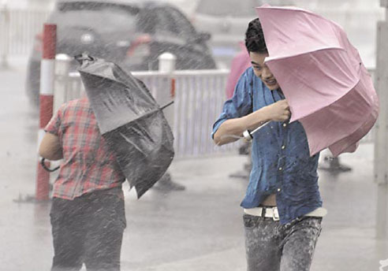
What were you doing when the rainstorm came?
I was making my way downtown.

Slide 3
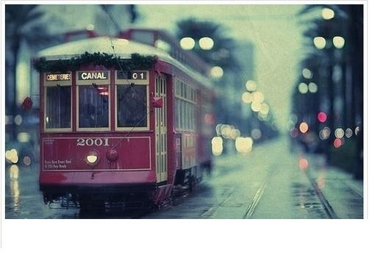
I was waiting for the bus.

Slide 4
I was in the library.

Slide 5
Self Check
1 Fill in the blanks with when or while.
1. ______ I was walking home from school, I saw a strange light in the sky. But ______ I pointed it out to my friend, it went away.
2. ______ I told my order brother about the strange light in the sky, he just laughed and didn’t believe me.
While
when
When

Slide 6
1 Fill in the blanks with when or while.
3. ______ my brother was laughing, the television news reported that other people had seen the light as well.
While

Slide 7
2 Fill in the blanks with the correct forms of the words in the brackets.
When I ___ (be) in the sixth grade, I _____ (join) a piano competition. I _____(practice) for four hours every day and my piano teacher ____ (come) three times a week to ____ (help) me. Then the big day finally _____ (arrive).

Slide 8
I ____ (be) so nervous when they ____ (call) my name. I _____ (go) up and _____ (start) to play. While I _____ (play), everyone _____ (sit) still and listened. I played the song without any mistakes. Then I ____(wait) for them to call out the winner.

Slide 9
2 Fill in the blanks with the correct forms of the words in the brackets.
When I _____(hear) my name, my heart ____(beat) so quickly I thought I would stop breathing. I couldn’t believe it. I ___ (win)! It ____(be) the happiest day of my life!

Slide 10
小结训练
1. Don’t go out, it is raining .
A. hardly B. heavily C. heavy D. big
2. He found a key on the ground and .
A. pick it up B. pick it out
C. picked up it D. picked it up
B
D

Slide 11
3. She doesn’t_____ staying at home alone.
A. want B. would like
C. feel like D. decide
4. You should believe in yourself.
Nobody else can _____ you.
A. win B. beat C. beats D. wins
C
B

