Slide 1
人教版必修第二册
Period 1 Listening & Speaking &Talking
Unit 1 Cultural Heritage

Slide 2
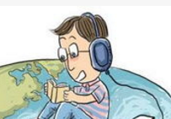
Part 1: Listening and Speaking Leading-in
What does the word “heritage” mean? Share your ideas about your understanding of it and you can use examples to illustrate your meaning.
Heritage means the traditional beliefs, values, customs, etc. of a family, country or society. For example, the Great Wall is the heritage of China.

Slide 3
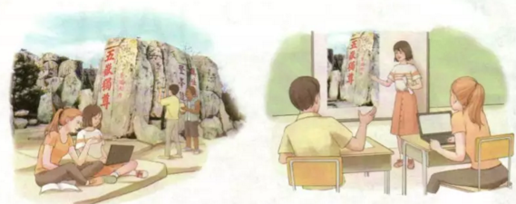
Before listening:
Prediction
Predict what the listening text is about by looking at the pictures.
The listening text is probably about how to protect a famous heritage site by some students

Slide 4
While listening: Play the tape, solve the following tasks. .
1. Listen to the conversation and sum up the main idea.
Youths from seven countries are working together to protect cultural relics on _______
Mount Tai.

Slide 5
While listening:
Play the tape again, answer the following questions.
International youth project,_________ high school students from 7 countries
Mount Tai, one of the most______________mountains in China
It has been_________________for more than 3,000 years.
22 temples, around 1 ,800_____________with writing on them
Dai Temple on____________; over 6,000_____________
23
famous
protected
stones
Mount Tai
steps

Slide 6
Learning Tip
Use context to guess words
To guess the meaning of new words, look at the other words and use what you know about the topic.

Slide 7
Step 2: While listening:
Guessing the meaning of the unknown words
Listen to the conversation again and use the context to guess the meaning of the words below. And tell the reasons why you guess so.
Preserve Promote
Preserve: to protect
Reason: the word means the same of a word I know.
Promote: to help sth to happen or develop
Reason: The word is explained by the speaker.

Slide 8
Talking Project
Work in pairs or groups and role play a conversation.
Suppose you are a reporter and interviewing the students who devote their time to protecting the heritage.

Slide 9
Reporter: It is said that you are one of the volunteers to preserve the pine trees on Mount Huang. What are you guys doing?
Volunteer: We are making some signs which are designed to educate people to protect the pine trees.
Volunteer: Besides, we took a lot of pictures of pine trees and create an app which aims to promote people’s awareness of protecting the precious trees.
Reporter: Sounds great and anything else?
Volunteer: We often wear volunteer clothes and send some brochures in the park to call on more people to protect the trees.
Reporter: Do your hard work pay off?
Volunteer: Definitely. More and more tourists are now stopping carving names on the trees or seldom take photos, climbing the trees.

Slide 10
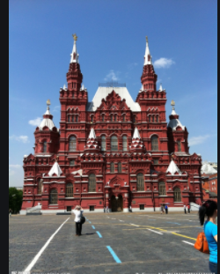
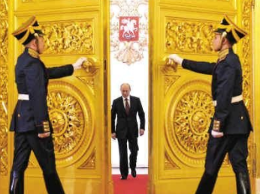
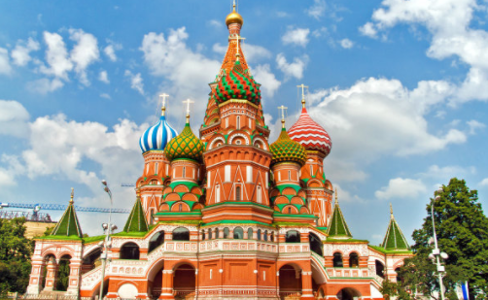
Part 2: Listening and Talking
What do you know about the Kremlin and Red Square?

Slide 11
Part 2: Listening and Talking
Listen to the conversation and choose the correct answers.
(1) .Where are the speakers?
On a street.
(2).What are they doing?
Sightseeing.

Slide 12
Part 2: Listening and Talking
What do you know about the Kremlin and Red Square? Listen again and complete the fact sheet.
World Cultural Heritage Site Fact Sheet
THE KREMLIN AND RED SQUARE, MOSCOW
●Built between the______ and ___________centuries
●The palace where______________ lives
●The Saint Basil's Cathedral looks like__________________
●The___________________ part of Moscow
●Place for parades, concerts, and even_________________
14th
17th
the Russian president
a flame/fire
central
ice hockey games

Slide 13
Talking Project
Work in groups. Choose a cultural site that you like and role-play a conversation between some tourists and their tour guide. Take turns to play the different roles.

Slide 14
Talking Project
Expressions used to start a conversation politely and properly:
I beg your pardon, but…
Forgive me for asking, but …
Excuse me, but what is …?
Excuse me Could you please tell me about …?
Do/Did you know ...?
I see that you are ...

Slide 15
Version 1:
Tourist A: I beg your pardon, but is this the Xuanyuan Mirror?
Could you please tell me about it?
Tour guide: Yes, it is. It is said that it's a mirror that can tell right from wrong!
…I see that you're looking at that carving on the roof. Did you know that it's called chiwen-- one of the nine sons of the Chinese dragon?
Tourist B: No, I didn't. That's so interesting!

Slide 16
Version 2:
Tourist: Excuse me, but could you tell me what we can enjoy in Mount Tai?
Tour guide: There are four marvelous spectacles in Mount Tai, and they are the sunrise, the sunset, the view of the Yellow River, and the sea of clouds.
Tourist: Oh, I can't wait.

Slide 17
Homework
Finish the exercise that is given today.

Slide 18
人教版必修第二册

