Slide 1

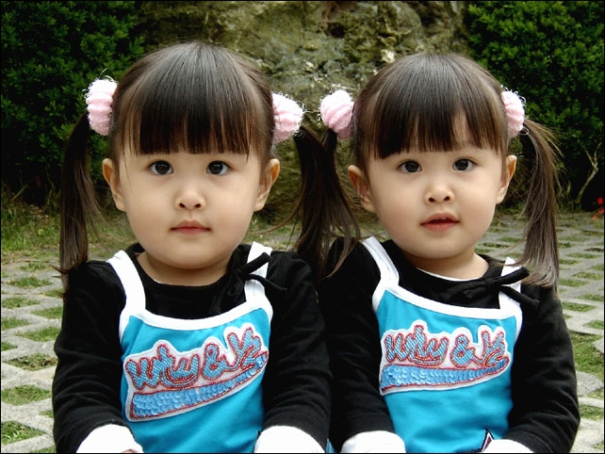
Unit3
I’m more outgoing than my sister.
第二课时
Section A (3a-3c)

Slide 2
§自主学习方案
1. Is Sam （更聪明）than Tom?
2. Are you as （友好的）as your friend?
3. Who’s （更勤奋）at school?
4. Do you study English （更努力）？
5. Paul is （更幽默）than Bill.
6. He runs （更快）than Tom.
7. Liu Ying talks （更多）than Liu Li
does.
8. This classroom is much （更大）
than that one.
cleverer
friendly
more hard-working
harder
funnier
faster
more
bigger

Slide 3
Step 1 准备与热身(Preparation)
Teacher: Hello! Last class we have learnt how to compare
people. Now look at the two students in our
class. (老师指出两个特点明显不同的学生)
Is A taller than B?
Students: Yes. he is./ No, he isn’t.
…
Teacher: Does A sing better than B?
Students: Yes, he does. /No, he doesn’t.
…

Slide 4
Step 2 呈现与输入 (Presentation)
(1) 汤姆比萨姆更聪明吗？
Is Tom _______ _____ Sam?
(2) 不是，萨姆比汤姆更聪明。
No, he isn’t. Sam is _____ _ _____ Tom.
(3) 塔拉比蒂娜更外向吗？
Is Tara ____ ________ ______ Tina？
(4) 不是，蒂娜比塔拉更外向。
No, she isn’t. Tina is _____ ________ ___ Tara.
smarter than
smarter than
more outgoing than
more outgoing than

Slide 5
(5) 你和你姐姐一样友善吗？
_____ you _____ friendly _____ your sister?
(6) 不是，我更友善一些。
No, I’m not. I’m ___________.
(7) 塔拉与蒂娜工作一样努力吗?
Does Tara work _____ ______ _____ Tina?
(8) 谁在学校里更努力一些？
Who’s ______ _____________ at school?
(9) 蒂娜认为她学习比我更努力。
Tina thinks she ______ _______ than me.
Are as as
friendlier
as hard as
more hard-working
works harder

Slide 6
Step 3 练习与体验 (Practice)
（一）
1.Julie/ tall/ you
Q: Is Julie as tall as you?
A: No, she isn’t. She’s shorter than me.
2. Jack/ run/ fast/ Sam
Q: ?
A: No, he doesn’t. He runs than Sam.
3. your cousin/ outgoing/ you
Q: ?
A: No, she isn’t. She’s than me.
4. Paul/ funny/ Carol
Q: ?
A: No, he isn’t. He’s than Carol.

Slide 7
（二）
1.Are you taller?
Yes, I am. I’m taller now than two years ago.
2. Are you funnier?
_________________________
3. Do you study English better?
_________________________
4. Are you more outgoing?
_________________________
5. Do you sing better?
_________________________

Slide 8
Step 4 运用与生成 (Production)
Play a game:
Who is she/ he?
A: She/ He is …She/ He is thinner than two years ago.
She/ He studies English better…Who is she/ he?
B: Is she/ he…?
A: Yes, she/ he is.
No, she/ he isn’t.

Slide 9
A: Who is smarter, your mother or your father?
B: I think my mother is smarter than my father.
….
 | Mother | Father
smart
funny
work hard
outgoing
friendly
sing well

Slide 10
Step 5 巩固与提高（Progress）
探究点
—Are you as friendly as your sister?
—No，I’m not. She’s friendlier.
——你和你的姐姐一样友好吗？
——不，我不是。她更友好。
表示两者在某一方面相同时用“as+形容词/副词原形+as”的句型。
e.g.I think science is as important as maths.
Tom runs as fast as Jack.
表示一方面和另一方面不及另一方面时用“not as/so+形容词/副词原形+as” 的句型。
e.g.It is not as/ so warm today as yesterday.
He did not come as/ so early as Wang Lin.

Slide 11
针对训练
Ben and Sam are the same height.（同义句转换）
Ben is Sam.
as tall as

Slide 12
一 、将下列形容词变成比较级形式。
Exercise
old→ fat→ young→ ugly→
high→ low→
light→ white→ sunny→ hot→
cool→
older
fatter
younger
uglier
higher
lower
lighter
whiter
sunnier
hotter
cooler

Slide 13
二、词汇。
shorter
longer
more outgoing
1. I’m tall but my sister is ________(short).
2. My mother has long hair, and my sister has
________ (long) hair.
3.This little baby is _________________
(outgoing) than that one.

Slide 14
4. In some ways we look the same, but in some
ways we look ____________(不同的).
5. Ann is a very ____________(安静的) girl.
She hardly makes noise.
different
quiet

Slide 15
三、单项选择。
1. The twins ______ lovely girls.
A. are all B. are both C. both are
2. I like drawing and I am good _____ it.
A. in B. on C. at
3. That box is _______ than others.
A. more heavier B. heavy
C. much heavier
B
C
C

Slide 16
4. She is three years _______ than I am.
A. old B. more old C. older
5. I think a good friend should make me
____.
A. laugh B. laughing C. to laugh
C
A

Slide 17
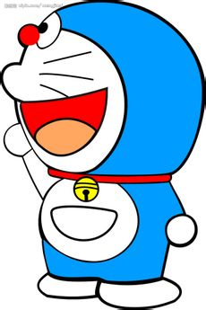
Step 6 家庭作业(Homework)
Introuduce your deskmate:
My deskmate is…
He/ She is…than me…

Slide 18
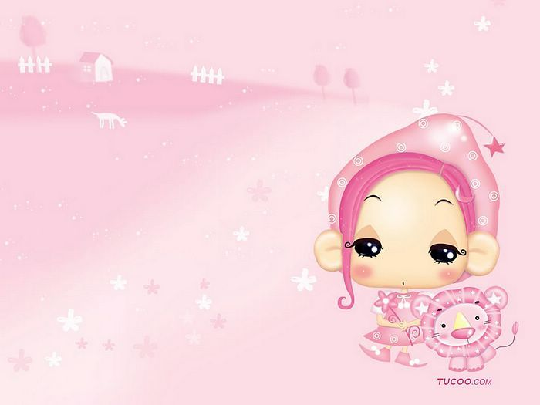
Thank you for listening!

