Slide 1
R·九年级全一册
Unit 6 When was it invented?
第一课时

Slide 2
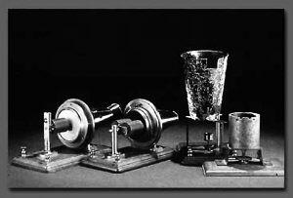
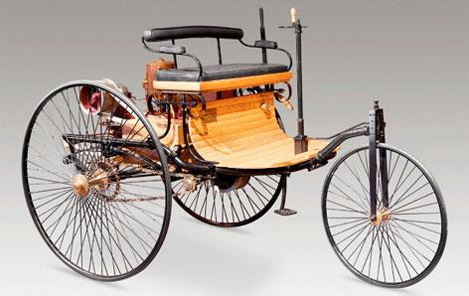
Lead in
telephone
car

Slide 3
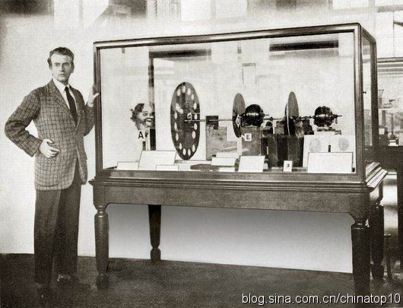
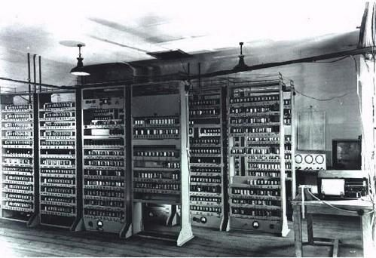
television
computer

Slide 4
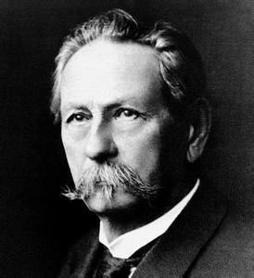
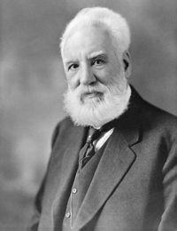
Karl Benz
Alexander Bell

Slide 5
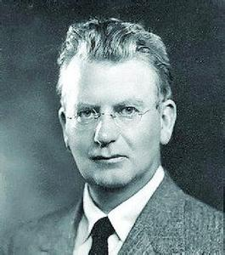
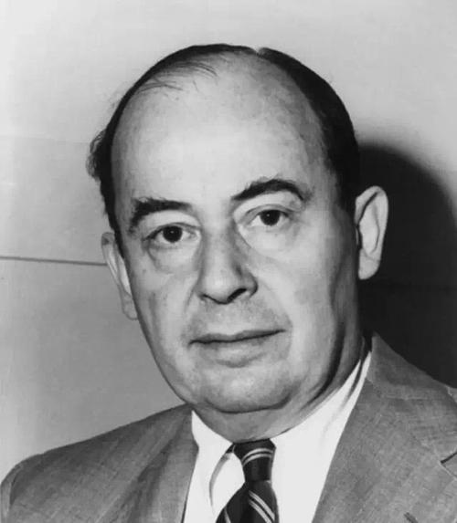
J. L. Baird
John von Neumann

Slide 6
Language points
一、辨析invent, discover, find
1. invent v. 发明
指经过认识和实践创造出前所未有的事物。
invention 名词，发明
inventor 名词，发明家

Slide 7
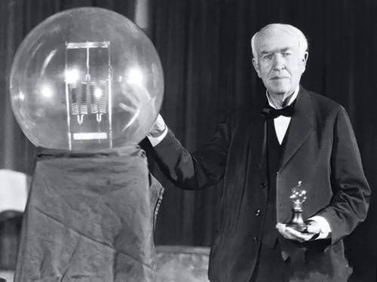
Edison is an inventor. He invented the light bulb and many other inventions.

Slide 8
2. discover 发现
指发现某种本来存在，但以前未被发现或未为人
所知的事物或现象。
3. find 找到；发现
指偶然发现或几乎没有困难地发现

Slide 9
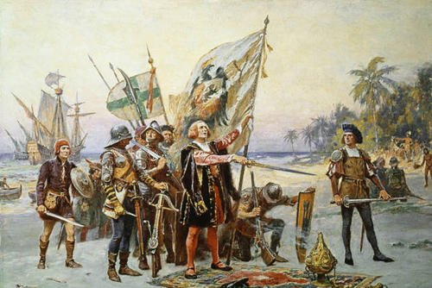
Columbus discovered the New World.

Slide 10
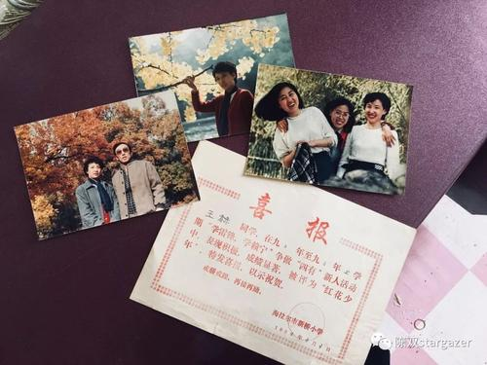
I found some old photos in that drawer.

Slide 11
I think the TV was invented before the car.
I think the TV was invented after the car.

Slide 12
4. was invented 被发明
一般过去时的被动语态的结构：
was/were + 及物动词的过去分词

Slide 13
The telephone was invented by Alexander Bell in 1876.

Slide 14
The car was invented by Karl Benz in 1885.

Slide 15
The TV was invented by J. L. Baird around 1927.

Slide 16
The computer was invented by John Von Neumann in 1971.

Slide 17
二、一般过去时的被动语态的疑问句型
1. 一般疑问句：
was/were+主语+过去分词+其他？
Was the TV invented before the car?

Slide 18
2. 特殊疑问句：
特殊疑问词+was/were+主语+过去分词+其他？
When was the car invented?
Where was the TV invented?
Which was invented earlier?

Slide 19
When and by who was the zipper invented ?
This book mentioned that the zipper was invented by Whitcomb Judson in 1893.

Slide 20
三、mention的用法
1. mention表示“提到；提及”，是及物动词，其后
接名词或代词作宾语时，无需用任何介词；
另外注意不接双宾语。
如：他从未向我提及他有个姐姐。
He never mentioned his sister to me.

Slide 21
2. 若后接动词，要用动名词，不能用不定式
我一提起踢足球，他就说太忙。
Whenever I mention playing football, he says he’s
too busy.
3. not to mention意为“更不用说；还不算”
他会说法语、德语和日语，更不用说英语。
He can speak French, German and Japanese, not to
mention English.

Slide 22
4. 口语中说 Don’t mention it. 主要用来回答感谢。
如：
A：Thank you very much. 多谢你了。
B：Don’t mention it. 不客气。

Slide 23
Practice
1. The electric lamp ____________ by Edison.
2. I lost my necklace last night. I haven’t ______ it.
3. America ______________ by who first?
was invented
found
was discovered

Slide 24
4. —Thank you for taking me around your school. — _____ A. Don’t mention it. B. Never mind.
C. Of course not. D. No problem.
A

Slide 25
Summary
1. 辨析 invent, discover, find；
2. 一般过去时的被动语态的疑问句型
① 一般疑问句：
was/were+主语+过去分词+其他？
② 特殊疑问句：
特殊疑问词+was/were+主语+过去分词+其他？
3. mention

Slide 26
THANKS

