Slide 1
What were you doing when the rainstorm came?
Unit 5
R 八年级下册
Section A 1a-2d

Slide 2
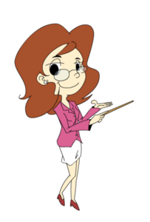
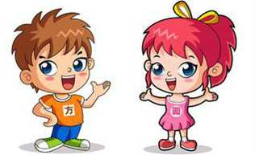
Where are you?
I am in the
classroom.

Slide 3
What are you
doing?
I am answering
your questions.
What were you
doing when I
came in?

Slide 4
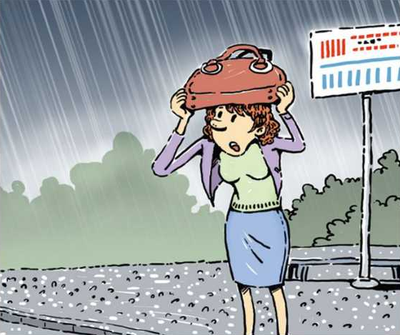
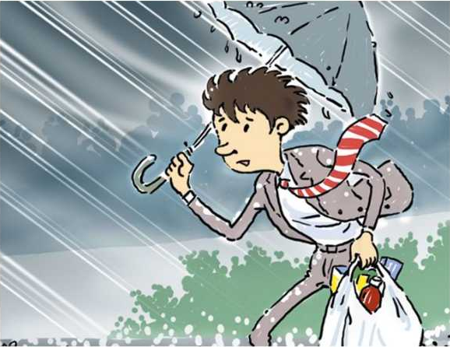
1a. Where were the people at the time of rainstorm?
Match the statements with the people in the picture.
a
c
b
d

Slide 5
1a
1. _____ I was in the library.
2. _____ I was in my house.
3. _____ I was on the street.
4. _____ I was at the bus stop.
b
a
d
c

Slide 6
1b. Listen to the TV report and circle the
correct responses.
a. doing my homework / studying
b. playing basketball / reading
c. going to work / waiting for the bus
d. walking home / shopping

Slide 7
1c. Talk about what the people in 1a were
doing at the time of the rainstorm.
What was the girl
doing at the time
of the rainstorm?
She was...

Slide 8
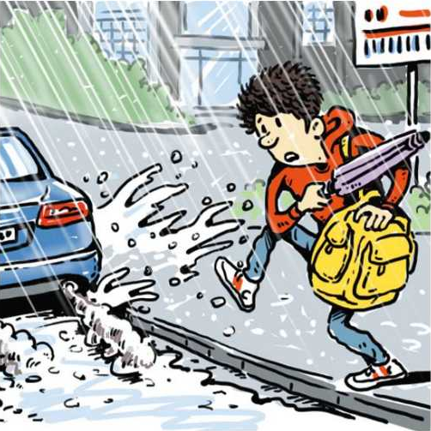
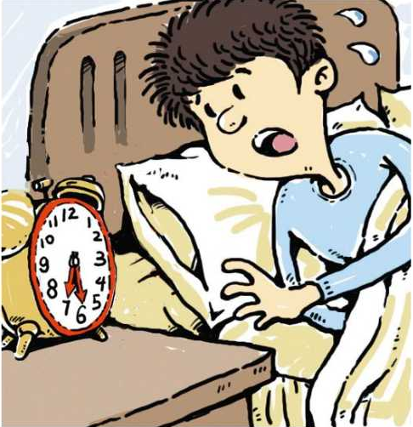
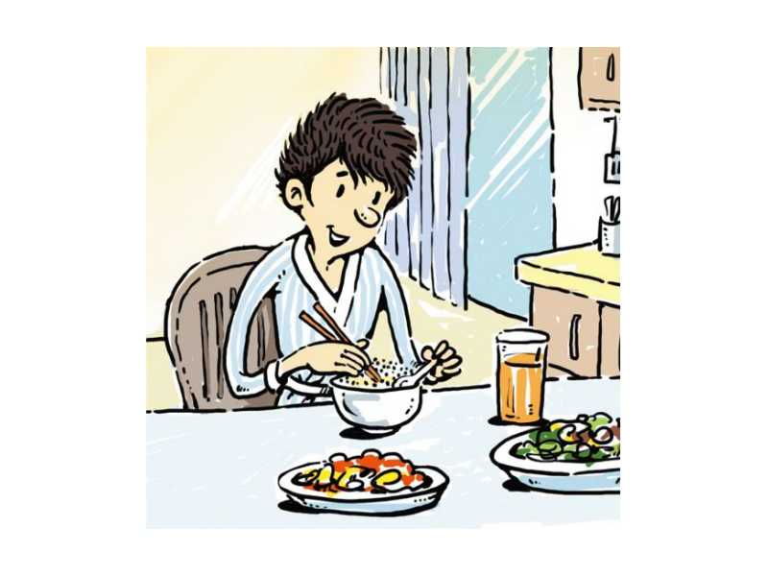
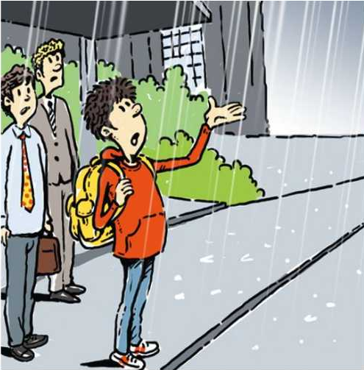
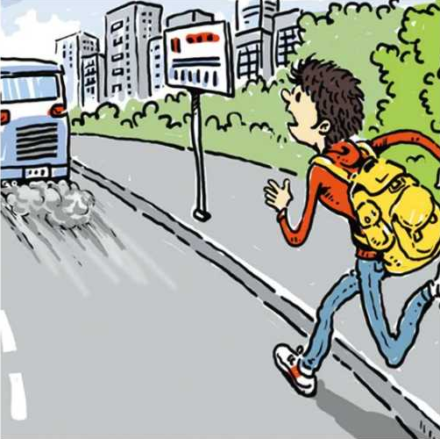
2a. Listen and number the pictures [1-5].
4
1
5
3
2

Slide 9
2b.Listen again. Fill in the blanks in the sentences in 2a .
I _____ so busy ________ the umbrella that I didn't see a car coming.
My alarm didn't go off
so I _______ up late.
I took a hot shower and
_____ some warm food.
was
looking
woke
ate

Slide 10
2b
I ________________
for the bus when it began to rain heavily.
was waiting
I _____ to the bus stop but I still missed the bus.
ran

Slide 11
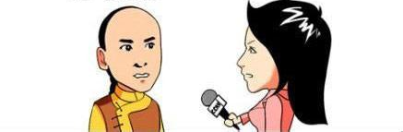
2c. Use the information in 2a to retell the
story in a conversation between the
boy and a TV reporter.
Tell us what happened
yesterday morning.
.......

Slide 12
2c. Use the information in 2a to retell the
story in a conversation between the
boy and a TV reporter.
So, when the rainstorm
suddenly came, what
were you doing?
.......

Slide 13
2d. Role-play the conversation.
Mary: What were you doing last night, Linda?
I called at seven and you didn't pick up.
Linda: Oh, I was in the kitchen helping my mom.
Mary: I see. I called again at eight and you didn't
answer then either.
Linda: What was I doing at eight? Oh, I know.
When you called, I was taking a shower.
Mary: But then I called again at nine.

Slide 14
2d
Linda: Oh, I was sleeping at that time.
Mary: So early? That's strange.
Linda: Yeah, I was tired. Why did you call so
many times?
Mary: I needed help with my homework. So while
you were sleeping, I called Jenny and she
helped me.

Slide 15
Language points
1．---What was she doing at the time of the
rainstorm?
---She was doing her homework.
What was she doing是过去进行时的特殊疑问句式；过去进行时表示在过去某一时刻或某一段时间内正在进行的动作；过去进行时的特殊疑问句句型:疑问词 + be 动词 +主语 +现在分词。
如：---What were you doing at that time last
night?昨晚那个时间你正在做什么？
---I was taking a shower.
我正在洗澡。

Slide 16
Language points
2.My alarm didn’t go off so I got up late.
（1）alarm是名词，意为“闹钟”。
如：My friend didn’t have alarm.
我的朋友没有闹钟。
（2）go off在此指“(闹钟)发出声响”。
如：My alarm can’t go off ,it doesn’t work.
我的闹钟不能发出响声，它坏了。

Slide 17
Language points
3. So when the rainstorm suddenly came,what were you doing?
(1)suddenly是副词，意为“突然；忽然”。
如：We were talking on the phone when,
suddenly, the line went dead.
我们正通着电话，突然电话断了。
The curtain was suddenly drawn and a bright light shone in.
突然窗帘拉了开来，一道强光照了进来。

Slide 18
Language points
(2)so 用在口语中时，表达的是一种惊讶或领会对方意图的意思，可翻译为“的确，如此，那么”。
如：So，what will you do then?
那么，你再如何做呢？
☆ so 可做连词，意思是“因此，所以”，但不能和because 同时使用。
如：He was ill，so he didn’t come。
他生病了，所以没来。
☆ so 可做副词，意思是“同样地，也”。
如：She likes apples，so do I 。
她喜欢吃苹果，我也是。

Slide 19
Language points
4. I called at seven and you didn’t pick up.
（1）pick up在此意为“接电话”。
如：Why doesn't he pick up?
为什么他不接电话？
（2）pick up意为“捡起；收集；继续；得到；
接人；偶然结识”。
如： He picked up the child and put her on
his shoulders.
他抱起孩子让她骑在自己的肩膀上。
He picked up news from all sources.
他从各种渠道收集消息。

Slide 20
单项选择。
1. What ____ you ____ at this time yesterday?
A. did; do B. are; doing
C. were; doing D. is; do
2. ____ Tom was playing computer games,
his father came in.
A. When B. While C. Until D. After
C
B

Slide 21
连词成句。
1. time, why, sister, you, did, call, many, your,
so
_____________________________________
2. late, my, up, alarm, off, got, go, didn't, so, I
_____________________________________
Why did you call your sister so many times?
My alarm didn't go off so I got up late.

