Slide 1
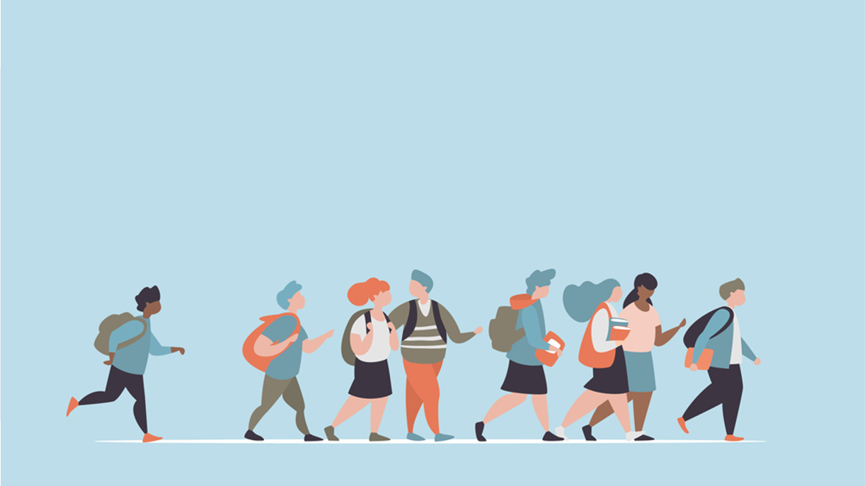
R·九年级全一册
Unit 10 You’re supposed to shake hands.
第二课时

Slide 2
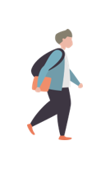
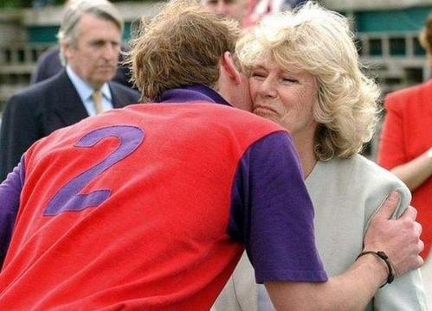
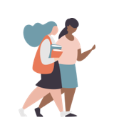
Look and guess
They are supposed to kiss when they meet for the first time.
They are from Brazil.

Slide 3
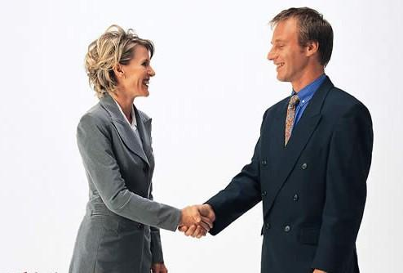
They are expected to shake hands when they meet for the first time.
They are from the United States or Mexico.

Slide 4
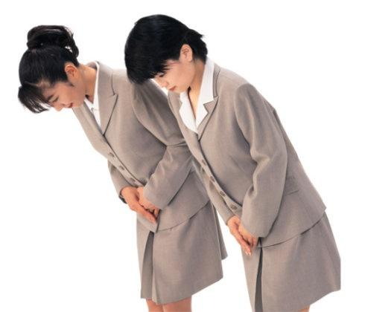
They should bow when they meet for the first time.
They are from Japan or Korea.

Slide 5
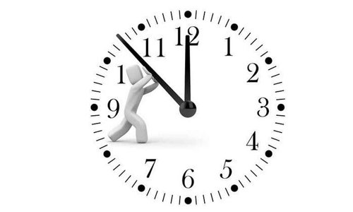
Let's think
What manners do you know about time?

Slide 6
In Colombia, we’re pretty relaxed about time.
It’s very important to be on time in Switzerland.

Slide 7
Language points
It’s+ adj. + to do sth.
It为形式主语，而不定式作为真正主语被后置。不定式做主语时，常用代词 it来代替不定式结构。

Slide 8
形式主语
真正主语
It is important to be on time.
It is very impolite to keep others waiting.

Slide 9
In Colombia, we often just drop by our friends’ homes if we have time.
In Switzerland, we never visit a friend’s house without calling first.

Slide 10
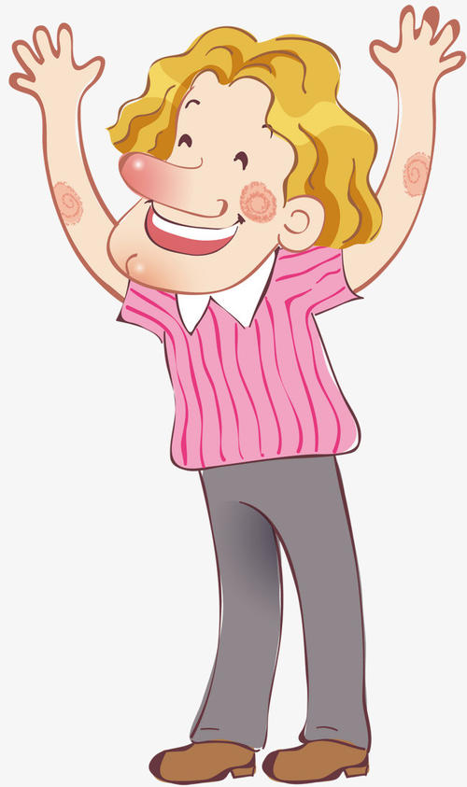
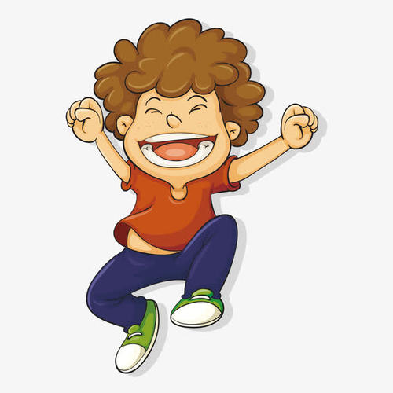
We don’t usually have to make plans to meet our friends in Colombia.
In Switzerland, we almost always make plans to see friends.

Slide 11
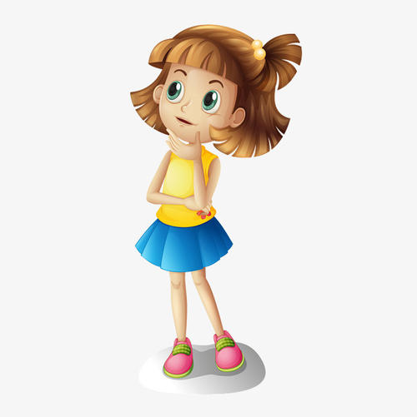
How much do you know about table manners around the world? Now take the following quiz.

Slide 12
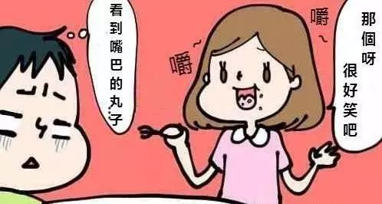
It is impolite to talk when your food is in the mouth.
talk when your food is in the mouth
You should not talk when your food is in the mouth.
You are not supposed/expected to talk when your food is in the mouth.

Slide 13
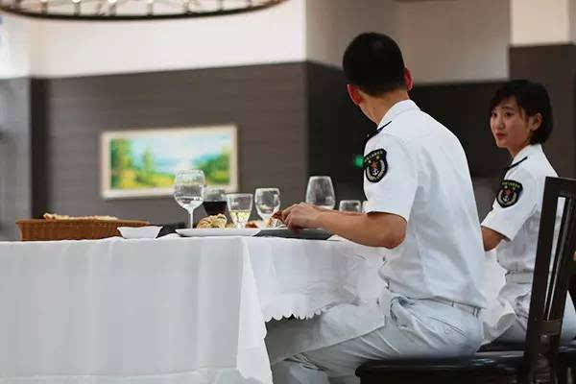
It is polite to put your napkin on legs.
You should put your napkin on legs.
put your napkin on legs
You are supposed/expected to put your napkin on legs.

Slide 14
It is polite to put your hands on the table.
put your hands on the table
You should put your hands on the table.
You are supposed/expected to put your hands on the table.

Slide 15
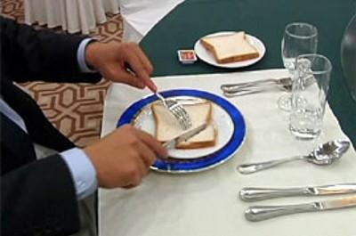
It is polite to fork in left knife in right
You should fork in left knife in right.
fork in left knife in right
You are supposed/expected to fork in left knife in right.

Slide 16
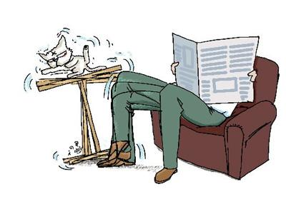
It is impolite to shake legs.
shake legs
You should not shake legs.
You are not supposed/expected to shake legs.

Slide 17
Practice
读书是有用的。
每天跑步是健康的。
迟到是糟糕的。
It is useful to read.
It is healthy to run every day.
It is bad to be late for school.

Slide 18
Summary
形式主语
1. —Is it impolite to keep others waiting?
—Yes, it's very impolite to keep others waiting.
2. In China, it's impolite to use your chopsticks to
hit an empty bowl.

Slide 19
THANKS

