Slide 1


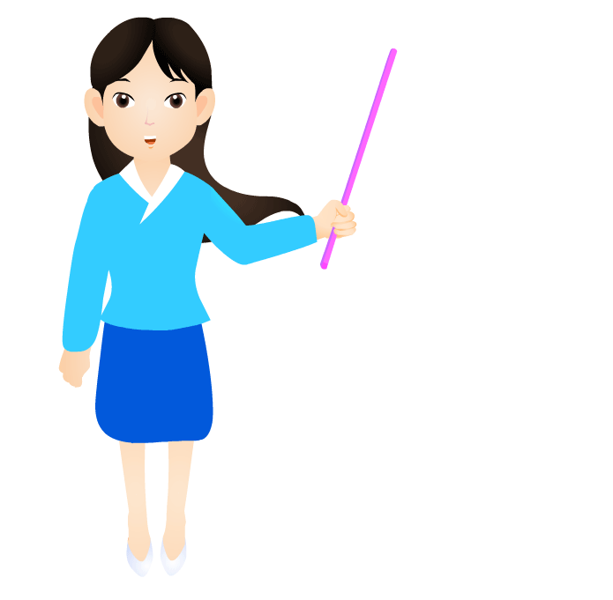
Unit 3
I’m more outgoing than my sister.
Review

Slide 2

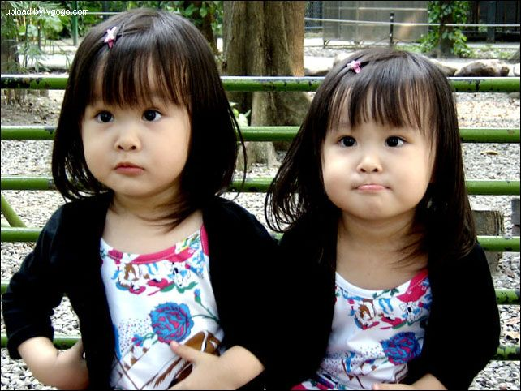
Free talk
Lily
Lucy
They are twins.
Lily is taller than Lucy.
Lucy is shorter than Lily.

Slide 3
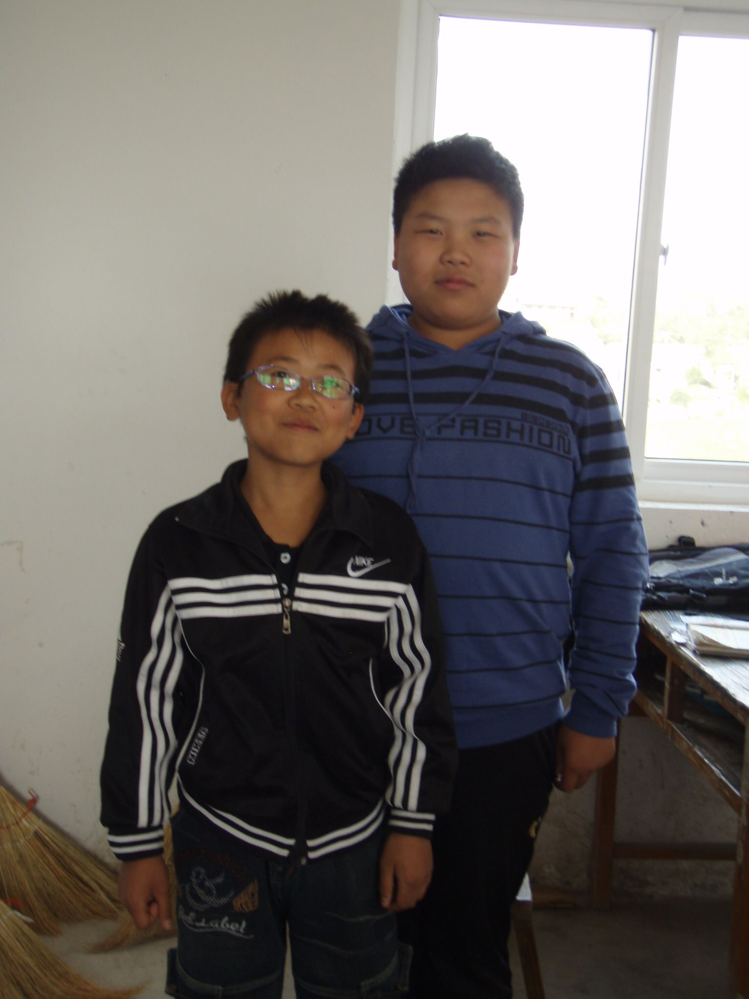
shorter
taller
thinner
heavier
smarter

Slide 4
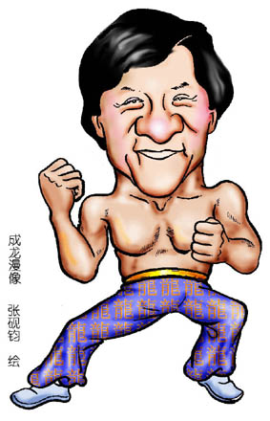
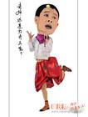
athletic
more athletic
Jackie Chan is more athletic.

Slide 5
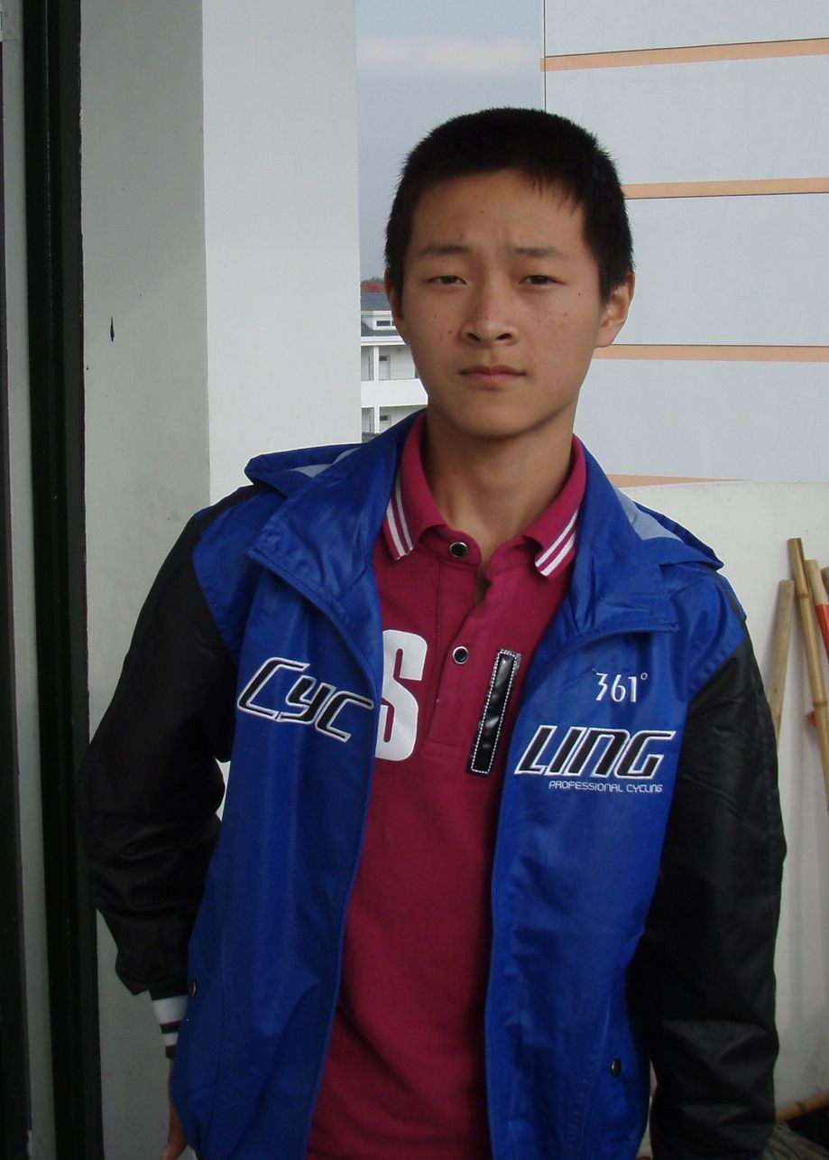
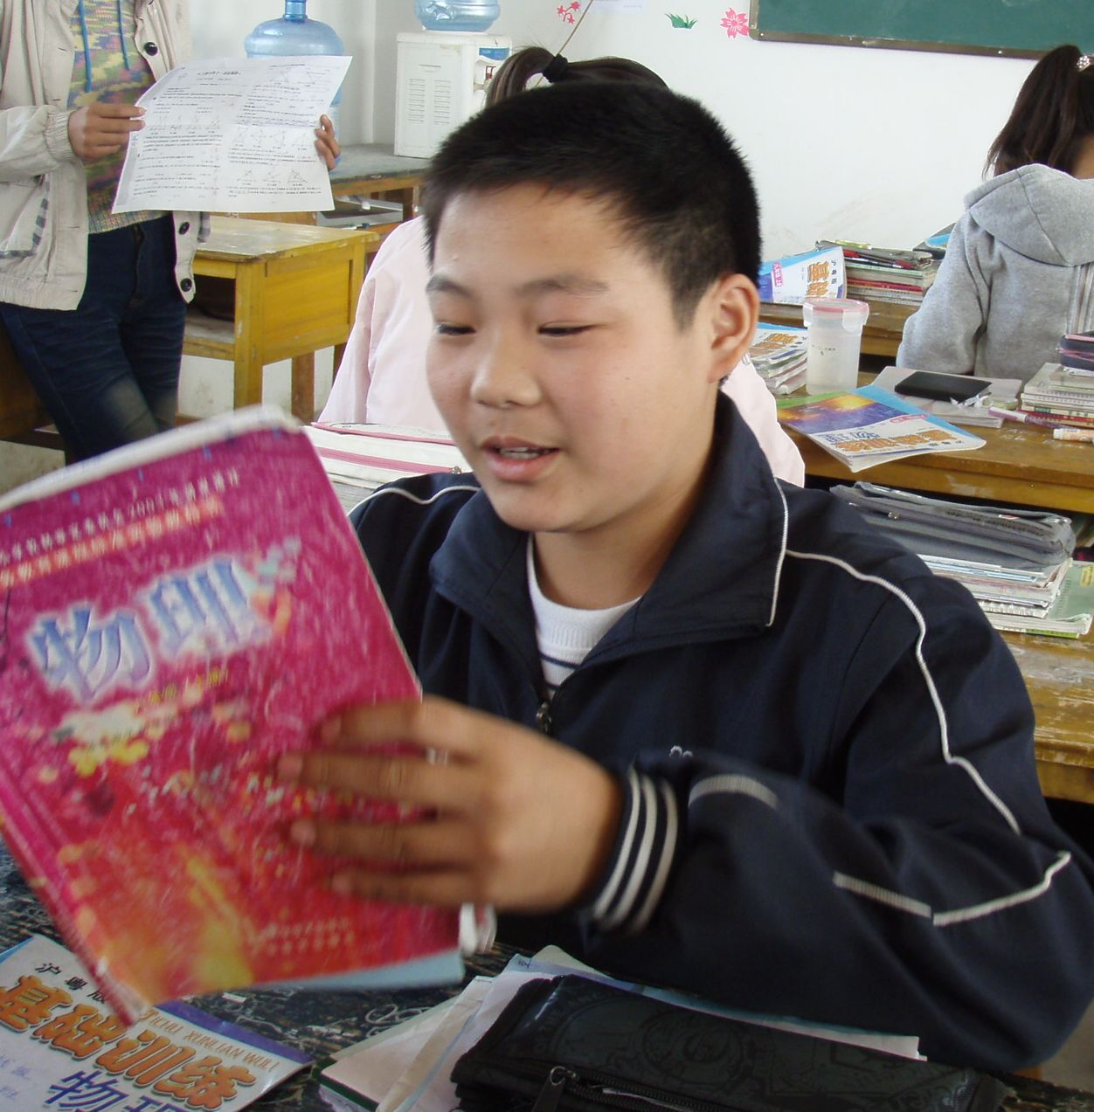
more outgoing
quieter

Slide 6
Sum-up
personality
appearance
tall
short
long
heavy
thin
beautiful
athletic
calm
wild
smart
serious outgoing

Slide 7

Comparatives of adj.(形容词比较级)
-er
-y
-ier
-…er
more ~
tall
short
long
wild
calm
smart
quiet
er
er
more
more
more
more
funny
heavy
beautiful
outgoing
serious
athletic
funnier
heavier
thin
thinner
er
er
er
er
er

Slide 8
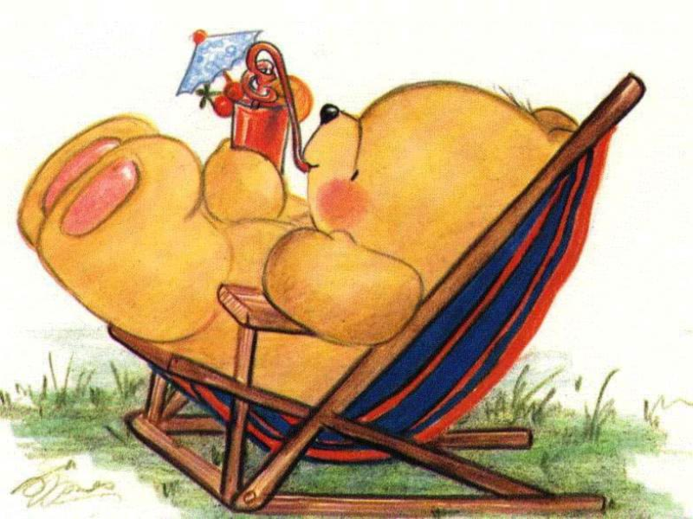
short
angry
smart
late
thin
early
serious
shorter
Test yourself
angrier
smarter
写出这些词的比较级形式
later
thinner
earlier
calm
fat
calmer
more serious
fatter

Slide 9
Exercises
A
1. It is hot today, thought not so as yesterday.
A. hot B. hotter C. hottest D. the hottest
2. —How are you today, Lucy?
—Much , but my doctor says I’ll still have to rest for another
some days.
A. well B. good C. better D. best
3. When the teacher came in, we stopped .
A. to talk B. talking C. talk D. talked
4. Who makes him here so long!
A. standing B. stand C.stands D. to stand
5. What are you at, speaking or writing?
A. good B. well C. better D. best
C
B
B
C

Slide 10
C
6. For me, music is as as sports.
A. more popular B. most popular
C. popular D. so popular
7. She bought much food the way home.
A. in B. by C. on D. to
8. Although we discussed the plan, we didn’t agree with
each other some ways.
A. at B. on C. by D. in
9. The twins ovely girls.
A. are all B. are both C. both are D. all are
10. This camera is better than that one.
A. less B. much C. more D. many
C
D
B
B

Slide 11
What kinds of friends are real friends?

Slide 12
For me, a good friend …
a. is friendly .
b. make me laugh when I am sad / unhappy.
c. is a good listener.
d. keep a secret.
e. help me when I am in trouble.
f. is good at schoolwork / study.
g. is popular in school.
h. is good at sports.
i. have cool clothes.
j. like to do the same things as me.

Slide 13
A friend in need is a friend
indeed.
患难朋友才是真朋友。
A friend is easier lost than
found.
朋友易失不易得。

Slide 14
Talk about you and your friend.

Slide 15
Useful words and phrases
friendly, funny, outgoing, athletic, wild,
quiet, serious, calm …
a. make me laugh when I am unhappy.
b. is a good listener.
c. is good at schoolwork / study.
d. is good at sports.
…

Slide 16
Compare yourself now and
two years ago.

Slide 17
Compare yourself now and two years ago.
Then write down.
Are you taller?
Are you smarter?
Are you more popular?
Are you more outgoing?
Are you a better student?
Two years ago.I was a primary school student. I’m taller now.
I work harder and I’m smarter than before . I was not popular in primary school. But now, I’m more popular in the middle school. Although I was not good at my schoolwork, I am a better student now.

Slide 18
常用描写人物短语
more than 超过
be interested in... 对……感兴趣
be good at 擅长……，在……方面做得好
the same as... 与……相同
be different from... 与……不同
as...as... 在……与……一样
not as/so...as... （前者）不如（后者）……
in some ways 在一些方面
be friendly to... 对……友好
be good with... 与……相处得好

Slide 19
常用描写人物的句型结构
A is +形容词比较级+than B. A比B更……
We both +动词... 我们两个都……
Both of us... 我们两个都……
My best friend is...
My friend is the same as me.
My good friend is different from me.
I think a good friend likes to do the same things as me/I do.
A is not as/so +形容词原级+as B. A不如B……

Slide 20

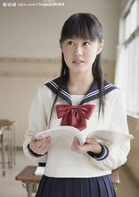
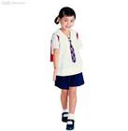
Writing
Think of yourself two years ago. Write about how you are different now.
Are you taller now?
Are you smarter?
Are you more popular?
Are you more outgoing?
Are you a better student?
Yes. I’m much taller now.
Yes. I’m a little smarter now.
Yes. I have more friends. And I’m more popular.
Yes. l play sports every day.
Yes. I’m better at math and English.

Slide 21
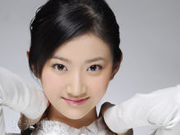
Example
Two years ago, I was a primary school student. Now I am a middle school student. And I’m taller than before now. I have longer hair than before. I work harder and smarter than before. I was a little quiet. But now I am more outgoing. I was not popular in primary school. But I’m more popular in middle school. I was good at math. Now I am better at English. I was not a good student before. Now I am a better student.

Slide 22
Exercises
句型转换
1. Tom is tall. Jim is short.(合并成一句)
Tom is _______ ______ Jim.
2. My hair is long. Mary’s hair is longer .(合并成一句)
Mary’s hair _______ _________ _______ mine.
3. Pedro is thinner than Sam. (改为同义句)
Sam is _______________ ________ Pedro.
4. My sister is better at study than me. She is clever. (改
为同义句)
My sister is ___________ intellectual (聪明的) than
me at study.
5. Peter is funny. Paul is funny, too. (合并成一句)
Peter is _______ funny ________ Paul.
taller
than
is
longer
than
fatter/heavier
than
more
as
as

Slide 23
6. I like singing. Tina likes singing, too. (合并成一句)
__________ he ________ I like singing.
7. My brother does well in English.(改为同义句)
My brother ______ _________ ______ English.
8. Both of us enjoy going to parties. (对画线部分提问)
________ _____ _______ ____ you enjoy doing?
9. Sue is 16 years old. I’m 16 years old, too. (合并为一
句)
_____ _____ ______ _____ _______ age.
Both
and
is
good
at
What
do
both
of
We
are
both
the
same
10. Tom is fatter than any other student in his class.
（改为同义句）
Tom is _____ than ___ _____ ________ in his class.
fatter the other students

Slide 24
Exercises
一、根据情景完成句子。
He is 160cm and his sister is 170cm,so
he is __________than his sister.
2. Tina always gets “A” in exams, but
Kate gets “C”. I guess Tina is ________
than Kate.
3. Most people think that comedies are __________ than documentaries.
shorter
smarter
funnier

Slide 25
4. I was only 50kg last year, but now I am 55kg. I was __________last year.
5. Our head teacher Ms Huang always smiles, but Ms Chen doesn’t. We think Ms Chen is _______________.
thinner
more serious

Slide 26
Exercises
二、根据情景提示完成句子。
7. 你认为你弟弟比你更鲁莽，你会这样说：“My brother __________________ me.”
8. 你想说Tom比Sam高，你会这样表达：
“Tom _________________Sam.”
9. 你想告诉别人你比妹妹更外向，你会这样说：“I ________________________my sister.”
10.你觉得英语比数学更有趣，你会这样表达：“English _________________________math.”
is wilder than
is taller than
am more outgoing than
is more interesting than

Slide 27

Homework
1.Finish off the exercises of this unit.
2.Prepare for the test.

