Slide 1
人教版必修第二册
Unit 2 Wildlife Protection
Period 3 Discovering Useful Structure
The Present Continuous Passive Voice

Slide 2
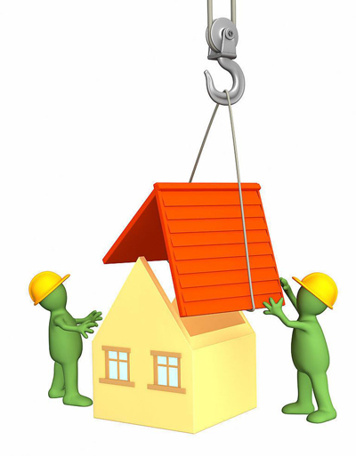
Play games
What are they doing now?
The workers are building a house.
A house is being built by the workers.

Slide 3
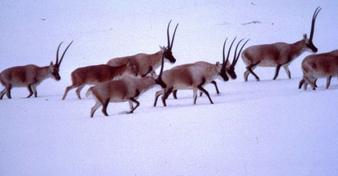
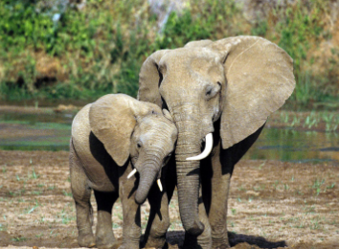
The Present Progressive Passive Voice
We're being killed for the wool beneath our stomachs. And our fur is being used to make sweaters for people like you.
We are being hunted for our ivories.

Slide 4
例句探究规律
• 1. Do you know any other endangered wildlife in China that is not being protected?
• 2. We’re being killed for the wool beneath our stomachs.
• 3. Is their fur being used to make sweaters for people like you?
• 4. What good things are being done here to save local wildlife?

Slide 5
A basketball is being played by Miki.
A book is being read by the girl.
Our fur is being used to make sweaters for people like you.
……
小结：Present Progressive Passive Voice
现在进行时的被动语态
am / is / are being +done
结构：_________________

Slide 6
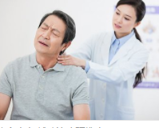
1.肯定式
2.否定式
主语 + am/is /are+ being +done …
not
not
1.She is being treated in China now.
not
2.My computer is being repaired now.
我的电脑正在修理中。

Slide 7
3.一般疑问式
4.特殊疑问式
Am/Is /Are+主语+ being + done…
疑问词
When How Where Why What
e.g: 1. Are these books being sent to Beijing？
Is the wall being painted
2. ___________________________?

Slide 8
When do we use the
Present Progressive Passive Voice?

Slide 9
WHEN
①表示说话时正在进行的被动动作.(now, at the moment)
Actions are being taken to realize Chinese Dream .

Slide 10
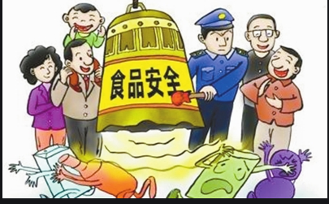
②表示现阶段正在进行的被动动作. (说话时不一定在进行)
The problem of food safety is being studied by scientists at present.

Slide 11
③表示一种习惯的被动行为(always, constantly ),带有赞扬、羡慕、讨厌等感情色彩。
Children of our neighbors are always being praised by our parents.

Slide 12
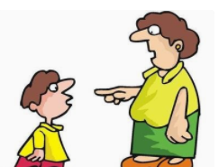
④与某些情态动词连用表示对正在发生的动作进行推测
As a result of staying up late talking last night, Jimmy may be being scolded by his headteacher.

Slide 13
Summary
现在进行时的被动语态的基本结构
肯定结构 | be(am/is/are)being done
否定结构 | be(am/is/are)+not+being done
一般疑问结构 | be(am/is/are)+主语+being done
特殊疑问结构 | 特殊疑问词+be(am/is/are)+主语+being done

Slide 14
难点
像take care of, look after, talk about, think of等动词与介词构成的短语用于
现在进行时的被动语态时, 其中的介词不可省略。
The ways to stop illegally hunting are being talked about.
阻止非法捕猎的方法正在研讨中。

Slide 15
2. “be(am/is/are)+under/in+n. ”有时可相当于现在进行时的被动语态。
Many questions are under discussion.
=Many questions are being discussed.
许多问题正在被讨论。

Slide 16
3. 有时表“状态, 心理活动, 情感”等的动词, 常用在一般
现在时的被动语态表示“正在进行”。
The runaway of the traffic accident is wanted by the police.
警方正在通缉交通事故的逃逸者。
The plan is being discussed at the meeting now.
现在这个计划正在讨论过程中。
A new law is being made to prevent endangered animals from extinction.
为了阻止濒危动物的灭绝新的法律正在制定中。

Slide 17
Workers are cutting down some trees in the park.
→Some trees are being cut down by workers in the park. (被动语态)
→Where are some trees being cut down by workers?
(特殊疑问句)

Slide 18
Challenge Time!

Slide 19
Grammar Filling 语法填空
用所给动词的适当形式填空
1 History is _________ by the people. ( make)
2 Some trees ________________ on the hill now. (plant)
3 A new subway _____________ (build) next year.
4 She ______________ (take) to the hospital already.
5 Thousands of satellites ______________ (send) up into the space so far.
6 Notes ______________( take)by you right now.
7 Young trees should ___________(water) often.
made
are being planted
will be built
has been taken
have been sent
are being taken
be watered

Slide 20
9.The grammar which ______________(learn) now is easy to master.
10.Some animals _________________(protect) well enough now.
11.The sports meeting ___________(hold) in our school at present.
12.My washing machine _______________(repair) this week, so I have
to wash my clothes by hand.
13. Now similar concerns ______________(raise) by the giants that deal
in data, the oil of the digital age.
14.Look! She _______________(criticize) by the teacher in the office.
are being protected
is being learned
is being held
is being repaired
are being raised
is being criticized

Slide 21
15.The sports meeting ___________in our school now.
16. bridge ____________over the Changjiang River.
is being held
is being built

Slide 22
小妙招
主动语态变被动语态的原则
“三变”原则:
原主变为by短语,
原宾变为现主语;
谓语主动变被动。
“三不变”原则:
原句意思不变; 原句时态不变;
原句主谓宾以外成分不变。

Slide 23
人教版必修第二册

