Slide 1




Welcome to our class!

Slide 2
Revision
Can you come to my party?
can 情态动词, 这里用来提出邀请，意思是“能”。
情态动词，后面跟动词原形。主语是第三人称单
数也如此。
I have to go to a doctor.
have to “必须，不得不”，着重于客观因素所致。
否定为:do not have to。
第三人称时用has to,
否定形式为doesn’t have to。

Slide 4
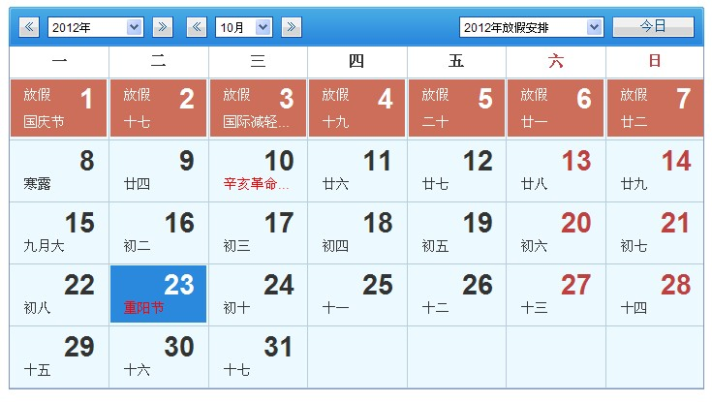
Calendar

Slide 5

What day is it today?
It’s Tuesday.
What day was it yesterday?
It was Monday.
What day is it tomorrow?
It’s Wednesday.
What day is it the day after tomorrow?
It’s Thursday.

Slide 6
What’s the date today?
It’s October the 23rd.
What was the date yesterday?
It was October the 22nd.
What’s the date tomorrow?
It’s October the 24th.
What’s the date the day after tomorrow?
It’s October the 25th.

Slide 7
A: What’s today?
B: It’s Tuesday, the 23rd.
A: What was yesterday?
B: It was…
A: What’s tomorrow?
B: It’s…
A: What’s the day after tomorrow?
B: It’s…

Slide 8
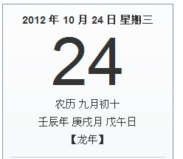
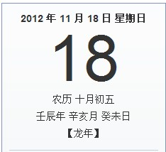
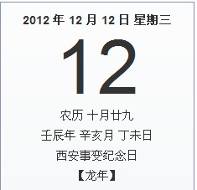
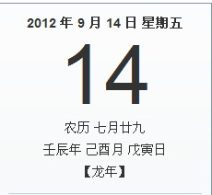

Slide 9
1b Write the words below the correct dates.
Sunday the______ | Monday the ______ | Tuesday the______ | Wednesday the______
21st
22nd
23rd
24th
yesterday
today
tomorrow
weekend
weekday
weekday
weekday
Thursday the_____ | Friday the______ | Saturday the______
25th
26th
27th
the day after tomorrow
weekday
weekday
weekend

Slide 10
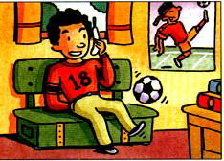
2a Listen. Can Vince play tennis with Andy？Circle Yes or No.
Yes No
中国英语教师网

Slide 11
2bListen again. Look at the chart. Match Vince’s activities with the days.
Vince’s activities | Days
____Play soccer | a. today b. tomorrow c. the day after tomorrow
____Go to the doctor
____Study for a test
____ Have a piano lesson
____ Babysit his sister
b
a
a
b
c

Slide 12
Pairwork
A: Hi, Vince, can you …with me?
B: When is it?
A: It’s...
B: Sorry, I can’t. I have to…
/I’m (doing)….

Slide 13
Retell
Vince’s calendar
today
tomorrow
the day after tomorrow
go to the doctor
study for a test
play soccer
have a piano lesson
babysit his sister

Slide 14
Vince ______play tennis with Andy. He _______ go to the doctor and study for a test today. ________, he ___________ soccer. After that, he has a piano________. And he is ________ to babysit his sister _____________.
can’t
has to
Tomorrow
is playing
lesson
going
the day after tomorrow
He is really ______ this week.
busy

Slide 15
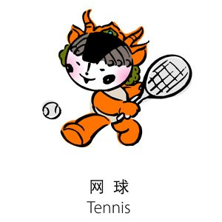

My calendar
Sunday
Monday | visit my friend
Tuesday | go to the movies
Wednesday
Thursday | have tennis training
Friday | go to the dentist
Saturday | have a chemistry class
free
have nothing to do

Slide 16

3a 1. Read as quickly as you can.
Can Sonia visit Henry this week?
Yes No

Slide 17
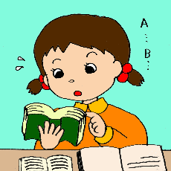
Read again and finish the following tasks.
1. Underline the times.
2. What day is it tomorrow?
What day is it today?

Slide 18
3a
2. Read again, complete Sonia’s calendar.
Sunday
Monday
Tuesday (tomorrow) | go to the dentist
Wednesday
Thursday
Friday
Saturday
go to my cousin’s birthday party
have tennis training
study for my chemistry test
go to the movies with some friends

Slide 19
Retell
can’t
Sonia ______ visit Henry this week. She is really _____. ____ Monday evening, she is __________ to her cousin’s birthday party. And on Tuesday, she has to go to the ________. The day after __________ she has tennis _________ with the school team. She ________ study for her _________ test on Thursday. On Friday evening, she is going to the movies _____ some friends. So she ________ Henry to come the movies with her.
busy
On
going
dentist
tomorrow
training
has to
chemistry
with
invites

Slide 20
My calendar
Sunday
Monday
Tuesday
Wednesday
Thursday
Friday
Saturday

