Slide 1
Unit 8

Slide 2
Unit 8
Is there a post office near here?

Slide 3
Section A 2
Grammar focus-3c

Slide 4
Let's watch and learn!

Slide 5
Grammar focus
阅读Grammar focus部分，完成下列句子。
1. 附近有银行吗？_________________________________
2. 是的。它在中心街上。
_________________________________
3. 附近有餐馆吗？
_________________________________
Is there a bank near here?
Yes, there is. It’s on Center Street.
Are there any restaurants near here?

Slide 6
有，在邮局前面有一家。
_________________________________
_________________________________
旅馆在哪里? ___________________
6. 它在公安局后面。_________________________________
Yes, there’s one in front of the post office.
Where’s the hotel?
It’s behind the police station.

Slide 7
7. 银行在哪里? __________________
8. 它紧挨着邮局。
_______________________
9. 公园在哪里？__________________
10. 它在银行对面，旅馆后面。 ____________________________________
11. 投币电话在哪里？
_____________________________
12. 他们在邮局与图书馆中间。 ___________________________________
Where’s the bank?
It’s next to the post office.
Where’s the park?
It’s across from the bank, behind the hotel.
Where are the pay phones?
They’re between the post office and the library.

Slide 8
探究乐园
There be 句型
一、There be ...句型表示的是“某处有(存
在) 某人或某物”，其肯定句式结构：
1. There be (is，are) +名词+地点状语
e.g. 在我的铅笔盒里有两块橡皮。
_____ ___ two erasers in my pencil box.
在房子前有一棵大树。
_____ __ a tall tree in front of the house.
There are
There is

Slide 9
2. 否定句：There isn’t / aren’t…
e.g. 大桥街上没有银行。
_____ _____ a bank on Bridge Street.
在教室里没有篮球。
______ _____ any basketballs in the
classroom.
There isn’t
There aren’t

Slide 10
3. 一般疑问句：Is/ Are + 主语 +…?
肯定回答：Yes, there is/are.
否定回答：No, there isn’t/aren’t.
e.g. 这附近有餐馆吗？
__ _____ a restaurant near here?
教室里有学生吗？
___ _____ any students in the classroom?
Is there
Are there

Slide 11
二、There be 句型中的主谓一致原则
There be句型中be动词的形式要和其后面的主语在人称和数上保持一致。
(1) 如果句子的主语是单数的可数名词，
或是不可数名词，be动词用“is”。
e.g. 紧挨着邮局有一个投币电话。
_____ __ a pay phone next to the post
office.
There is

Slide 12
(2) 如果句子的主语是复数名词，be动
词就用“are”。
e.g. 在公园里很多树。
_____ ___ many trees in the park.
There are

Slide 13
(3) 如果有两个或两个以上的名词作主
语，be动词要和最靠近它的那个主语
在数上保持一致，也就是我们常说的
“就近原则”。
e.g. 在桌子上有一个桔子和一些香蕉。
_____ __ an orange and some bananas
on the table.
在桌子上有一些香蕉和一个桔子。
_____ ___ some bananas and an
orange on the table.
There is
There are

Slide 14
三、There be 句型与have的区别
There be句型表示 “存在”，have\has表示 “拥有”、 “所有”，两者不能同时使用。例如:
桌子上有一架模型飞机。
_____ __ a model plane on the desk.
我有一架模型飞机。
_ _____ a model plane.
There is
I have

Slide 15
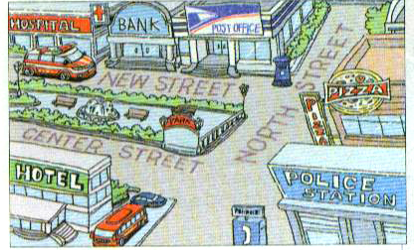
Look at the map and answer the questions.
3a

Slide 16
1. Where is the bank?
_____________________________________
2. Is there a restaurant on North Street?
_____________________________________
3. Where’s the pay phone?
_____________________________________
4. Where’s the post office?
_____________________________________
5. Is there a hospital near the pay phone?
______________________________________
It’s between the hospital and the post office.
Yes, there is.
It’s next to the police station.
It’s next to the bank, across from the hotel.
Yes, there is.

Slide 17
Look at the map in 3a and write three sentences.
3b
1. The bank is next to the hospital and across from the bank.
2. ____________________________________
____________________________________
3. _____________________________________
______________________________
The police station is across from the hotel on North Street.
The restaurant is next to the police station on North Street.

Slide 18
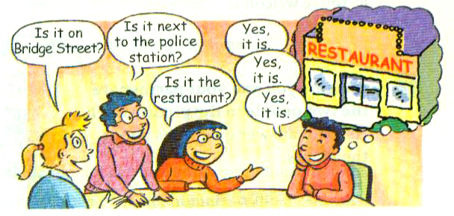
Game
Take turns to choose a place in the picture in 1a on Page 43. Your
classmates ask questions and then
guess the place.
3c

Slide 19
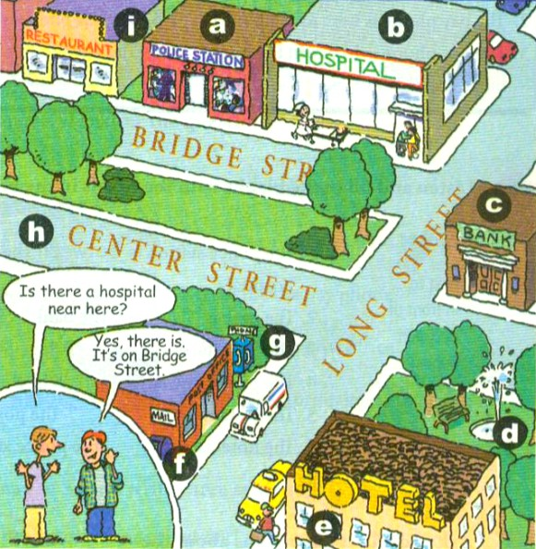
A: Where is the hospital? Is it on
Bridge Street?
B: Yes, it is.
A: Is it next to the police station?
B: Yes, it is.
A: Is it between the hotel and the
bank?
B: No, it isn’t.

Slide 20
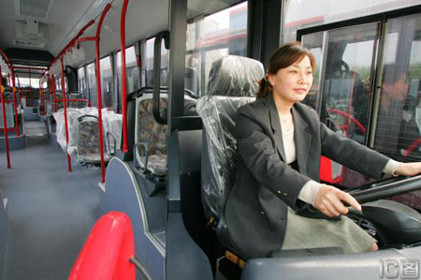
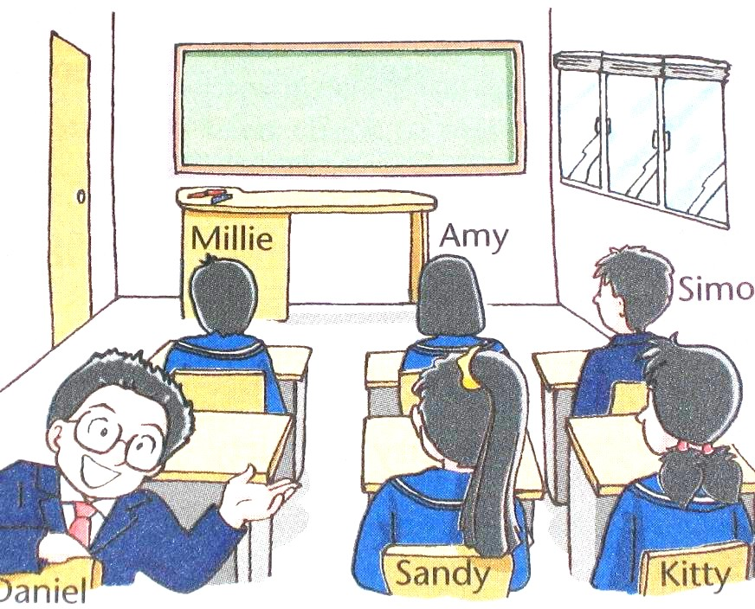
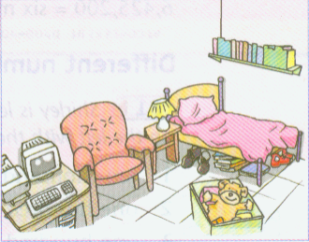
Practice
根据图片提示补全对话。
—Where ___ the driver?
—She is ____________ the bus.
is
in the front of
—Where is Kitty?
—She sits ________ Sandy.
.
next to
—___ _____ a beside table in
the bedroom?
—Yes, _____ __. It’s ________
the bed and the armchair.
Is there
there is
between

Slide 21
Exercise
根据汉语提示完成句子。
1. 火车站在公园对面。
__________________________________
2. 餐馆紧挨着邮局。
__________________________________
3. 在银行前有一个投币电话。
______________________________________
4. 在医院后面有一个公园。
_________________________________
5. 在公安局附近有一个超市吗？
______________________________________
The train station is across from the park.
The restaurant is next to the post office.
There is a pay phone in front of the bank.
There is a park behind the hospital.
Is there a supermarket near the post office?

Slide 22
Homework
Remember the sentences in the
Grammar focus.
2. 用所学的介词描述你所在地周围这
些场所的位置。
post office, police station, school,
bus station

