Slide 1
Unit 1 Art
Period 5
Reading for writing
新人教版高中英语选择性必修第三册

Slide 2
Discuss
Lead in
01
章节 PART

Slide 3
Lead in
Have you ever been to a museum?
1. Are there many museums in your hometown?
2. Do you think museums are important?
3. Do people in China like visiting museums and art galleries?
4. Do you think museums are useful for visitors to your hometown?
5. What can people learn from art galleries and museums?
6. Do you think going to museums is beneficial for children?

Slide 4
Reading
Lead in
02
Write down!
章节 PART

Slide 5
Lead in
Learn the new words.

Slide 6
Lead in
the Richfield Museum of Fine Art
里奇菲尔德美术博物馆
the Middle Kingdom 中央王国（即中国）
bronze bowl 青铜碗
ceramic base 陶瓷花瓶
jade sculpture 玉雕
artistic genius 艺术天分

Slide 7
Lead in
the highlight of this exhibition 本次展览的亮点
Clearing After Snow on a Mountain Pass 函关雪霁图
the great work 杰作
the Ming Dynasty 明朝
the civil service 公务员制度
extraordinary skill 非凡的技巧

Slide 8
Lead in
primary note 形容十分重要的事物
bronze objects 青铜器藏品
beautiful piece 美丽的作品
the items on display 展品
Emperor Qianlong 乾隆皇帝
admirer 赞赏者

Slide 9
Lead in
fine examples 精品
Buddhist origin 佛教
the seventh century 第七世纪
the Silk Road 丝绸之路
exceptional beauty and quality 外观精美、品质上乘
the figures 外观；外形

Slide 10
Lead in
The Richfield Museum of Fine Art is proud to present our new exhibition.
proud: 骄傲的；自豪的
be proud of = be pride in: 为…骄傲

Slide 11
Lead in
2.… from Shang to Qing: Chinese Art Through the Ages.
through the Ages: 历代；古往今来

Slide 12
Lead in
3. Tang sought and failed to gain entry into the civil service, so he turned to painting instead.
entry n. 进入 enter v. 进入
gain entry into: 进入
turn to sth.: 转向

Slide 13
Lead in
… he gained recognition as one of the greatest artists China has ever known.
gain recognition as 作为…获得认可

Slide 14
Lead in
… it looks as fresh and full of life as the day it was created.
full of life 充满生机
Translate: 这个城市本身充满活力，个性十足。

Slide 15
Lead in
6.These works were intended to spread Buddhism.
be intended to: 目的是

Slide 16
Lead in
7.No one will be admitted into the exhibition
after 4: 30 p.m.
be admitted into 获准进入

Slide 17
The Richfield Museum of Fine Art is proud to present our new exhibition, “from Shang to Qing Chinese Art Through the Ages.” Join us as we explore more than 3,000 years of wonderful art from the Middle Kingdom. From bronze bowls to ceramic vases, and jade sculptures to ink wash paintings, our goal is to display the Chinese artistic genius from ancient times.
里奇菲尔德美术博物馆很荣幸为您介绍我们的新展览——“从商朝到清朝:历代中国艺术”。加入我们一起来探索来自中国具有 3,000 多年历史的美妙艺术。从青铜碗到陶瓷花瓶，从玉雕到水墨画，我们的目标是展示中国古代的艺术天分。

Slide 18
The highlight of this exhibition is the painting Clearing After Snow on a Mountain Pass, one of the great works of Tang Yin (1470-1524). Born during the Ming Dynasty, Tang sought and failed to gain entry into the civil service, so he turned to painting instead.
本次展览的亮点是唐寅(1470—1524)的杰作之一——《函关雪霁图》。唐寅出生在明朝，他曾试图考取文官，但失败了，所以他转而从事绘画。

Slide 19
In time, he gained recognition as one of the greatest artists China has ever known. This painting, showing high mountains, trees, and houses covered in snow, was made with extraordinary skill. Though it is over 500 years old, it looks as fresh and full of life as the day it was created.
最终，他被公认为中国有史以来最伟大的艺术家之一。这幅画运用了非凡的技巧，展现了高山、树木和被雪覆盖的房屋。虽然它已经有500多年的历史了，但看起来清新且充满生机，就像刚被创作出来一样。

Slide 20
Also of primary note is a collection of nearly 100 bronze objects from the Shang Dynasty(1600-1046 BCE). While the artists who made these great works are not known, they showed great skill in creating these beautiful pieces. Some of the items on display are thought to have come from the collection of Emperor Qianlong (1711-1799), a great admirer of Shang Dynasty bronze.
同样十分重要的（看点）是来自商代（公元前1600 - 公元前1046）的近百件青铜器藏品。虽然不清楚创作这些伟大作品的艺术家是谁，但他们在创作这些美丽的作品时表现出了高超的技艺。其中一些展品祓认为是乾隆皇帝(1711 - 1799)的收藏品，乾隆皇帝十分赞赏商朝的青铜器。

Slide 21
Finally, we have many fine examples of Tang Dynasty (618-907) sculptures. Most of these are of Buddhist origin. Even though Buddhism entered China much earlier, it did not really begin to show expansion until the seventh century. During this same period, trade along the Silk Road also boomed.
最后，我们还有许多唐代(618—907)的雕塑精品。这些雕塑中大多数与佛教有关。虽然很早之前佛教便传入了中国，但直到公元7世纪它才真正开始传播开来。与此同时，丝绸之路沿线的贸易也蓬勃发展。

Slide 22
Chinese sculpture thus found itself highly influenced by Buddhist art brought from India and Central Asia through the Silk Road. These works were intended to spread Buddhism and they are of exceptional beauty and quality. Looking at the faces of the figures in these sculptures, one sees the faces of the past. History is brought to life.
因此，中国雕塑深受由印度和中亚经丝绸之路传来的佛教艺术的影响。这些作品是为了传播佛教，而且它们外观精美、品质上乘。看着这些雕塑中人物的脸，你会看到过去的面孔。历史被赋予了生命。

Slide 23
This is just a small taste of what is in store for you in this exhibition. We guarantee that “From Shang to Qing: Chinese Art Through the Ages” will transport you to another time with its amazing collection of works.
“From Shang to Qing: Chinese Art Through the Ages” will run until November 25
这只是本次展览供您参观的展品中的一小部分。我们保证“从商朝到清朝:历代中国艺术”展将凭借其令人惊叹的藏品让你穿越至另一个时代。
“从商朝到清朝：历代中国艺术”展将持续到11月25日。

Slide 24
Opening hours are from 9: 00 a. m. to 5: 00 p.m., from Tuesday to Sunday (the museum is closed on Mondays). No one will be admitted into the exhibition after 4: 30 p.m.
Admission: $10 for adults; S8 for students $5 for children under 12; free forchildren under 5.
No photos or food and drink are allowed in the museum.
开放时间为星期二到星期日的上午9点到下午5点（博物馆星期一闭馆)。下午四点半以后不准任何人进入展馆。
门票：成人10美元；学生8美元；12岁以下儿童5美元；5岁以下儿童免费。
博物馆内禁止拍照和饮食。

Slide 25
Reading task
Read the text again and complete the advertising leaflet below.
NEW EXHIBITION
Name:
Items on display:
Goal of the show:
Highlight:
What can get:
More details: (1) date; (2) opening hours; (3) tickets; (4) other rules.

Slide 26
Reading task
NEW EXHIBITION
Name:
from Shang to Qing: Chinese Art Through the Ages
Items on display:
more than 3,000 years of wonderful art from China on display —
Bronze bowls; ceramic vases; jade sculpture; ink wash paintings.
Goal of the show:
to display the Chinese artistic genius from ancient times.

Slide 27
Reading task
NEW EXHIBITION
Highlight:
The painting Clearing After Snow on a Mountain Pass, by Tang Yin
A collection of nearly 100 bronze objects from the Shang Dynasty
many fine example of Tang Dynasty sculptures
What can get:
You will be amazed/thrilled/fascinated

Slide 28
Reading task
NEW EXHIBITION
More details:
(1) date: it runs until Nov. 25.
(2) opening hours: 9:00 a.m. — 5:00 p.m. from Tuesday to Sunday (closed on Mondays) No one will be admitted after 4:30 p.m.
(3) tickets: students — 8$; children under 12 — 5$; children under 5 — free; adults — 10$.
(4) other rules: no photos or food and drink are allowed.

Slide 29
Language points
03
章节 PART

Slide 30
Language points
You are now going to write an announcement for art club members about a trip to see an exhibition.

Slide 31
Language points
You are now going to write an announcement for art club members about a trip to see an exhibition.
1. Work in groups. Brainstorm the details about the exhibition and take notes:
What is the exhibition about?
Where shall you meet?
What are the highlights?
How are you going to get there?
When are you going?
What should you bring?

Slide 32
Language points
撰写通知注意事项：
确定文体：这是一则通知。
确定时态：一般现在时和一般将来时。
确定人称：以第三人称为主。
确定语体：用词较口语化，句子不会太复杂，讲清楚内容即可。

Slide 33
Language points
作文点津
本单元的写作任务是写一个美术展览的通知。此类文章一般应包括以下几个方面∶
大体介绍此次展览的内容;
交代清楚此次展览的时间、票价等细节信息;
强调参观此次展览需要注意的事情;
表达祝愿。

Slide 34
Language points
There is an interesting exhibition next Sunday.
Some of the paintings are made by some...
The highlight of this exhibition is the...
The exhibition will be on from.
Admission:…..for adults'. For children….
No photos or food and drink are allowed in the museum
.Hope you will enjoy it.

Slide 35
Language points
Exchange drafts with a partner. Use this checklist to give feedback on your partner draft.
Is the announcement clear and to the point?
Is all the necessary information about the exhibition and the trip included?
Does the writer use correct grammar, punctuation, and spelling?
Get your draft back and revise it. Then put up your announcement in the classroom.

Slide 36
Exercise
2. Write your announcement based on your notes.
To: ____________________
From: __________________________
Subject: On _________, we will go to see __________________.
This exhibition is …

Slide 37
Exercise
范文
An Art Exhibition Announcement
Hello,everyone ! We will go to see an exhibition next Sunday.The exhibition is about some paintings by several famous painters. The highlight of the exhibition is one painting created by Tang Yin.It is recognized that Tang Yin is one of the greatest artists China has ever known.

Slide 38
Exercise
范文
An Art Exhibition Announcement
Though the painting is over 500 years old , it looks as fresh and full of life as the day it was created.We will enjoy some other paintings, which are also very famous.

Slide 39
Exercise
范文
An Art Exhibition Announcement
No one will be admitted into the exhibition after 4: 30 p.m.and no photos or food and drink are allowed in the museum.We willget there by bus and please wait at the school gate at7 : 00 a.m.next Sunday.Have fun!

Slide 40
Practice
04
Part4
章节 PART

Slide 41
Exercise
After reading the passage，please fill in the following blanks.
A new exhibition, “From Shang to Qing: Chinese Art Through the Ages” will be on in the Richfield Museum of Fine Art. The items include bronze bowls, ceramic _____(vase), jade sculptures and ink wash paints. The goal is ________(display) the Chinese artistic genius from ancient times. The highlight of this exhibition is the painting ________(call) Clearing After Snow on a Mountain Pass, one of the great works of Tang Yin, ____ gained recognition as one of the _________(great) artists China has ever known.
vases
to display
called
who
greatest

Slide 42
Exercise
After reading the passage， please fill in the following blanks.
A collection of nearly 100 bronze objects from the Shang Dynasty is eye-catching as well, some of which are thought _______________ (come) from the collection of Emperor Qianlong, ______ great admirer of Shang Dynasty bronze. Many fine examples of Tang Dynasty sculptures will be ___ display, too. These works were intended ________(spread) Buddhism and they are of exceptional beauty and quality. The exhibition will transport you to another time with ____ (it) amazing collection of works.
to have come
a
on
to spread
its

Slide 43
Summary
章节 PART
05
Part5
章节 PART

Slide 44
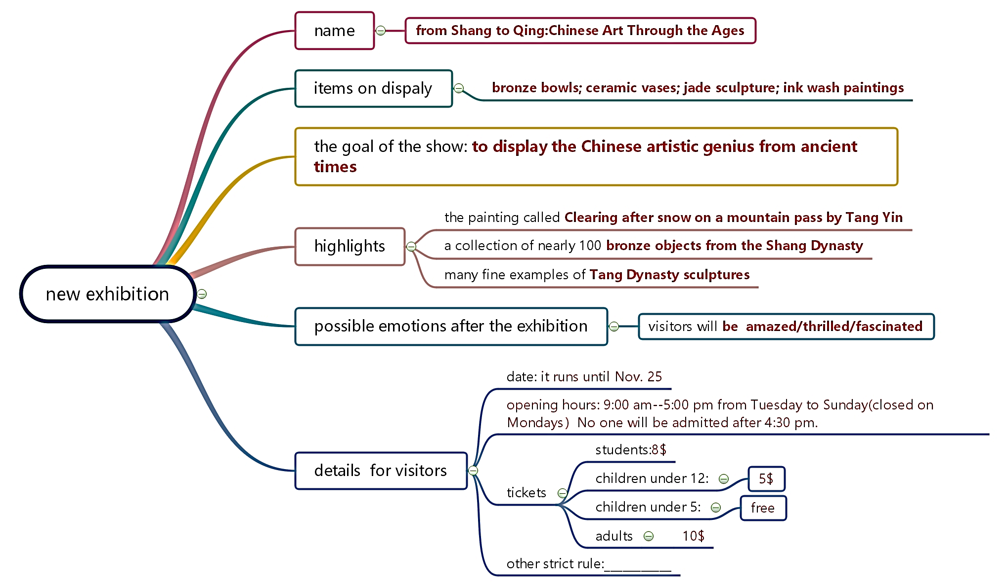
Summary

