Slide 1
R·九年级全一册
Unit 11 Sad movies make me cry.
第二课时

Slide 2
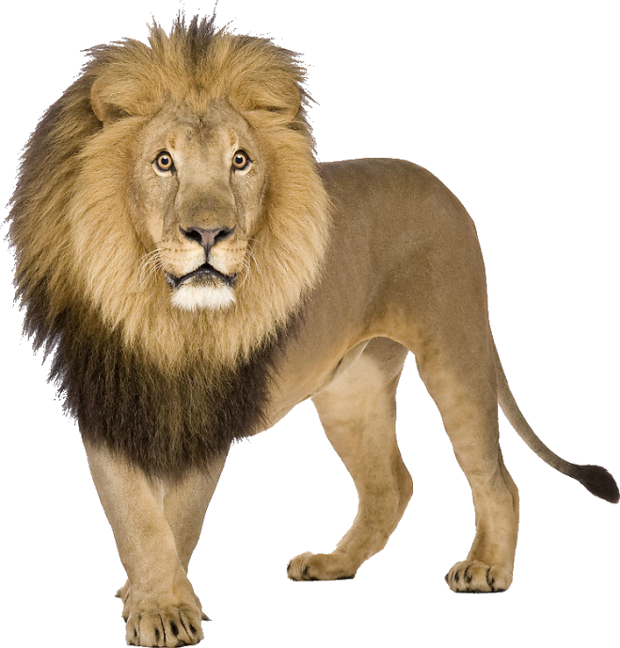
Lead in
The lion makes me frighted.

Slide 3
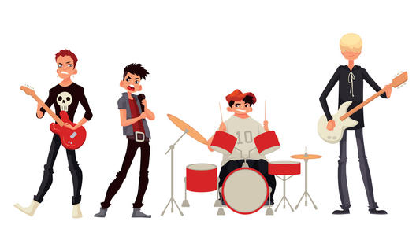
The music makes me excited.

Slide 4
The beach makes me relaxed.

Slide 5
The flowers make her happy.

Slide 6
Can you list more words?
unhappy
sad
stressed out
nervous
tense
surprised
annoyed
tired
comfortable
... makes me ...
scared
bored
frightened
…
relaxed
excited

Slide 7
Language points
How does waiting for people make you feel?
It makes me awful and uncomfortable.

Slide 8
Did you have dinner together? How does the restaurant make you feel?
It makes me easy and comfortable.

Slide 9
一、make 的用法
Computers make it easier to learn English.
1. 在make + it + adj. + to do sth...
“使做某事怎么样”
it作形式宾语，而动词不定式才是真正的宾语，而且要后置。

Slide 10
2. 当然，除了接形容词作宾补外，还可以接名词、动词的过去分词等作宾补。
They all want to make Jim their monitor.

Slide 11
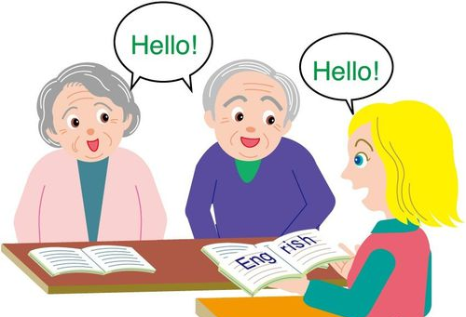
Can you easily make yourself understood in English?

Slide 12
3. make + sb. + do sth.
“使某人或某物做某事”
当把这样的句子变为被动语态时，原句中省略的动词不定式符号to必须要还原。

Slide 13
She made me wait for a long time.
I was made to wait for a long time(by her).

Slide 14
4. make的其它用法：
当 make的意思是“做、制造、制作”时
① make sth. 意为“制造某物”
②make sb. sth. / make sth. for sb.
意为“为某人制造某物”

Slide 15
His mother made him a beautiful coat.
His mother made a beautiful coat for him.

Slide 16
状元成才路
③在被动语态中，常用于以下结构：
be made of / from ……是由……制成的
be made in ……是在……制成的
be made by ……是被……制成的
状元成才路
状元成才路
状元成才路
状元成才路
状元成才路
状元成才路
状元成才路
状元成才路
状元成才路
状元成才路
状元成才路
状元成才路
状元成才路
状元成才路
状元成才路
状元成才路
状元成才路
状元成才路
状元成才路
状元成才路
状元成才路
状元成才路
状元成才路
状元成才路
状元成才路
状元成才路
状元成才路
状元成才路
状元成才路
状元成才路
状元成才路
状元成才路
状元成才路
状元成才路
状元成才路
状元成才路
状元成才路
状元成才路
状元成才路
状元成才路
状元成才路
状元成才路
状元成才路
状元成才路
状元成才路
状元成才路
状元成才路
状元成才路
状元成才路

Slide 17
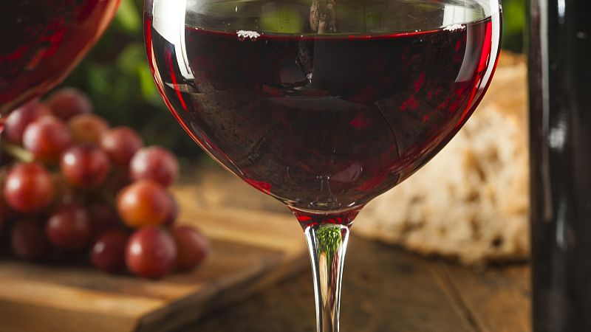
Wine is made from grapes.

Slide 18
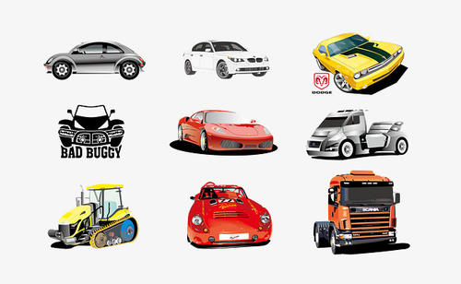
These cars were made in Changchun.

Slide 19
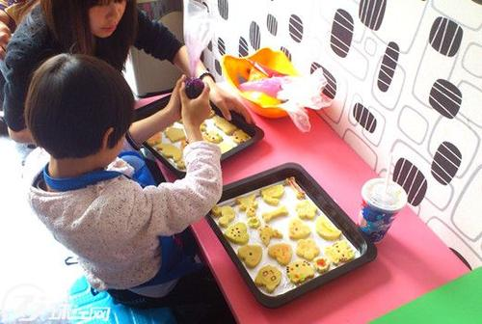
They are made by themselves.

Slide 20
4. 拓展：关于make的短语
铺床 制定计划 交朋友 捣蛋；惹麻烦
make the bed
make a plan
make friends
make trouble

Slide 21
做鬼脸 赚钱 编造；化妆；构成 取得进步 请自便
make face
make money
make up
make progress
make yourself at home
状元成才路
状元成才路
状元成才路
状元成才路

Slide 22
Practice
1. 老师让她每天练习弹琴。
2. 这个消息让我们兴奋。
3. 这部电影使我们笑了。
The teacher makes her play the piano every day.
The news made us excited.
The film makes us laugh.

Slide 23
Summary
make的用法：
1.做、制造、制作
(1)make sth.
(2)make sb. sth. / make sth. for sb.
(3)be made of / from, be made in, be made by
2.使，使得
(1)make + sb. / sth. + adj.
(2)make + sb. / sth. + 省略to的动词不定式

Slide 24
THANKS

