Slide 1
Unit 5
Do you have a soccer ball?
Section B (3a-Self Check)
人教版七年级(初中)英语上册
0

Slide 2
Learning objectives
1）To review the words,phrases and sentence patterns in this unit.
2）To use “have/ has” to talk about ownership.
3）To write about your sports collections.
0

Slide 3
Lead in
Translate these phrases.
1.ping-pong bat ________________
2.在同一所学校 _________________
3. play sports ________________
4. (英式)足球 ________________
5. play basketball ________________
6.在学校 ________________
7. go to school _________________
乒乓球拍
in the same school
参加体育运动
soccer
打篮球
at school
去上学

Slide 4
Lead in
8.看电视 _______________
9. watch ... on TV _______________
10.玩电脑游戏 ____________________
11. a tennis bat ________________
12.课后 ________________
13. love sports ________________
14.迟到 ________________
watch TV
在电视上看
play computer game
一个网球拍
after class
喜爱运动
be late

Slide 5
Presentation
Self Check
1 List all the sports you know. Write what you think of them.
Sports Your opinion
______________ _________________
______________ _________________
______________ _________________
______________ _________________
volleyball
fun, difficult
soccer
boring, difficult
basketball
interesting, exciting
ping-pong
relaxing, interesting

Slide 6
Presentation
2 Complete the questions and answers.
A: _______________________________?
B: Yes, my mom has a baseball bat.
2. A: Do you have a volleyball?
B:_________________________.
3. A: _________________________________?
B: Yeah, my father has a soccer ball.
4. A: _________________________________?
B: No, she doesn’t. My teacher has a tennis ball.
Does your mom have a baseball bat
Yes, I do/No, I don’t
Does your father have a soccer ball
Does she have a tennis ball

Slide 7
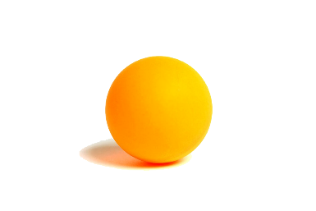
Presentation
Talk about your likes and dislikes.
I ____ ping-pong. It’s ____ for me.
I _________ soccer ball. It’s ________ for me.
like
easy
difficult
don’t like

Slide 8
Presentation
3a Write more questions about sports equipment.
Sports Survey
1. Do you have a soccer ball? ( ) Yes, I do. ( ) No, I don’t.
2. ______________________ ( ) Yes, I do. ( ) No, I don’t.
3. ______________________ ( ) Yes, I do. ( ) No, I don’t.
4. ______________________ ( ) Yes, I do. ( ) No, I don’t.
Do you have a basketball?
Do you have a baseball?
Do you have a volleyball?

Slide 9
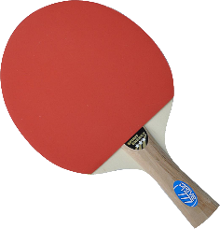
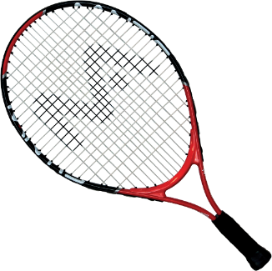
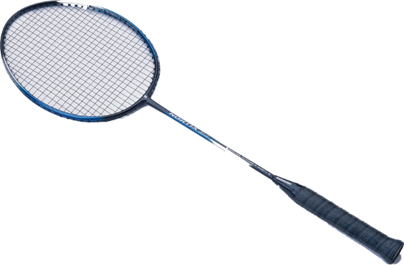
Presentation
3b Exchange books with a partner. Answer his or her questions in 3a.
A: Do you have a …
B: Yes, I do./No, I don’t.

Slide 10
Presentation
3c Look at the information in 3a. Write about yourself and your partner with but.
I don’t have a baseball, but I have a soccer ball.
Tom has a baseball, but he doesn’t have a baseball bat.
_____________________________________________________________________________________________________________________________________________________________________________________________________________________________________________________

Slide 11
Presentation
经典例题
审题立意
假如你叫 张鹏，是一个爱运动的男孩。请你根据表格中的提示内容，以 “I Like Sports” 为题写一篇 60 词左右的短文。
人称：第一人称
时态：一般现在时
体裁：说明文

Slide 12
Presentation
爱好 | 运动
物品 | 两个篮球和三个足球,没有棒球。
观点 | 篮球很难，不打篮球，只在电视上观 看；足球简单有趣，放学后常和同学们一起踢足球；棒球太无聊，不打棒球。
要点：1.介绍收藏物品 2.发表观点

Slide 13
Presentation
谋篇布局
自我介绍
总体概括
↓
Hello, my name is... I like sports.
↓
I have...
I don’t play... I think it is... for me.
I think... is... for me, so I often play it with...
I don’t have... I think it’s...
介绍藏品发表观点
↓
↓
↓
提出问题引发思考
Sports are good for us. What sports do you like? Please tell me.

Slide 14
Presentation
积句成篇：短语储备
play basketball/volleyball/ baseball 打篮球/排球/棒球
play soccer 踢足球 play sports 做运动
watch TV 看电视 on TV 在电视上
after class 课后 after school 放学后

Slide 15
Presentation
积句成篇：句型荟萃
开头句：I like sports. 我喜欢运动。
I love playing sports. 我喜爱做运动。
中间句：I have...
He/ She has...
I play… with...
I think... is very interesting/ boring.
It is easy/ difficult... for me...
I only watch it on TV.
结尾句：
Sports are good for us.
运动对我们有好处。
What sports do you like? Please tell me.
你喜欢什么运动？请告诉我。

Slide 16
Presentation
写作练习
假如你叫 张鹏，是一个爱运动的男孩。请你根据表格中的提示内容，以 “I Like Sports” 为题写一篇 60 词左右的短文。
爱好 | 运动
物品 | 两个篮球和三个足球,没有棒球。
观点 | 篮球很难，不打篮球，只在电视上观 看；足球简单有趣，放学后常和同学们一起踢足球；棒球太无聊，不打棒球。

Slide 17
Exercise
选词填空。
after, has, doesn’t, for, does, sounds, on, but, play
1. ______ Jenny have a ping-pong bat?
2. Ping-pong is easy _____ me.
3. — Let’s play volleyball _______ school.
— That ________ interesting.
4. I don’t ______ sports. I only watch them _____TV.
5. My grandfather ______ six baseballs and bats, _____
he _________ have a basketball.
Does
for
after
sounds
play
on
has
but
doesn’t

Slide 18
Homework
1. Write a passage to tell us about your sports collection with the title “I Like Sports” .

