Slide 1
Unit 4

Slide 2
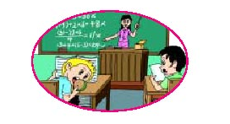
Unit 4
Don’t eat in class.

Slide 3
Section A 2
Grammar Focus-3c

Slide 4
Lead in
说唱下列歌谣：
Be polite to each other. Wear school uniform. Don’t be late for school.
Don’t say rude remarks in school. Don’t eat snacks in class. Don’t shout in class.

Slide 5
Grammar Focus
阅读Grammar Focus部分，完成下列句子。
1. 不要在楼道里跑。
______________________________
2. 不要打架。
____________________
3. 有什么规则？
______________________________
4. 我们必须按时上课.
_______________________________
Don’t run in the hallways.
Don’t fight.
What are the rules?
We must be on time for class.

Slide 6
5. 我们可以在教室里吃东西吗？
_____________________________
6. 不能。但我们可以在餐厅里吃东西。
________________________________
________________________________
7. 我们可以在上课的时候带帽子吗？
_____________________________
Can we eat in the classroom?
No, we can’t, but we can eat in the dining hall.
Can we wear a hat in class?

Slide 7
8. 他在学校里必须穿校服吗？
__________________________________
9. 是的，必须。/ 不，不必。
_______________________________
10. 你们必须做什么？
_______________________________
11. 在图书馆里我们必须保持安静。
_________________________________
Does he have to wear a uniform at school?
Yes, he does. / No, he doesn’t.
What do you have to do?
We have to be quiet in the library.

Slide 8
祈使句
祈使句是表示请求、命令、建议等的句子。句子中通常不出现主语，谓语动词一律用原形。根据句子语气的强弱，句末用感叹号或句号。

Slide 9
一、祈使句的肯定式
1. 以行为动词原形开头，简称Do型。
e.g. Come here. 到这儿来。
2. 以动词be开头，简称Be型。
e.g. Be quiet, please. 请安静。
3. 以Let开头，简称Let型。
e.g. Let’s go! 咱们走吧!

Slide 10
注意
有时可在祈使句的句首或句尾加上please，使语气显得客气、有礼貌。如果在句尾加please，应该用逗号与前句隔开。
e.g. Go this way, please. 请这边走。

Slide 11
二、祈使句的否定式
1. Do型和Be型的否定式是在句首加don’t。
e.g. Don’t sit here. 不要坐在这儿。
Don’t be late. 别迟到。
2. 以let开头的祈使句，其否定式有两种：
一种是直接在句首加don’t，另一种是“let
+ 宾语 + not +动词原形+ (其他)”。
e.g. Don’t let him go. 不要让他走。
Let’s not go there. 咱们别去那儿。

Slide 12
注意
“No+名词/动词⁃ing形式”表示禁止或规劝，常用于公共场所。
e.g. No photos! 禁止拍照！
No smoking！ 禁止吸烟！

Slide 13
将下列句子翻译成英语。
1. 请看这幅图画。
2. 不要在教室里跑。
3. 让我们帮助他。
Please look at the picture. / Look at the picture, please.
Don’t run in the classroom.
Let’s help him.

Slide 14
4. 在图书馆保持安静。
5. 上课不要迟到。
Be quiet in the library.
Don’t be late for class.

Slide 15
3a Write the rules for the school library.
Library Rules
Don’t talk.
__________________
__________________
__________________
Don’t listen to music.
Don’t eat or drink.
Don’t take photos.
方法指导：
1. 由图示可知都是一些禁止类的祈使句。
2. 可知应用“Don’t + 动词原形”句子。

Slide 16
Writing
3b Use the words to make questions
about the rules. Then write
answers according to your school.
Be quiet? (she/have to /in the library)
Q: Does she have to be quiet in the library?
A: Yes, she does.

Slide 17
2. Eat? (he/have to/in the dinning hall)
Q: __________________________
A: __________________________
Listen to music? (we/can/in the hallways)
Q: __________________________
A: __________________________
4. Wear a hat? (we/can/in the classroom)
Q: ________________________
A: ________________________

Slide 18
方法指导
1. 根据例句，可知要求我们造一般疑问句并根据实际情况进行回答。
2. 先确定句子的主语。
3. 再确定用情态动词还是用助动词来构成疑问语序。
4. 根据实际情况做出肯定或否定回答，答语的主语要与问句保持一致。

Slide 19
Then answer the questions.
2. Eat? (he/have to/in the dining hall)
Q: ________________________________?
A: _____________
3. Listen to music? (we/can/in the hallways)
Q: ________________________________?
A: _____________
4. Wear a hat? (we/can/in the classroom)
Q: _____________________________?
A: ____________
Does he have to eat in the dining hall
Yes, he does.
Can we listen to music in the hallways
No, we can’t.
Can we wear a hat in the classroom
No, we can’t.

Slide 20
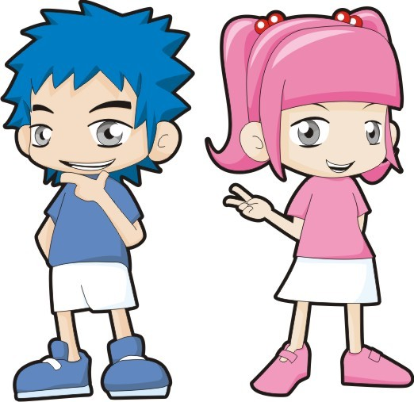
3c Make up five cool rules for your
dream school. Share your rules with
the class. Your classmates vote for
the Coolest School!
At my dream school, we don’t have to come to school every day. …
We can eat in class. …

Slide 21
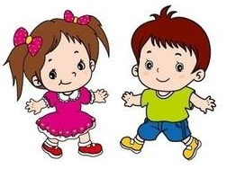
We can listen to music in class. …
We don’t have to wear school uniforms. …

Slide 22
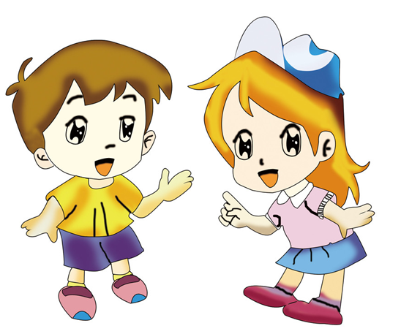
We can eat in the classroom. …
We don’t have to do homework. …

Slide 23
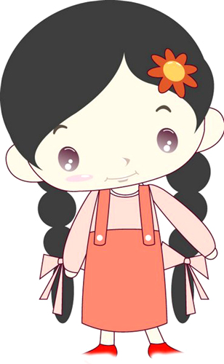
Report
At my dream school, we don’t have to come to school every day. We can eat in the classroom.
We can listen to music in class.
We don’t have to do homework.
We don’t have to wear school uniforms at school.
Great! Jim’s school is the coolest.

Slide 24
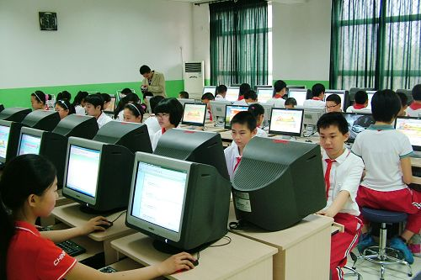
Discuss and make rules for the computer room in your school.
Group work
Computer Rules
_______________
_______________
_______________
________________
________________

Slide 25
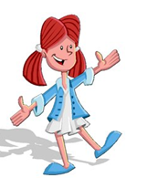
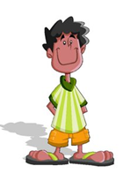
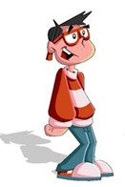
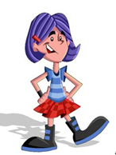
Don’t run in the computer room.
We must be quiet in the computer room.
Wear slippers in the computer room.
Don’t eat or drink in the computer room.

Slide 26
Report
Computer Rules
___________________________________
___________________________________
___________________________________
___________________________________
___________________________________
We must be quiet in the computer room.
Don’t eat or drink in the computer room.
Don’t run in the computer room.
Wear slippers in the computer room.
Clean the computer room every day.

Slide 27
Exercise
句型转换
1. He has to eat breakfast quickly. (改为一般疑问句)
__________________________________
2. Play volleyball after class. (改为否定句)
________________________________
Does he have to eat breakfast quickly?
Don’t play volleyball after class.

Slide 28
3. We can wear sports shoes in class. (改为一般疑问) ______________________________
4. Don’t arrive late for class. (改为同义句)
_______________________________
5. Eric has to do his homework before six. (对划线部分提问)
___________________________________
Can we wear sports shoes in class?
We must be on time for class.
What does Eric have to do before six?

Slide 29
Homework
1. Remember the sentences in the
Grammar Focus.
2. Write five rules in your family.

Slide 30
Thank you!

