Slide 1
Unit 2
This is my sister.
Section B (2a-2c)
人教版七年级(初中)英语上册
0

Slide 2
Learning objectives
1）To learn the expression of family members. 2）To tell something about your family photo.
3）To tell the male and female names.
4）To improve students' reading skills and abilities.
0

Slide 3
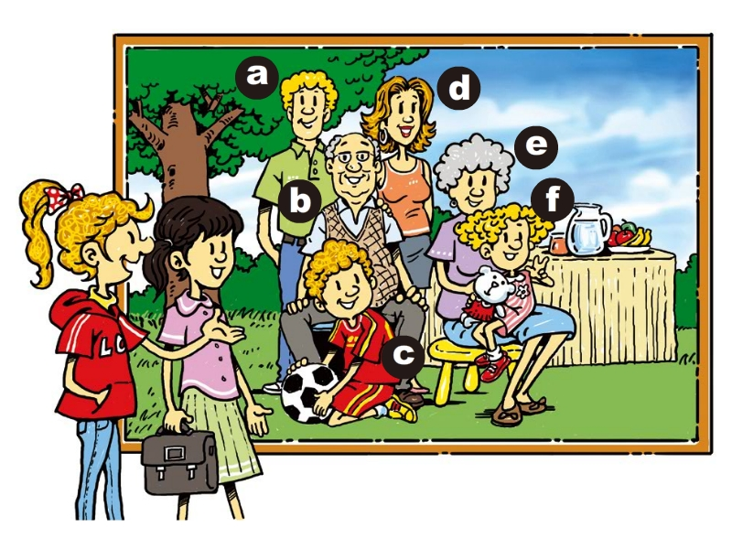
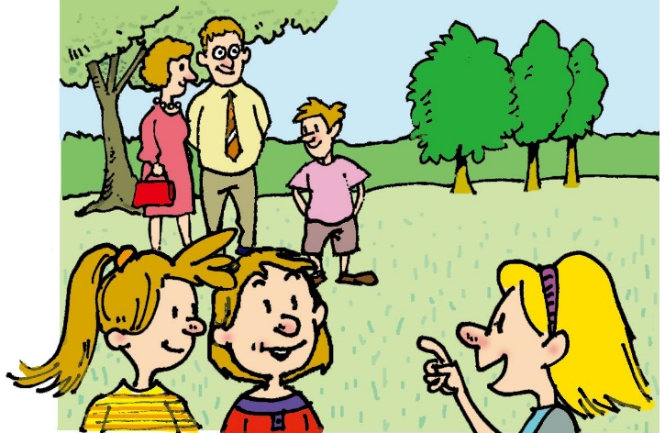
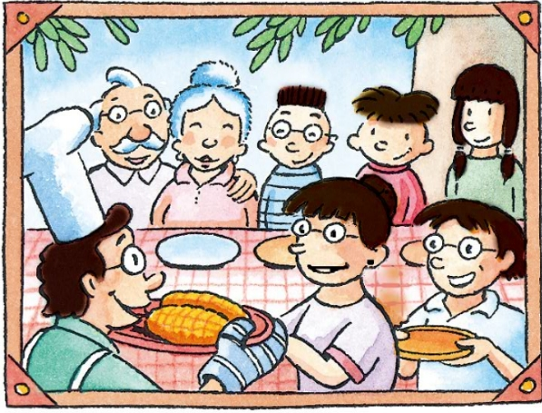
Lead in
We meet many families in this unit. We meet many new friends.
Can you say their names?
Tom
Jenny
Linda
Bob
Paul
Mary
Jack
Li Lan
Sally
Kate
Jane
Jiang Shan
Jiang Tao
Cindy

Slide 4
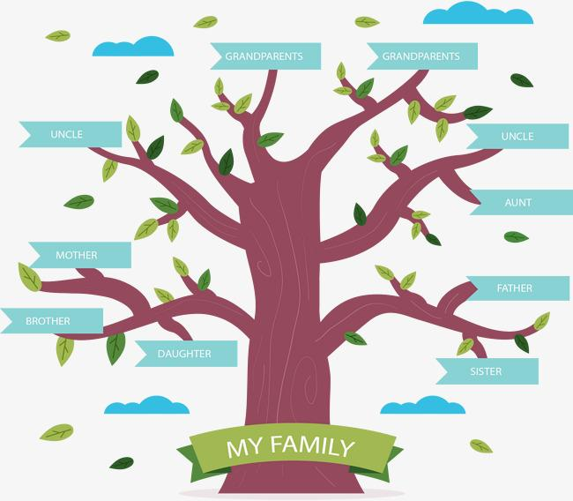
Lead in
Family Tree
grandpa
grandma
father
uncle
aunt
mother
me
cousin
brother
sister
cousin

Slide 5
Presentation
Can you tell(分辨) the male and female first names?
Frank
Mary
Alan
Tony
Sonia
Cindy
Dale
Bob
Jack
Anna
Kim
Alice
David
Jenny
Tim
Jim

Slide 6
Presentation
2a Find the male and female first names in this unit and write them.
Male
Female
Tom Bob
Jack Paul
Jiang Tao Alan
Eric John
Bill Dale
Cindy Li Lan
Jenny Linda
Mary Sally
Kate Jane
Jiang Shan Helen
Lin Fang

Slide 7
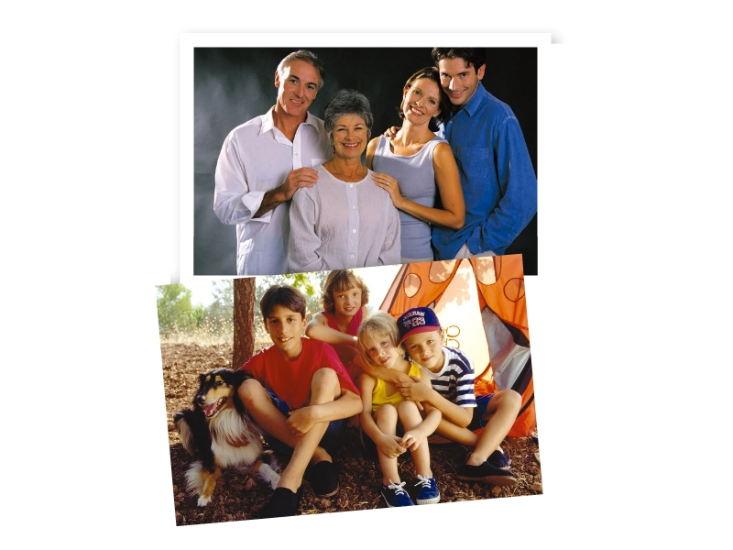
Presentation
Look and guess
What is the passage about?
It is about the two family photos and the persons in the family.

Slide 8
Presentation
Let’s look at the pictures. This is Jenny’s family.
How many people can you see in the first picture?
Four.
How many people can you see in the second picture?
Four.
What else can you see in the second picture?
A dog.

Slide 9
Presentation
2b Read about Jenny’s family and circle the names.
My Family
Hi, I’m Jenny. Here are two nice photos of my family. My
grandfather and grandmother are in the first photo. These
are my parents, Alan and Mary. In the next picture are my
brothers, Bob and Eric. These two girls are my sister
Cindy and my cousin Heleln. Coco is in my family, too.

Slide 10
Presentation
Tips: 做细节理解题的时候，定位，画线关键词，找答案。
Read quickly and fill in the blanks.
My Family
Hi, I’m Jenny. Here are two nice photos of my family. My grandfather and grandmother are in the first photo. These are my parents, Alan and Mary. In the next picture are my brothers, Bob and Eric. These two girls are my sister Cindy and my cousin Helen. Coco is in my family, too.
1. My grandparents are in the _____ photo.
2. My sister is in the _____ photo.
3. My brothers are _____ and _____.
4. Coco is ________.
first
next
Eric
Bob
a dog

Slide 11
Presentation
Check the sentences true (T) or false(F).
1. Jenny's grandparents are both in the picture.
2. Jenny is Mary's mother.
3. Helen is Cindy's sister.
4. Bob is Helen's father.
T
Mary
Jenny's
F
cousin
F
Jenny and Cindy's father
F

Slide 12
Presentation
2c Read the passage again and complete the sentences.
1. My name is _______.
2. Alan and Mary are my _______.
3. Bob and Eric are my ________.
4. Cindy is my ________.
5. Helen is my ________.
6. ______ is the name of my dog.
Jenny
parents
brothers
sister
cousin
Coco

Slide 13
Language points
1. Here are two nice photos of my family.
本句是以here开头的倒装句，用来引起注意或加强语气，其正常语序为“Two nice photos of my family are here.”。在倒装句中， 谓语动词的单复数形式取决于后面名词（短语）的数。
Here is my jacket. 这是我的夹克衫。
Here are my friends. 这是我朋友。

Slide 14
Language points
2. photo为可数名词，“照片”， 其复数形式为photos。
take photos/a photo (of…)意为“（给······）拍照”。
a photo of …意为“一张······的照片”
3. of prep.属于（某人或某物）；关于（某人或某物）
of作介词，表示所属关系，其后接名词、代词或
名词性物主代词，常用于构成名词所有格。

Slide 15
Exercise
一、单项选择：
1.In the first picture ________ my brothers and I. A. are B. is C. am D. Be
2.Is that a photo _______ your parents?
A. to B. of C. for D. with
3.Look! Here __________your pen and pencil box.
A. is B.am C. are D. be

Slide 16
Exercise
二、完成句子:
1. 这里有两张我的好看的全家福。
_______ ______ two nice ________ _____ my family.
2. 第一张照片中是我的外公外婆。
My grandfather and grandmother _____ in the ______ _______.
3. 下一张照片中有我的兄弟，鲍勃和埃里克。
In the ______ picture _____ my brothers, Bob and Eric.
Here
are
photos
of
are
first
photo
next
are

Slide 17
Homework
1. Do the exercises in students’ book.

