Slide 1
Unit 1 Art
Period 2
Build up your vocabulary
新人教版高中英语选择性必修第三册

Slide 2
Discuss
Lead in
01
Write down!
章节 PART

Slide 3
Lead in
Part 1
Brainstorming.
Brainstorm words or phrases concerning art.

Slide 4
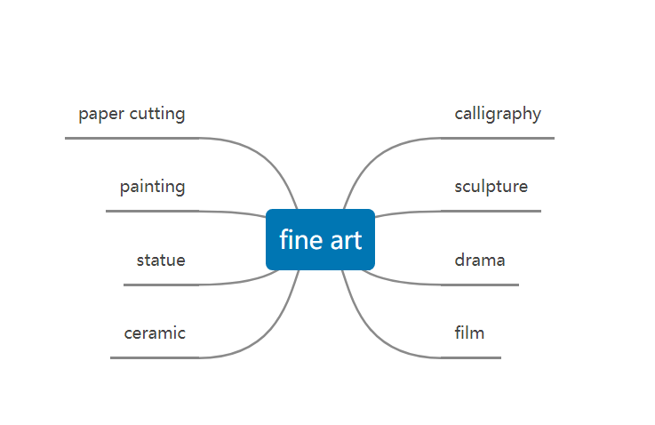
Lead in

Slide 5
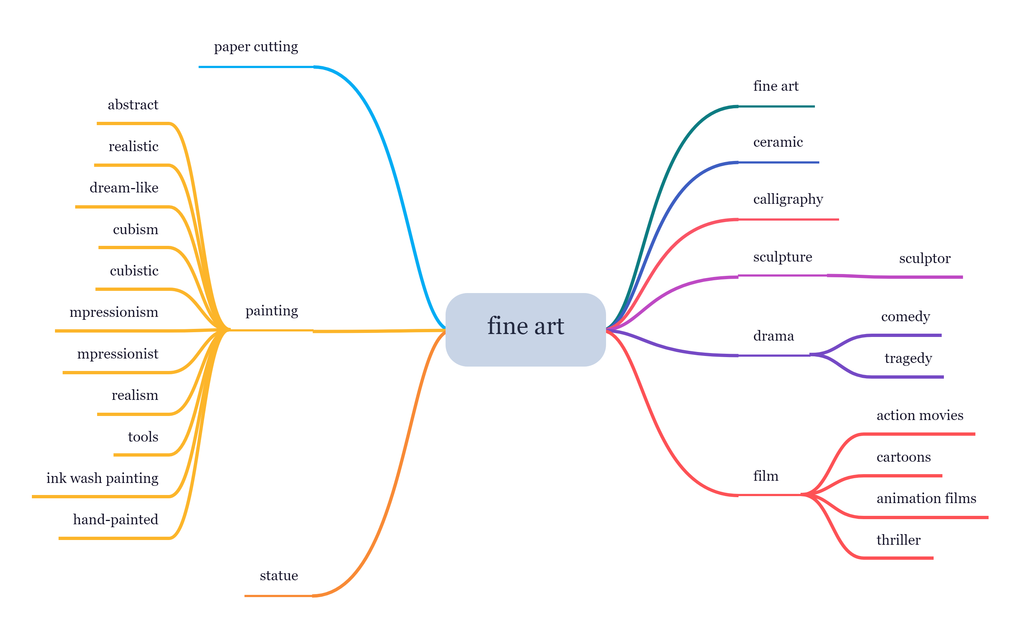
Lead in

Slide 6
Reading
02
Write down!
章节 PART

Slide 7
a master of shadow and light | 光影大师
historical events | 历史事件
Stories from mythology | 神话故事
subjective impression | 主观印象
a detailed record | 详细的记录
Scenes of daily life | 日常生活的场景
in the natural world | 在自然界中
abstract art | 抽象艺术
Presentation
光影大师
历史事件
神话故事
主观印象
详细的记录
日常生活的场景
在自然界中
抽象艺术

Slide 8
Presentation
讲究 | be particular about
简而言之 | in brief
给出一个精确的定义 | give a precise definition
了解西方艺术的最佳途径 | the best way to understand Western art
在真实环境中展示真实的人 | show real people in a real environment
人文素质 | humanistic qualities
集中精力 | concentrate one’s efforts on
be particular about
in brief
give a precise definition
the best way to understand Western art
show real people in a real environment
humanistic qualities
concentrate one's efforts on

Slide 9
Reading task
Fill in the passage with the correct words.
Unlike the earlier Realists who painted in an _________(现实的）style. Impressionist painters focused more on their ___________ （主观的） feelings of things and instant impressions. When Impressionism _________ （出现） in France in the late 19th century, artists became more interested in everyday subject matter. They were also fascinated by modern objects. As one of the most__________（有影响力的）impressionist painters, Claude Monet was impressed by the visual effects of the steam engine ____________(尤其是）and he later produced twelve paintings of a train station in Paris.
realistic
subjective
emerged
influential
in particular

Slide 10
Reading task
Fill in the passage with the correct words.
In 1883, Monet and his a house large family moved to Giverny, where he _________ （购买）a house and some land for his gardens. During his days at Giverny, Monet ____________ （喜欢）painting his own gardens, with the water lilies, the pond, and the arched bridge. From this we can see that there were two clear_________ （主题）apparent in his work throughout his career: colors and reflections in water.
purchased
was fond of
themes

Slide 11
Language points
03
章节 PART

Slide 12
Language points
搭配：
adopt one's suggestion/advice
采纳某人的建议
adopt measures
采取措施
adopt
采用；采纳；收养

Slide 13
Language points
搭配：
have a good/bad reputation
有好/ 坏名声
earn sb. a good reputation
为某人赢得好名声
reputation
名誉；名声

Slide 14
Language points
vt. 购买；采购
01
搭配：purchase sth. from sb. 向某人购买某物
purchase
购买；购买的东西
n.买；购买 ，购买的东西
02
搭配：make a purchase
采购

Slide 15
Language points
In particular，his paintings are set apart from other paintings by their realistic human faces and deep emotional impact.
他的绘画作品中真实的人脸和深刻的情感影响尤其使他的绘画不同于其他绘画。
particular adj.特定的；特别的；挑剔的
in particular尤其；特别
particularly adv.特别地；尤其

Slide 16
Language points
Fill in the blanks
We should help emerging markets and developing countries，African countries and the least developed countries .（particular.）
We are （particular） grateful to him for his timely help.
in particular
____________
particularly
____________

Slide 17
Language points
Zheng He went to more than thirty countries. As a result，China’s economy developed faster and China was known by more people in the world.
郑和到过30 多个国家。因此，中国经济发展得更快，中国被世界上更多的人知道。
as a result 结果,因此
without result 徒劳；毫无结果
result from 由于；源自
result in 结果为；导致

Slide 18
Language points
用result的相关词（短语）填空
as a result of
————————
Many seabirds died the oil spill.
Their success years of hard graft.
was the result of
_________________

Slide 19
Language points
permanent 永久的；永恒的
permanently 永久地
investment 投资额；投资
invest 投资；投入

Slide 20
Language points
memorial 纪念碑
memorize 记住
criticise 批评，指责
criticism 批评；指责

Slide 21
Language points
artistic 艺术的；艺术家的
artist 艺术家
representative 典型的； 代表
represent 代表

Slide 22
Language points
enter v．进入
entry 加入；进入；参与
recognition 承认；认出
recognize 认出

Slide 23
Language points
sculpture 雕像；雕刻术
sculptor 雕刻家；雕塑家
expansion 扩张；扩大
expand 扩大

Slide 24
Practice
04
Part4
章节 PART

Slide 25
Exercise
Work in groups.Look up each group of words in the dictionary and discuss their differences.Then create a blank-filling activity based on your understanding of these words.Exchange your activity with another group and see how well you can do.
accurately/precisely/exactly rank/grade/degree subsequent/later/latter
realistic/practical/actual reputation/fame/popularity
EXAMPLE realistic/practical/actual
You need to have expectations of the returns from investments.
The bride appeared five years younger than her age.
Mr Liu has a lot of experience in restoring historic buildings.
realistic
_____________
__________
actual
practical
____________

Slide 26
Exercise
The first group: realistic / practical/ actual
You need to have expectations of the returns from investments.
The bride appeared five years younger than her age.
Mr. Liu has a lot of experience in restoring historic buildings.
The difference between them is that:
is expressed or represented as being accurate;
is existing in act or reality, not just potentially; really acted or acting; occurring in fact;
is based on practice or action rather than theory or hypothesis.
realistic
___________
actual
________
practical
_____________
Realistic
__ ________
Actual
________
____________
Practical

Slide 27
Exercise
The second group: accurately / precisely / exactly
We should train our students to speak English fluently and
It's not clear how the accident happened.
This one works in the same way as the other.
The difference between them is that:
is in an accurate manner; exactly; precisely; without error or defect;
is (manner) in a precise manner; exactly;
is (manner) without approximation; precisely.
accurately.
______________
________
precisely
exactly
________
Accurately
__________
_________
Precisely
Exactly
________

Slide 28
Exercise
The third group: rank / grade / degree
Within months she was elevated to ministerial .
All the materials used were of the highest .
Her job demands a high of skill.
The difference between them is that:
is the position, especially a high position, that sb has in a particular organization, society, etc;
is a level of ability or rank that sb has in an organization
is the amount or level of sth.
rank
______
grade
_______
degree
________
______
Rank
_______
Grade
Degree
________

Slide 29
Exercise
The fourth group: reputation / fame / popularity
She soon acquired a as a first-class cook.
One of the penalties of is loss of privacy.
Her clearly shows no sign of waning
The difference between them is that:
is what somebody is known for;
is what is said or reported; gossip, rumor;
is the quality or state of being popular; especially, the state of being esteemed by, or of being in favor with, the people at large.
reputation
____________
fame
_______
popularity
______________
____________
Reputation
_______
Fame
____________
Popularity

Slide 30
Exercise
The fifth group: subsequent / later / latter
There have been further developments to our meeting.
This is discussed in more detail in a chapter.
The point is the most important.
The difference between them is that:
is following in time; coming or being after something else at any time, indefinitely;
is (late);
is relating to or being the second of two items.
subsequent
____________
_________
later
_________
latter
____________
Subsequent
________
Later
_________
Latter

Slide 31
Summary
章节 PART
05
Part5
章节 PART

Slide 32
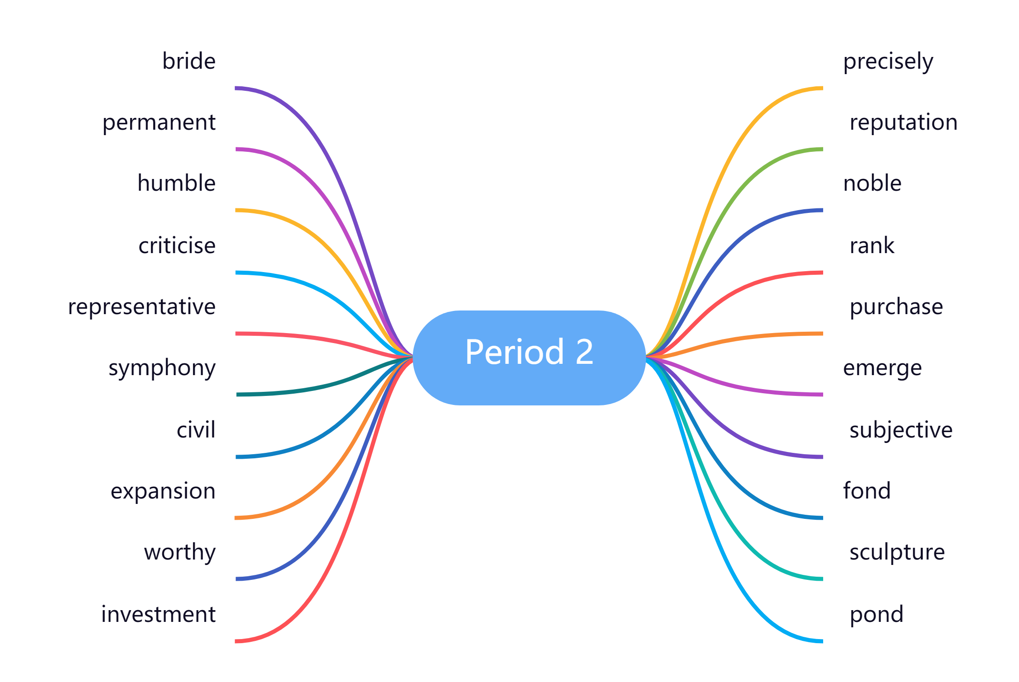
Summary

Slide 33
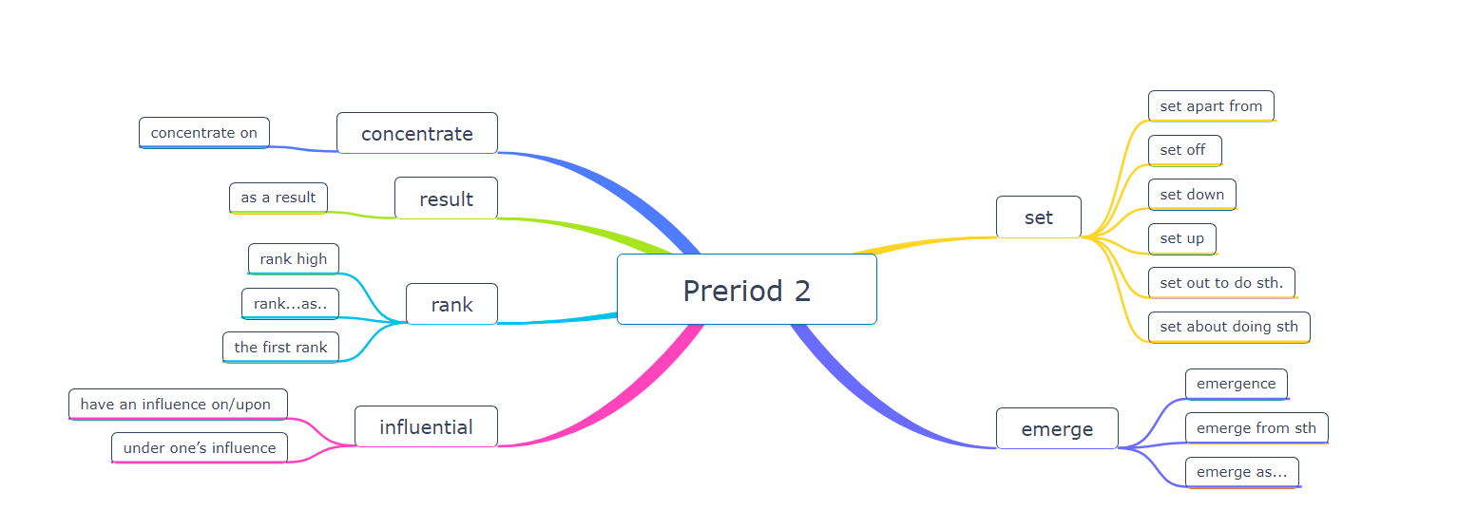
Summary

