Slide 1
R·九年级全一册
Unit 6 When was it invented?
第二课时

Slide 2
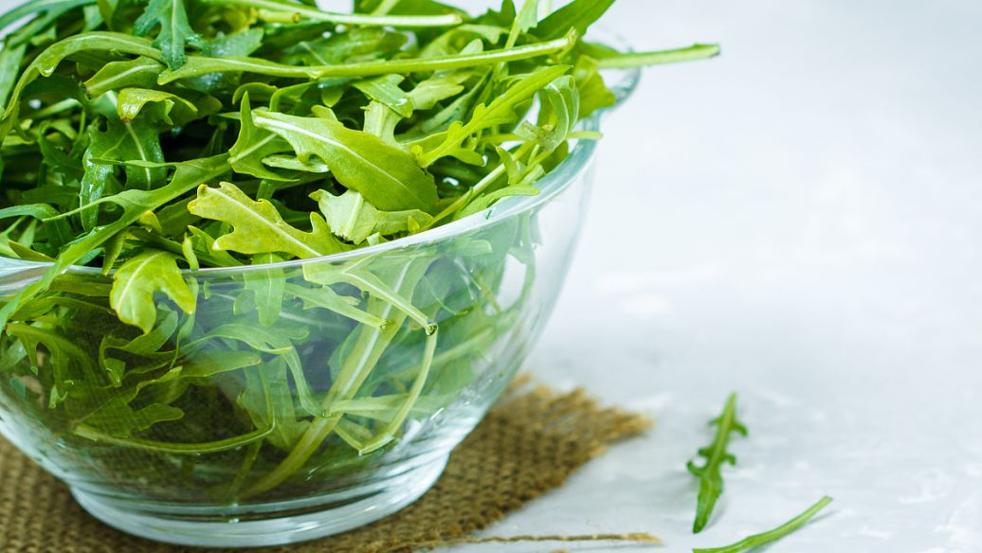
Lead in
Who invented the tea?
How was the tea invented?
Tea was invented by accident.

Slide 3
Language points
一、by accident的用法
by accident 偶然；意外地
介词短语，在句中作状语，相当于by chance
反义词组：on purpose 故意地

Slide 4
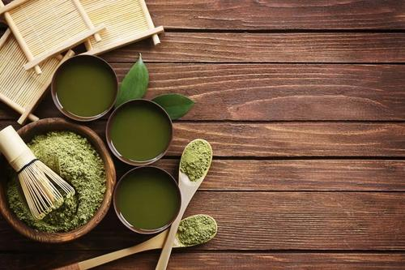
It is believed that tea was brought to Korea and Japan during the 6th and 7th centuries.

Slide 5
二、It is believed that…的用法
1. It is believed that…
＝People believe that… 人们认为/相信……
其中it为形式主语，真正的主语是that引导的从句。

Slide 6
2. 类似的句型：
It is said that … 据说……
It is reported that… 据报道……
It’s known that… 众所周知……
It is supposed/thought that… 人们认为……
状元成才路
状元成才路
状元成才路
状元成才路
状元成才路
状元成才路
状元成才路
状元成才路
状元成才路
状元成才路
状元成才路
状元成才路
状元成才路

Slide 7
形式主语
It is said that a Chinese ruler called Shen Nong was the first to discover tea as a drink.
that引导的真正主语
It is said that 据说……
the first to do sth. 第一个做某事的人

Slide 8
三、一般过去时的被动语态的句式结构
1. 肯定句
主语+was/were+及物动词的过去分词（ + by…）
2. 否定句
主语+was/were + not+及物动词的过去分词（+ by…)

Slide 9
3. 疑问句
Was/Were+主语+及物动词的过去分词（+by …)?
特殊疑问词+was/were+主语+及物动词的过去分词（ +by...)?

Slide 10
三、一般过去时的被动语态的基本用法
1. 表示过去某一具体时间发生的动作，且句子的主语是谓语动词动作的承受者:
The house was built in 1990.

Slide 11
2. 讲述发生在过去的动作，且不知道动作的执行者:
He was honored with the name “Father of Hybrid Rice”（杂交水稻之父）.

Slide 12
3.含双宾语和复合宾语的主动句变为被动语
态的方法
① 含有双宾语的主动句变为被动语态
若将指 “人”的间接宾语变为主语，而指“物”的直接宾语则不变。
I brought him some food.
He was brought some food.

Slide 13
② 如果要把指“物”的直接宾语变为主语，则在
间接宾语前加to或for。
I brought him some food.
Some food was brought to him (by me).

Slide 14
③ 含有复合宾语的主动句变为被动语态时，要将
其中的宾语变成主语，宾语补足语不变。
Jim asked Tom to go for a walk.
Tom was asked (by Jim) to go for a walk.

Slide 15
④ 如果宾语补足语是不带to的动词不定式，主动
语态变成被动语态时要加上不定式符号 to。
We often heard Kate sing in the room.
Kate was often heard to sing in the room (by us).

Slide 16
Let's talk
What is tea used for?
It’s used for drinking.

Slide 17
When was tea first drunk?
Many people believe that tea was first drunk about 5,000 years ago.

Slide 18
Who was it invented by?
It was discovered as a drink by Shen Nong.

Slide 19
When was tea brought to Korea?
It was brought to Korea during the 6th and 7th centuries.

Slide 20
Practice
1. It was invented _________ Edison.
A. by B. in C. for D. to
2. Basketball ______ by people all over the world.
A. is enjoyed B. is like
C. love D. enjoyed
A
A

Slide 21
Summary
1. It is said that a Chinese ruler called Shen Nong was the first to discover tea as a drink.
2. 一般过去时的被动语态
①句式结构
②基本用法
③含双宾语和复合宾语的主动句变为被动语态的方法

Slide 22
THANKS

