Slide 1
What were you doing when the rainstorm came?
Unit 5
R 八年级下册
Section B 2a-2b

Slide 2
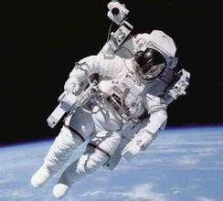
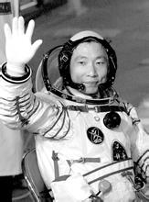
What do you doing at that time?
Yang Liwei flew around the Earth

Slide 3
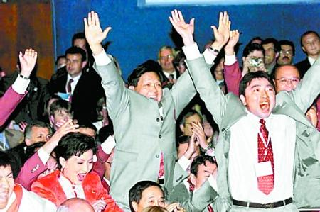
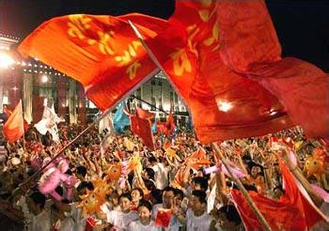
What do you doing at that time?
Beijing was made host to the 2008 Olympics.

Slide 4
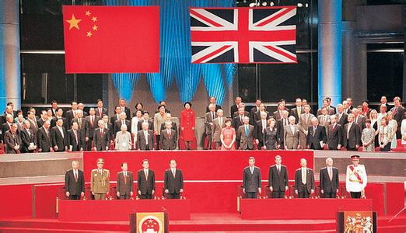
What do you doing at that time?
Hong Kong returned to motherland.

Slide 5
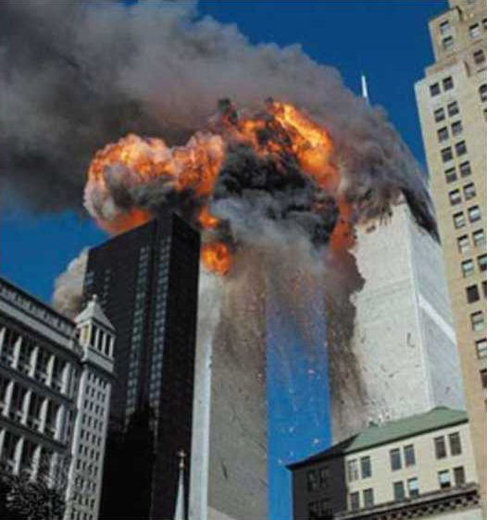
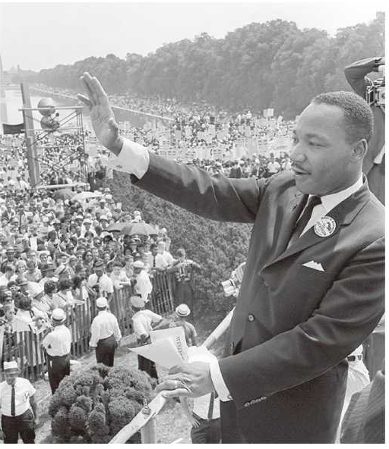
2a. Look at the pictures and title in
the passage. What do you think
the passage is about?

Slide 6
2b.Read the passage and answer the questions.
1.What are the two events in the passage?
2. When did they happen?
Dr. Martin Luther King was killed; The World Trade Center in New York was taken down by terrorists.
April 4, 1968; September 11, 2001.

Slide 7
Language points
1.What are the two events in the passage?
passage是名词，意为“章节；段落”， 作“(文章的)段落”解时,不限于文章的一个自然段,也可以由若干句话或若干个paragraphs组成。
如：This passage may be given several
interpretations.
这个段落可以有不同的解释。
How do you read this passage?
你怎么理解这段话?

Slide 8
Language points
2.Although some people may not remember
who killed him ,they remember what they
were doing when they heard the news.
although 相当于though 或even though，意为“尽管，虽然”，做连词，用来引导让步状语从句。这三个词都不能和but连用，但可以和副词yet，still，连用，也可以用but改写为同义句。
如：Although he is poor,he is still evry happy .
= He is poor, but he is still very happy .
虽然很穷，但他还是很幸福。

Slide 9
Language points
3. Robert Allen is now over 50,but he was a school pupil at that time.
（1）over more than意为“超过，多于”，相当于over，与数词连用。
如：There are more than 70 students in this class.
这个班上有70多名学生。

Slide 10
Language points
（2）pupil是名词，意为“学生”， pupil后面通常接in引起的短语,说明是“哪方面的学生”,有时也可接of或to短语,说明是“某人的学生”。
如：A teacher can't give individual attention to each pupil if his class is large. 如果班上的人数多，老师就不能给予个别学生辅导了。
The pupil divided the pencils by colour.
这名小学生按颜色把铅笔分类。

Slide 11
Language points
4. We were having fun in the playground when the school bell rang.
（1）have fun意为“玩得开心”，与该词组意思相同的短语是：enjoy oneself ,have a good time.
如：It's a good place to have fun.
那是个玩耍的好地方。
Did you have fun at the wedding?
你在婚礼上玩儿的好吗？

Slide 12
Language points
（2）playground是名词，意为“操场”。
如：The students are playing on
the playground.
学生们正在操场上玩。
The children were taking turns on the slides in the playground.
孩子们在操场上轮流滑滑梯。

Slide 13
Language points
5. We were completely surprised!
（1）completely是副词，意为“彻底地；完全地”。
如：A mosquito netting completely surrounds our bed.一顶蚊帐把我们的床完全围住了。
He is a contemporary of mine, but our experiences are completely different.
他和我是同龄人，但我们的经历截然不同。

Slide 14
Language points
6. School closed for the day,and Robert and his friends walked home in silence.
silence 是名词，意为“无声，缄默，沉默”，keep silence = keep quiet 。
如：There was nothing but silence in the room.
这间屋内声息全无，一片寂静。
We interpreted his silence as a refusal.
我们认为他的沉默是拒绝的表示。

Slide 15
Language points
它的形容词形式是silent ，副词形式为silently，本句中in silence 意为“沉默；无声”就相当于silently。
如：A patient throng was waiting in silence.
一大群人默默地静候着。

Slide 16
1. Don't _____ the window when the car is
running on the road. It's too dangerous.
A. look for B. look at
C. look out D. look up
2. He was ____ in a car accident.
A. kill B. to kill C. killed D. killing
3. ____ the water was cold, Wei Qinggang
jumped into it to save the little boy.
A. When B. Although C. If D. Because
C
C
B

Slide 17
4. The little boy made a mistake, when he
saw his father he was in ______.
A. silence B. silent
C. silently D. unsilence
5. When I got to school yesterday, I _____
I left my homework at home.
A. remember B. forgot
C. realized D. saw
A
C

