Slide 1

Unit 9
Can you come to my party?

Slide 2

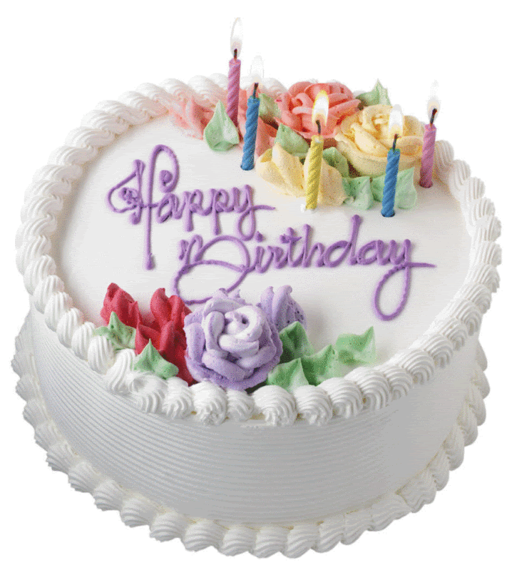
Section A
(1a-2c)

Slide 3
一、自主学习案
1.复习备考______________
2. 帮助我的父母干家务
__________________________
3. 去看医生________________
4. 见我朋友_____________
5.太多作业_____________________
6.谢谢你的邀请______________________
study for a test
help my parents do housework
go to the doctor
meet my friend
too much homework
thanks for your invitation

Slide 4

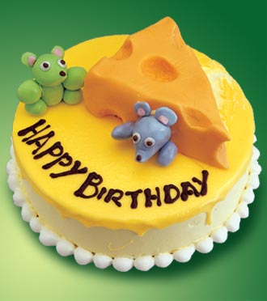
Can you come to my party?
Listen to the song !
And tell me if you can
come to my party?

Slide 5

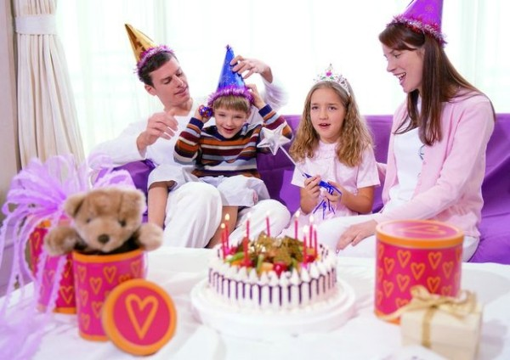
Presentation
A: Can you come to my party?
B: Sure, I’d love to.
Sorry, I can’t. I have to …

Slide 6
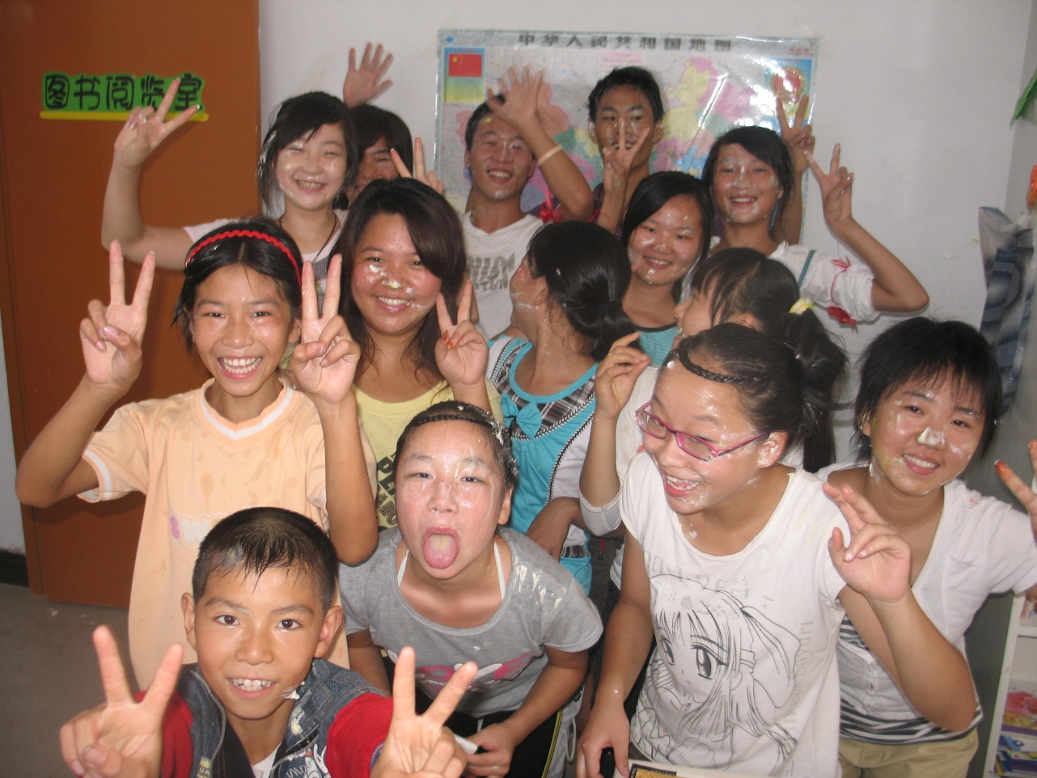
A: Can you come to my party?
B: Sure, I’d love to.

Slide 7
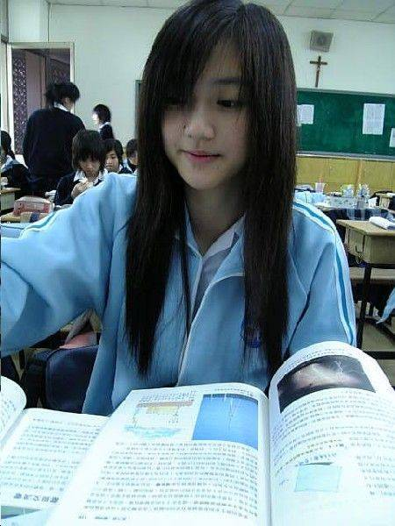
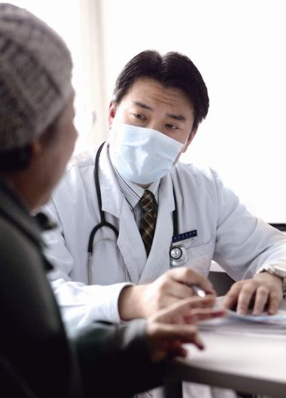
A: Can you come to my party?
B: I’m sorry, I can’t. I have to….
准备考试
看医生
prepare for an exam
go to the doctor

Slide 8
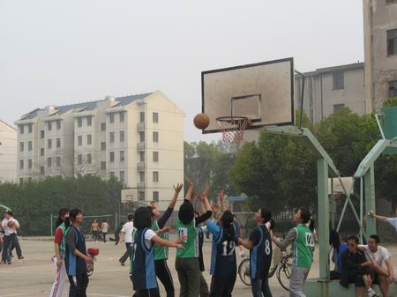
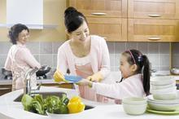
A: Can you play basketball with us?
B: Sorry, I can’t. I have to …
帮助父母
help my parents

Slide 9
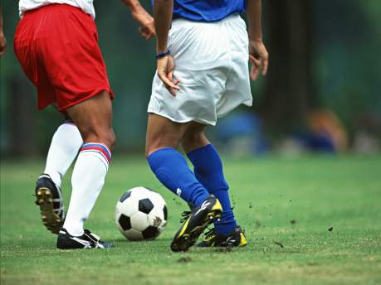
play soccer with us
A: Can you ________________ ?
B: Sorry, I can’t. I have to …
会见我的朋友
meet my friend

Slide 10
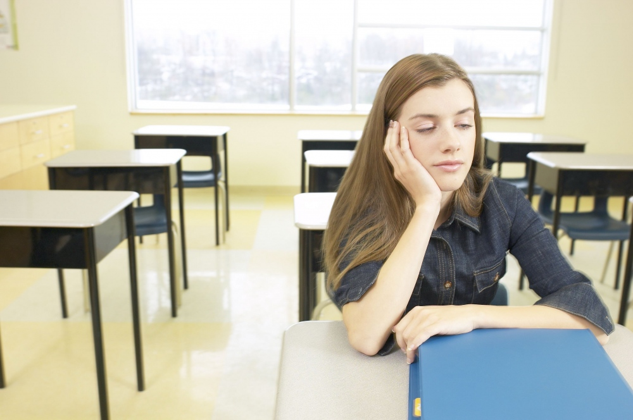
A: Can Lucy______________?
go to the party
has the flu
B: Sorry, she _____. She___________.
can’t
参加聚会
得流感
Lucy
Notes:
Ask students to talk about their life in ten years.
E.g. I’ll be an engineer.
I’ll go to Sydney on vacation.

Slide 11
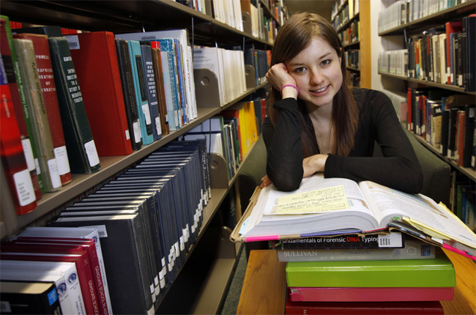
A: Can Kate____________?
go fishing
B: Sorry, she ______.
She______________
can’t
must prepare for the math exam.
钓鱼
必须准备数学考试
Kate
Notes:
Ask students to talk about their life in ten years.
E.g. I’ll be an engineer.
I’ll go to Sydney on vacation.

Slide 12
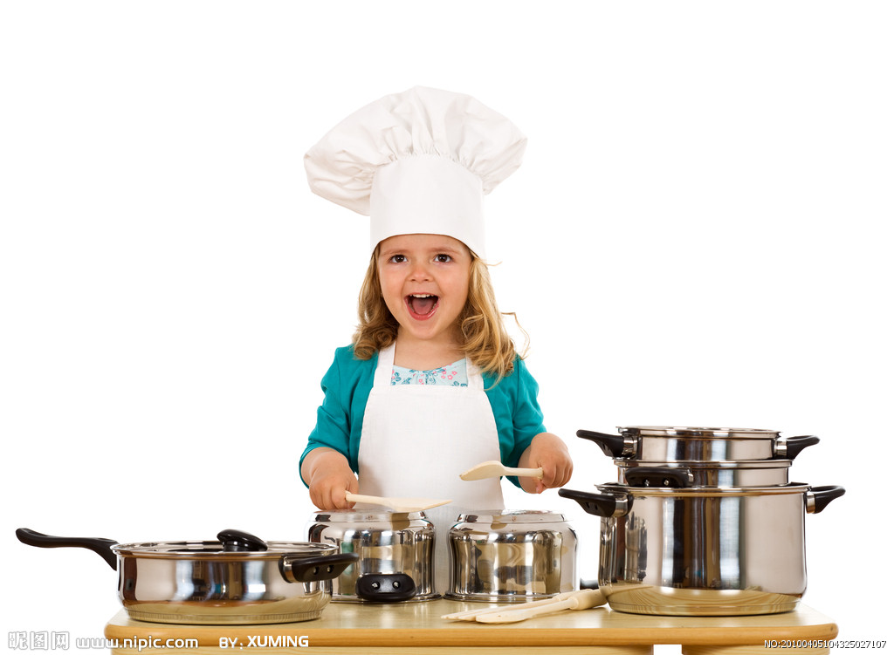
A: Can Linda_________________?
go to the movies
has to help her
parents.
B: Sorry, she ______. She______________
can’t
看电影
不得不帮助她的父母
Linda
Notes:
Ask students to talk about their life in ten years.
E.g. I’ll be an engineer.
I’ll go to Sydney on vacation.

Slide 13
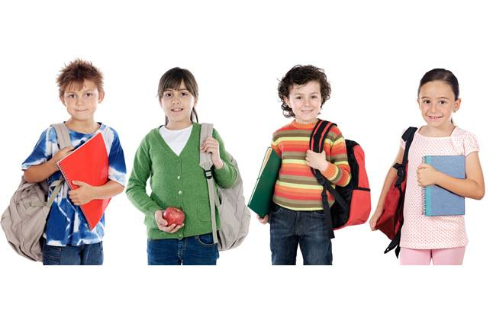
A: Can they____________?
go shopping
have to visit
their grandparents
B: Sorry, they _____. They______________.
can’t
购物
不得不拜访他们的祖父母
they
Notes:
Ask students to talk about their life in ten years.
E.g. I’ll be an engineer.
I’ll go to Sydney on vacation.

Slide 14
Self-study Result

Slide 15
【预习闯关一】
1.备考
2. 去看医生
3.帮助我的父母
4. 会见我的朋友
5.得流感
6.在星期六下午
7.当然，我乐意去。
8.我没有空。
9. 另外一个时间
10.感谢邀请。
prepare for an exam
go to the doctor
help my parents
meet my friend
have the flu
on Saturday afternoon
Sure, I’d love to.
I’m not available.
another time
Thanks for asking.

Slide 16
【探索闯关】
1> Can you play the guitar? Yes, I can.
2>--Can you come to my party on Wednesday?
--Sure , I’d love to.
--Sorry, I can’t .I have to go to the doctor.
例句1> 在初一我们学过can表示做某事的能力，意思为“______________”。
例句2>can在本课在疑问句中表示委婉的请求或邀请。同意对方时常用_____________________来回答。不同意时要用_________________来委婉拒接，一般情况下说明理由。
能 ，会
Sure, I’d love to. Of course.
I’m sorry, I can’t.

Slide 17
How to accept an invitation:
拓展
Yes, I’d love/like to.
Certainly, I’d love/like to.
Sure, I’d love/like to.
Thanks for your invitation.
Thanks for asking me.

Slide 18
How to decline an invitation:
I’m sorry, I can’t. I have to…
I’d love to, but I have to…
Sorry, I can’t. I’m going to the movies.

Slide 19
【活学活用】
1.—Can you go shopping with us this Sunday?
—_______
Yes, I can. B. Sorry, I can.
C. Sure, I’d love to. D. No, I can’t.
2.— Can you come to my English party this weekend?
— Sure,______.
I’d love to B.I’d like
C.I’d love D.I have to
3.—Can you stay here for dinner?
—Sorry, I _____. I have something important to do.
A. don’t B.didn’t C.needn’t D.can’t
C
A
D

Slide 20
Exercise:
1. ——你能来参加我的聚会吗？
——对不起, 我不能去。我必须在家做作业。
—____ you come to my party?
—Sorry, I _____. I _______ do my homework
at home.
2. 汤姆, 你可以进来了。
Tom, you ___ ____ __.
3. 罗莎不得不为数学测试学习。
Rosa ___ __ ____ for a math test.
Can
can’t must
can come in
has to study

Slide 21

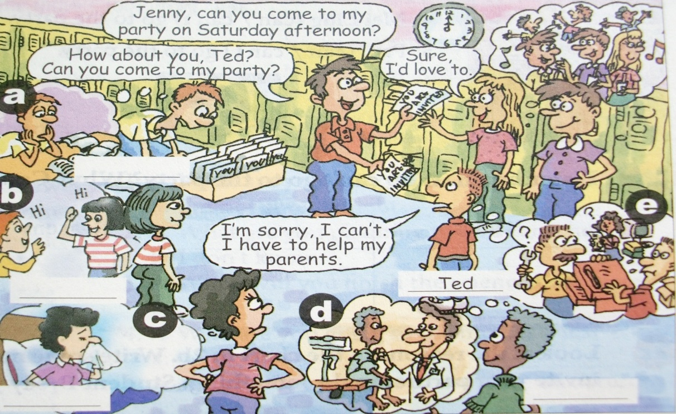
1a
Match the phrases with the pictures (a-e).
a
1. prepare for an exam ______
2. help my parents ______
3. go to the doctor ______
4. meet my friend ______
5. have the flu ______
e
d
b
c

Slide 22
Listening
1b
Listen and write the names (Tim, Kay, Anna and Wilson) next to the correct students in the picture.

Slide 23

Tim
Anna
Wilson
Kay

Slide 24
Saturday
Sun Ning:Hey,Ted.Can you come to my party on __________afternoon?
Ted: I’m sorry, I can’t, Sun Ning. I _____ ___help my parents.
Sun Ning: Too bad. ____ _____you,Jenny? Can you _____ ___my
party?
Jenny: I’d love to.
Sun Ning: Tim? What about you?
Tim:When is it?
Sun Ning: Saturday afternoon.
Tim: Oh,no,I can’t. I have to _______ ___ an exam.
Sun Ning: What about you,Wilson?
Wilson: Sorry, I must ____ _____ ____ _______.
Sun Ning: Anna, can you come?
Anna: I can’t, Sun Ning. I __ _____have to _______ _____ _______.
Kay: I can’t ________,Sun Ning. I ______ ______ _______.
Sun Ning: That’s too bad, Kay. Oh, maybe _______ _______. What a
_______ party!
have to
How about
come to
prepare for
go to the doctor
might
meet my friend
either
have the flu
next time
small

Slide 25

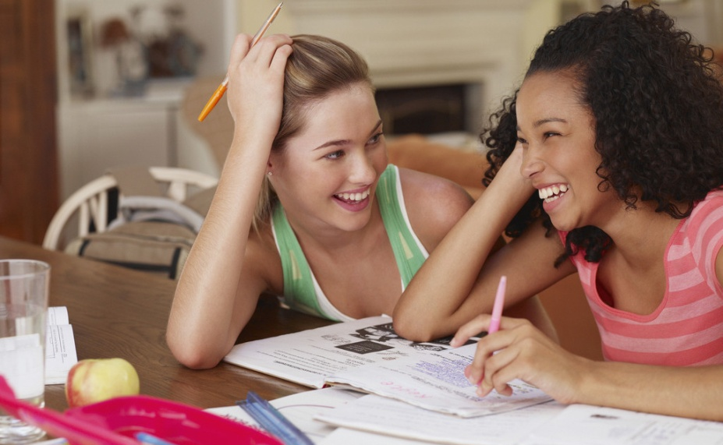
1c
Pair work
You are the students in the picture. Student A, invite three students to your party. Student B, C and D, give answers.
Can you come to my party on Saturday afternoon?
Sure, I’d love to.

Slide 26
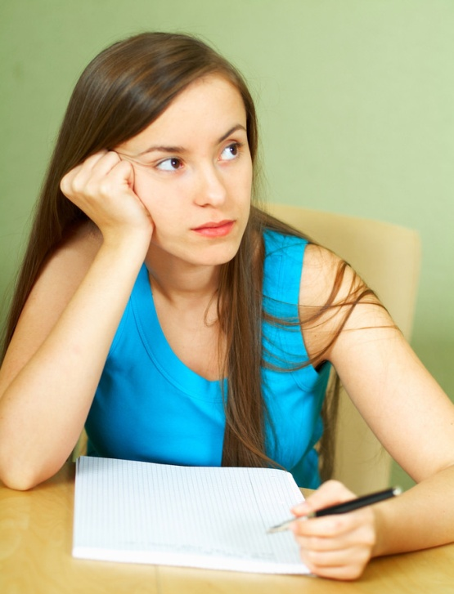
Sorry, I can’t. I have to prepare for an exam.
I’m sorry, too. I must go to the doctor.

Slide 27
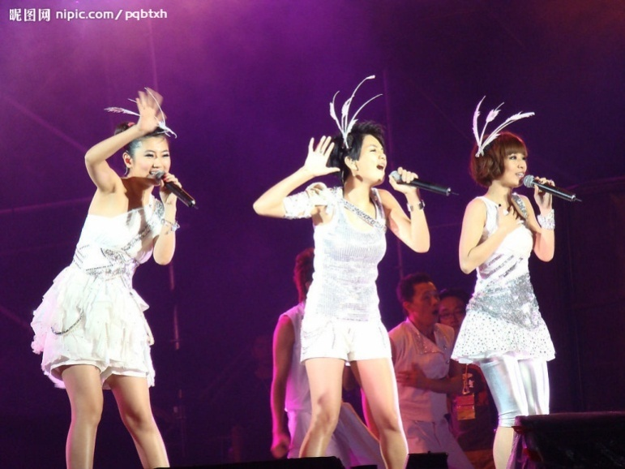
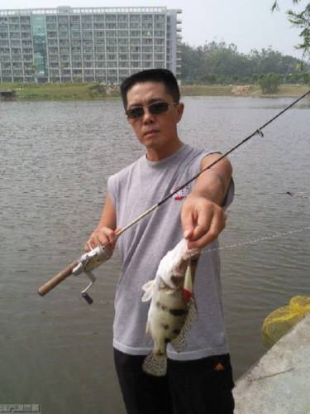
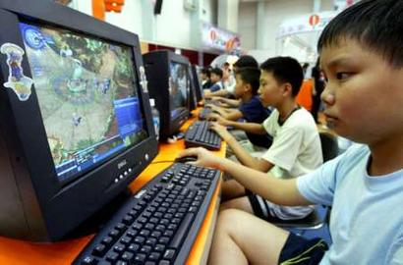
Pair work
A:Can you …?
B:Sure, I’d love to.
I’m sorry, I can’t. I …
I’d love to, but I…
go to the concert
go fishing
play computer games

Slide 28

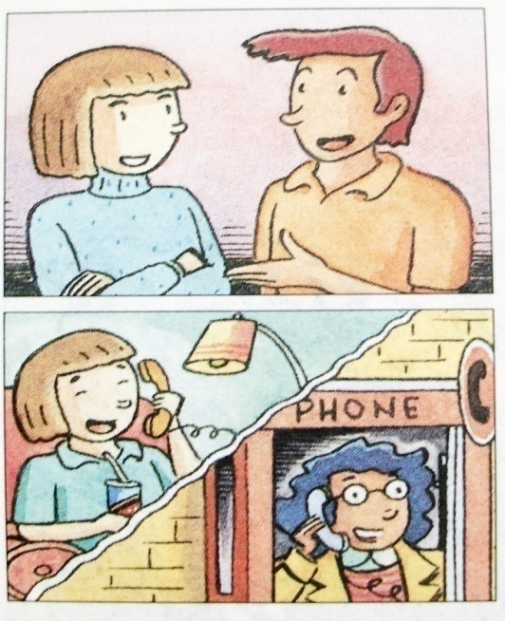
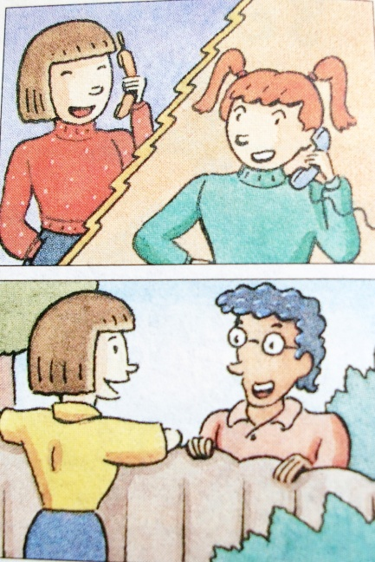
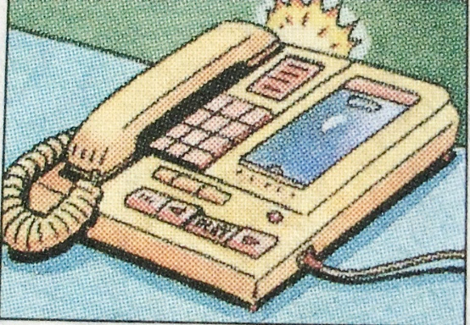
Listening
2a
Listen and circle can or can’t.
1. Jeff (can / can’t ) go to the party.
2. Mary (can / can’t) go to the party.
3. May (can / can’t) go to the party.
4. Mei Ling (can / can’t) go to the party.
5. Paul (can / can’t) go to the party.

Slide 29
2b
Listen again. Who can’t go to the party? Why? Complete the chart.
Names | Reasons
Jeff
meet his friend on Saturday
May
has the flu
Mei Ling
study for a math test

Slide 30

2c
Pairwork
Look at the reason in the chart in 2b. Write some more. Then, Student A, invite your partner to do something. Student B, say you can’t go and why.
1. too much homework
2. ____________________
____________________
____________________

Slide 31
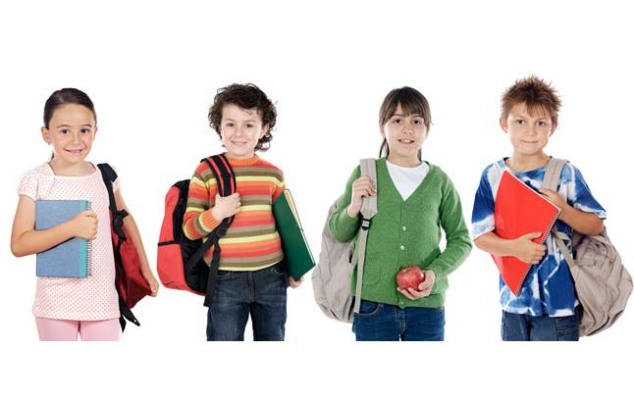
Hey, Dave. Can you go to the movies on Saturday?
I’m sorry, I’m not available. I have too much homework this weekend.
That’s too bad. Maybe another time.
Sure, Joe. Thanks for asking.

Slide 32
针对性训练
用所给词的适当形式填空。
1. I’d love （play）soccer with you.
2. He （go）to the movies tomorrow afternoon.
3. Can Kate （come）to the party？
4.Thanks for （ask）us to the party.
5. My mother （have）to wash many clothes every day.

Slide 33
单项选择
1. I have _____ homework to do.
A. too many B. too much C. much too D. a few
2. He ___ stay at home, because his mother
was ill.
A. has to B. have to C. had D. had to
3. I went to the mountain _____.
A. next week B. the day after tomorrow
C. yesterday D. tomorrow
B
D
C

Slide 34
4. ____ Friday morning, I like to go to the
movie ___ friends.
A. In; on B. On; with C. On; and D. At; with
5. Would you please ____me ____ the
housework?
help; in B. to help; with
C. help; doing D. help; do
B
D

Slide 35
6. Are you ___ football this weekend?
A. playing B. play C. play a D. Plays
7. I have to go to my guitar lesson ____
19:00___20:00 __ the evening.
A. from; to; on B. in; at; on
C. from; to; in D. at; at; on
A
C

Slide 36

Thank you!

