Slide 1
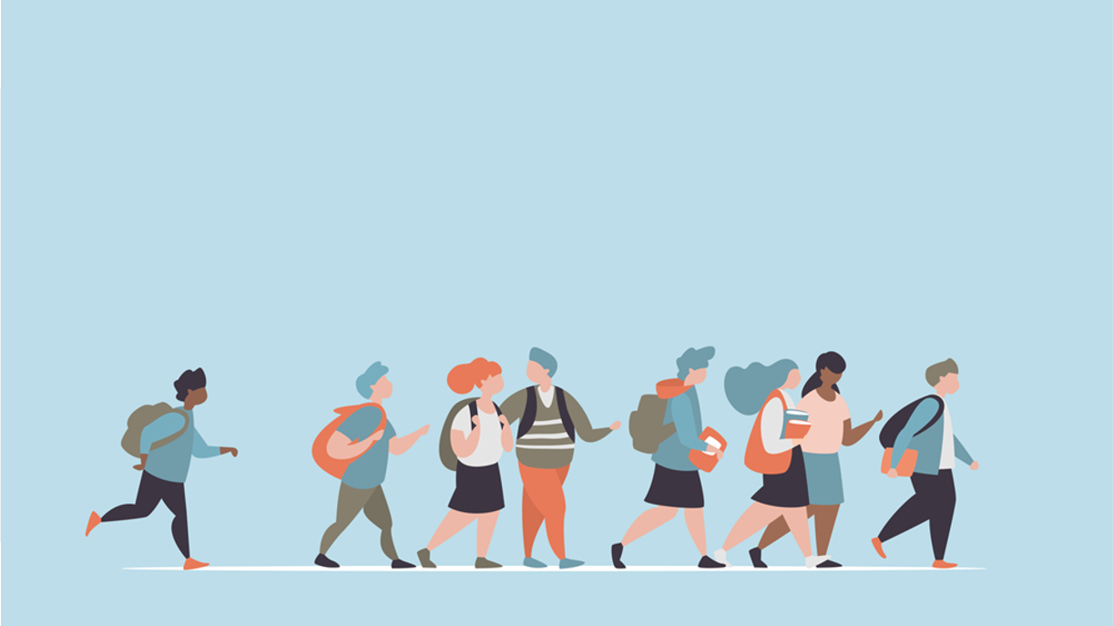
R·九年级全一册
Unit 2 I think that mooncakes are delicious!
第三课时

Slide 2
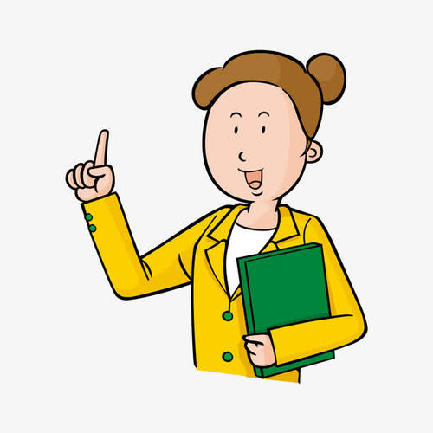
Lead in
What is your favorite Chinese festival? Can you tell more about it? Why do you like it?
状元成才路

Slide 3
What is the name of the festival?
When is it?
What do people eat?
What do people do?
Why do you like it so much?
Mid-Autumn Festival
The 15th day of the 8th lunar month
Mooncakes
Admire the moon, share mooncakes, tell folk stories about Mid-Autumn Festival
Families get together on Mid-Autumn Day

Slide 4
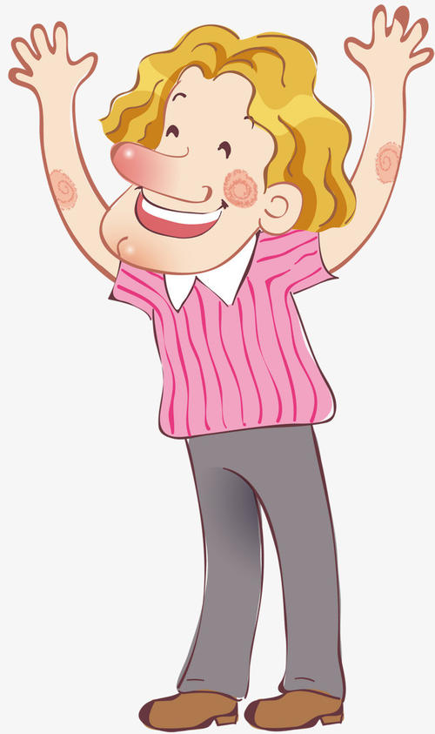
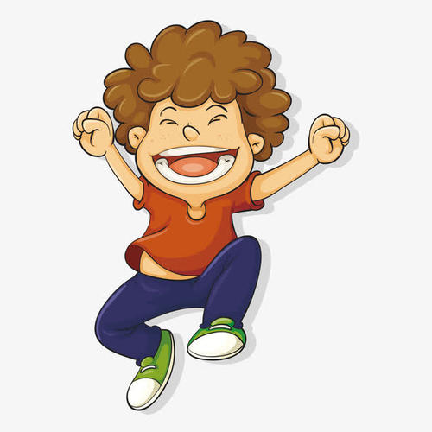
Language points
I wonder if it’s similar to the Water Festival of the Dai people in Yunnan Province.
What do you think of the water festival?

Slide 5
询问别人对人对事的看法，可以用句型： What…think of…?
How do/ does...like...?

Slide 6
be similar to 跟……类似；与……同样的
be different from … 与……不同
My problems are very similar to yours.

Slide 7
Write a letter to your pen pal and tell him/her about your favorite Chinese festival.

Slide 8
Use the following expressions to help you:
My favorite Chinese festival is…
It is celebrated in/ on… During this festival, people…
It’s my favorite festival because…
It makes me feel…

Slide 9
In your letter
First, introduce the festival and when it is celebrated.
My favorite Chinese festival is…
It is celebrated in/on …
状元成才路
状元成才路
状元成才路
状元成才路
状元成才路
Then talk about what people do and eat.
During this festival, people…
状元成才路
状元成才路
状元成才路
状元成才路
状元成才路
状元成才路
Finally, explain why you like it best and how it makes you feel.
It’s my favorite festival because…
It makes me feel…

Slide 10
Sample writing
Dear Tony,
Do you know Mid-Autumn Festival in China? It’s my favorite festival. It’s celebrated on the 15th day of the 8th lunar month.
During this festival, people usually hold Mid-Autumn Festival celebrations. People say “Happy Moon Festival” to each other.

Slide 11
On Mid-Autumn night, families get together in the open air outside their houses, admire the moon and eat mooncakes. People also tell folk stories about Mid-Autumn Festival. For example, the story of Chang’e is one of the most popular ones.
It’s my favorite festival because families get together during the festival. It makes me happy.
Yours,
Li Ming

Slide 12
Practice
Make sentences about a festival/festivals you like using these words + that/whether/if.
that mooncakes with yolks are more delicious than the ones without
I think ___________________________________
___________________________________.
I know ___________________________________
___________________________________.
that the shape of the mooncake symbolizes the full moon at mid-autumn

Slide 13
I believe_____________________________________.
I wonder_____________________________________
_____________________________________.
we will have good luck in the new year
whether we will eat zongzi the next Dragon Boat Festival

Slide 14
Summary
1. I wonder if…
I wonder if it’s similar to the Water Festival of the Dai people in Yunnan Province.
2. What do/does + sb. + think of sth.?
What does Wu Yu think of this festival?

Slide 15
THANKS

