Slide 1

Unit 7
How much are these socks?
Section A (1a-1c)
人教版七年级(初中)英语上册
0

Slide 2
Learning objectives
1）To learn the new words: much, sock, T-shirt, shorts, sweater, trousers, shoe, skirt, dollar
2）To learn the following sentence patterns:
① —How much is this T-shirt? —It’s seven dollars.
② —How much are these socks? —They’re two dollars.
3）To learn to ask about prices and talk about clothing.
0

Slide 3
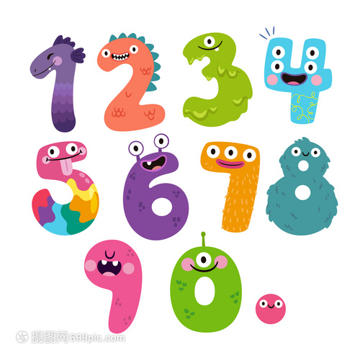
Lead in
Let's review the numbers from 0-10.
zero
one
one
two
three
three
four
five
six
seven
eight
nine
ten

Slide 4
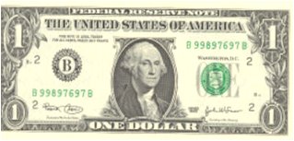
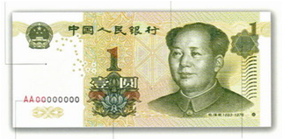
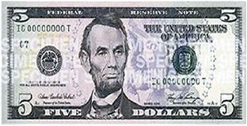
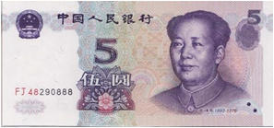
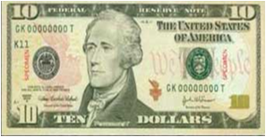
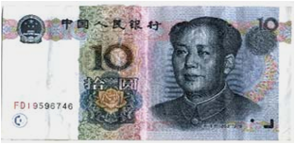
Lead in
Do you know the money?
$ dollar
￥ yuan
$1
￥1
= 1 dollar
= 1 yuan
$5
￥5
= 5 dollars
= 5 yuan
$10
￥10
= 10 dollars
= 10 yuan

Slide 5

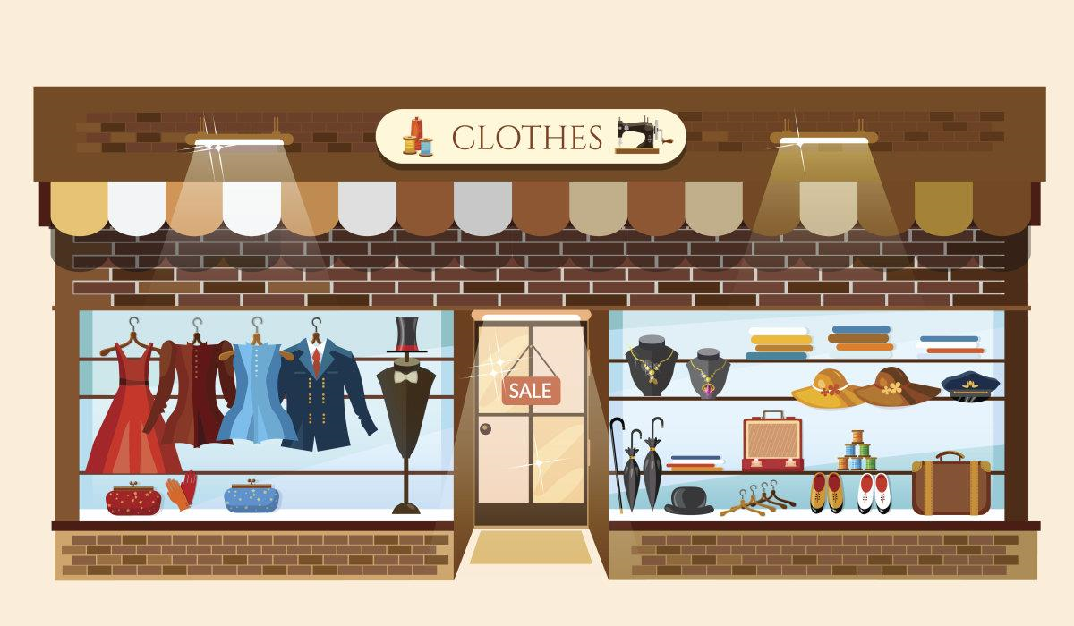
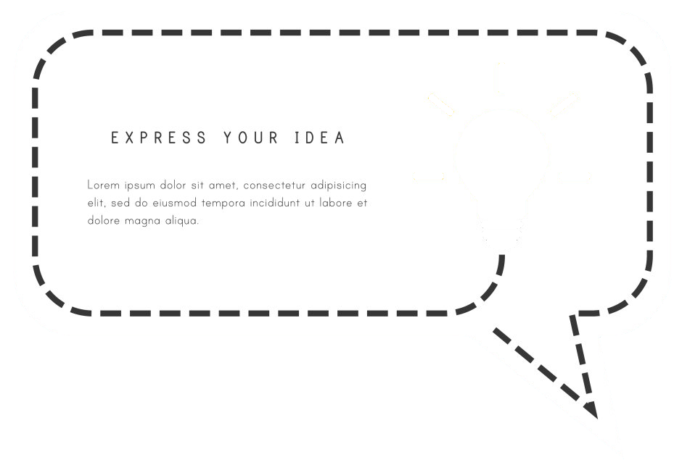
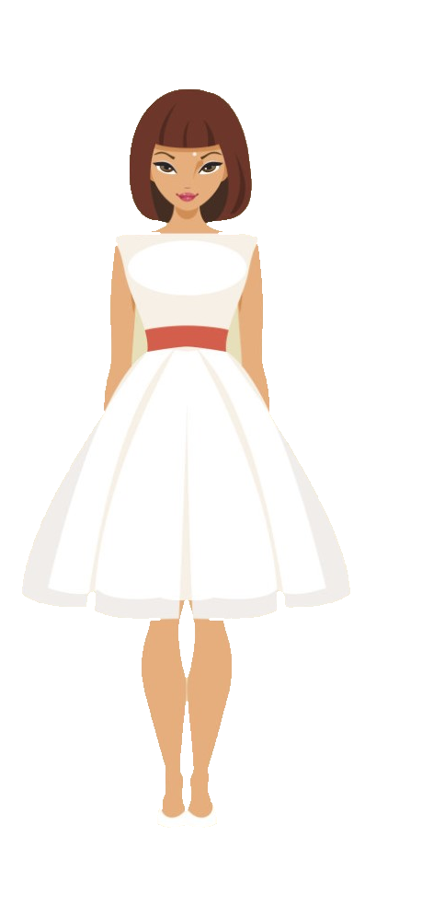
Presentation
This is my clothes store!

Slide 6
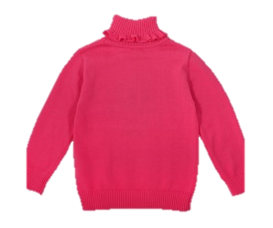
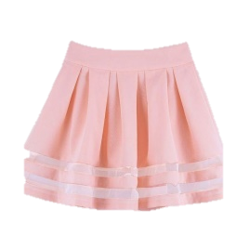
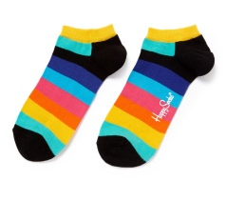
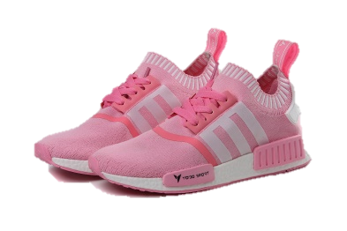
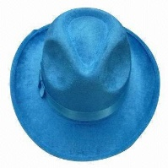
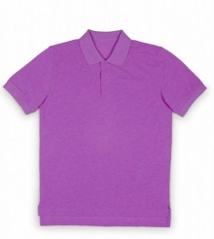
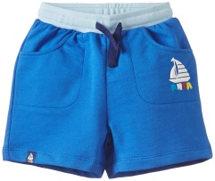
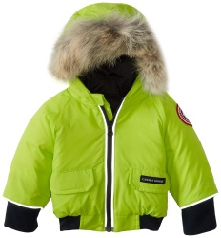
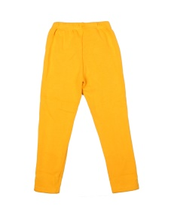
Presentation
What's/are this/these?
sweater
socks
skirt
clothes
hat
shoes
T-shirt
shorts
jacket
trousers

Slide 7
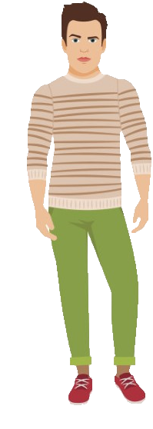





Presentation
What do they wear?

Slide 8
Presentation
What does he/she wear?
?
?
?
?
?
?
?
?

Slide 9
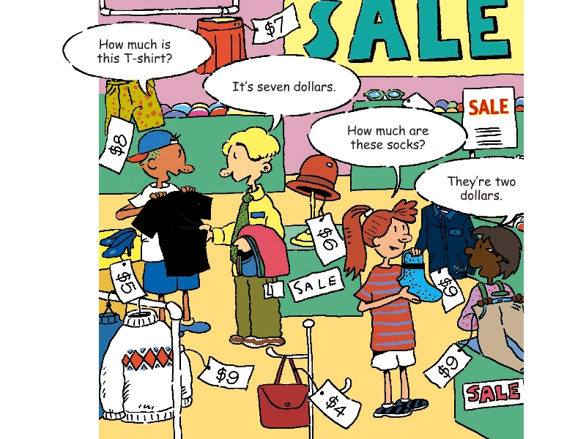
Presentation
1a Match the words with the things in the picture.
i
1. socks _____
2. T-shirt _____
3. shorts _____
4. sweater _____
5. bag _____
6. hat _____
7. trousers _____
8. shoes _____
9. jacket _____
10. skirts _____
d
e
a
a
c
g
f
g
b
h
j
d
i
b
j
h
e
c
f

Slide 10

1b Listen and circle the things you hear in the picture in 1a.
Presentation
e
a
g
h
b
d
i
j
c
f

Slide 11
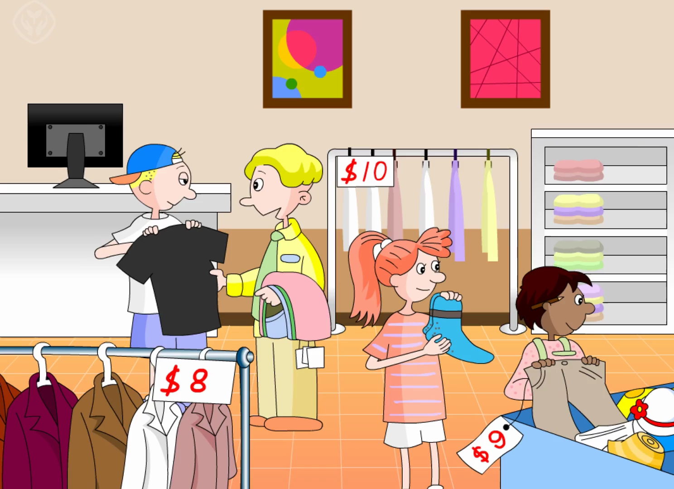
Presentation
Repeat the conversation.

Slide 12
Presentation
Complete the conversation.
Girl: How much is the ________?
Woman: It's _____________.
Girl: And how much are ______________?
Woman: Oh, they're _____________.
Girl: And _____________? How much is it?
Woman: Let's see. It's ____________.
hat
six dollars
these shorts
eight dollars
this sweater
nine dollars

Slide 13
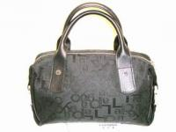
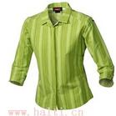
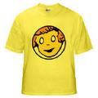
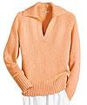
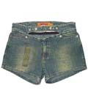
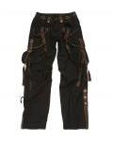
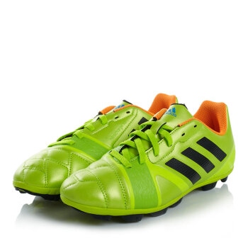
Presentation
1c Practice the conversation with your partner. Then make your own conversations.
— How much is this...?
— How much are these...?
— It’s... dollars.
— They’re... dollars.
$12
$7
$2
$10
$9
$5
$11
$1

Slide 14
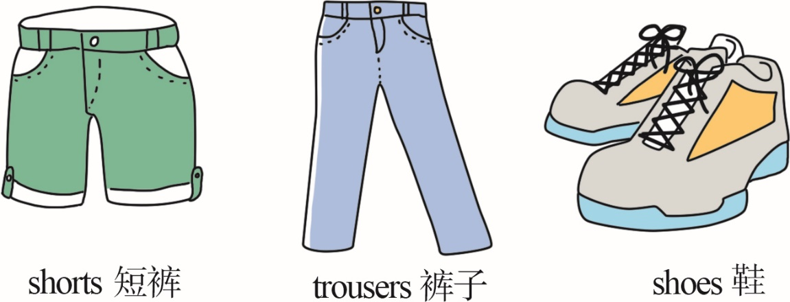
Language points
1. socks n. 短袜
常以复数形式出现。表示“一双短袜”用a pair of socks。
与socks一样，成对出现的名词还有：

Slide 15
Language points
2. —How much is this T-shirt?
—It’s seven dollars.
“How much is/are...?”是询问物品价格的句型，其答语通常为“It’s/They’re+价格”，也可直接说出价格。
—How much is the schoolbag? 这个书包多少钱？
—It’s twelve dollars. 12美元。
—How much are these apples? 这些苹果多少钱？
—They’re nine dollars. 9美元。

Slide 16
Language points
How much “多少” 提问不可数名词的数量
How much rice do you need?
你需要多少米饭？
—How much milk is there in your box? 你的箱子里有多少牛奶？
—There are 12 bags of milk. 12袋牛。

Slide 17
Language points
much可作形容词或代词，用来指代或修饰不可数名词。
There is much milk in the bottle. 瓶子里有许多牛奶。
（作形容词，修饰milk）
Don’t eat too much for dinner. 晚餐不要吃太多。
（作代词，指代much food）

Slide 18
Language points
1) dollar是美国、加拿大等国的货币单位，复数形式为dollars，
符号为$。
The tennis bat is 10 dollars. 这个网球拍10美元。
This skirt is $15. 这条短裙15美元。
拓展：dollars作主语时，看作单数。
Ten dollars is enough. 10美元足够了。

Slide 19
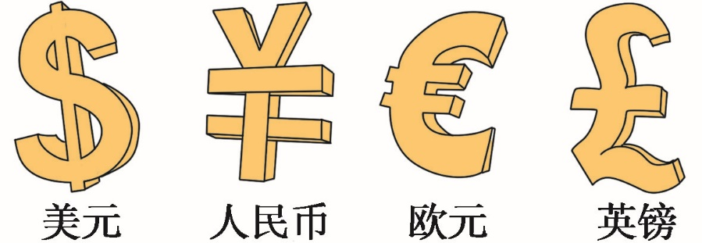
Language points
人民币的单位是元（yuan）、角（jiao）、分（fen），在英语中用汉语拼音表示（汉语拼音要斜体），没有复数形式。
—How much is the T-shirt? 这件T恤衫多少钱？
—Fifty yuan. 50元。
【常见货币符号】

Slide 20

Exercise
单项选择:
1. Her black shoes 50 dollars.
A. isn’t B. is C. are D. don’t
2. —How much are the black socks?
— .
A. It’s 10 yuan. B. It’s 10 yuans.
C. They’re 10 yuan. D. They’re 10 yuans.

Slide 21
Exercise
3. — is it? —It’s orange (橙色的) .
A. What B. What color
C. How much D. How many
4. — ?
—Yes, please. I want a skirt.
A. Is this your skirt B. What do you do
C. What do you want D. Can I help you
5. How much do you want?
A. tomatoes B. chicken
C. apples D. eggs

Slide 22
Homework
1. Copy the key words in 1a for three times.
2. Make up two similar conversations according to 1c.

