Slide 1
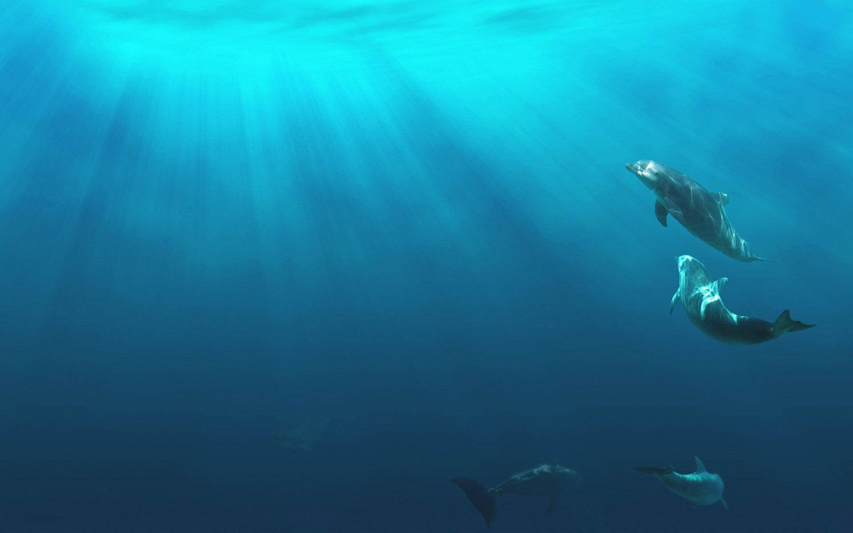
Unit 2
Iconic Attractions

Slide 2
内容索引
Period Four Using Language & Other Parts
语篇理解 精读演练 萃取文本精华
基础自测 自主学习 落实基础知识
互动探究 探究重点 互动撞击思维
达标检测 当堂检测 基础达标演练

Slide 3
语 篇 理 解
精读演练 萃取文本精华
Ⅰ.Read the passage quickly and get the general idea of the passage.
1.What’s the main idea of the passage?
A.The kangaroos of Australia.
B.The koalas of Australia.
C.The duck-billed platypus of Australia.
D.The creatures unique to Australia.
√

Slide 4
2.Read the passage and match the main idea of each part.
Part 1 A.The duck-billed platypus of Australia.
Part 2 B.The kangaroos of Australia.
Part 3 C.The koalas of Australia.
Part 4 D.The Tasmanian devils of Australia.

Slide 5
Ⅱ.Read the passage carefully and choose the best answer.
1.Which animal is a symbol of Australia?
A.The duck-billed platypus.
B.The kangaroos.
C.The koalas.
D.The Tasmanian devils.
√

Slide 6
2.Which of the following statement is NOT true?
A.In many places in Australia，it is against the law to hold the koalas.
B.Koalas are not only quite cute but also very sensitive creatures.
C.Koalas like to interact with humans.
D.People can hold a koala for only a limited time and on a limited
frequency of occasions.
√

Slide 7
3.What can we know about the Tasmanian devils from the text?
A.They can easily be seen.
B.They can make very loud noise.
C.They can wake the dead.
D.They don’t eat dead animals.
√

Slide 8
4.All the following are true EXCEPT that .
A.the duck-billed platypus lays eggs in a nest like a bird
B.the duck-billed platypus is a primitive mammal，with a unique biology
C.the duck-billed platypus uses its senses of sight or smell to find food
D.the duck-billed platypus finds food by using electrical sensors in its bill
√
返 回

Slide 9
基 础 自 测
自主学习 落实基础知识
重点单词
1. n.高尔夫球运动
2. n.海峡
3. n.样本；样品
4. n.纪念碑(或馆、堂、像等)；历史遗迹
5. adj.暂时的；短暂的
6. n.阶段；时期
7. n.树干
8. n.能力；容量
9. n.一场；一段时间；会议
golf
strait
sample
monument
temporary
phase
trunk
capacity
session

Slide 10
10. n.巢穴；鸟窝；秘密窝点
11. n.哺乳动物
12. vi.孵出；破壳
vt.使孵出；策划；(尤指)密谋
13. n.栅栏；围栏
14. n.监狱；监禁
15. adj.大；宏大的
16. n.分布；分配；分发
→ v.分配；散发；分布
nest
mammal
hatch
fence
prison
grand
distribution
distribute

Slide 11
17. n.发生率；重复率；(声波或电磁波振动的)频率
→ adj.频繁的；时常发生的；惯常的
18. vt.批准；许可
n.(＝licence)许可证；执照
→ adj.得到正式许可的
19. n.生理；生物学
→ n.生物学家
20. adj.暴力的；猛烈的
→ n.暴力；暴行
frequency
frequent
license
licensed
biology
biologist
violent
violence

Slide 12
掌握规律 巧记单词
biology(n.生理；生物学)＋-ist(表名词，表示信仰者，专家或从事的人)→biologist n.生物学家
例如：science n.科学→scientist n.科学家
social adj.社会的→socialist n.社会主义者

Slide 13
核心短语
1. 到达；找到……的去路
2. 一群(羊或鸟)
3. 也；和……一样；不但……而且
4. 少数人(或物)；一把(的量)
5. 捡起；获得；收拾；乘车，搭载；不费
力地学会
6. 在这个阶段之后
7. 违法
8. 与……的互动
9. 在限频率的场合
10. 对……施暴
find one’s way into/to
a flock of
as well as
a handful of
pick up
after this phase
be against the law
interaction with
on a limited frequency of occasions
be violent towards

Slide 14
经典句式
1.where引导定语从句
If you want to hold a koala，you have to go to certain licensed zoos and that they are handled for only a limited time and on a limited frequency of occasions.
如果你想抱一个考拉，你必须去某些许可的动物园，动物专家确保选择作为交流的考拉处于良好状态，而且只有在有限的时间和限频率的场合(才可以)。
where animal experts make sure that the koalas selected for each session are in a good state for human contact

Slide 15
2.while引导让步状语从句
，it’s really a primitive
mammal，with a unique biology.
虽然它可能像鸟一样在巢里产卵，但它确实是一种原始的哺乳动物，具有独特的生物学特性。
While it may lay eggs in a nest like a bird
返 回

Slide 16
互 动 探 究
探究重点 互动撞击思维
重点词汇
It has to be the kangaroo，as it has a wide distribution throughout the country.它必须是袋鼠，因为它在全国各地都有广泛的分布。
1
distribution n.分布；分配；分发
distribute vt.分发；分配；分布；分类
distribute sth. to把某物分发/配给
distribute according to根据……分类
distribute among在……中分发

Slide 17
(1)The map shows the distribution of this species across the world.
这张地图显示了这个物种在全世界的分布情况。
(2)Please distribute books the students.
请把书发给学生。
(3)The books in the library (distribute) according to subjects.
图书馆的书按科目分类。
among
are distributed

Slide 18
If you want to hold a koala，you have to go to certain licensed zoos where animal experts make sure that the koalas selected for each session are in a good state for human contact and that they are handled for only a limited time and on a limited frequency of occasions.如果你想抱一个考拉，你必须去某些许可的动物园，动物专家确保选择作为交流的考拉处于良好状态，而且只有在有限的时间和限频率的场合(才可以)。
2
licensed adj.得到正式许可的
license vt.批准；许可n.(＝licence)许可证；执照
license (sb. /sth. ) for sth. 批准……拥有(出售，发放)某物
under license许可；特许

Slide 19
(1)He told me he didn’t have a driver’s/driving license.
他告诉我他没有驾照。
(2)I must ask you to stop singing as the inn is not licensed music.
我必须要求你们停止唱歌，因为这个小客栈没被批准搞音乐活动。
(3)The restaurant (license) for the sale of beer，but not spirits.
这个饭店获准出售啤酒，但不准出售烈酒。
for
is licensed

Slide 20
[名师点津] (1)license的基本意思是批准某人以某种资格从事某种行动或经营某种业务，并授予正式的法律许可。引申则可表示“授权”。
(2)license只用作及物动词，接名词或代词作宾语，还可接以动词不定式充当补足语的复合宾语。license可用于被动结构。

Slide 21
frequency n.发生率；重复率；(声波或电磁波振动的)频率
increasing frequency越来越频繁
at/with...frequency 以……的频率
(4)He wrote to Mike with tolerable frequency.
他和迈克通信相当频繁。
(5)Accidents on that highway are happening increasing frequency.
那条公路上车祸发生得越来越频繁。
(6)This radio station broadcasts on four different (frequency).
这家无线电台用四种不同的频率播放节目。
with
frequencies

Slide 22
It has a capacity to find food in the water by using electrical sensors in its bill.它的喙上有一个电子传感器，可以在水中找到食物。
3
capacity n.能力；容量
have a capacity to do sth. /of sth. 有……的能力
in the capacity of以……的资格，有……的资格

Slide 23
(1)China’s grain production capacity has improved.
中国的粮食生产能力提高了。
(2)The pipeline has a capacity some 1.2m barrels a day.
该管线的输送量为每天约120万桶。
(3)She has an unbounded capacity (imitate) and adopt the new.
她有模仿和接受新事物的无限能力。
(4)She alone was the negotiation.
只有她有资格开始谈判。
of
to imitate
in the capacity of beginning

Slide 24
经典句式
If you want to hold a koala，you have to go to certain licensed zoos where animal experts make sure that the koalas selected for each session are in a good state for human contact and that they are handled for only a limited time and on a limited frequency of occasions.
如果你想抱一个考拉，你必须去某些许可的动物园，动物专家确保选择作为交流的考拉处于良好状态，而且只有在有限的时间和限频率的场合(才可以)。
where引导限制性定语从句，是关系副词，在从句中作地点状语，其前面有表示地点的先行词，where引导的从句修饰先行词。

Slide 25
(1)However，Molai went looking on his own and discovered a nearby island where he began to plant trees.(2020·新高考全国Ⅰ)
然而，Molai 开始自己去寻找，发现了附近的一个岛，并开始在那里种树。
[易混辨析] where引导的定语从句和地点状语从句的区别：
※where引导定语从句时，是关系副词，在从句中作地点状语，其前面有表示地点的先行词，where引导的从句修饰先行词。
※where引导状语从句时，是从属连词，其引导的从句修饰主句的谓语动词，where前面没有表示地点的先行词。
※在有些情况下，where引导的定语从句可转换为where引导的地点状语从句。
(2)Where there is a will，there is a way.
有志者事竟成。

Slide 26
[一句多译]
(3)在以前曾是沙漠的地方盖起了一幢高楼。
①A tall building was put up .(状语从句)
②A tall building was put up .(定语从句)
where there used to be a desert
at the place where there used to be a desert
返 回

Slide 27
达 标 检 测
当堂检测 基础达标演练
Ⅰ.单句语法填空
1.He has great capacity of learning languages.
2. he loves his students，he is very strict with them.
3.The bus stops regularly to set down and pick passengers.
4.Bamboo grows best in places it is warm and rains often.
5.The pine-trees have been planted in a very wide (distribute).
6.She will live here (temporary) before moving into her new house.
7.The shop where my younger brother works (license) to sell tobacco.
a
While
up
where
distribution
temporarily
is licensed

Slide 28
Ⅱ.完成句子
8. ，I can see his bad ones.
尽管我承认他的长处，但我也能看到他的不足。
9.This sum of money .
这笔钱应该在本地区的学校中分配。
10.I miss the place .
我很想念我童年居住过的地方。
11.Traffic accidents have decreased over recent years.
近年来交通事故发生的频率已经下降。
While I admit his good points
should be distributed in the local schools
where I lived in my childhood
in frequency

Slide 29
Ⅲ.选词填空
下面的短文是P19－21的课文改写，请从下表中选择合适的词汇并用其适当的形式完成此文。
frequent；hang onto；have a wide distribution；license；mammal；pick it up；hatch；find；a small handful of；among which

Slide 30
Australia has lots of unique animals，12. kangaroo is a symbol of the country as it 13. throughout the country.
Koalas which spend quite a lot of time 14. tree trunks are very cute but sensitive.So you shouldn’t approach it to 15. or even touch it unless in certain 16. zoos for only a limited time and on a limited
17. of occasions.
among which
has a wide distribution
hanging onto
pick it up
licensed
frequency

Slide 31
Australia also has a unique animal called the duck-billed platypus.Its eggs
18. after about ten days，and then the baby platypus nurses from its mother like all other 19. .It has a capacity 20. food in the water by using electrical sensors in its bill.There are only 21. animals in the world that can do that!
hatch
mammals
to find
a small handful of
返 回

Slide 32
本课结束

