Slide 1
Unit 2
How often do you exercise?

Slide 2
Section A
(1a-2d)

Slide 3
自主学习案
翻译下列词组。
1帮忙做家务_______________
2几乎不_______________
3去购物_______________
4多久一次_______________
5一周一次 _______________
6一个月三次_______________
7 使用因特网_______________
8摇摆舞_______________
9 我最爱的节目_______________
10 上钢琴课_______________

Slide 4
Lead in
Did you enjoy your last weekend?
Was it interesting?
What did you do on the last weekend?

Slide 5
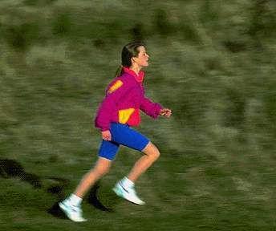
Work in pairs and ask your partners what they usually do on weekends.
do homework
exercise

Slide 6
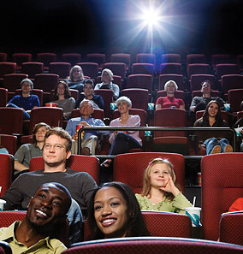
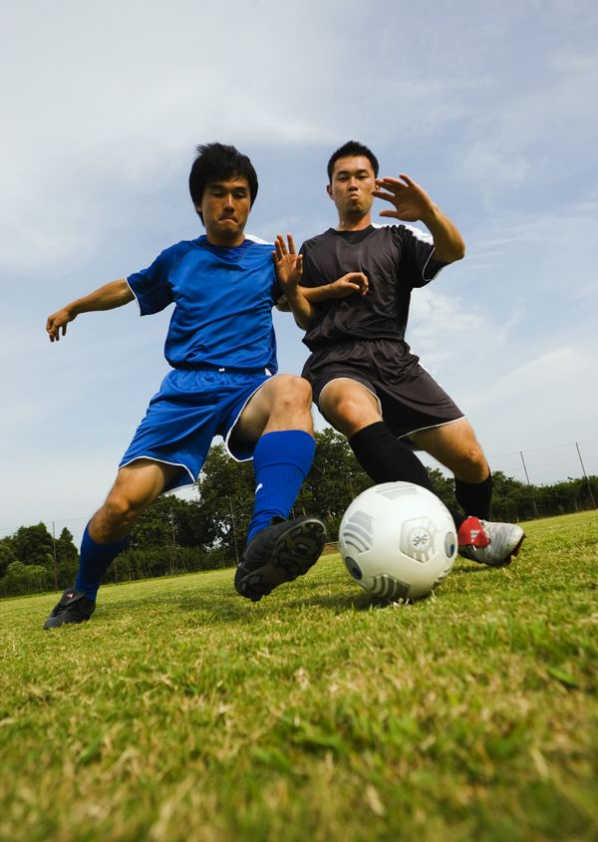
play football
go to the movies

Slide 7
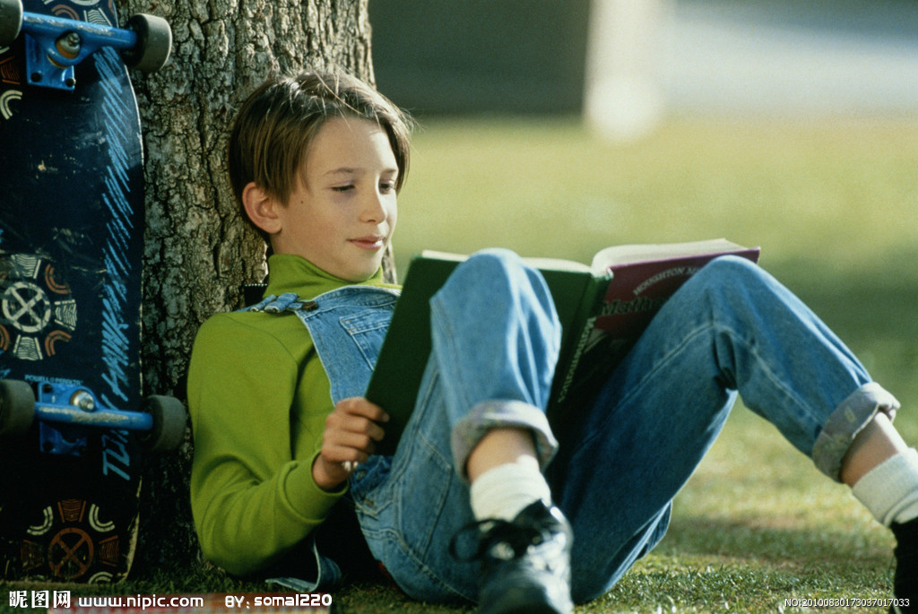
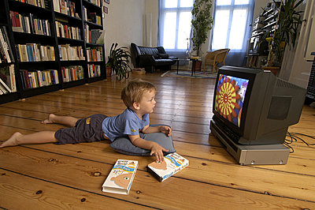
watch TV
read

Slide 8
swim
shop

Slide 9
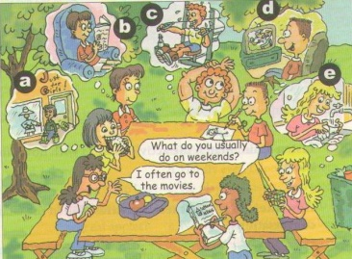
1a
Look at the picture. Make a list of the weekend activities.
Write
1. __________
__________
2. __________
3. __________
4. __________
5. __________
help with housework
watch TV
exercise
read a book
go shopping

Slide 10
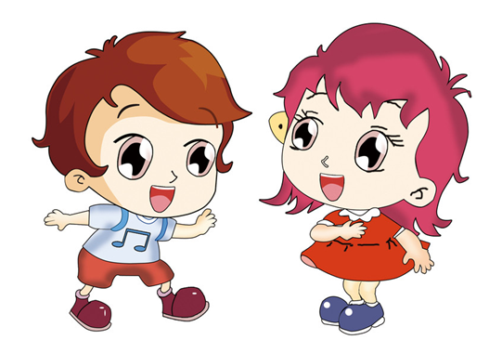
Presentation
What do you do on weekends?
I often play soccer.
What does Alice do on weekends?
She often helps with housework.

Slide 11
频率副词
always意为 “总是”, 表示动作的重复或状态的
延续。
usually意为 “通常”, 表示很少有例外。
often意为 “经常”, 表示动作的重复, 但不如
usually那么频繁, 中间有间断。
sometimes意为 “有时”, 表示动作偶尔发生。
hardly意为 “几乎不”, 常和ever连用表示强调。
never意为 “从未”。

Slide 12
100%
≥ 80%
≥ 60%
always
usually
often
≥ 20%
＜ 5%
0%
sometimes
hardly ever
never
[提示] 频率副词在句中的位置是：
实义动词之前, be动词或助动词之后。

Slide 13
e.g.It’s always interesting to watch other
people show their talents.
Why do people usually make resolutions?
When we watch movies about the future,
we sometimes see robots.
They hardly ever watch TV.

Slide 14
Listening
Listen and write the activities next to the correct frequency words.
1b
1. always _____________
2. usually _________
3. often ____________________
4. sometimes ______________
5. hardly ever _________
6. never _____________
exercise, read
watch TV
help with housework
go shopping
watch TV
go shopping

Slide 15
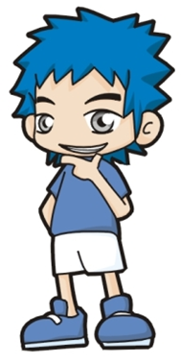
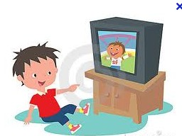
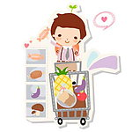
1c
Practice the conversation in the picture. Then make your own conversations about what you do on weekends.
I usually
watch TV.
What do you do on weekends?
Do you go shopping?
No, I never go shopping.

Slide 16
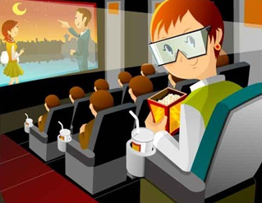
Pair work
What does she do
on weekends?
She …
Does she go to cinema?
Yes, …

Slide 17
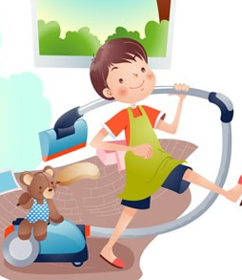
What does he do
on weekends?
He …
No, …
Does he use the Internet?

Slide 18
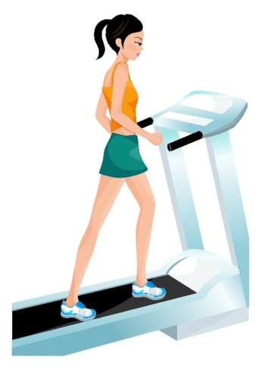
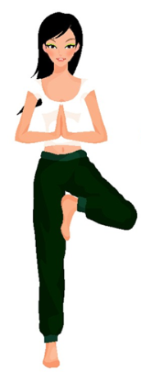
What do they do on weekends?
They often…

Slide 19
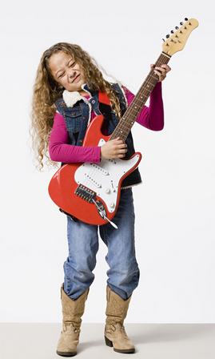
Game
比一比，看谁说得又快又好？
100%
≥ 80%
≥ 20%
I always play the guitar on weekends.
I usually play the guitar on weekends.
I sometimes play the guitar on weekends.

Slide 20
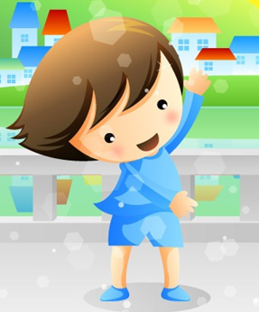
≥ 20%
＜ 5%
0%
I sometimes exercise on weekends.
I hardly ever exercise on weekends.
I never exercise on weekends.

Slide 21
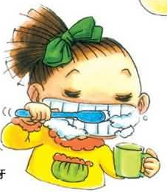
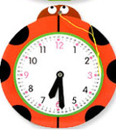
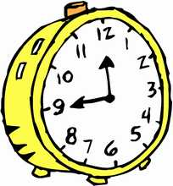
Presentation
How often...? ……多久一次？
twice a day 一天两次

Slide 22
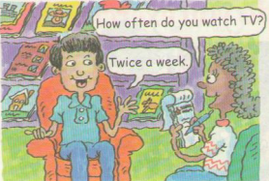
Listening
2a
Listen. Cheng Tao is talking about how often he does these activities. Number the activities [1-5] in the order you hear them.

Slide 23
 | Activities
____ | a. go to the movies
____ | b. watch TV
____ | c. shop
____ | d. exercise
____ | e. read
3
1
5
4
2

Slide 24
2b
Listen again. Match the activities in 2a with how often Cheng Tao does them.
How often
every day
once a week
twice a week
three times a week
once a month
twice a month
Activities
a. go to the movies
b. watch TV
c. shop
d. exercise
e. read

Slide 25
2c
How often do you do these activities? Fill in the chart and then make conversations.
Activities | How often
watch TV
use the Internet
read English books
go to the movies
exercise
every day
twice a week
four times a week
once a month
every day

Slide 26
How often do you watch TV?
I watch TV every day.
What’s your favorite program?
Animal World.
How often do you watch it?
Twice a week.

Slide 27
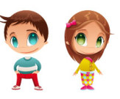
Pair work
How often do you use the Internet?
I use the Internet …
What’s your favorite website?
…

Slide 28
How often do you read English books?
I read English books…
What’s your favorite book?
...
…
How often do you read it?

Slide 29
How often do you…?
I ...
What’s your…?
...

Slide 30
Read
Read the conversation and match the activity with the right time.
2d
Wednesday and Friday
dance lesson
piano lesson
Tuesday
play tennis
Monday

Slide 31
Role-play the conversation
Hi, Claire, …
Hmm, ...

Slide 32
Explanation
1. hardly只用作副词，其意思是“几乎不”，表示否定概念。
e.g. He can hardly speak English.
他不太会说英语。
hardly ever 几乎从不
e.g. Peter is hardly ever late. 彼得几乎不迟到。

Slide 33
[辨析] hard也用副词，意为“努力地,刻苦地,猛烈地” 。
e.g. He works hard only before exams.
他只在考试前努力学习。

Slide 34
2. once , twice, three times等次数的表达法
1) 这三个词都表示____，once是____，twice是____，除了一次、两次，其他的次数都表达 ___________。
如：三次是__________，五次是_________。
次数
一次
两次
数字 + times
three times
five times

Slide 35
2) 这些表次数的词后与一段时间连用，
表示动作多长时间发生几次，即动作
的_____。
3) 翻译：
两周一次 ________________
一年两次 ________________
一个月两次 ________________
频率
once two weeks
once a year
twice a month

Slide 36
Exercises
1. 去看电影 _________________
2. 运动 _________________
3. 看电视 _________________
4. 读英语书 _________________
5. 上网 _________________
6. 购物 _________________
7. 多久一次 _________________
8. every day _________________
go to the movies
exercise
watch TV
read English books
use the Internet
shop
how often
每天

Slide 37
9. once a week ____________
10. twice a week ____________
three times a week ____________
three or four times a week
_____________
13. once a month _____________
14. twice a month _____________
一周一次
一周两次
一周三次
一周三到四次
一个月一次
一个月两次

Slide 38
Homework
翻译：
1. ——周末你通常做什么？
——我通常踢足球。
2. ——周末他们通常做什么？
——他们经常去看电影。

Slide 39
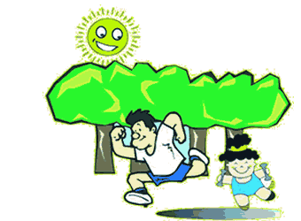
记住好好锻炼身体哟！
Thank you!

